Slide 1
Sqoop
Do it yourself
https://github.com/ashishobeystalent/Bigdata_ppt/upload/master/sqoop.pptx

Slide 2
What is Pig?
Apache Sqoop is a tool designed for efficiently transferring bulk data between Apache Hadoop and external datastores such as relational databases, enterprise data warehouses..
Why Pig?
Apache Sqoop efficiently transfers bulk data between Apache Hadoop and structured datastores such as relational databases. Sqoop helps offload certain tasks (such as ETL processing) from the EDW to Hadoop for efficient execution at a much lower cost. Sqoop can also be used to extract data from Hadoop and export it into external structured datastores. Sqoop works with relational databases such as Teradata, Netezza, Oracle, MySQL, Postgres, and HSQLDBand appeals to developers already familiar with scripting languages and SQL.

Slide 3
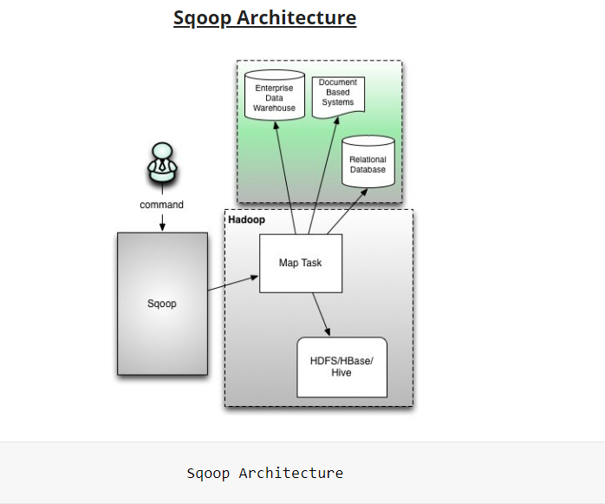

Slide 4
Sqoop provides many salient features like:
Full Load
Incremental Load
Parallel import/export
Import results of SQL query
Compression
Connectors for all major RDBMS Databases
Kerberos Security Integration
Load data directly into Hive/Hbase
Support for Accumulo

Slide 5
Sqoop installation
As usual we have 3 node cluster , one namenode (namenode1) and two datanodes (datanode1,datanode2). We already have hdfs and java configured.
We have sqoop software present in /home/Hadoop/softwares/
Perform below steps in namenode1
Create folder
mkdir /usr/local/sqoop
Grant permission
Sudo chmod -R 777 /usr/local/sqoop
Change owner
Sudo chown -R hadoop:hadoop /usr/local/sqoop

Slide 6
Sqoop installation
Perform below steps in namenode1
Copy software
cp /home/hadoop/softwares/sqoop-1.99.7-bin-hadoop200.tar.gz /usr/local/sqoop/
Or
Download
cd /usr/local/sqoop/
wget https://archive.apache.org/dist/sqoop/1.4.5/sqoop-1.4.5.bin__hadoop-2.0.4-alpha.tar.gz
Extract the file
tar –xvzf sqoop-1.99.7-bin-hadoop200.tar.gz
Move file
cd /usr/local/sqoop/ sqoop-1.99.7
mv * ../
rmdir sqoop-1.99.7

Slide 7
Sqoop Installation
Set path for hbase/bin in ~/.bashrc file
gedit ~/.bashrc
export SQOOP_HOME=/usr/local/sqoop
export PATH=$PATH:$SQOOP_HOME/bin
Now execute
source ~/.bashrc
Now change the configuration of sqoop
cd $SQOOP_HOME/conf
cp sqoop-env-template.sh sqoop-env.sh
export HADOOP_COMMON_HOME=/usr/local/hadoop
export HADOOP_MAPRED_HOME=/usr/local/hadoop

Slide 8
Copy the mysql-connector-java-5.1.28.jar to /sqoop/lib/ folder.
cp /usr/share/java/mysql-connector-java-5.1.28.jar /usr/local/sqoop/lib
SET remote Login server information
gedit /etc/mysql/my.cnf
bind-address = 198.168.1.2
Restart mysql service
sudo /etc/init.d/mysql restart
Also make sure mysql is installed on all nodes so run below commands on both datanodes
sudo apt-get install mysql-server
sudo apt-get install mysql-client
Login and grant Permissions
mysql -u root –p
GRANT ALL ON *.* TO root@192.168.1.3 IDENTIFIED BY 'hadoop';
GRANT ALL ON *.* TO root@192.168.1.4 IDENTIFIED BY 'hadoop';
GRANT ALL ON *.* TO root@datanode1 IDENTIFIED BY 'hadoop';
GRANT ALL ON *.* TO root@datanode2 IDENTIFIED BY 'hadoop';

Slide 9
Make sure you are able to login from all the servers
mysql --host=192.168.1.2 --database=test --user=root --password=Hadoop
List the table present on database which we can import
sqoop list-databases --connect jdbc:mysql://namenode1:3306/ --username root --password hadoop

Slide 10
Import a table
login
mysql --host=192.168.1.2 --database=test --user=root --password=hadoop
Create table
create table c (id integer ,address varchar(20));
insert into c values (1,'A');
insert into c values (2,'B');
insert into c values (3,'C');
insert into c values (4,'D');
commit;
Run Sqoop import Command
sqoop import \
--connect jdbc:mysql://namenode1:3306/test \
--username root \
--password hadoop \
--table a --m 1

Slide 11
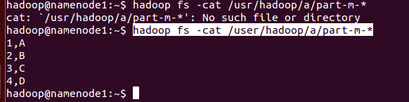
Check the availability of file
hadoop fs -cat /user/hadoop/a/part-m-*
Conditional Import
create table b (id integer ,address varchar(20));
insert into b values (1,'A');
insert into b values (2,'B');
insert into b values (3,'C');
insert into b values (4,'D');
commit;
sqoop import --connect jdbc:mysql://namenode1:3306/test --username root --password hadoop --table b --m 1 --where "address ='A'" --target-dir /tmp/p1

Slide 12
Incremental import
sqoop import --connect jdbc:mysql://namenode1:3306/test --username root --password hadoop --table b --m 1 --target-dir /tmp/p1 --incremental append --check-column id --last-value 4

Slide 13
Import all tables
sqoop import-all-tables \
--connect jdbc:mysql://namenode1:3306/test \
--username root \
--password hadoop \
--m 1

Slide 14
Export from Sqoop (hdfs to RDBMS)
The default operation is to insert all the record from the input files to the database table using the INSERT statement. In update mode, Sqoop generates the UPDATE statement that replaces the existing record into the database.
**mandatory table structure needs to be present in database
sqoop export \
--connect jdbc:mysql://namenode1:3306/test \
--username root \
--password hadoop \
--table c \
--export-dir /user/hadoop/c

Slide 15
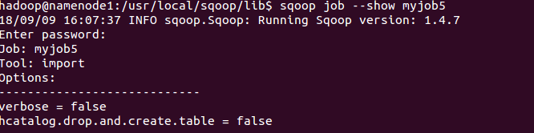
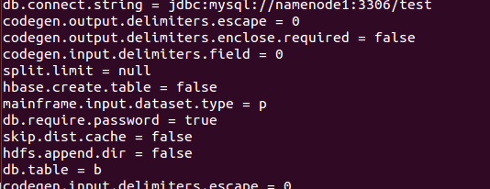
Sqoop job
Sqoop job creates and saves the import and export commands. It specifies parameters to identify and recall the saved job. This re-calling or re-executing is used in the incremental import, which can import the updated rows from RDBMS table to HDFS.
Create a JOB
Make sure java-json file is present in “/usr/local/sqoop/lib/”
sqoop job --create myjob5 -- import --connect jdbc:mysql://namenode1:3306/test --username root --password hadoop --table b --m 1
List Available Jobs
Sqoop job –list
Inspect Job
sqoop job --show myjob5

Slide 16
Execute Job
sqoop job --exec myjob5
Delete Job
sqoop job --delete myjob5

Slide 17
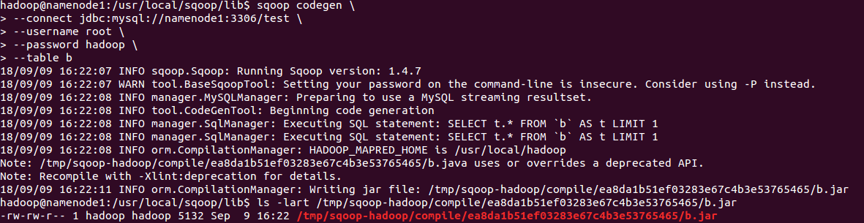
Sqoop - Codegen
Every database table has one DAO class that contains ‘getter’ and ‘setter’ methods to initialize objects. This tool (-codegen) generates the DAO class automatically
sqoop codegen \
--connect jdbc:mysql://namenode1:3306/test \
--username root \
--password hadoop \
--table b

Slide 18
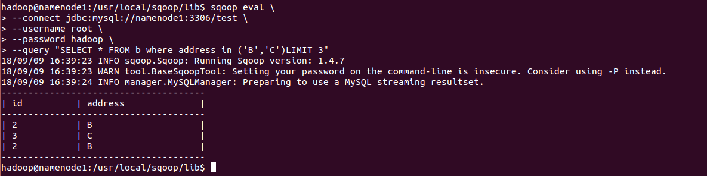
Sqoop Eval
preview the result in the console
sqoop eval \
--connect jdbc:mysql://namenode1:3306/test \
--username root \
--password hadoop \
--query "SELECT * FROM b where address in ('B','C')LIMIT 3"

Slide 19
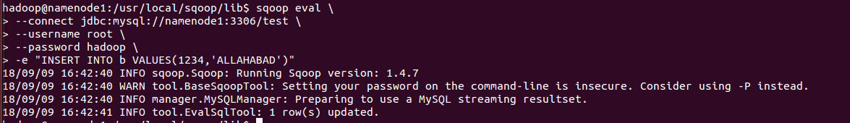
Evaluate the insert statement
sqoop eval \
--connect jdbc:mysql://namenode1:3306/test \
--username root \
--password hadoop \
-e "INSERT INTO b VALUES(1234,'ALLAHABAD')"

Slide 20
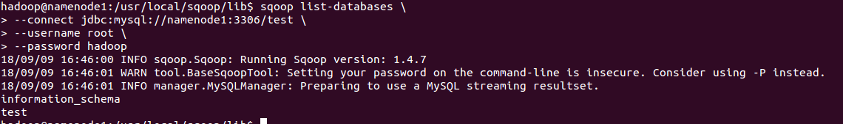
List databases
sqoop list-databases \
--connect jdbc:mysql://namenode1:3306/test \
--username root \
--password hadoop

Slide 21
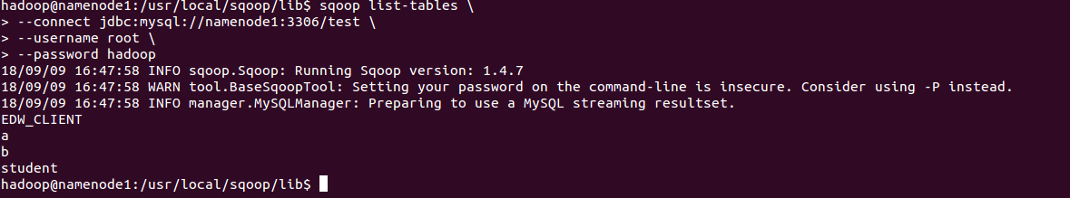
List Tables
sqoop list-tables \
--connect jdbc:mysql://namenode1:3306/test \
--username root \
--password hadoop

