Slide 1
Hbase
Do it yourself
https://github.com/ashishobeystalent/Bigdata_ppt/blob/master/hbase.pptx

Slide 2
What is HBASE?
Apache HBase is a NoSQL random access database for Hadoop. . It runs on top of HDFS and provides real time data access to distributed data via its key/value store.
Why HBASE?
Hadoop cannot handle high velocity of random writes and reads and also cannot change a file without completely rewriting it.
“Anybody who wants to keep data within an HDFS environment and wants to do anything other than brute-force reading of the entire file system [with MapReduce] needs to look at HBase. If you need random access, you have to have HBase."- said Gartner analyst Merv Adrian.
Who uses?
Pinterest runs 38 different HBase clusters with some of them doing up to 5 million operations every second. Goibibo uses HBase for customer profiling. Facebook Messenger uses HBase architecture and many other companies like Flurry, Adobe Explorys use HBase in production.

Slide 3
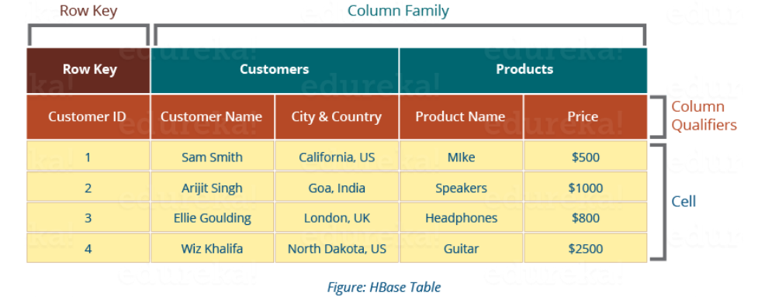
HBase Data Model
HBase Tables – Logical collection of rows stored in individual partitions known as Regions.
HBase Row – Instance of data in a table.
RowKey -Every entry in an HBase table is identified and indexed by a RowKey.
Columns - For every RowKey an unlimited number of attributes can be stored.
Column Family – Data in rows is grouped together as column families and all columns are stored together in a low level storage file known as HFile.

Slide 4
Hbase installation
HBase can be installed in three modes
Standalone mode installation (No dependency on Hadoop system)
This is default mode of HBase
It runs against local file system
It doesn't use Hadoop HDFS
Only HMaster daemon can run
Not recommended for production environment
Runs in single JVM
Pseudo-Distributed mode installation ( Single node Hadoop system + HBase installation)
It runs on Hadoop HDFS
All Daemons run in single node
Recommend for production environment
Fully Distributed mode installation ( MultinodeHadoop environment + HBase installation)
It runs on Hadoop HDFS
All daemons going to run across all nodes present in the cluster
Highly recommended for production environment

Slide 5
Hbase installation in fully distributed mode
As usual we have 3 node cluster , one namenode (namenode1) and two datanodes (datanode1,datanode2). We already have hdfs and java configured.
We have hbase software present in /home/Hadoop/softwares/
Perform below steps in namenode1,datanode1,datanode2
Create folder
mkdir /usr/local/hbase
Grant permission
Sudo chmod -R 777 /usr/local/hbase
Change owner
Sudo chown -R hadoop:hadoop /usr/local/hbase

Slide 6
Hbase installation in fully distributed mode
Perform below steps in namenode1
Copy software
cp /home/hadoop/softwares/hbase* /usr/local/hbase/
Or
Download
cd /usr/local/hbase/
wget https://www.apache.org/dist/hbase/stable/hbase-1.4.6-bin.tar.gz
Extract the file
tar –xvzf hbase-1.4.6-bin.tar.gz
Move file
cd /usr/local/hbase/hbase-1.4.6
mv * ../
rmdir hbase-1.4.6

Slide 7
Hbase installation in fully distributed mode
Create folder for PID
/var/hbase/pids
Grant access
Sudo chmod -R 777 /var/hbase/pids
Change owner
Sudo chown –R hadoop:hadoop /var/hbase

Slide 8
Hbase installation in fully distributed mode
Change configurational files on namenode1
gedit /usr/local/hbase/config/hbase-site.xml
<configuration>
<property>
<name>hbase.rootdir</name>
<value>hdfs://namenode1:10001/hbase</value>
</property>
<property>
<name>hbase.cluster.distributed</name>
<value>true</value>
</property>
<property>
<name>hbase.master</name>
<value>namenode1</value>
</property>
<property>
<name>hbase.zookeeper.property.dataDir</name>
<value> hdfs://namenode1:10001/zookeeper</value>
</property>
<property>
<name>hbase.zookeeper.quorum</name>
<value>namenode1,datanode1,datanode2</value>
</property>
<property>
<name>hbase.zookeeper.property.clientPort</name>
<value>2181</value>
</property>
</configuration>

Slide 9
Hbase installation in fully distributed mode
Change configurational files on namenode1
gedit /usr/local/hbase/conf/hbase-env.sh
Set the following setting in hbase-env.sh file
HBASE_MANAGES_ZK=true ( if we want Hbase to manage it’s own instance of zoo keeper.)
export HBASE_PID_DIR=/var/hbase/pids
export HBASE_REGIONSERVERS=usr/local/hbase/conf/regionservers
export JAVA_HOME=/usr/lib/jvm/java-1.8.0-openjdk-amd64
Comment these lines
# Configure PermSize. Only needed in JDK7. You can safely remove it for JDK8+
#export HBASE_MASTER_OPTS="$HBASE_MASTER_OPTS -XX:PermSize=128m -XX:MaxPermSize=128m"
#export HBASE_REGIONSERVER_OPTS="$HBASE_REGIONSERVER_OPTS -XX:PermSize=128m -XX:MaxPermSize=128m"

Slide 10
Hbase installation in fully distributed mode
Configure regionserver details on namenode1
gedit /usr/local/hbase/conf/regionservers
datanode1
datanode2
Set path for hbase/bin in ~/.bashrc file
gedit ~/.bashrc file
export HBASE_HOME=/usr/local/hbase
export PATH=$HBASE_HOME/bin:$PATH
Now execute
source ~/.bashrc

Slide 11
Create folder on hdfs
hdfs dfs -mkdir /hbase
hdfs dfs -chmod -R 777 /hbase
hdfs dfs -mkdir /zookeeper
hdfs dfs -chmod -R 777 /zookeeper
Copy every thing to datanode1 and datanode2
scp -r /usr/local/hbase/* hadoop@datanode1:/usr/local/hbase
scp -r /usr/local/hbase/* hadoop@datanode2:/usr/local/hbase
scp -r ~/.bashrc hadoop@datanode1: ~/.bashrc
scp -r ~/.bashrc hadoop@datanode1: ~/.bashrc
Run below command in datanode1 and datanode2
source ~/.bashrc
Run this on namenode1
sudo cat ~/.ssh/id_rsa.pub >> ~/.ssh/authorized_keys
Now this completes our configuration of Hbase on all our servers in distributed mode

Slide 12
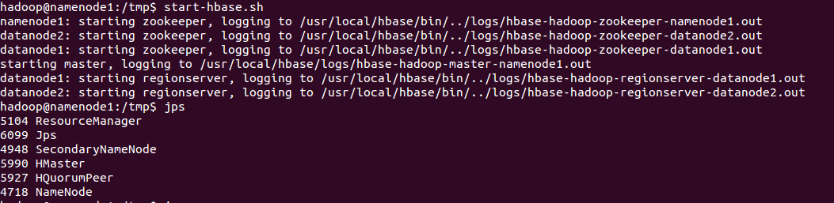
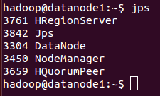
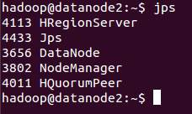
Run Hbase
Run Hbase
hadoop@namenode1:/usr/local/hbase/bin$ start-hbase.sh
Namenode1
Datanode1 and datanode2

Slide 13
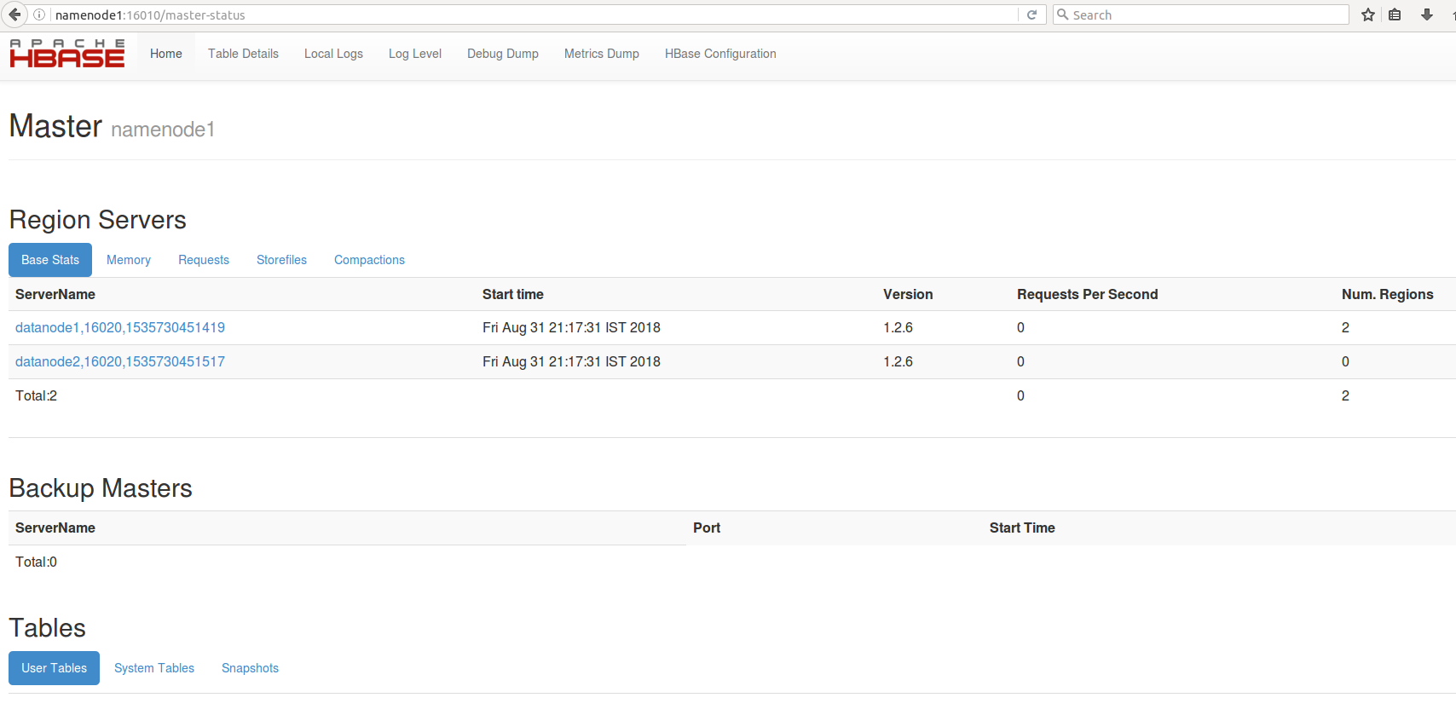
http://namenode1:16010
Master

Slide 14
http://datanode1:16030
Region Server

Slide 15
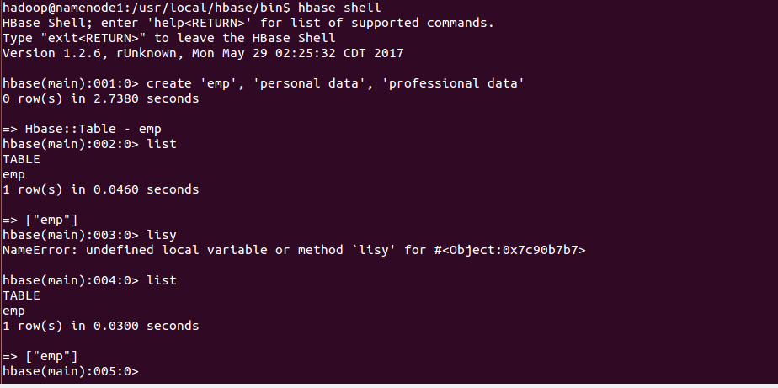
Run hbase Shell
Hbase shell

Slide 16
Hint and finding of errors
Make both version are same, here hbase is confused to bind the log
Locate slf4j-log4j12
You will find files with different versions
just make both same by copy paste

