Slide 1
Apache Hive
Do it yourself

Slide 2
Why need of Hive
The size of data being collected and analyzed in industry for business intelligence (BI) is growing rapidly making traditional warehousing solution prohibitively expensive.
Facebook started working on deploying warehouse solutions on Hadoop that resulted in Hive.
Facebook Hive warehouse contains tens of thousands of tables, stores over 700TB and is used for reporting and ad-hoc analyses by 200 Fb users

Slide 3
Hive-vs-RDBMS
Hive enforces schema on read time whereas RDBMS enforces schema on write time.
In RDBMS, a table’s schema is enforced at data load time, If the data being loaded doesn’t conform to the schema, then it is rejected. This design is called schema on write.
But Hive doesn’t verify the data when it is loaded, but rather when a it is retrieved. This is called schema on read.
Schema on write makes query time performance faster, since the database can index columns and perform compression on the data but it takes longer to load data into the database.
Hive is based on the notion of Write once, Read many times but RDBMS is designed for Read and Write many times.
In RDBMS, record level updates, insertions and deletes, transactions and indexes are possible. Whereas these are not allowed in Hive because Hive was built to operate over HDFS data using MapReduce, where full-table scans are the norm and a table update is achieved by transforming the data into a new table.
In RDBMS, maximum data size allowed will be in 10’s of Terabytes but whereas Hivecan 100’s Petabytes very easily.
As Hadoop is a batch-oriented system, Hive doesn’t support OLTP (Online Transaction Processing) but it is closer to OLAP (Online Analytical Processing) but not ideal since there is significant latency between issuing a query and receiving a reply, due to the overhead of Mapreduce jobs and due to the size of the data sets Hadoop was designed to serve.

Slide 4
Hive is?
Developed by Facebook and a top-level Apache project
A data warehousing infrastructure based on Hadoop
Immediately makes data on a cluster available to non-Java programmers via SQL like queries
Built on HiveQL (HQL), a SQL-like query language and Hive also allows MR scripts
Interprets HiveQL and generates MapReduce jobs that run on the cluster
Enables easy data summarization, ad-hoc reporting and querying, and analysis of large volumes of data
MR is very low level and requires customers to write custom programs.
HIVE supports queries expressed in SQL-like language called HiveQL which are compiled into MR jobs that are executed on Hadoop.
It also includes MetaStore that contains schemas and statistics that are useful for data explorations, query optimization and query compilation.
Hive is not?
Hive, like Hadoop, is designed for batch processing of large datasets
Not an OLTP or real-time system
Latency and throughput are both high compared to a traditional RDBMS
Even when dealing with relatively small data ( <100 MB )

Slide 5
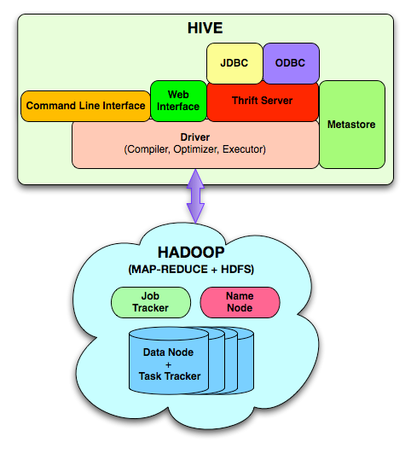
Hive Architecture

Slide 6
Data Hierarchy
Hive is organised hierarchically into:
Databases: namespaces that separate tables and other objects
Tables: homogeneous units of data with the same schema
Hive structures data into well-understood database concepts such as: tables, rows, cols, partitions
Partitions: determine how the data is stored
Allow efficient access to subsets of the data
Buckets/clusters
For subsampling within a partition
Join optimization
SerDe: serialize and deserialized API is used to move data in and out of tables

Slide 7
HiveQL
HiveQL / HQL provides the basic SQL-like operations:
Select columns using SELECT
Filter rows using WHERE
JOIN between tables
Evaluate aggregates using GROUP BY
Store query results into another table
Download results to a local directory (i.e., export from HDFS)
Manage tables and queries with CREATE, DROP, and ALTER

Slide 8
Data Types
Type | Comments
Tinyint, smallint, int, bigint | 1, 2, 4 and 8-byte integers
Boolean | TRUE/FALSE
Float, double | Single and double precision real numbers
String | Character string
Timestamp | Unix-epoch offset or datetime string
DECIMAL | Arbitrary-precision decimal
BINARY | Opaque; ignore these bytes
Struct | A collection of elements
 | If S is of type STRUCT {a INT, b INT}:
 | S.a returns element a
MAP | Key-value tuple
 | If M is a map from 'group' to GID:
 | M['group'] returns value of GID
Array | Indexed list
 | If A is an array of elements ['a','b','c']:
 | A[0] returns 'a'

Slide 9
HiveQL Limitations
HQL only supports equi-joins, outer joins, left semi-joins
Because it is only a shell for mapreduce, complex queries can be hard to optimise
Missing large parts of full SQL specification:
HAVING clause in SELECT
Correlated sub-queries
Sub-queries outside FROM clauses
Updatable or materialized views
Stored procedures

Slide 10
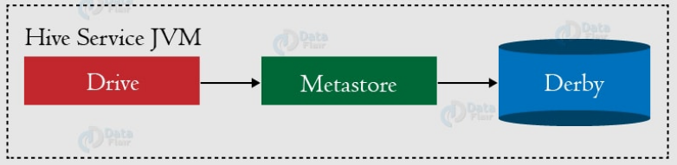
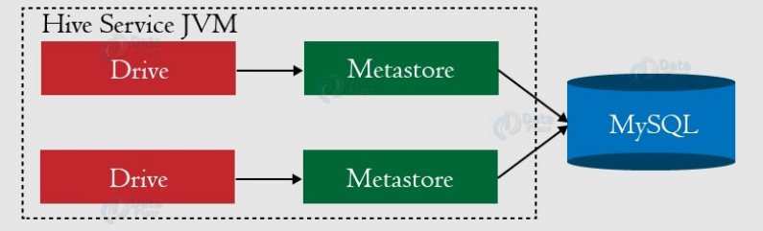
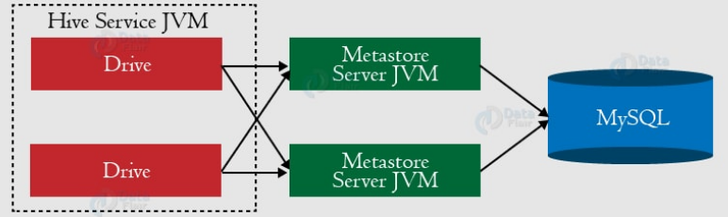
Hive Metastore
Stores Hive metadata
Default metastore database uses Apache Derby
Various configurations:
Embedded (in-process metastore, in-process database)
Mainly for unit tests
Local (in-process metastore, out-of-process database)
Each Hive client connects to the metastore directly
Remote (out-of-process metastore, out-of-process database)
Each Hive client connects to a metastore server, which connects to the metadata database itself

Slide 11
Hive Warehouse
Hive tables are stored in the Hive “warehouse”
Default HDFS location: /user/hive/warehouse
Tables are stored as sub-directories in the warehouse directory
Partitions are subdirectories of tables
External tables are supported in Hive
The actual data is stored in flat files

Slide 12
Create Table Syntax
CREATE TABLE table_name
(col1 data_type,
col2 data_type,
col3 data_type,
col4 datatype )
ROW FORMAT DELIMITED
FIELDS TERMINATED BY ','
STORED AS format_type;

Slide 13
Simple Table
CREATE TABLE page_view
(viewTime INT,
userid BIGINT,
page_url STRING,
referrer_url STRING,
ip STRING COMMENT 'IP Address of the User' )
ROW FORMAT DELIMITED
FIELDS TERMINATED BY '\t'
STORED AS TEXTFILE;

Slide 14
More Complex Table
CREATE TABLE employees (
(name STRING,
salary FLOAT,
subordinates ARRAY<STRING>,
deductions MAP<STRING, FLOAT>,
address STRUCT<street:STRING,
city:STRING,
state:STRING,
zip:INT>)
ROW FORMAT DELIMITED
FIELDS TERMINATED BY '\t'
STORED AS TEXTFILE;

Slide 15
External Table
CREATE EXTERNAL TABLE page_view_stg
(viewTime INT,
userid BIGINT,
page_url STRING,
referrer_url STRING,
ip STRING COMMENT 'IP Address of the User') ROW FORMAT DELIMITED
FIELDS TERMINATED BY '\t'
STORED AS TEXTFILE
LOCATION '/user/staging/page_view';

Slide 16
Difference in external and normal table
CREATE TABLE
LOAD: file moved into Hive’s data warehouse directory
DROP: both metadata and data deleted
CREATE EXTERNAL TABLE
LOAD: no files moved
DROP: only metadata deleted
Use this when sharing with other Hadoop applications, or when you want to use multiple schemas on the same data

Slide 17
Partitioning
Can make some queries faster
Divide data based on partition column
Use PARTITION BY clause when creating table
Use PARTITION clause when loading data
SHOW PARTITIONS will show a table’s partitions
DROP TABLE IF EXISTS T_USER_LOG1;
CREATE TABLE T_USER_LOG1 (USER_ID INT,NAME STRING,SITE STRING)
PARTITIONED BY (DT STRING,COUNTRY STRING)
ROW FORMAT DELIMITED
FIELDS TERMINATED BY '\t’
STORED AS TEXTFILE;
LOAD DATA LOCAL INPATH '/home/hadoop/softwares/data_files/local/UserLogSrc.txt' OVERWRITE INTO TABLE T_USER_LOG PARTITION (DT='2016-04-29',COUNTRY='UK’);
LOAD DATA LOCAL INPATH '/home/hadoop/softwares/data_files/local/UserLogSrc.txt' OVERWRITE INTO TABLE T_USER_LOG PARTITION (DT='2016-04-30',COUNTRY='UK’);
LOAD DATA LOCAL INPATH '/home/hadoop/softwares/data_files/local/UserLogSrc.txt' OVERWRITE INTO TABLE T_USER_LOG PARTITION (DT='2016-05-24',COUNTRY='INDIA’);
LOAD DATA LOCAL INPATH '/home/hadoop/softwares/data_files/local/UserLogSrc.txt' OVERWRITE INTO TABLE T_USER_LOG PARTITION (DT='2016-05-23',COUNTRY='INDIA');

Slide 18
Dynamic Partitioning
DROP TABLE IF EXISTS T_USER_LOG_DYN;
CREATE TABLE T_USER_LOG_DYN (USER_ID INT,NAME STRING,SITE STRING)
PARTITIONED BY (DT STRING,COUNTRY STRING)
ROW FORMAT DELIMITED
FIELDS TERMINATED BY '\t’
STORED AS TEXTFILE;
DROP TABLE IF EXISTS T_USER_LOG_SRC;
CREATE TABLE T_USER_LOG_SRC (USER_ID INT,NAME STRING,SITE STRING,DT STRING,COUNTRY STRING)
ROW FORMAT DELIMITED
FIELDS TERMINATED BY '\t’
STORED AS TEXTFILE;
LOAD DATA LOCAL INPATH '/home/hadoop/softwares/data_files/local/UserLogSrc.txt' OVERWRITE INTO TABLE T_USER_LOG_SRC;
SET hive.exec.dynamic.partition = true;
SET hive.exec.dynamic.partition.mode = nonstrict;
INSERT OVERWRITE TABLE T_USER_LOG_DYN PARTITION(DT,COUNTRY) SELECT USER_ID,NAME,SITE,DT,COUNTRY FROM T_USER_LOG_SRC;

Slide 19
Bucketing
Can speed up queries that involve sampling the data
Sampling works without bucketing, but Hive has to scan the entire dataset
Use CLUSTERED BY when creating table
For sorted buckets, add SORTED BY
To query a sample of your data, use TABLESAMPLE
DROP TABLE IF EXISTS T_USER_LOG_BUCKET;
CREATE TABLE T_USER_LOG_BUCKET (USER_ID INT,NAME STRING,SITE STRING,COUNTRY STRING)
PARTITIONED BY (DT STRING)
CLUSTERED BY (USER_ID) INTO 4 BUCKETS
ROW FORMAT DELIMITEDFIELDS TERMINATED BY '\t'STORED AS TEXTFILE;
SET hive.exec.dynamic.partition=true;SET hive.exec.dynamic.partition.mode=nonstrict;SET hive.exec.max.dynamic.partitions.pernode=1000;
SET hive.enforce.bucketing=true;
INSERT OVERWRITE TABLE T_USER_LOG_BUCKET PARTITION(DT) SELECT USER_ID,NAME,SITE,COUNTRY,DT FROM T_USER_LOG_SRC;

Slide 20
Bucket uses
Bucket Sampling :
SELECT * FROM T_USER_LOG_BUCKET TABLESAMPLE (BUCKET 1 OUT OF 4);
(It will select the data from the first buckets of each partition from T_USER_LOG_BUCKET table otherwise in normal select we can't select data in such distributed and evenly manner. )
Block Sampling:
SELECT * FROM T_USER_LOG_BUCKET TABLESAMPLE (20 PERCENT);

Slide 21
Browsing Tables And Partitions
Command | Comments
SHOW TABLES; | Show all the tables in the database
SHOW TABLES 'page.*'; | Show tables matching the specification ( uses regex syntax )
SHOW PARTITIONS page_view; | Show the partitions of the page_view table
DESCRIBE page_view; | List columns of the table
DESCRIBE EXTENDED page_view; | More information on columns (useful only for debugging )
DESCRIBE page_view PARTITION (ds='2008-10-31'); | List information about a partition

Slide 22
Loading Data
Use LOAD DATA to load data from a file or directory
Will read from HDFS unless LOCAL keyword is specified
Will append data unless OVERWRITE specified
PARTITION required if destination table is partitioned
LOAD DATA LOCAL INPATH '/tmp/pv_2008-06-8_us.txt'
OVERWRITE INTO TABLE page_view
PARTITION (date='2008-06-08', country='US')

Slide 23
Inserting Data
Use INSERT to load data from a Hive query
Will append data unless OVERWRITE specified
PARTITION required if destination table is partitioned
FROM page_view_stg pvs
INSERT OVERWRITE TABLE page_view
PARTITION (dt='2008-06-08', country='US')
SELECT pvs.viewTime, pvs.userid, pvs.page_url, pvs.referrer_url
WHERE pvs.country = 'US';

Slide 24
Inserting Data
Normally only one partition can be inserted into with a single INSERT
A multi-insert lets you insert into multiple partitions
FROM page_view_stg pvs
INSERT OVERWRITE TABLE page_view
PARTITION ( dt='2008-06-08', country='US‘ )
SELECT pvs.viewTime, pvs.userid, pvs.page_url, pvs.referrer_url WHERE pvs.country = 'US'
INSERT OVERWRITE TABLE page_view
PARTITION ( dt='2008-06-08', country='CA' )
SELECT pvs.viewTime, pvs.userid, pvs.page_url, pvs.referrer_url WHERE pvs.country = 'CA'
INSERT OVERWRITE TABLE page_view
PARTITION ( dt='2008-06-08', country='UK' )
SELECT pvs.viewTime, pvs.userid, pvs.page_url, pvs.referrer_url WHERE pvs.country = 'UK';

Slide 25
Inserting Data During Table Creation
Use AS SELECT in the CREATE TABLE statement to populate a table as it is created
CREATE TABLE page_view AS
SELECT pvs.viewTime, pvs.userid, pvs.page_url, pvs.referrer_url
FROM page_view_stg pvs
WHERE pvs.country = 'US';

Slide 26
Loading And Inserting Data: Summary
Use this | For this purpose
LOAD | Load data from a file or directory
INSERT | Load data from a query One partition at a time Use multiple INSERTs to insert into multiple partitions in the one query
CREATE TABLE AS (CTAS) | Insert data while creating a table
Add/modify external file | Load new data into external table

Slide 27
Sample Select Clauses
Select from a single table
SELECT *
FROM sales
WHERE amount > 10 AND
region = "US";
Select from a partitioned table
SELECT page_views.*
FROM page_views
WHERE page_views.date >= '2008-03-01' AND
page_views.date <= '2008-03-31'

Slide 28
Relational Operators
ALL and DISTINCT
Specify whether duplicate rows should be returned
ALL is the default (all matching rows are returned)
DISTINCT removes duplicate rows from the result set
WHERE
Filters by expression
Does not support IN, EXISTS or sub-queries in the WHERE clause
LIMIT
Indicates the number of rows to be returned

Slide 29
Relational Operators
GROUP BY
Group data by column values
Select statement can only include columns included in the GROUP BY clause
ORDER BY / SORT BY
ORDER BY performs total ordering
Slow, poor performance
SORT BY performs partial ordering
Sorts output from each reducer

Slide 30
Advanced Hive Operations
JOIN
If only one column in each table is used in the join, then only one MapReduce job will run
This results in 1 MapReduce job:
SELECT * FROM a JOIN b ON a.key = b.key JOIN c ON b.key = c.key
This results in 2 MapReduce jobs:
SELECT * FROM a JOIN b ON a.key = b.key JOIN c ON b.key2 = c.key
If multiple tables are joined, put the biggest table last and the reducer will stream the last table, buffer the others
Use left semi-joins to take the place of IN/EXISTS
SELECT a.key, a.val FROM a LEFT SEMI JOIN b on a.key = b.key;

Slide 31
Advanced Hive Operations
JOIN
Do not specify join conditions in the WHERE clause
Hive does not know how to optimise such queries
Will compute a full Cartesian product before filtering it
Join Example
SELECT
a.ymd, a.price_close, b.price_close
FROM stocks a
JOIN stocks b ON a.ymd = b.ymd
WHERE a.symbol = 'AAPL' AND
b.symbol = 'IBM' AND
a.ymd > '2010-01-01';

Slide 32
References
http://hive.apache.org

