Slide 1
Hbase
Do it yourself
https://github.com/ashishobeystalent/Bigdata_ppt/blob/master/hbase.pptx

Slide 2
What is HBASE?
Apache HBase is a NoSQL random access database for Hadoop. . It runs on top of HDFS and provides real time data access to distributed data via its key/value store.
Why HBASE?
Hadoop cannot handle high velocity of random writes and reads and also cannot change a file without completely rewriting it.
“Anybody who wants to keep data within an HDFS environment and wants to do anything other than brute-force reading of the entire file system [with MapReduce] needs to look at HBase. If you need random access, you have to have HBase."- said Gartner analyst Merv Adrian.
Who uses?
Pinterest runs 38 different HBase clusters with some of them doing up to 5 million operations every second. Goibibo uses HBase for customer profiling. Facebook Messenger uses HBase architecture and many other companies like Flurry, Adobe Explorys use HBase in production.

Slide 3
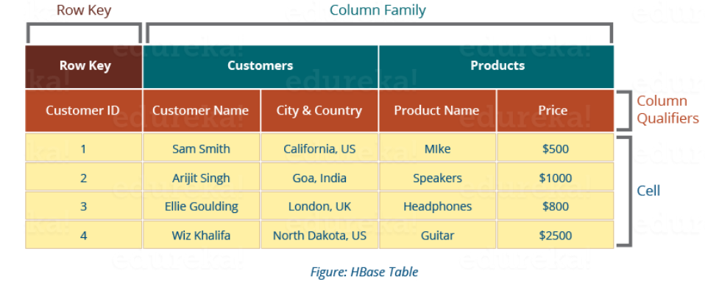
HBase Data Model
HBase Tables – Logical collection of rows stored in individual partitions known as Regions.
HBase Row – Instance of data in a table.
RowKey -Every entry in an HBase table is identified and indexed by a RowKey.
Columns - For every RowKey an unlimited number of attributes can be stored.
Column Family – Data in rows is grouped together as column families and all columns are stored together in a low level storage file known as HFile.

Slide 4
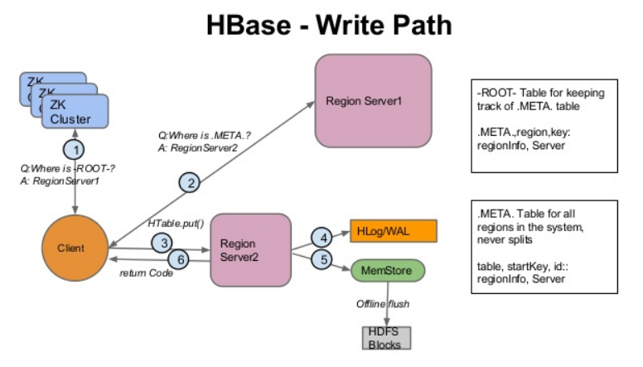
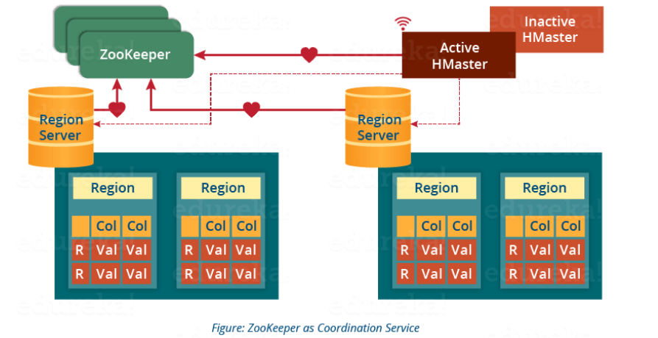
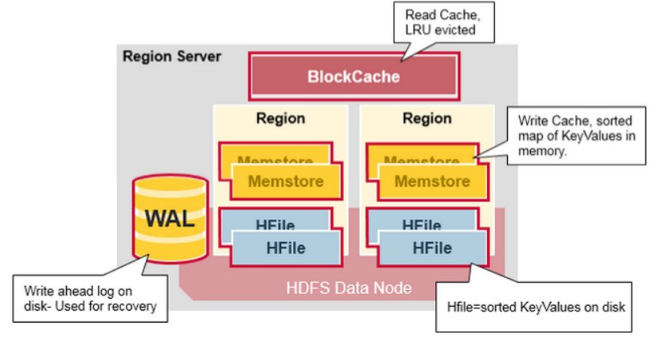
.META file maintains the table in form of keys and values. Key represents the start key of the region and its id whereas the value contains the path of the Region Server.
WAL: Write Ahead Log (WAL) is a file attached to every Region Server inside the distributed environment. The WAL stores the new data that hasn’t been persisted or committed to the permanent storage. It is used in case of failure to recover the data sets.
Block Cache : It stores the frequently read data in the memory. If the data in BlockCache is least recently used, then that data is removed from BlockCache.
MemStore : It is the write cache. It stores all the incoming data before committing it to the disk or permanent memory. There is one MemStore for each column family in a region. The data is sorted in lexicographical order before committing it to the disk.
HFile: it stores the actual cells on the disk. MemStore commits the data to HFile when the size of MemStore exceeds.

Slide 5
Hbase installation
HBase can be installed in three modes
Standalone mode installation (No dependency on Hadoop system)
This is default mode of HBase
It runs against local file system
It doesn't use Hadoop HDFS
Only HMaster daemon can run
Not recommended for production environment
Runs in single JVM
Pseudo-Distributed mode installation ( Single node Hadoop system + HBase installation)
It runs on Hadoop HDFS
All Daemons run in single node
Recommend for production environment
Fully Distributed mode installation ( MultinodeHadoop environment + HBase installation)
It runs on Hadoop HDFS
All daemons going to run across all nodes present in the cluster
Highly recommended for production environment

Slide 6
Hbase installation in fully distributed mode
As usual we have 3 node cluster , one namenode (namenode1) and two datanodes (datanode1,datanode2). We already have hdfs and java configured.
We have hbase software present in /home/Hadoop/softwares/
Perform below steps in namenode1,datanode1,datanode2
Create folder
mkdir /usr/local/hbase
Grant permission
Sudo chmod -R 777 /usr/local/hbase
Change owner
Sudo chown -R hadoop:hadoop /usr/local/hbase

Slide 7
Hbase installation in fully distributed mode
Perform below steps in namenode1
Copy software
cp /home/hadoop/softwares/hbase* /usr/local/hbase/
Or
Download
cd /usr/local/hbase/
wget https://www.apache.org/dist/hbase/stable/hbase-1.4.6-bin.tar.gz
Extract the file
tar –xvzf hbase-1.4.6-bin.tar.gz
Move file
cd /usr/local/hbase/hbase-1.4.6
mv * ../
rmdir hbase-1.4.6

Slide 8
Hbase installation in fully distributed mode
Perform blow step in namenode1,datanode1,datanode2
Create folder for PID
/var/hbase/pids
Grant access
Sudo chmod -R 777 /var/hbase/pids
Change owner
Sudo chown –R hadoop:hadoop /var/hbase

Slide 9
Hbase installation in fully distributed mode
Change configurational files on namenode1
gedit /usr/local/hbase/config/hbase-site.xml
<configuration>
<property>
<name>hbase.rootdir</name>
<value>hdfs://namenode1:10001/hbase</value>
</property>
<property>
<name>hbase.cluster.distributed</name>
<value>true</value>
</property>
<property>
<name>hbase.master</name>
<value>namenode1</value>
</property>
<property>
<name>hbase.zookeeper.property.dataDir</name>
<value> hdfs://namenode1:10001/zookeeper</value>
</property>
<property>
<name>hbase.zookeeper.quorum</name>
<value>namenode1,datanode1,datanode2</value>
</property>
<property>
<name>hbase.zookeeper.property.clientPort</name>
<value>2181</value>
</property>
</configuration>

Slide 10
Hbase installation in fully distributed mode
Change configurational files on namenode1
gedit /usr/local/hbase/conf/hbase-env.sh
Set the following setting in hbase-env.sh file
HBASE_MANAGES_ZK=true ( if we want Hbase to manage it’s own instance of zoo keeper.)
export HBASE_PID_DIR=/var/hbase/pids
export HBASE_REGIONSERVERS=usr/local/hbase/conf/regionservers
export JAVA_HOME=/usr/lib/jvm/java-1.8.0-openjdk-amd64
Comment these lines
# Configure PermSize. Only needed in JDK7. You can safely remove it for JDK8+
#export HBASE_MASTER_OPTS="$HBASE_MASTER_OPTS -XX:PermSize=128m -XX:MaxPermSize=128m"
#export HBASE_REGIONSERVER_OPTS="$HBASE_REGIONSERVER_OPTS -XX:PermSize=128m -XX:MaxPermSize=128m"

Slide 11
Hbase installation in fully distributed mode
Configure regionserver details on namenode1
gedit /usr/local/hbase/conf/regionservers
datanode1
datanode2
Set path for hbase/bin in ~/.bashrc file
gedit ~/.bashrc file
export HBASE_HOME=/usr/local/hbase
export PATH=$HBASE_HOME/bin:$PATH
Now execute on all nodes
source ~/.bashrc

Slide 12
Create folder on hdfs
hadoop dfs -mkdir /hbase
hadoop dfs -chmod -R 777 /hbase
hadoop dfs -mkdir /zookeeper
hadoop dfs -chmod -R 777 /zookeeper
Copy every thing to datanode1 and datanode2
scp -r /usr/local/hbase/* hadoop@datanode1:/usr/local/hbase
scp -r /usr/local/hbase/* hadoop@datanode2:/usr/local/hbase
scp -r ~/.bashrc hadoop@datanode1: ~/.bashrc
scp -r ~/.bashrc hadoop@datanode1: ~/.bashrc
Run below command in datanode1 and datanode2
source ~/.bashrc
Run this on namenode1
sudo cat ~/.ssh/id_rsa.pub >> ~/.ssh/authorized_keys
Now this completes our configuration of Hbase on all our servers in distributed mode

Slide 13
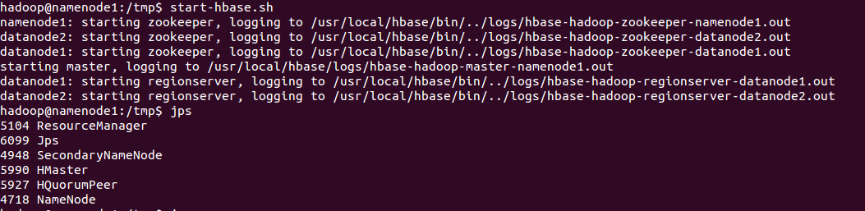
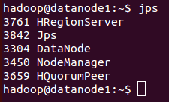
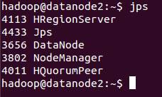
Run Hbase
Run Hbase
hadoop@namenode1:/usr/local/hbase/bin$ start-hbase.sh
Namenode1
Datanode1 and datanode2

Slide 14
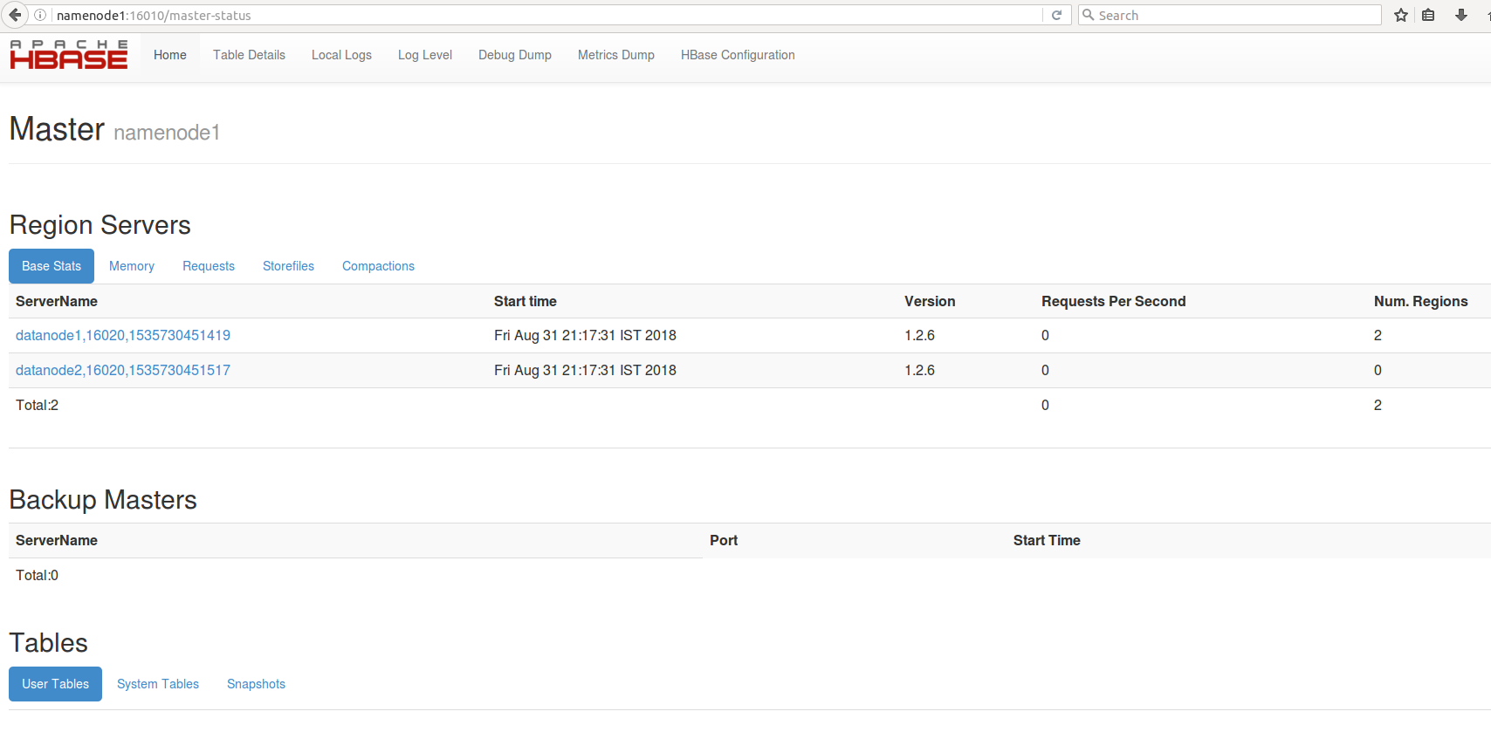
http://namenode1:16010
Master

Slide 15
http://datanode1:16030
Region Server

Slide 16
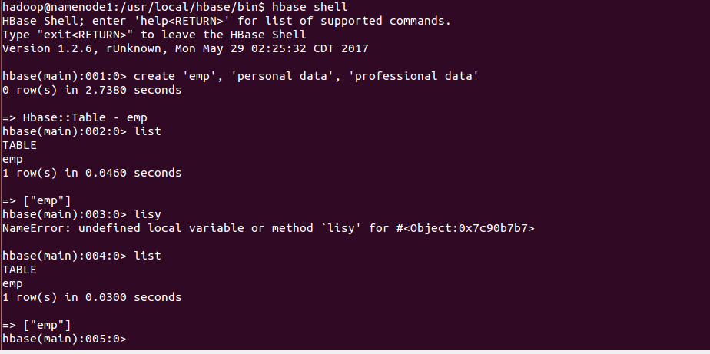
Run hbase Shell
Hbase shell

Slide 17
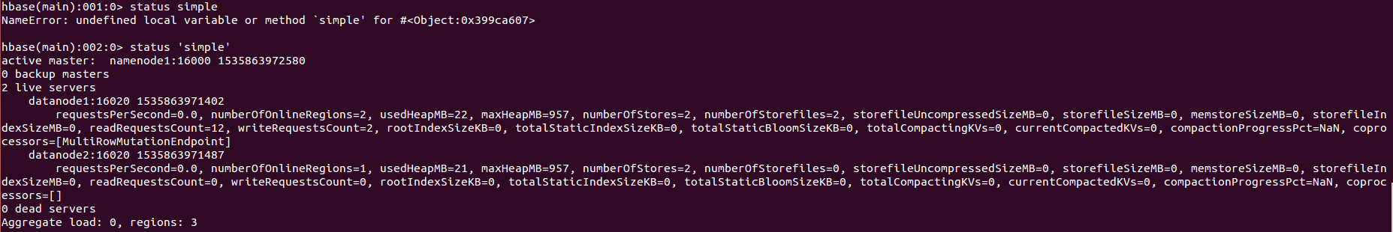
Hbase hands on Practice
1) General HBase shell commands
status | Show cluster status. Can be ‘summary’, ‘simple’, or ‘detailed’. The
 | default is ‘summary’.
 | hbase> status
 | hbase> status ‘simple’
 | hbase> status ‘detailed’
version | Output this HBase versionUsage:
 | hbase> version
whoami | Show the current hbase user.Usage:
 | hbase> whoami

Slide 18
Tables Managements commands Create List Describe Disable Disable_all Enable Enable_all Drop Drop_all Show_filters Alter Alter_status
Data manipulation commands
Count
Put
Get
Delete
Delete all
Truncate
Scan
﻿Cluster Replication Commands
add_peer
remove_peer
start_replication
stop_replication

Slide 19
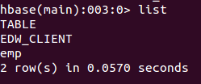


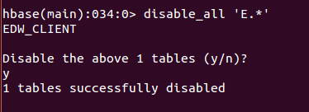
hbase(main):004:0> create 'EDW_CLIENT','CLIENT_REACH’
hbase(main):004:0> list
hbase(main):004:0> describe 'EDW_CLIENT’
hbase(main):004:0> disable ‘EDW_CLIENT’
hbase(main):004:0> enable ‘EDW_CLIENT’
hbase(main):004:0> disable_all ‘E.*’

Slide 20
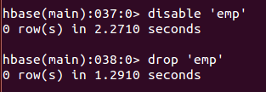
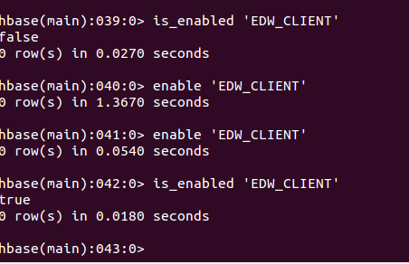
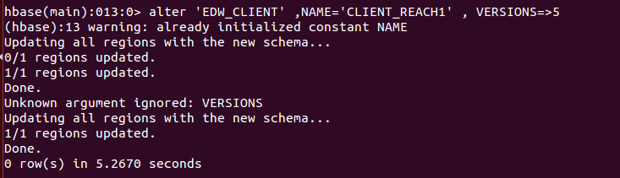

hbase(main):037:0> disable 'emp’
hbase(main):038:0> drop 'emp’
hbase(main):038:0> is_enabled ‘EDW_CLIENT’
hbase(main):038:0> alter 'EDW_CLIENT' ,NAME='CLIENT_REACH1' , VERSIONS=>6
hbase(main):047:0* alter_status 'EDW_CLIENT’

Slide 21
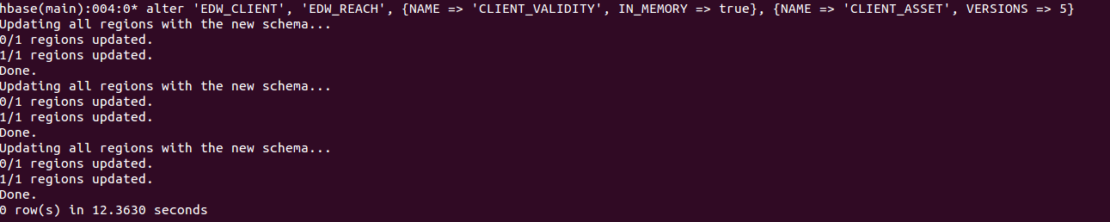
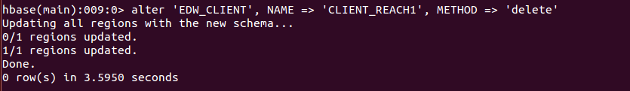
hbase(main):047:0> alter_status 'EDW_CLIENT’
﻿ hbase(main):047:0 >alter 'EDW_CLIENT', 'EDW_REACH', {NAME => 'CLIENT_VALIDITY', IN_MEMORY => true}, {NAME => 'CLIENT_ASSET', VERSIONS => 5}
hbase(main):047:0 > alter 'EDW_CLIENT', NAME => ‘EDW_REACH', METHOD => 'delete’
hbase(main):047:0 > alter 'EDW_CLIENT ', 'delete' =>' EDW_REACH '

Slide 22
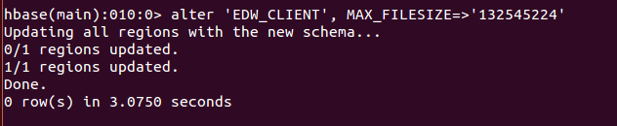
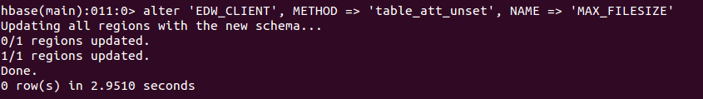
You can change table-scope attributes like MAX_FILESIZE, READONLY, MEMSTORE_FLUSHSIZE, DEFERRED_LOG_FLUSH, etc. These can be put at the end;for example, to change the max size of a region to 128MB or any other memory value we use this command.
hbase(main):010:0> alter 'EDW_CLIENT', MAX_FILESIZE=>'132545224’
﻿ hbase(main):010:0> alter ' 'EDW_CLIENT ', METHOD => 'table_att_unset', NAME => 'MAX_FILESIZE'

Slide 23
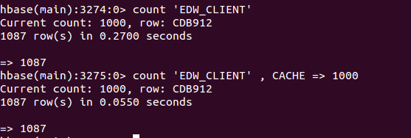
Count
The CACHE in above syntax represents, current count is shown per every 1000 rows by default.
This CAHCE size is 10 rows by default.
HBase count shell command will work fast when it is configured with right Cache size.
hbase(main):3275:0> count 'EDW_CLIENT'
hbase(main):3275:0> count 'EDW_CLIENT' , CACHE => 1000

Slide 24
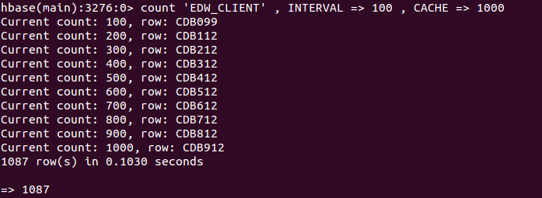
INTERVAL with count
count 'EDW_CLIENT' , INTERVAL => 100 , CACHE => 1000

Slide 25
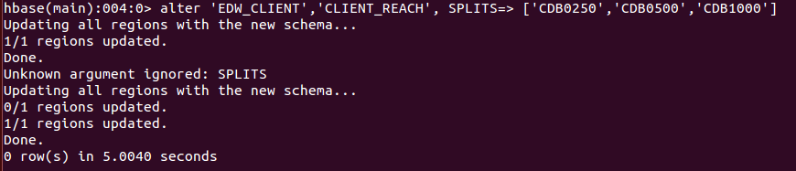
hbase(main):004:0> alter 'EDW_CLIENT','CLIENT_REACH', SPLITS=> ['CDB0250','CDB0500','CDB1000']
scan 'hbase:meta' ,{FILTER=>"PrefixFilter('EDW_CLIENT')"}

Slide 26
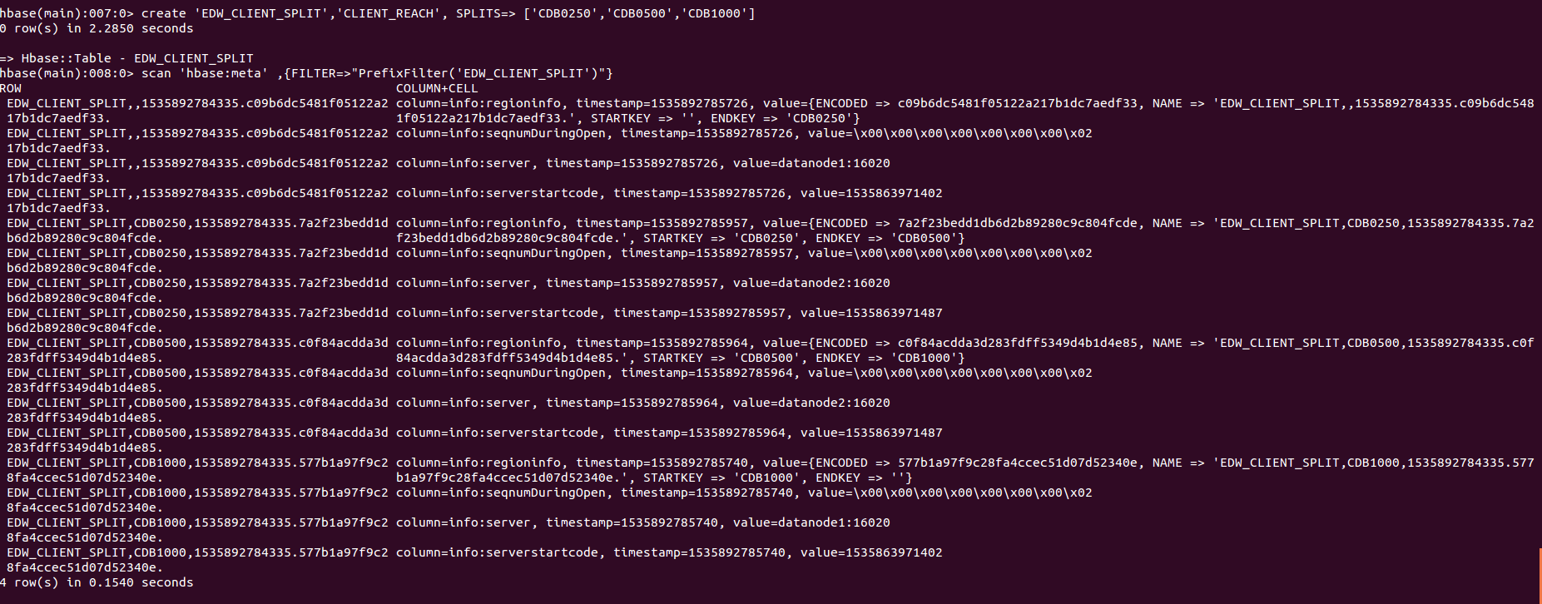
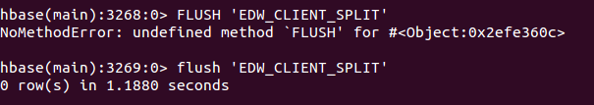

Slide 27
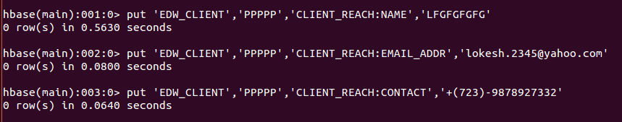
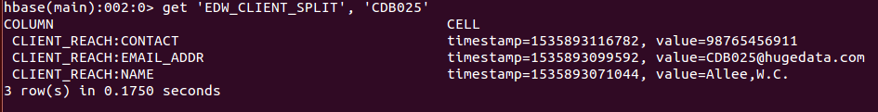
Insert data into table
put 'EDW_CLIENT’,’PPPPP','CLIENT_REACH:NAME',’LFGFGFGFG'
put 'EDW_CLIENT', ’PPPPP ','CLIENT_REACH:EMAIL_ADDR','lokesh.2345@yahoo.com'
put 'EDW_CLIENT', ’PPPPP ','CLIENT_REACH:CONTACT','+(723)-9878927332'
get 'EDW_CLIENT_SPLIT', 'CDB025'

Slide 28
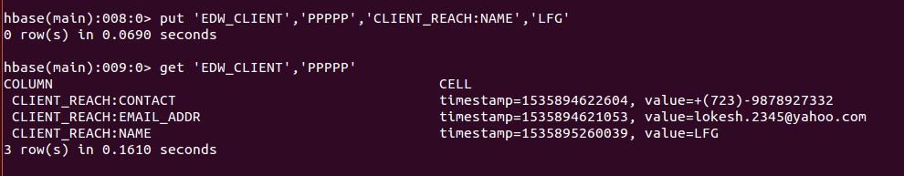
Update table data

Slide 29
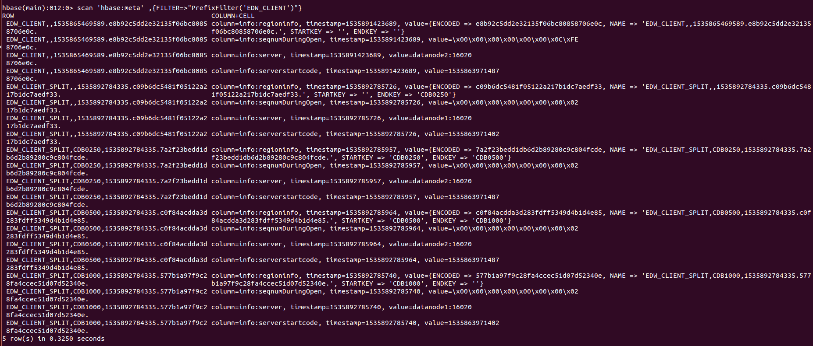
scan 'hbase:meta' ,{FILTER=>"PrefixFilter('EDW_CLIENT')"}

Slide 30
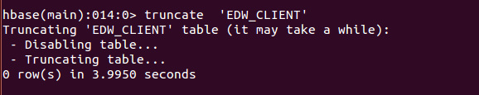
Truncate tables
hbase(main):014:0> truncate 'EDW_CLIENT'

Slide 31
﻿Cluster Replication Commands
Command | Functionality
add_peer | Add peers to cluster to replicate hbase> add_peer '3', zk1,zk2,zk3:2182:/hbase-prod
remove_peer | Stops the defined replication stream. Deletes all the metadata information about the peer hbase> remove_peer '1'
start_replication | Restarts all the replication features hbase> start_replication
stop_replication | Stops all the replication features hbase>stop_replication

Slide 32
Hint and finding of errors
Make both version are same, here hbase is confused to bind the log
Locate slf4j-log4j12
You will find files with different versions
just make both same by copy paste

