Slide 1
Kafka-Streaming
Do it yourself
https://github.com/ashishobeystalent/Bigdata_ppt/upload/master/kafka.pptx

Slide 2
What is Kafka?
Apache Kafka is an open-source message broker project developed by the Apache Software Foundation written in Scala. The project aims to provide a unified, high-throughput, low-latency platform for handling real-time data feeds. It is, in its essence, a "massively scalable pub/sub message queue architected as a distributed transaction log," making it highly valuable for enterprise infrastructures to process streaming data.
Why Kafka?
Kafka is a unified platform for handling all the real-time data feeds. Kafka supports low latency message delivery and gives guarantee for fault tolerance in the presence of machine failures. It has the ability to handle a large number of diverse consumers. Kafka is very fast, performs 2 million writes/sec. Kafka persists all data to the disk, which essentially means that all the writes go to the page cache of the OS (RAM). This makes it very efficient to transfer data from page cache to a network socket

Slide 3
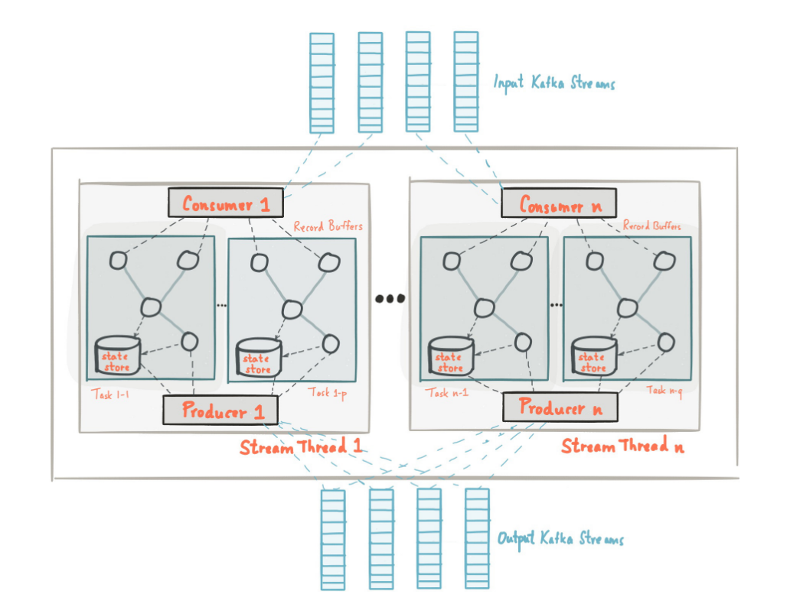
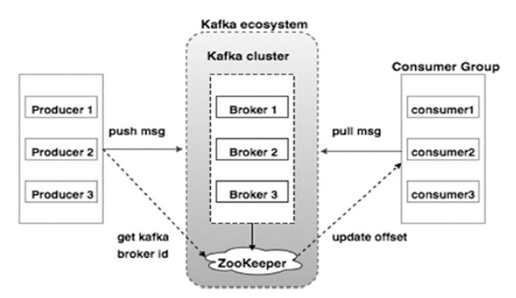

Slide 4
Kafka installation
Perform below steps in namenode1,datanode1,datanode2
Create folder /usr/local/kafka and /var/kafkalog
sudo mkdir /usr/local/kafka
sudo mkdir /var/kafkalog
sudo chmod –R 777 /usr/local/kafka
sudo chmod –R 777 /var/kafkalog
sudo chown –R hadoop:hadoop /usr/local/kafka
sudo chown –R hadoop:hadoop /var/kafkalog

Slide 5
Kafka installation
Perform below steps in namenode1
Copy software
cp /home/hadoop/softwares/kafka_2.11-1.0.0.tgz /usr/local/kafka/
Or
Download
cd /usr/local/kafka/
wget http://www-eu.apache.org/dist/kafka/1.0.1/kafka_2.12-1.0.1.tgz
Extract the file
tar –xvzf kafka_2.11-1.0.0.tgz
Move file
cd /usr/local/kafka/ kafka_2.11-1.0.0
mv * ../
rmdir kafka_2.11-1.0.0

Slide 6
Kafka installation
Now change the property file
gedit /usr/local/kafka/config/server.properties
broker.id=1
listeners=PLAINTEXT://:9092
advertised.listeners=PLAINTEXT://namenode1:9092
zookeeper.connect=namenode1:2181,datanode1:2181,datanode2:2181
delete.topic.enable = true
log.dirs=/var/kafkalog

Slide 7
Kafka Installation
Set path for kafka/bin in ~/.bashrc file
gedit ~/.bashrc
export KAFKA_HOME=/usr/local/kafka
export PATH=$KAFKA_HOME/bin:$PATH
Now execute
source ~/.bashrc

Slide 8
Copy every thing to datanode1 and datanode2
scp -r /usr/local/kafka/* hadoop@datanode1:/usr/local/kafka
scp -r /usr/local/kafka/* hadoop@datanode2:/usr/local/kafka
scp -r ~/.bashrc hadoop@datanode1:~/.bashrc
scp -r ~/.bashrc hadoop@datanode2:~/.bashrc
Run below command in datanode1 and datanode2
source ~/.bashrc
Change configuration on datanode1 and datanode2
gedit /usr/local/kafka/config/server.properties
on datanode1
broker.id=2
advertised.listeners=PLAINTEXT://datanode1:9092
on datanode2
broker.id=3
advertised.listeners=PLAINTEXT://datanode2:9092

Slide 9
Start Servers
Start Zookeeper
/usr/local/zookeeper/bin/zkServer.sh start /usr/local/zookeeper/conf/zoo.cfg
Check status
/usr/local/zookeeper/bin/zkServer.sh status
Start Kafka server
/usr/local/kafka/bin/kafka-server-start.sh -daemon /usr/local/kafka/config/server.properties

Slide 10
Create topic
/usr/local/kafka/bin/kafka-topics.sh --create --zookeeper namenode1:2181,datanode1:2181,datanode2:2181 --replication-factor 3 --partitions 2 --topic edw
Describe topic
/usr/local/kafka/bin/kafka-topics.sh --zookeeper namenode1:2181,datanode1:2182,datanode2:2183 --describe --topic edw
List all the topic
/usr/local/kafka/bin/kafka-topics.sh --list --zookeeper namenode1:2181,datanode1:2182,datanode2:2183
Start Producer
/usr/local/kafka/bin/kafka-console-producer.sh --broker-list namenode1:9092,datanode1:9092,datanode2:9092 --topic edw
Start Consumer
/usr/local/kafka/bin/kafka-console-consumer.sh --zookeeper namenode1:2181,datanode1:2181,datanode2:2181 --topic edw --from-beginning

Slide 11
You may have to install some extra tools
brew install mysql elasticsearch kibana jq
wget -qO - http://packages.confluent.io/deb/3.3/archive.key | sudo apt-key add -
sudo add-apt-repository "deb [arch=amd64] http://packages.confluent.io/deb/3.3 stable main"
sudo apt-get install confluent-platform-oss-2.11

