Slide 1
Pig
Do it yourself
https://github.com/ashishobeystalent/Bigdata_ppt/upload/master/pig.pptx

Slide 2
What is Pig?
Pig enables people to focus more on analyzing bulk data sets and to spend less time in writing Map-Reduce programs.
Why Pig?
Pig is a high level scripting language that is used withApache Hadoop. Pig enables data workers to write complex data transformations without knowing Java.Pig's simple SQL-like scripting language is called PigLatin, and appeals to developers already familiar with scripting languages and SQL.
Who uses Pig?
Company | Website | Country | Revenue | Company Size
Hortonworks Inc | hortonworks.com | United States | 100M-200M | 500-1000
Comscore Inc | comscore.com | United States | 200M-1000M | 1000-5000
The MITRE Corporation | mitre.org | United States | >1000M | 5000-10000
VISUAL BI SOLUTIONS, INC | visualbi.com | United States | 10M-50M | 50-200
Ocwen Financial Corp | ocwen.com | United States | >1000M | 5000-10000

Slide 3
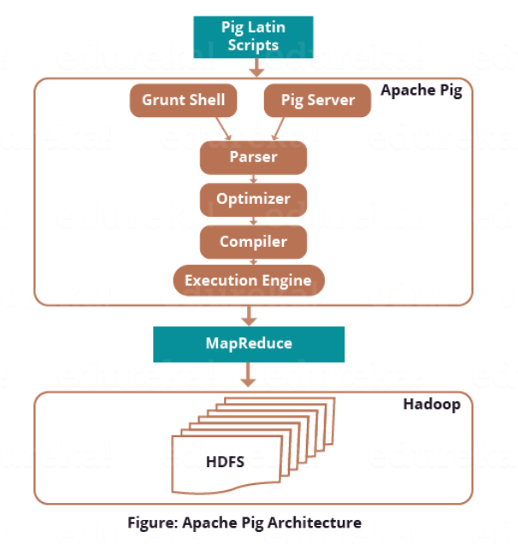
Pig Architecture
Parser
Parser basically checks the syntax of the script, does type checking, and other miscellaneous checks. Later output of Parser will be a DAG (directed acyclic graph) that represents the Pig Latin statements as well as logical operators.
Optimizer
Logical plan (DAG) is passed to the logical optimizer. It carries out the logical optimizations further such as projection and push down.
Compiler
Then compiler compiles the optimized logical plan into a series of MapReduce jobs.
Execution engine
MapReduce jobs are submitted to Hadoop in a sorted order.

Slide 4
Pig Latin Data Model
Atom
Atom is defined as any single value in Pig Latin, irrespective of their data. Atomic values of Pig are int, long, float, double, char array, and byte array.
For Example − ‘Shubham’ or ‘25’
Tuple
Tuple is a record that is formed by an ordered set of fields. However, the fields can be of any type. In addition, a tuple is similar to a row in a table of RDBMS.
For Example − (Shubham, 25)
Bag
An unordered set of tuples is what we call Bag. To be more specific, a Bag is a collection of tuples (non-unique). Moreover, each tuple can have any number of fields (flexible schema). Generally, we represent a bag by ‘{}’.
For Example − {(Shubham, 25), (Pulkit, 35)}
In addition, when a bag is a field in a relation, in that way it is known as the inner bag.
Example − {Shubham, 25, {9826022258, Shubham@gmail.com,}}
Map
A set of key-value pairs is what we call a map (or data map). Basically, the key needs to be of type char array and should be unique. Also, the value might be of any type. And, we represent it by ‘[]’
For Example − [name#Shubham, age#25]
Relation
A bag of tuples is what we call Relation. In Pig Latin, the relations are unordered. Also, there is no guarantee that tuples are processed in any particular order.

Slide 5
Pig installation
As usual we have 3 node cluster , one namenode (namenode1) and two datanodes (datanode1,datanode2). We already have hdfs and java configured.
We have pig software present in /home/Hadoop/softwares/
Perform below steps in namenode1
Create folder
mkdir /usr/local/pig
Grant permission
Sudo chmod -R 777 /usr/local/pig
Change owner
Sudo chown -R hadoop:hadoop /usr/local/pig

Slide 6
PIG installation
Perform below steps in namenode1
Copy software
cp /home/hadoop/softwares/pig-0.17.0.tar.gz /usr/local/pig/
Or
Download
cd /usr/local/hbase/
wget http://www-us.apache.org/dist/pig/pig-0.16.0/pig-0.16.0.tar.gz
Extract the file
tar –xvzf pig-0.17.0.tar.gz
Move file
cd /usr/local/hbase/ pig-0.17.0
mv * ../
rmdir pig-0.17.0

Slide 7
Pig Installation
Set path for hbase/bin in ~/.bashrc file
gedit ~/.bashrc file
export PIG_HOME=/usr/local/pig
export PATH=$PATH:$PIG_HOME/bin
export PIG_CLASSPATH=$HADOOP_CONF_DIR
Now execute
source ~/.bashrc

Slide 8
Run Pig
Execution modes in Apache Pig:
MapReduce Mode – This is the default mode, which requires access to a Hadoop cluster and HDFS installation. Since, this is a default mode, it is not necessary to specify -x flag ( you can execute pig OR pig -x mapreduce). The input and output in this mode are present on HDFS.
Local Mode – With access to a single machine, all files are installed and run using a local host and file system. Here the local mode is specified using ‘-x flag’ (pig -x local). The input and output in this mode are present on local file system.

Slide 9
Start JobHistoryServer
To Start:
$HADOOP_PREFIX/sbin/mr-jobhistory-daemon.sh start historyserver
To Stop:
$HADOOP_PREFIX/sbin/mr-jobhistory-daemon.sh stop historyserver
If the Cluster setup is Pseudo Distributed, no additional properties are required.
In a multinode cluster setup, Add these JobHistoryServer properties in mapred-site.xml:
<property>
<name>mapreduce.jobhistory.address</name>
<value>hostname:10020</value> <!-- hostname of machine where jobhistory service is started -->
</property>
<property>
<name>mapreduce.jobhistory.webapp.address</name>
<value>hostname:19888</value>
</property>

Slide 10
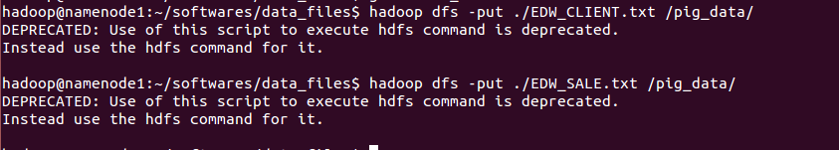
Put data into pig
We need to put data into HDFS in order to use mapreduce mode of pig execution because In MapReduce mode, Pig reads (loads) data from HDFS and stores the results back in HDFS.
Relation_name = LOAD 'Input file path' USING function as schema;
relation_name − We have to mention the relation in which we want to store the data.
Input file path − We have to mention the HDFS directory where the file is stored. (In MapReduce mode)
function − We have to choose a function from the set of load functions provided by Apache Pig (BinStorage, JsonLoader, PigStorage, TextLoader).
Schema − We have to define the schema of the data. We can define the required schema as follows
( id:Int, firstname:chararray, lastname:chararray, phone:chararray,city:chararray );
Example:-
A = load '/pig_data/daily_show_guests' using PigStorage(',') AS (year:chararray,occupation:chararray,date:chararray,group:chararray,gusetlist:chararray);

Slide 11
Storing data in Pig
STORE Relation_name INTO ' required_directory_path ' [USING function];
Example
grunt> A = load '/pig_data/daily_show_guests' using PigStorage(',') AS (year:chararray,occupation:chararray,date:chararray,group:chararray,gusetlist:chararray);
grunt> STORE A INTO ' hdfs://namenode1:10001/pig_Output/ ' USING PigStorage (',');

Slide 12

Diagnostic Operators.
DUMP:
The DUMP operator is used to run Pig Latin statements and display the results on the screen. In this example, the operator prints ‘loading1’ on to the screen.
DESCRIBE:
Use the DESCRIBE operator to review the schema of a particular relation. The DESCRIBE operator is best used for debugging a script.
ILLUSTRATE:
This operator is used to review how data is transformed through a sequence of Pig Latin statements. ILLUSTRATE command is your best friend
when it comes to debugging a script. This command alone might be a good reason for choosing Pig over something else.
EXPLAIN:
The EXPLAIN operator prints the logical and physical plane.

Slide 13
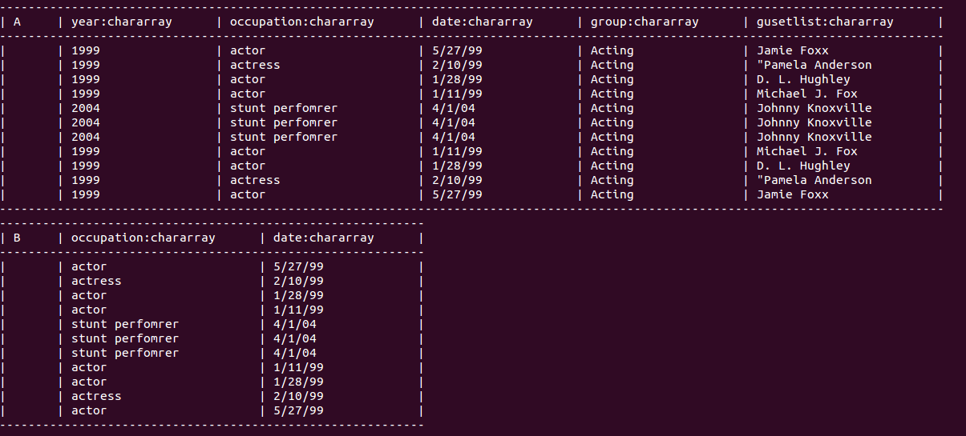
Illustrate command example

Slide 14
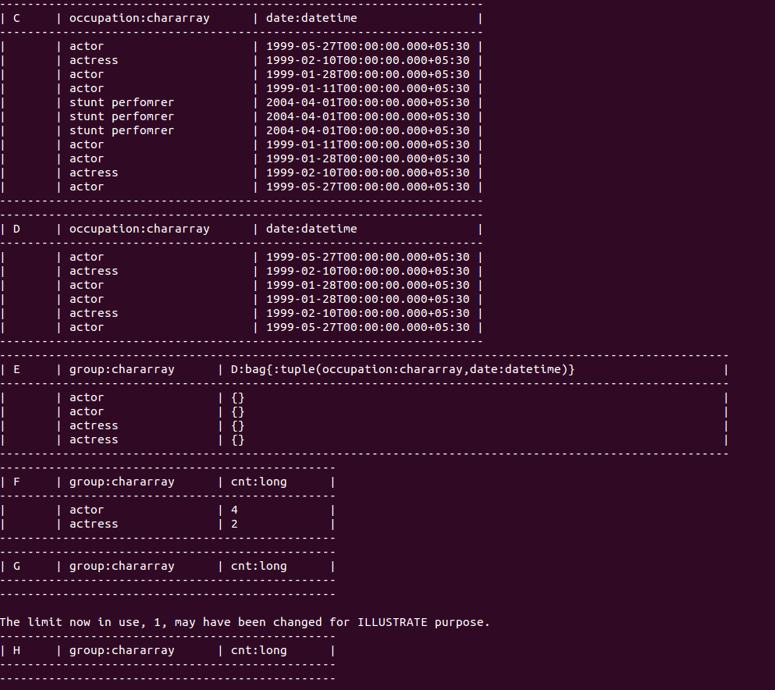

Slide 15
Group By Operator
grunt> Group_data = GROUP Relation_name BY age;
Group more than one set of data
grunt> cogroup_data = COGROUP student_details by age, employee_details by age;
Relation3_name = CROSS Relation1_name, Relation2_name;

Slide 16
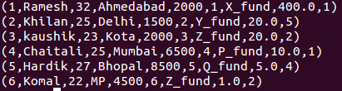
Joins in PIG
Self-join
Inner-join
Outer-join − left join, right join, and full join
EDW_CLIENT = LOAD 'hdfs://namenode1:10001/pig_data/EDW_CLIENT.txt' USING PigStorage(',')as (CLIENT_ID:int, name:chararray, age:int, address:chararray,wallet_money:int);
EDW_SALE = LOAD 'hdfs://namenode1:10001/pig_data/EDW_SALE.txt' USING PigStorage(',')as (CLIENT_ID:int, FUND_NAME:chararray,FUND_PRICE:float,UNITS:int);
CLIENT_SALE_inner = JOIN EDW_CLIENT BY CLIENT_ID, EDW_SALE BY CLIENT_ID;
CLIENT_SALE_self = JOIN EDW_CLIENT BY CLIENT_ID, EDW_CLIENT BY CLIENT_ID;
CLIENT_SALE_left = JOIN EDW_CLIENT BY CLIENT_ID left outer, EDW_SALE BY CLIENT_ID;
CLIENT_SALE_right = JOIN EDW_CLIENT BY CLIENT_ID right , EDW_SALE BY CLIENT_ID;
CLIENT_SALE_outer = JOIN EDW_CLIENT BY CLIENT_ID full outer, EDW_SALE BY CLIENT_ID;

Slide 17
EVAL function in Pig
AVG - To compute the average of the numerical values within a bag.
MAX - To calculate the highest value for a column (numeric values or chararrays) in a single-column bag.
MIN - To get the minimum (lowest) value (numeric or chararray) for a certain column in a single-column bag.
COUNT - To get the number of elements in a bag, while counting the number of tuples in a bag.
DIFF - The DIFF() function of Pig Latin is used to compare two bags (fields) in a tuple. It takes two fields of a tuple as input and matches them. If they match, it returns an empty bag.
SUBTRACT - The subtract() function of Pig Latin is used to subtract two bags It takes two bags as inputs and returns a bag which contains the tuples of the first bag that are not in the second bag.
IsEmpty - The isEmpty() function of Pig Latin is used to check if a bag or map is empty.
Pluck Tuple - After performing operations like join to differentiate the columns of the two schemas, we use the function PluckTuple(). To use this function, first of all, we have to define a string Prefix and we have to filter
for the columns in a relation that begin with that prefix.

Slide 18
Cross Command
grunt>EDW_CORSS = CROSS EDW_CLIENT, EDW_SALE;
Union Command
grunt>EDW_UNION = UNION EDW_CLIENT, EDW_SALE;
SPLIT Command
grunt>SPLIT EDW_CLIENT into EDW_CLIENT_BADA if age<23, EDW_CLIENT_CHOTA if (22<age and age>25);
Filter Command
grunt>filter_data = FILTER EDW_CLIENT BY city == 'Hyderabad’;
Distinct Command
grunt>distinct_data = DISTINCT EDW_CLIENT;
Foreach Command
grunt>foreach_data = FOREACH EDW_CLIENT GENERATE CLIENT_ID,name,wallet_money;

Slide 19
Order Command
grunt>order_by_data = ORDER EDW_CLIENT BY age DESC;
Limit Commad
grunt> limit_data = LIMIT EDW_CLIENT 2;
Run Script
pig -x mapreduce hdfs://namenode1:10001/pig_data/Sample_script.pig

Slide 20
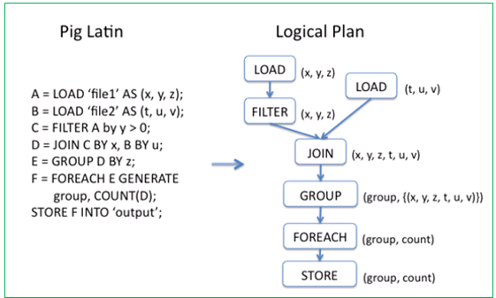

Slide 21
Example use case
Find the top five kinds of GoogleKnowlege_Occupation people who were guests in the show, in a particular time period.
A = load '/pig_data/daily_show_guests' using PigStorage(',') AS (year:chararray,occupation:chararray,
date:chararray,group:chararray,gusetlist:chararray);
B = foreach A generate occupation,date;
C = foreach B generate occupation,ToDate(date,'MM/dd/yy') as date;
D = filter C by ((date> ToDate('1/11/99','MM/dd/yy')) AND (date<ToDate('6/11/99','MM/dd/yy')));
E = group D by occupation;
F = foreach E generate group, COUNT(D) as cnt;
G = order F by cnt desc;
H = limit G 5;

Slide 22
Find out the number of politicians who came each year.
A = load '/pig_data/daily_show_guests' using PigStorage(',') AS (year:chararray,occupation:chararray,date:chararray
,group:chararray,gusetlist:chararray);
B = foreach A generate year,group;
C = filter B by group == 'Politician';
D = group C by year;
E = foreach D generate group, COUNT(C) as cnt;
F = order E by cnt desc;

