Slide 1
Zookeeper
Do it yourself

Slide 2
What is Zookeeper
ZooKeeper is a distributed co-ordination service to manage large set of hosts. Co-ordinating and managing a service in a distributed environment is a complicated process. ZooKeeper solves this issue with its simple architecture and API. ZooKeeper allows developers to focus on core application logic without worrying about the distributed nature of the application.
The common services provided by ZooKeeper are as follows −
Naming service − Identifying the nodes in a cluster by name. It is similar to DNS, but for nodes.
Configuration management − Latest and up-to-date configuration information of the system for a joining node.
Cluster management − Joining / leaving of a node in a cluster and node status at real time.
Leader election − Electing a node as leader for coordination purpose.
Locking and synchronization service − Locking the data while modifying it. This mechanism helps you in automatic fail recovery while connecting other distributed applications like Apache HBase.
Highly reliable data registry − Availability of data even when one or a few nodes are down.

Slide 3
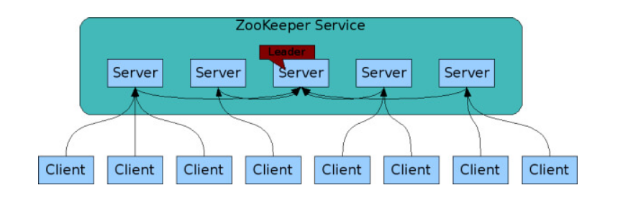
Architecture of Zookeeper
one ZooKeeper client is connected to one ZooKeeper server. Each ZooKeeper server can handle a large number of client connections at the same time. Each client periodically sends pings to the ZooKeeper server it is connected to let it know that it is alive and connected. The ZooKeeper server responds with an acknowledgment of the ping, indicating the server is alive as well. When the client doesn't receive an acknowledgment from the server within the specified time, the client connects to another server in the ensemble, and the client session is transparently transferred over to the new ZooKeeper server.

Slide 4
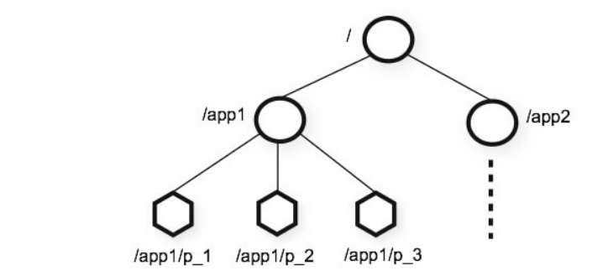
Data Model of Zookeeper

Slide 5
Different modes for Znodes
Persistent and ephemeral znodes
Sequential znodes
Versions
ZooKeeper Watches
ZooKeeper Quorums

Slide 6
Installation
In this example we have 3 node cluster, One is namenode1 and two are datanode1,datamode2
Perform the below steps in all three of them
Create directory
Usr/local/zookeeper
Change Permission of zookeeper folder so that zookeeper user can access this location
Sudo chmod –R 777 Usr/local/zookeeper
Download or extract zookeeper from /home/Hadoop/software(local location to our server) folder
And copy it to /usr/local/zookeeper
gunzip zookeeper-3.4.10.tar.gz

Slide 7
Installation
Untar the file
tar –xvf zookeeper-3.4.10.tar
Create folder
/var/zookeeper/
Change location for this folder
Sudo chmod –R 777 /var/zookeeper

Slide 8
Change usr/local/zookeeper/conf/zoo.cfg at namenode1
tickTime=2000
dataDir=/var/zookeeper
clientPort=2181
initLimit=5
syncLimit=2
server.1=0.0.0.0:2888:3888
server.2=datanode1:2888:3888
server.3=datanode2:2888:3888
Change usr/local/zookeeper/conf/zoo.cfg at datanode1
tickTime=2000
dataDir=/var/zookeeper
clientPort=2181
initLimit=5
syncLimit=2
server.1=namenode1:2888:3888
server.2=0.0.0.0:2888:3888
server.3=datanode2:2888:3888
Change usr/local/zookeeper/conf/zoo.cfg at datanode2
tickTime=2000
dataDir=/var/zookeeper
clientPort=2181
initLimit=5
syncLimit=2
server.1=namenode1:2888:3888
server.2=datanode1:2888:3888
server.3=0.0.0.0:2888:3888

Slide 9
Create Myid folders so that servers can differentiate there ids
Create file myid at namenode1
echo “1” > /var/zookeeper/myid
Create file myid at datanode1
echo “2” > /var/zookeeper/myid
Create file myid at datanode2
echo “3” > /var/zookeeper/myid
Provide path variable for Zookeeper in all three servers
gedit ~/.bashrc
export ZOOKEEPER_HOME=/usr/local/zookeeper
export PATH=$PATH:$ZOOKEEPER_HOME/bin
Run this after making change
source ~/.bashrc

Slide 10
Run
Run the command in all three servers in /usr/local/zookeeper folder
java -cp zookeeper-3.4.10.jar:lib/log4j-1.2.16.jar:lib/slf4j-log4j12-1.6.1.jar:lib/slf4j-api-1.6.1.jar:conf org.apache.zookeeper.server.quorum.QuorumPeerMain conf/zoo.cfg

Slide 11
Basic Commands
Start Zookeeper shell
bin/zkCli.sh
Create first Znode
create /FirstZnode “Myfirstzookeeper-app”
To create an Ephemeral Znode, add -e flag as shown below.
create -e /SecondZnode “Ephemeral-data”
Get data
get /FirstZnode

Slide 12
Basic Commands
Watch
get /FirstZnode 1
Set Data
set /SecondZnode Data-updated
Create Children / Sub-znode
create /FirstZnode/Child1 firstchildren
List Children
ls /MyFirstZnode
Check Status
stat /FirstZnode
Remove a Znode
rmr /FirstZnode

