Slide 1
Spark and Scala
Do it yourself
https://github.com/ashishobeystalent/Bigdata_ppt/upload/master/sparkscala.pptx

Slide 2
What is Spark?
Spark Programming is nothing but a general-purpose & lightning fast cluster computing platform. In other words, it is an open source, wide range data processing engine. That reveals development API’s, which also qualifies data workers to accomplish streaming, machine learning or SQL workloads which demand repeated access to data sets.
Why Spark?
There was no powerful engine in the industry, that can process the data both in real-time and batch mode. Also, there was a requirement that one engine can respond in sub-second and perform in-memory processing.

Slide 3
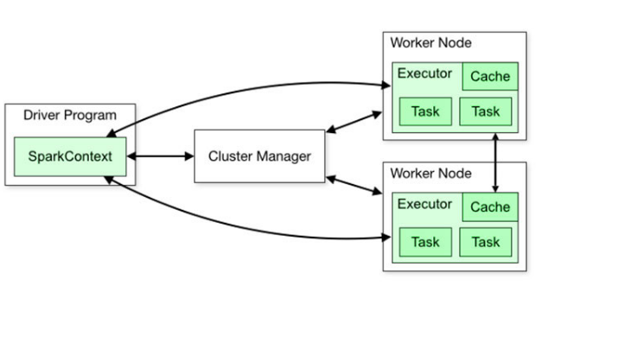

Slide 4
Spark and scala installation
As usual we have 3 node cluster , one namenode (namenode1) and two datanodes (datanode1,datanode2). We already have hdfs and java configured.
We have spark and scala software present in /home/Hadoop/softwares/
Perform below steps in namenode1
Create folder
sudo mkdir /usr/local/spark
sudo mkdir /usr/local/scala
sudo mkdir /var/spark
sudo mkdir /var/spark/tmp
Grant permission
sudo chmod -R 777 /usr/local/spark
sudo chmod -R 777 /usr/local/scala
sudo chmod -R 777 /var/spark
Change owner
sudo chown -R hadoop:hadoop /usr/local/scala
sudo chown -R hadoop:hadoop /usr/local/spark
sudo chown -R hadoop:hadoop /var/spark

Slide 5
Spark and Scala installation
Perform below steps in namenode1
Copy software
cp /home/hadoop/softwares/spark-2.2.0-bin-hadoop2.7.tgz /usr/local/spark/
cp /home/hadoop/softwares/scala-2.10.5.tgz /usr/local/scala/
Extract the file
tar –xvzf spark-2.2.0-bin-hadoop2.7.tgz
tar –xvzf scala-2.10.5.tgz
Move file
cd /usr/local/spark/spark-2.2.0-bin-hadoop2.7
mv * ../
rmdir spark-2.2.0-bin-hadoop2.7
cd /usr/local/spark/ scala-2.10.5
mv * ../
rmdir scala-2.10.5

Slide 6
cd /usr/local/spark/conf
Spark and Scala Installation
Set path for spark/bin in ~/.bashrc file
gedit ~/.bashrc
export SCALA_HOME=/usr/local/scala
export SPARK_HOME=/usr/local/spark
export PATH=$SPARK_HOME/bin:$JAVA_HOME/bin:$SCALA_HOME/bin:$PATH
export SPARK_CLASSPATH=/usr/share/java/mysql-connector-java-5.1.28.jar
export LD_LIBRARY_PATH=$HADOOP_PREFIX/lib/native:$LD_LIBRARY_PATH
export HADOOP_CONF_DIR=$HADOOP_PREFIX/etc/hadoop
export PATH=/usr/share/java/mysql-connector-java-5.1.28.jar:$PATH
Now execute
source ~/.bashrc
Now change the configuration of spark
cd /usr/local/spark/conf
cp Copy the spark-env.sh.template to spark-env.sh

Slide 7
cd /usr/local/spark/conf
Spark and Scala Installation
gedit spark-env.sh
export SCALA_HOME=/usr/local/scala
export SPARK_HOME=/usr/local/spark
export SPARK_CLASSPATH=/usr/local/hive/lib/mysql-connector-java.jar
export JAVA_HOME=/usr/lib/jvm/java-1.8.0-openjdk-amd64
export HADOOP_CONF_DIR=/usr/local/hadoop/etc/hadoop
export YARN_CONF_DIR=/usr/local/hadoop/etc/hadoop
export SPARK_WORKER_MEMORY=1g
export SPARK_WORKER_INSTANCES=2
export SPARK_MASTER_IP=192.168.1.2
export SPARK_MASTER_PORT=7077
export SPARK_WORKER_DIR=/var/spark/tmp

Slide 8
cd /usr/local/spark/conf
Spark and Scala Installation
cp spark-defaults.conf.template spark-defaults.conf
gedit spark-defaults.conf
spark.driver.extraClassPath = /usr/local/spark/mysql-connector-java-5.1.28.jar
spark.executor.extraClassPath = /usr/local/spark/mysql-connector-java-5.1.28.jar
spark.master yarn
#spark://192.168.1.2:7077
spark.driver.memory 512m
gedit usr/local/spark/conf/slaves
192.168.1.3
192.168.1.4

Slide 9
cd /usr/local/spark/conf
Spark and Scala Installation
Copy
scp -r /usr/local/spark hadoop@datanode1:/usr/local/spark
scp -r /usr/local/spark Hadoop@dtaanode2:/usr/local/spark
scp -r /usr/local/scala hadoop@datanode1:/usr/local/scala
scp -r /usr/local/scala Hadoop@dtaanode2:/usr/local/scala
scp -r ~/.bashrc Hadoop@datanode2:~/.bashrc
scp -r ~/.bashrc Hadoop@datanode1:~/.bashrc
Do this on all nodes
source ~/.bashrc

Slide 10
cd /usr/local/spark/conf
Data Representation
RDD – RDD is a distributed collection of data elements spread across many machines in the cluster. RDDs are a set of Java or Scala objects representing data.
DataFrame – A DataFrame is a distributed collection of data organized into named columns. It is conceptually equal to a table in a relational database.
DataSet – It is an extension of DataFrame API that provides the functionality of – type-safe, object-oriented programming interface of the RDD API and performance benefits of the Catalyst query optimizer and off heap storage mechanism of a DataFrame API

Slide 11
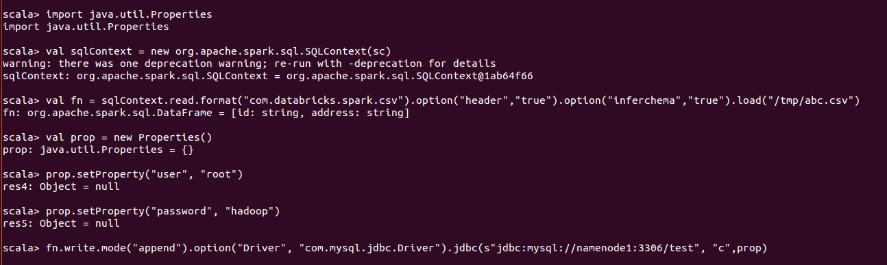
Scala Loading database from CSV
import java.util.Properties
val sqlContext = new org.apache.spark.sql.SQLContext(sc)
val fn = sqlContext.read.format("com.databricks.spark.csv").option("header","true").option("inferchema","true").load("/tmp/abc.csv")
val prop = new Properties()
prop.setProperty("user", "root")
prop.setProperty("password", "hadoop")
fn.write.mode("append").option("Driver", "com.mysql.jdbc.Driver").jdbc(s"jdbc:mysql://namenode1:3306/test", "c",prop)

Slide 12
Scala using with clause
val df2 = df1.withColumn("mobile",lit("9878676757 "))

Slide 13
Scala Transformation
map(func)
The map function iterates over every line in RDD and split into new RDD. Using map() transformation we take in any function, and that function is applied to every element of RDD.
val mapFile = datatab.map(line => (line,line.length))
flatMap()
With the help of flatMap() function, to each input element, we have many elements in an output RDD. The most simple use of flatMap() is to split each input string into words.
val flatmapFile = datatab.flatMap(lines => lines.split(" "))

Slide 14
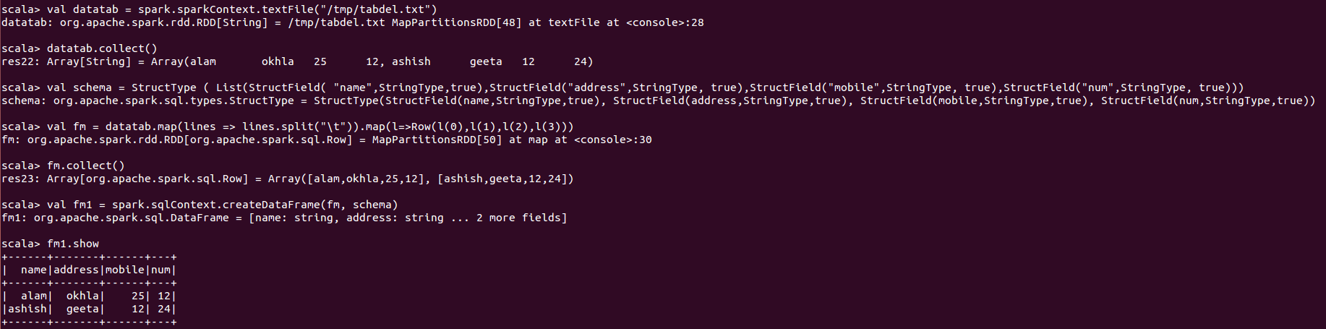
Create a file with 4 columns
scala> val datatab = spark.sparkContext.textFile("/tmp/tabdel.txt")
scala> datatab.collect()
scala> val schema = StructType ( List(StructField( "name",StringType,true),StructField("address",StringType, true),StructField("mobile",StringType, true),StructField("num",StringType, true)))
scala> val fm = datatab.map(lines => lines.split("\t")).map(l=>Row(l(0),l(1),l(2),l(3)))
scala> val fm1 = spark.sqlContext.createDataFrame(fm, schema)

Slide 15
Scala Transformation
filter(func)
Spark RDD filter() function returns a new RDD, containing only the elements that meet a predicate. It is a narrow operation because it does not shuffle data from one partition to many partitions.
val data = spark.read.textFile("spark_test.txt").rdd
val mapFile = data.flatMap(lines => lines.split(" ")).
union(dataset)
With the union() function, we get the elements of both the RDD in new RDD. The key rule of this function is that the two RDDs should be of the same type.
val rdd1 = spark.sparkContext.parallelize(Seq((1,"jan",2016),(3,"nov",2014),(16,"feb",2014)))
val rdd2 = spark.sparkContext.parallelize(Seq((5,"dec",2014),(17,"sep",2015)))
val rdd3 = spark.sparkContext.parallelize(Seq((6,"dec",2011),(16,"may",2015)))
val rddUnion = rdd1.union(rdd2).union(rdd3)

Slide 16
Scala Transformation
intersection(other-dataset)
With the intersection() function, we get only the common element of both the RDD in new RDD. The key rule of this function is that the two RDDs should be of the same type.
.
val rdd1 = spark.sparkContext.parallelize(Seq((1,"jan",2016),(3,"nov",2014, (16,"feb",2014)))
val rdd2 = spark.sparkContext.parallelize(Seq((5,"dec",2014),(1,"jan",2016)))
val comman = rdd1.intersection(rdd2)
distinct()
It returns a new dataset that contains the distinct elements of the source dataset. It is helpful to remove duplicate data.
val rdd1 = park.sparkContext.parallelize(Seq((1,"jan",2016),(3,"nov",2014),(16,"feb",2014),(3,"nov",2014)))
val result = rdd1.distinct()

Slide 17
Scala Transformation
groupByKey()
When we use groupByKey() on a dataset of (K, V) pairs, the data is shuffled according to the key value K in another RDD. In this transformation, lots of unnecessary data get to transfer over the network.
.
val data = spark.sparkContext.parallelize(Array(('k',5),('s',3),('s',4),('p',7),('p',5),('t',8),('k',6)),3)
val group = data.groupByKey().collect()
dataframe
pppp.groupBy("mobile").count()
sortByKey()
When we apply the sortByKey() function on a dataset of (K, V) pairs, the data is sorted according to the key K in another RDD.
val data = spark.sparkContext.parallelize(Seq(("maths",52), ("english",75), ("science",82), ("computer",65), ("maths",85)))
val sorted = data.sortByKey()
Data frame
pppp.sort("mobile").show()

Slide 18
Scala Transformation
join()
The Join is database term. It combines the fields from two table using common values. join() operation in Spark is defined on pair-wise RDD. Pair-wise RDDs are RDD in which each element is in the form of tuples. Where the first element is key and the second element is the value.
.
val data = spark.sparkContext.parallelize(Array(('A',1),('b',2),('c',3)))
val data2 =spark.sparkContext.parallelize(Array(('A',4),('A',6),('b',7),('c',3),('c',8)))
val result = data.join(data2)
coalesce()
To avoid full shuffling of data we use coalesce() function. In coalesce() we use existing partition so that less data is shuffled. Using this we can cut the number of the partition. Suppose, we have four nodes and we want only two nodes. Then the data of extra nodes will be kept onto nodes which we kept.
val rdd1 = spark.sparkContext.parallelize(Array("jan","feb","mar","april","may","jun"),3)
val result = rdd1.coalesce(2)
result.foreach(println)

Slide 19
Scala Transformation
RDD Action
count()
Action count() returns the number of elements in RDD.
val data = spark.read.textFile("spark_test.txt").rdd
val mapFile = data.flatMap(lines => lines.split(" ")).filter(value => value=="spark")
println(mapFile.count())
collect()
The action collect() is the common and simplest operation that returns our entire RDDs content to driver program. The application of collect() is unit testing where the entire RDD is expected to fit in memory. As a result, it makes easy to compare the result of RDD with the expected result.
val data = spark.sparkContext.parallelize(Array(('A',1),('b',2),('c',3)))
val data2 =spark.sparkContext.parallelize(Array(('A',4),('A',6),('b',7),('c',3),('c',8)))
val result = data.join(data2)
println(result.collect().mkString(","))

Slide 20
Scala Transformation
RDD Action
take(n)
The action take(n) returns n number of elements from RDD. It tries to cut the number of partition it accesses, so it represents a biased collection. We cannot presume the order of the elements.
val data = spark.sparkContext.parallelize(Array(('k',5),('s',3),('s',4),('p',7),('p',5),('t',8),('k',6)),3)
val group = data.groupByKey().collect()
val twoRec = result.take(2)
top()
If ordering is present in our RDD, then we can extract top elements from our RDD using top(). Action top() use default ordering of data.
val data = spark.read.textFile("spark_test.txt").rdd
val mapFile = data.map(line => (line,line.length))
val res = mapFile.top(3)
res.foreach(println)

Slide 21
Scala Transformation
RDD Action
countByValue()
The countByValue() returns, many times each element occur in RDD.
For example, RDD has values {1, 2, 2, 3, 4, 5, 5, 6} in this RDD “rdd.countByValue()” will give the result {(1,1), (2,2), (3,1), (4,1), (5,2), (6,1)}
val data = spark.read.textFile("spark_test.txt").rdd
val result= data.map(line => (line,line.length)).countByValue()
result.foreach(println)
reduce()
The reduce() function takes the two elements as input from the RDD and then produces the output of the same type as that of the input elements. The simple forms of such function are an addition. We can add the elements of RDD, count the number of words. It accepts commutative and associative operations as an argument.
val rdd1 = spark.sparkContext.parallelize(List(20,32,45,62,8,5))
val sum = rdd1.reduce(_+_)
println(sum)

Slide 22
Scala Transformation
fold()
The signature of the fold() is like reduce(). Besides, it takes “zero value” as input, which is used for the initial call on each partition. But, the condition with zero value is that it should be the identity element of that operation. The key difference between fold() and reduce() is that, reduce() throws an exception for empty collection, but fold() is defined for empty collection.
val rdd1 = spark.sparkContext.parallelize(List(("maths", 80),("science", 90)))
val additionalMarks = ("extra", 4)
val sum = rdd1.fold(additionalMarks){ (acc, marks) => val add = acc._2 + marks._2
("total", add)
}
println(sum)
foreach()
When we have a situation where we want to apply operation on each element of RDD, but it should not return value to the driver. In this case, foreach() function is useful. For example, inserting a record into the database
val data = spark.sparkContext.parallelize(Array(('k',5),('s',3),('s',4),('p',7),('p',5),('t',8),('k',6)),3)
val group = data.groupByKey().collect()
group.foreach(println)

