Slide 1
Spark and Scala
Do it yourself
https://github.com/ashishobeystalent/Bigdata_ppt/upload/master/sparkscala.pptx

Slide 2
What is Spark?
Spark Programming is nothing but a general-purpose & lightning fast cluster computing platform. In other words, it is an open source, wide range data processing engine. That reveals development API’s, which also qualifies data workers to accomplish streaming, machine learning or SQL workloads which demand repeated access to data sets.
Why Spark?
There was no powerful engine in the industry, that can process the data both in real-time and batch mode. Also, there was a requirement that one engine can respond in sub-second and perform in-memory processing.

Slide 3
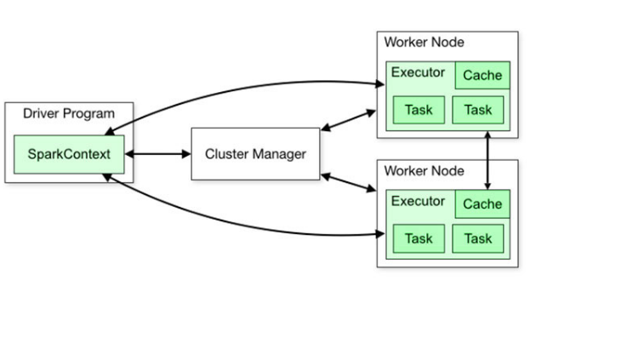

Slide 4
Spark and scala installation
As usual we have 3 node cluster , one namenode (namenode1) and two datanodes (datanode1,datanode2). We already have hdfs and java configured.
We have spark and scala software present in /home/Hadoop/softwares/
Perform below steps in namenode1
Create folder
sudo mkdir /usr/local/spark
sudo mkdir /usr/local/scala
sudo mkdir /var/spark
sudo mkdir /var/spark/tmp
Grant permission
sudo chmod -R 777 /usr/local/spark
sudo chmod -R 777 /usr/local/scala
sudo chmod -R 777 /var/spark
Change owner
sudo chown -R hadoop:hadoop /usr/local/scala
sudo chown -R hadoop:hadoop /usr/local/spark
sudo chown -R hadoop:hadoop /var/spark

Slide 5
Spark and Scala installation
Perform below steps in namenode1
Copy software
cp /home/hadoop/softwares/spark-2.2.0-bin-hadoop2.7.tgz /usr/local/spark/
cp /home/hadoop/softwares/scala-2.10.5.tgz /usr/local/scala/
Extract the file
tar –xvzf spark-2.2.0-bin-hadoop2.7.tgz
tar –xvzf scala-2.10.5.tgz
Move file
cd /usr/local/spark/spark-2.2.0-bin-hadoop2.7
mv * ../
rmdir spark-2.2.0-bin-hadoop2.7
cd /usr/local/spark/ scala-2.10.5
mv * ../
rmdir scala-2.10.5

Slide 6
cd /usr/local/spark/conf
Spark and Scala Installation
Set path for spark/bin in ~/.bashrc file
gedit ~/.bashrc
export SCALA_HOME=/usr/local/scala
export SPARK_HOME=/usr/local/spark
export PATH=$SPARK_HOME/bin:$JAVA_HOME/bin:$SCALA_HOME/bin:$PATH
export SPARK_CLASSPATH=/usr/share/java/mysql-connector-java-5.1.28.jar
export LD_LIBRARY_PATH=$HADOOP_PREFIX/lib/native:$LD_LIBRARY_PATH
export HADOOP_CONF_DIR=$HADOOP_PREFIX/etc/hadoop
export PATH=/usr/share/java/mysql-connector-java-5.1.28.jar:$PATH
Now execute
source ~/.bashrc
Now change the configuration of spark
cd /usr/local/spark/conf
cp Copy the spark-env.sh.template to spark-env.sh

Slide 7
cd /usr/local/spark/conf
Spark and Scala Installation
gedit spark-env.sh
export SCALA_HOME=/usr/local/scala
export SPARK_HOME=/usr/local/spark
export SPARK_CLASSPATH=/usr/local/hive/lib/mysql-connector-java.jar
export JAVA_HOME=/usr/lib/jvm/java-1.8.0-openjdk-amd64
export HADOOP_CONF_DIR=/usr/local/hadoop/etc/hadoop
export YARN_CONF_DIR=/usr/local/hadoop/etc/hadoop
export SPARK_WORKER_MEMORY=1g
export SPARK_WORKER_INSTANCES=2
export SPARK_MASTER_IP=192.168.1.2
export SPARK_MASTER_PORT=7077
export SPARK_WORKER_DIR=/var/spark/tmp

Slide 8
cd /usr/local/spark/conf
Spark and Scala Installation
cp spark-defaults.conf.template spark-defaults.conf
gedit spark-defaults.conf
spark.driver.extraClassPath = /usr/local/spark/mysql-connector-java-5.1.28.jar
spark.executor.extraClassPath = /usr/local/spark/mysql-connector-java-5.1.28.jar
spark.master yarn
#spark://192.168.1.2:7077
spark.driver.memory 512m
gedit usr/local/spark/conf/slaves
192.168.1.3
192.168.1.4

Slide 9
cd /usr/local/spark/conf
Spark and Scala Installation
Copy
scp -r /usr/local/spark hadoop@datanode1:/usr/local/spark
scp -r /usr/local/spark Hadoop@dtaanode2:/usr/local/spark
scp -r /usr/local/scala hadoop@datanode1:/usr/local/scala
scp -r /usr/local/scala Hadoop@dtaanode2:/usr/local/scala
scp -r ~/.bashrc Hadoop@datanode2:~/.bashrc
scp -r ~/.bashrc Hadoop@datanode1:~/.bashrc
Do this on all nodes
source ~/.bashrc

