Slide 1
Kafka-Streaming
Do it yourself
https://github.com/ashishobeystalent/Bigdata_ppt/upload/master/kafka.pptx

Slide 2
What is Kafka?
Apache Kafka is an open-source message broker project developed by the Apache Software Foundation written in Scala. The project aims to provide a unified, high-throughput, low-latency platform for handling real-time data feeds. It is, in its essence, a "massively scalable pub/sub message queue architected as a distributed transaction log," making it highly valuable for enterprise infrastructures to process streaming data.

Slide 3
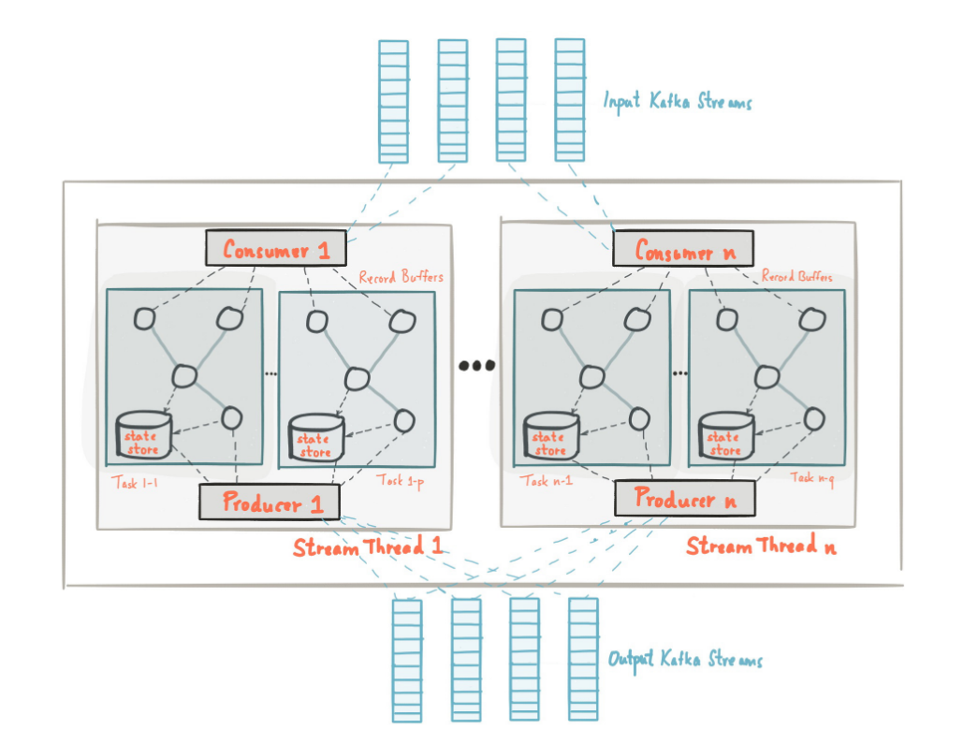

Slide 4
Kafka installation
Perform below steps in namenode1,datanode1,datanode2
Create folder /usr/local/kafka and /var/kafkalog
sudo mkdir /usr/local/kafka
sudo mkdir /var/kafkalog
sudo chmod –R 777 /usr/local/kafka
sudo chmod –R 777 /var/kafkalog
sudo chown –R Hadoop_Hadoop /usr/local/kafka
sudo chown –R Hadoop_Hadoop /var/kafkalog

Slide 5
Kafka installation
Perform below steps in namenode1
Copy software
cp /home/hadoop/softwares/kafka_2.11-1.0.0.tgz /usr/local/kafka/
Or
Download
cd /usr/local/sqoop/
wget http://www-eu.apache.org/dist/kafka/1.0.1/kafka_2.12-1.0.1.tgz
Extract the file
tar –xvzf kafka_2.11-1.0.0.tgz
Move file
cd /usr/local/kafka/ kafka_2.11-1.0.0
mv * ../
rmdir kafka_2.11-1.0.0

Slide 6
Kafka installation
Now change the property file
gedit /usr/local/kafka/server/properties
broker.id=1
listeners=PLAINTEXT://:9092
advertised.listeners=PLAINTEXT://namenode1:9092
zookeeper.connect=namenode1:2181,datanode1:2181,datanode2:2181
delete.topic.enable = true
log.dirs=/var/kafkalog

Slide 7
Sqoop Installation
Set path for kafka/bin in ~/.bashrc file
gedit ~/.bashrc
export KAFKA_HOME=/usr/local/kafka
export PATH=$KAFKA_HOME/bin:$PATH
Now execute
source ~/.bashrc

Slide 8
Copy every thing to datanode1 and datanode2
scp -r /usr/local/kafka/* hadoop@datanode1:/usr/local/kafka
scp -r /usr/local/kafka/* hadoop@datanode2:/usr/local/kafka
scp -r ~/.bashrc hadoop@datanode1: ~/.bashrc
scp -r ~/.bashrc hadoop@datanode1: ~/.bashrc
Run below command in datanode1 and datanode2
source ~/.bashrc
Change configuration on datanode1 and datanode2
gedit /usr/local/kafka/config/server.properties
on datanode1
broker.id=2
on datanode2
broker.id=3

Slide 9
Start Servers
Start Zookeeper
/usr/local/zookeeper/bin/zkServer.sh start /usr/local/zookeeper/conf/zoo.cfg
Check status
/usr/local/zookeeper/bin/zkServer.sh status
Start Kafka server
/usr/local/kafka/bin/kafka-server-start.sh -daemon /usr/local/kafka/config/server.properties

Slide 10
Create topic
/usr/local/kafka/bin/kafka-topics.sh --create --zookeeper namenode1:2181,datanode1:2181,datanode2:2181 --replication-factor 3 --partitions 2 --topic edw
Describe topic
/usr/local/kafka/bin/kafka-topics.sh --zookeeper namenode1:2181,datanode1:2182,datanode2:2183 --describe --topic edw
List all the topic
/usr/local/kafka/bin/kafka-topics.sh --list --zookeeper namenode1:2181,datanode1:2182,datanode2:2183
Start Producer
/usr/local/kafka/bin/kafka-console-producer.sh --broker-list namenode1:9092,datanode1:9092,datanode2:9092 --topic edw
Start Consumer
/usr/local/kafka/bin/kafka-console-consumer.sh --zookeeper namenode1:2181,datanode1:2181,datanode2:2181 --topic edw --from-beginning

Slide 11
You may have to install some extra tools
brew install mysql elasticsearch kibana jq
wget -qO - http://packages.confluent.io/deb/3.3/archive.key | sudo apt-key add -
sudo add-apt-repository "deb [arch=amd64] http://packages.confluent.io/deb/3.3 stable main"
sudo apt-get install confluent-platform-oss-2.11

