Slide 1
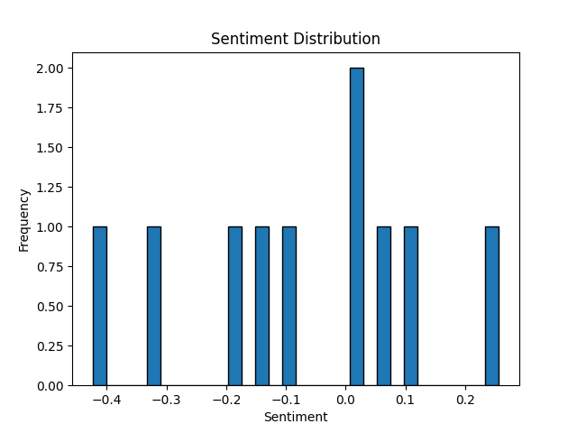
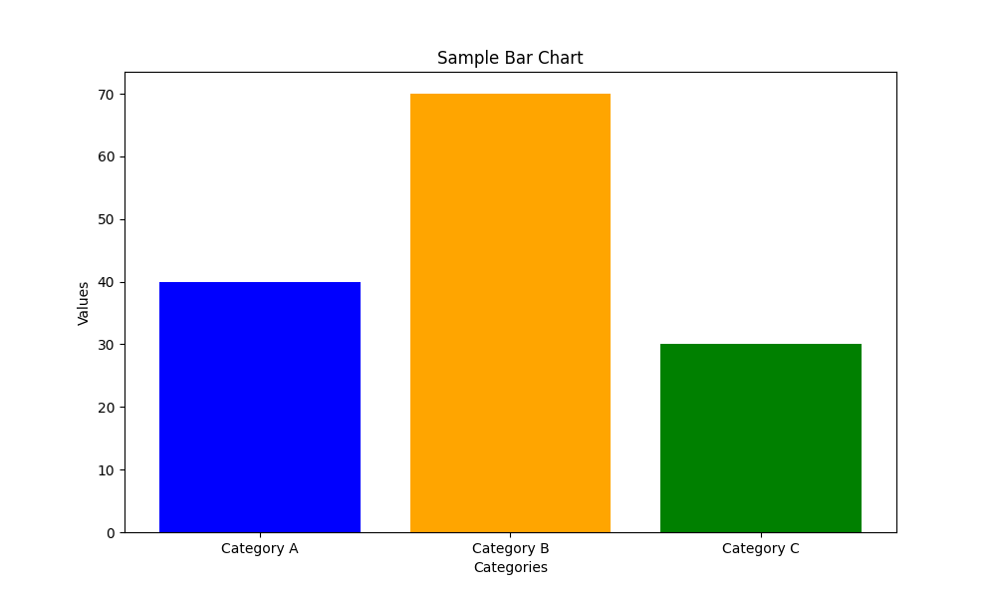
British Airways Customer Feedback Analysis
Key Findings:
1. Positive reviews: 60%
2. Negative reviews: 25%
3. Neutral reviews: 15%
4. Common topics: service quality, punctuality, comfort

