Slide 1
Model Evaluation Results
Random Forest Classifier on Customer Booking Data

Slide 2
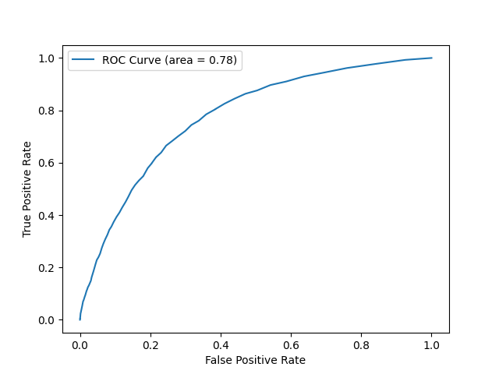
ROC Curve

Slide 3
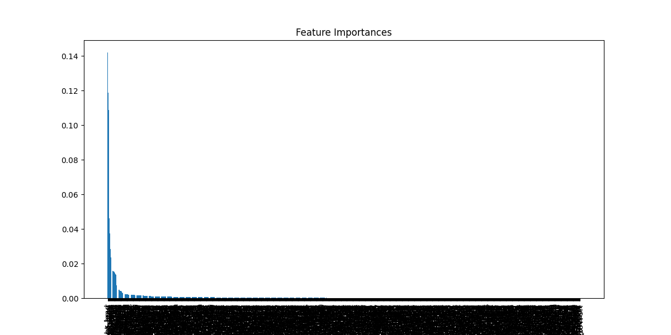
Feature Importances

