Slide 1
PROGRESS REPORT · 2026-07-07
Adaptive Delivery of LLM-Generated Diagnostic Test Recommendations
Aashna Shah
Reproducing & extending Nori et al. (2025) — SDBench + MAI-DxO

Slide 2
PART 1
Introduction
Why delivery, not diagnosis · prior work & its gaps · the research question

Slide 3
§1.1 · MOTIVATION
The constraint is delivery, not diagnosis
Reasoning LLMs now match or exceed physicians on diagnostic tasks (Brodeur '26, Kanjee '23, Nori '25)
Goh 2024 (RCT): the model alone beat physicians — yet physicians given the model did not improve
The capability was available and went unused
Indiscriminate, interruptive alerts → alert fatigue → overrides (AHRQ, Baron, Park)
3

Slide 4
§1.2 · PRIOR WORK
Nori et al. (2025): SDBench + MAI-DxO
SDBench turns 304 NEJM CPC cases into interactive sequential encounters — ask, order, or diagnose through a gatekeeper
MAI-DxO: an orchestrator that role-plays a panel of five physician personas in one model
On o3: ~80% accuracy vs. ~20% for generalist physicians, at lower cumulative test cost
A strong foundation — but four gaps for the question of clinical impact
4

Slide 5
§1.2 · FOUR GAPS WE ADDRESS
From a diagnostic benchmark to clinical impact
Ends at diagnosis — models generation, not whether it is delivered or acted on → we add scoring, delivery, response & evaluation
One regime (rare CPC) → three regimes: CPC, MIMIC-IV (acute), Clalit (routine)
Triple Aim omits clinician workload / experience → addressed via the delivery layer
Closed frontier model → open models & public data throughout
5

Slide 6
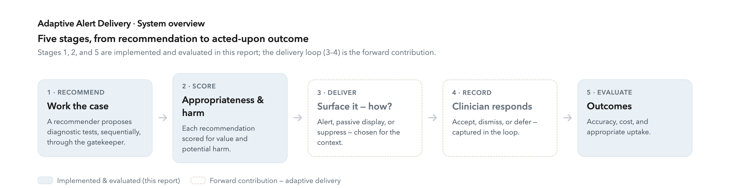
§1.3 · RESEARCH QUESTION
Not just whether a recommendation is right — how it is delivered
Can adaptive, context-aware delivery raise appropriate clinician uptake without adding alert burden?
Stages 1, 2, 5 implemented & evaluated here; the delivery loop (3–4) is the forward contribution
6

Slide 7
PART 2
Methods
Environments · case presentation · gatekeeper · recommenders · judge · metrics

Slide 8
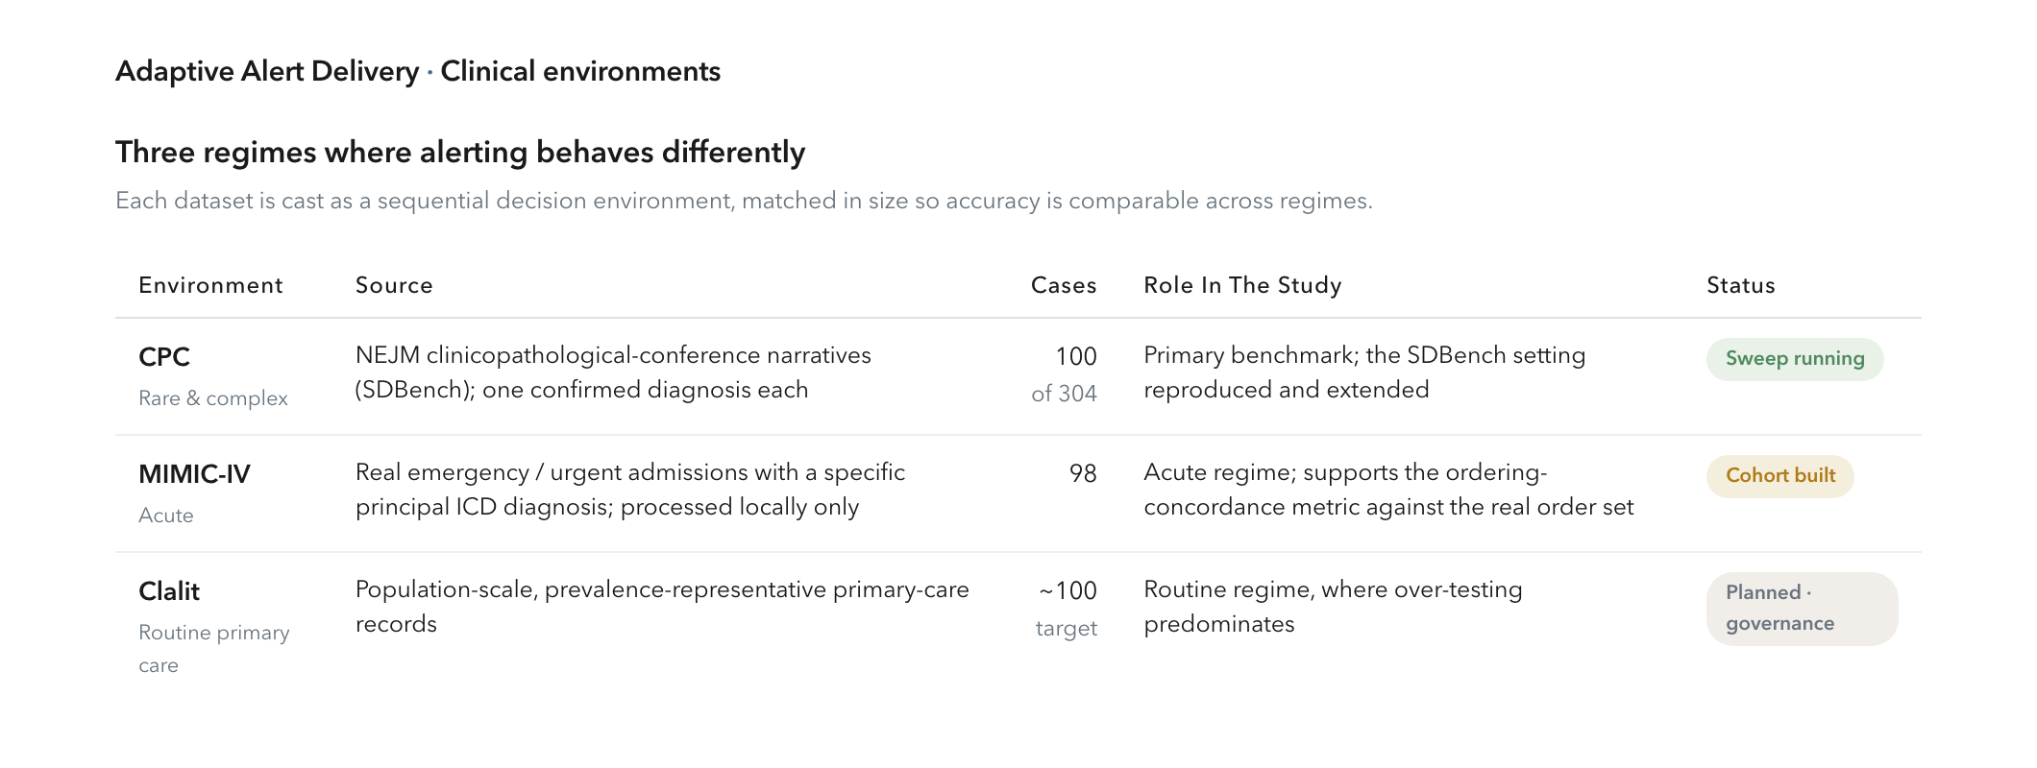
§2.1 · CLINICAL VIGNETTES
Three regimes where alerting behaves differently
Matched in size so accuracy is comparable across regimes
8

Slide 9
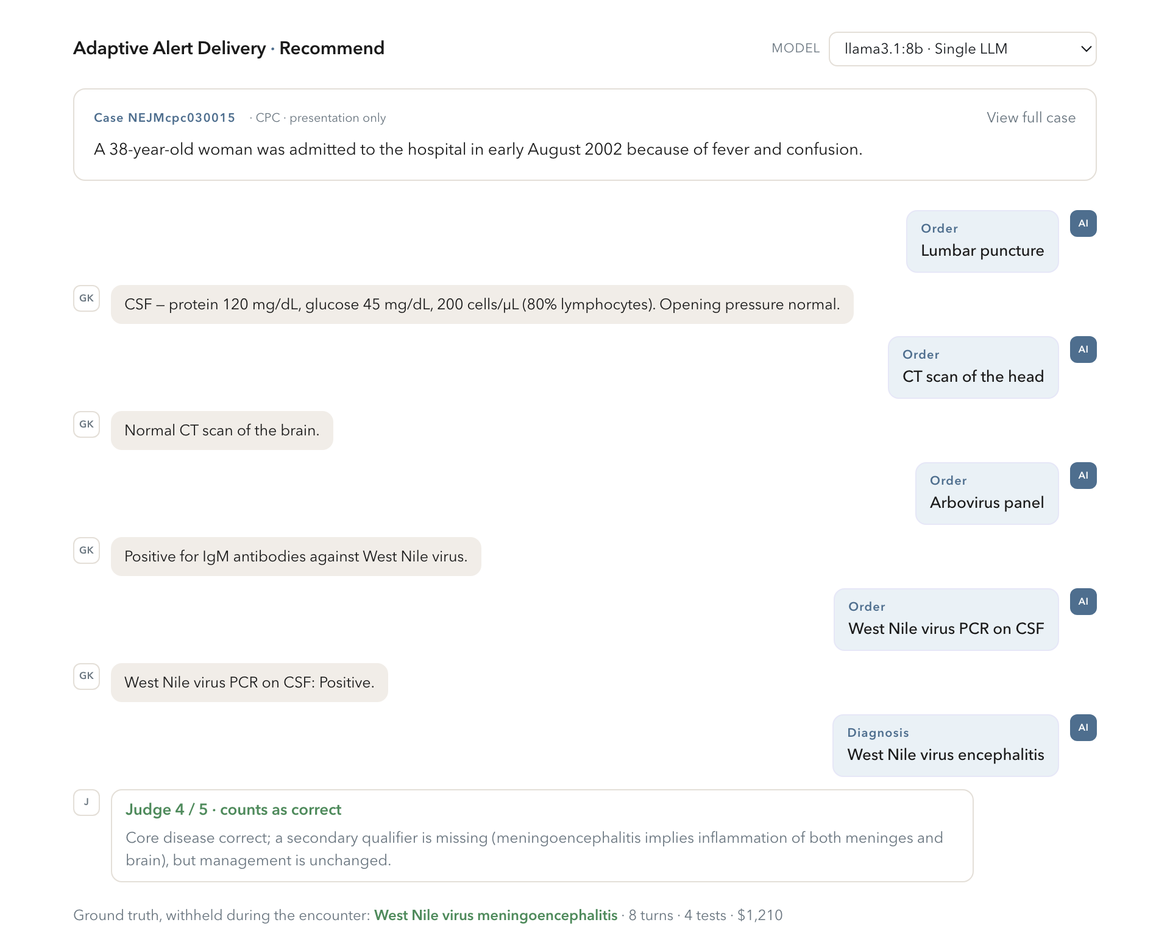
§2.2 · CASE PRESENTATION
Each case is worked step by step
Abstract first; orders batched (≤3/turn); ≤8 turns; a diagnosis is forced if none is committed
9

Slide 10
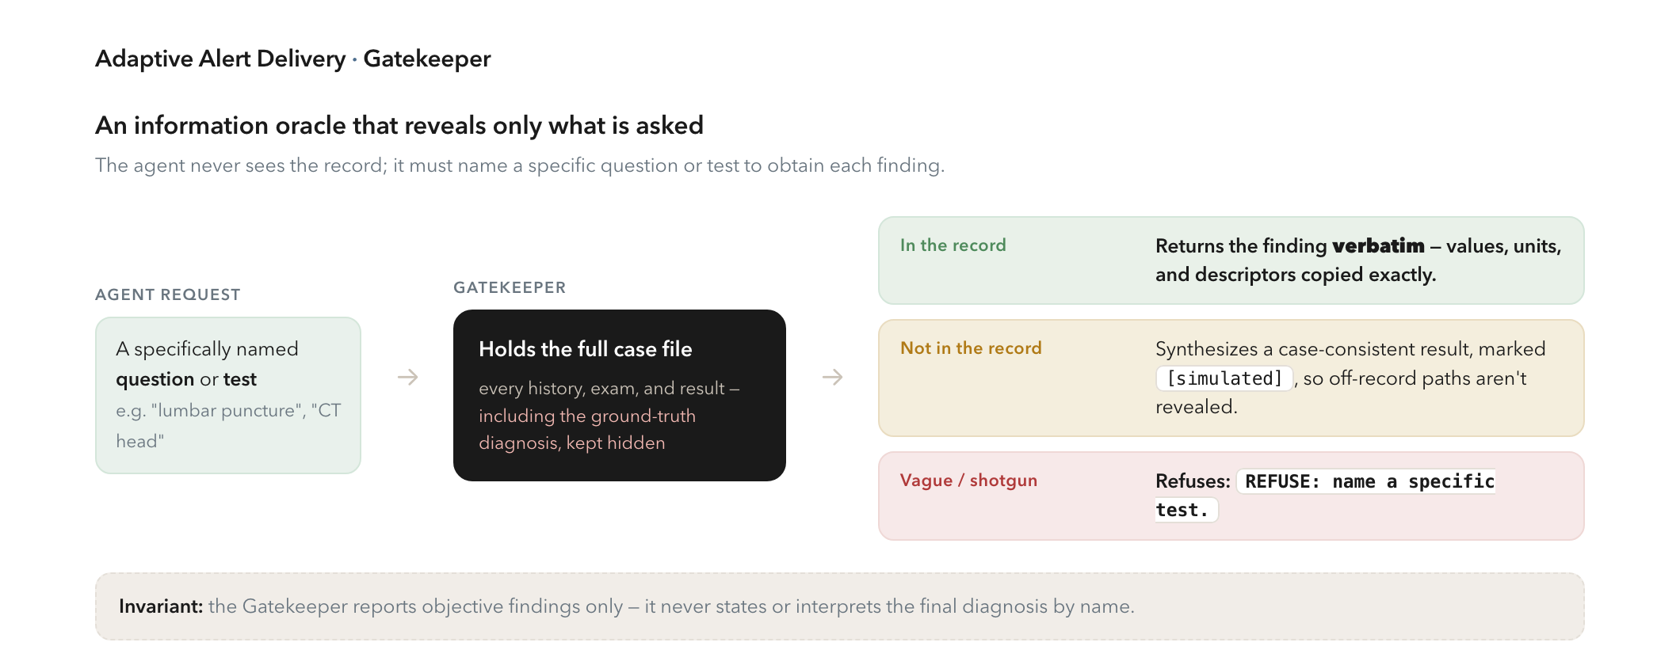
§2.3 · THE GATEKEEPER
An oracle that reveals only what is asked
Synthesize rather than refuse; never reveal the diagnosis — following Nori et al.
10

Slide 11
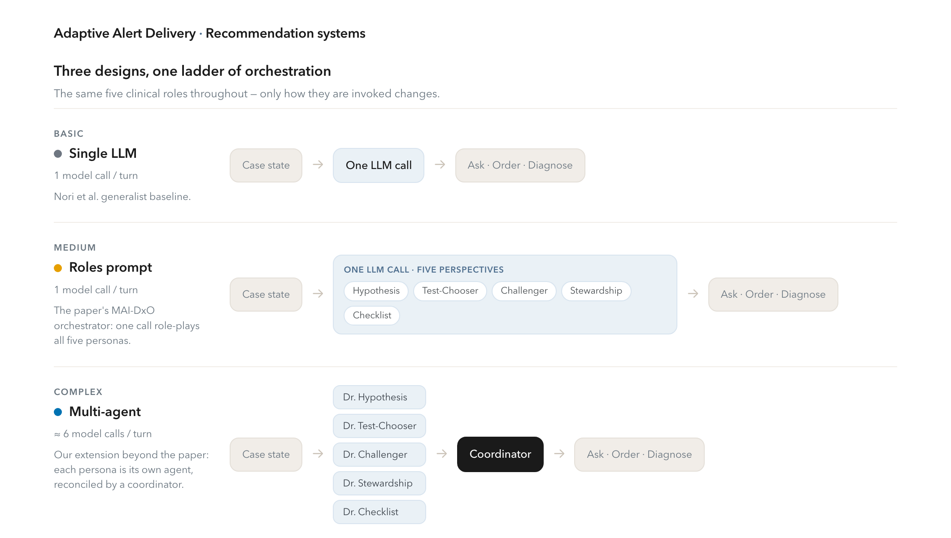
§2.4 · RECOMMENDATION SYSTEMS
Three designs, one ladder of orchestration
Same five roles throughout — only the orchestration changes, isolating its effect
11

Slide 12
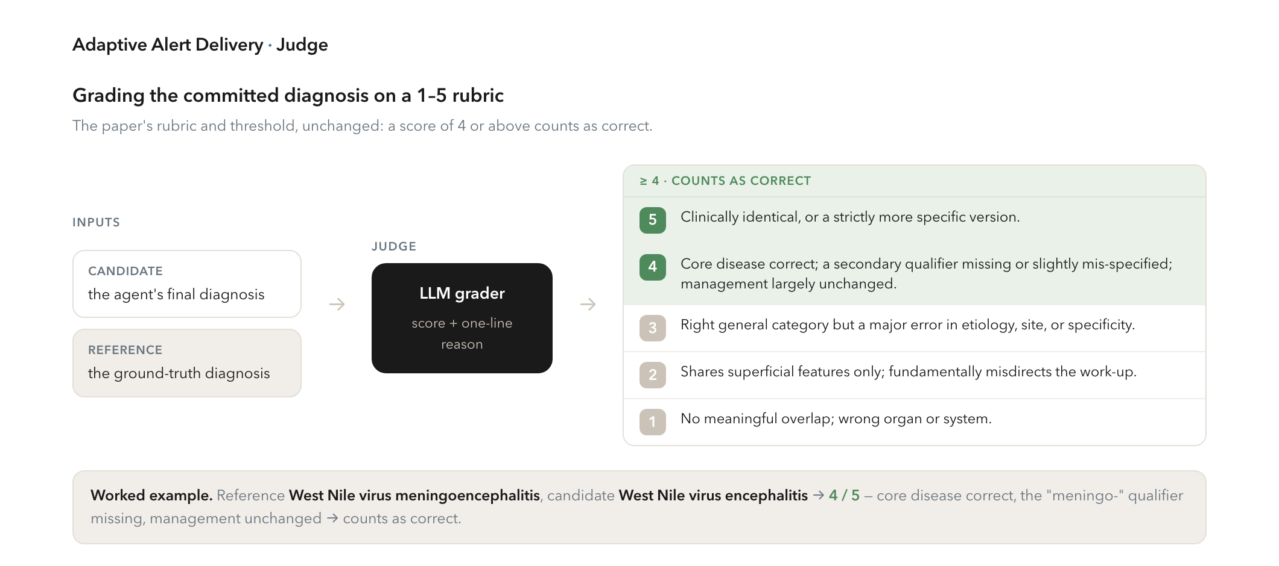
§2.5 · THE JUDGE
Grading the committed diagnosis, 1–5
The paper's rubric & threshold, unchanged — a score of 4+ counts as correct
12

Slide 13
§2.6 · EVALUATION METRICS
What we measure — automatic vs. clinician-graded
Diagnostic quality: accuracy (share scored ≥4) + mean Judge score
Cost & effort: a $300 visit fee + a per-test price schedule; turns, tests, tokens, latency
Ordering concordance (MIMIC / Clalit): recall & precision vs. the labs actually measured
Appropriateness & harm: clinician-graded (NOHARM-style prototype scorer, kept hidden)
Ablations & a budget sweep probe the panel and how designs degrade under cost caps
13

Slide 14
PART 3
Results
Does more orchestration help? — the full 100-case CPC run on Llama-3.1-8B

Slide 15
§3 · KEY RESULT
More orchestration does not buy accuracy
23%
13%
~1.9× / 4.3×
Single LLM & Roles prompt — indistinguishable
Multi-agent panel — the weakest
the tokens / wall-clock time of a single call
Holding the five roles fixed, the single call and the roles prompt track each other exactly; the genuine multi-agent panel is lower and far more expensive.
Llama-3.1-8B · full 100-case CPC run · 95% CIs ±8
15

Slide 16
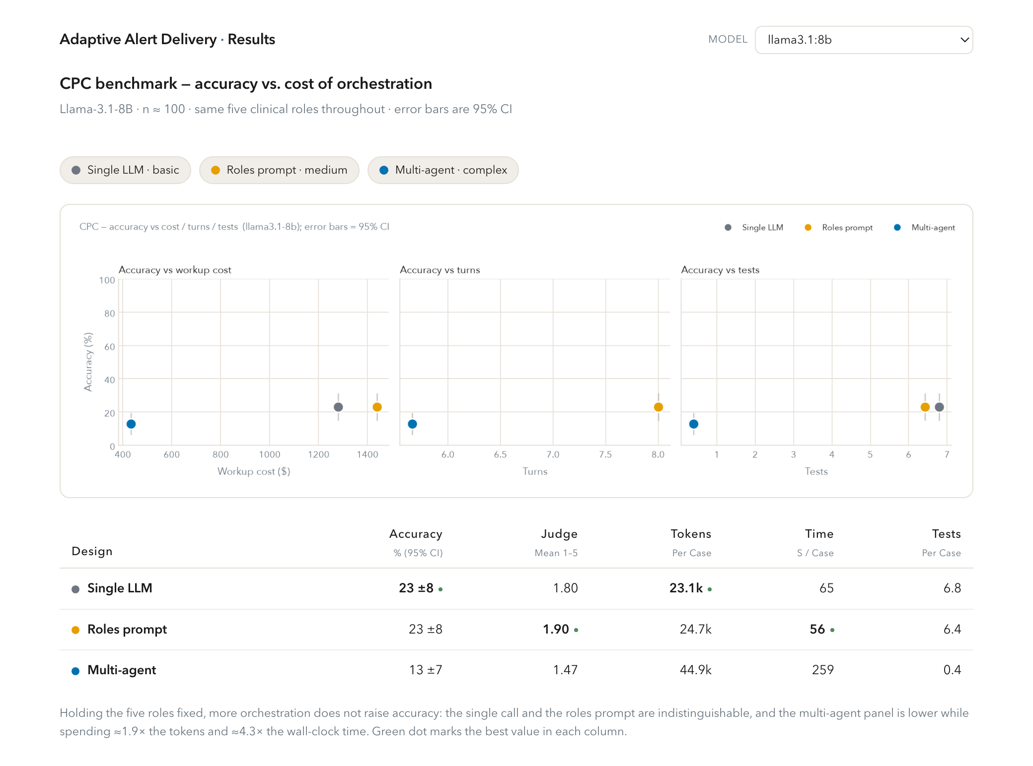
§3.1 · ACCURACY VS. COST
The controlled ladder, side by side
Points nearer the upper-left are better; whiskers are 95% CIs
16

Slide 17
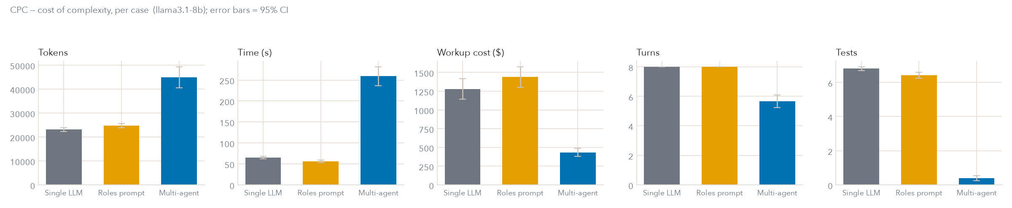
§3.2 · THE COST OF COMPLEXITY
Same accuracy question, very different compute
The panel issues ~6 model calls per turn against one — ~1.9× tokens, ~4.3× wall-clock time
17

Slide 18
§3.1 · WHY THE PANEL UNDERPERFORMS
It commits early instead of testing
The panel commits after ~6 turns (not the full 8) and orders ~0.4 tests/case (vs. ~6.5)
On an 8B model the coordinator's structured output often fails to parse → it falls back and commits
Example (West Nile): it had WNV-positive CSF in hand at turn 2 — but committed “undetermined” (Judge 1/5)
Its low dollar cost reflects early commitment, not efficient work-up
18

Slide 19
§3.3 · EVALUATION IN PROGRESS
Instrumented, not yet informative
Panel ablation (leave-one-persona-out): needs a capable model to separate personas
Budget sweep (accuracy under cost ceilings): curves pending a capable model
Ordering concordance: MIMIC-IV cohort built (98 cases); sweep in progress; Clalit pending
Appropriateness & harm: grading console built; awaits clinician grading
19

Slide 20
PART 4
Discussion & next steps
Toward 80% · the adaptive delivery layer · timeline & contributions

Slide 21
§4.1 · FINALIZING THE PIPELINE
Toward the benchmark's ~80%
Finish the model sweep — Qwen3-32B, 70B at full n, and hosted frontier models (GPT-5, Gemini-2.5-Pro, Claude-Sonnet-5)
De-noise the environment — move Judge & Gatekeeper onto a fixed, strong model
Sharpen cost & coverage — CPT-coded prices; load real MIMIC-IV and Clalit
Run the deferred evaluations — ablation, budget sweep, per-specialty breakdown
21

Slide 22
§4.2 · THE NOVEL CONTRIBUTION
An adaptive delivery layer
Once generation is solid, learn how to present each scored recommendation — interruptive alert, passive display, or suppress — to raise appropriate uptake without adding alert burden.
Context-aware: the same recommendation surfaced differently in a busy ED vs. a low-load clinic
Calibrated & validated with a human study on real clinician response
22

Slide 23
§4.3 · TIMELINE
Plan & target venues
PERIOD | MILESTONE | VENUE
Q1 · Sep '26 | Benchmark & EHR environments | NeurIPS workshop (GenAI4Health)
Q2 · Nov '26 | Recommender & scoring | AAAI Health Intelligence
Q3 · Jan '27 | Delivery-interface co-design | CHI
Q3 · Jan '27 | Adaptive delivery policy | ICML (archival)
Q4 · May '27 | Full system + clinical results | Nature Medicine (archival)
23

Slide 24
SUMMARY
Contributions & the takeaway
Contributions: the first study of the delivery of LM clinical recommendations; reusable sequential test-ordering environments from real EHR data; a safety-grounded, multi-objective alerting layer reproducible on public data
Finding so far: on an open 8B model, added orchestration does not buy accuracy — a single call matches the roles prompt, and the multi-agent panel is weaker at ~1.9× the compute
Next: frontier models toward ~80%, then the adaptive delivery layer
24

