Slide 1

Progress Update Development of Skill Diagnostic Tool
Ashutosh Pathak
Prashant Mishra
Ganga Hariharan
Amritha Sugumarn
Sanjay Anandan
Project Mentor: Axel Penzo
Date: 28th March 2025

Slide 2
AGENDA
Project Recap
Methodology & Overall System Pipeline
Data Source
AI powered Skill Generations
Skill Extraction & Ranking
Skill Gap Detection & Course Recommendation
Technical Stack
Next Steps
Achievements so Far

Slide 3

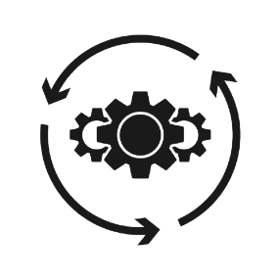


Project Recap
User Input
AI-Based Skill Analysis
User skill
Personalized Learning Paths
Users answers the asked Questions
Machine Learning (ML) models compare user skills with job market data.
The tool allows users to choose the skills they are confident in and rate their expertise level, helping personalize the learning path based on actual competency.
Personalized Course Suggestions

Slide 4


Methodology and Overall System Pipeline
Database 4
Fall back -AI based -Job description generation
Database 3
Fall back- Lightcast/
EMSI
Flan- T5 NLP Model
Open API
Extract (Fuzzy NLP) & Rank Skills (Lightcast / EMSI API)
Confidence Level, Rank & Cluster Skills
(Lightcast/
EMSI
)
Self-assessment:
User Selection for proposed missing skills and Level competency
User Profiling
Input: Sector, Job Role, Experience, Education, Department
Captures intent and context
Recommend Courses Based on Gaps. (By skill match, experience level and Competency Level)
Normalization, Role Existing, Fetch, Compare
Web scraped
Web scraped
Database 1
Skills from Jobs based on the job role
Database 2
Skills from Coursera courses
Job Role Description Seniority Level Skills
Course Title Course Skills
System Architecture

Slide 5
User Inputs
What the User Provides
Sector (e.g., Solar Energy, Wind Energy, Smart Buildings)
Job Role (e.g., Energy Analyst, Sustainability Consultant)
Years of Experience
Education Level (e.g., Bachelors, Masters)
Department / Functional Area (e.g., Tech, Business, Sales)
These inputs help us personalize skill extraction and learning recommendations.
How it Works?
Job Title Normalization – Cleans and standardizes the job title
Role Database Check – Checks for role in Jobs database and Courses database.
Metadata Enrichment – Adds related job keywords or categories.
Fallback Triggering – If role not found, activates Flan-T5 job description generator.

Slide 6
Data Source
976
21,769
Course Skill Entries Extracted
Total Job Records Processed
1,355
5,090
Unique Skills Extracted from Course Content
Total Extracted unique Skills
( Jobs + Courses)
3,735
Unique Skills Extracted from Job Descriptions
In addition to the jobs and courses datasets, the system also auto-sources data from Lightcast (EMSI API) and AI-generated skill insights

Slide 7
Job Description Generation (Flan-T5)
This component acts as a fallback mechanism when the system is unable to match skills from the existing database. It automatically generates realistic job descriptions based on user inputs such as role, sector, experience, and department.
Why Job Description Generation?
When relevant job data is missing or incomplete, especially in specialized fields like renewable energy- users often receive limited or no skill recommendations. Rather than leaving them without guidance, we introduce an AI-driven solution.
The energy sector often lacks structured, skill-rich job data.
Many roles reuse similar skill sets, leading to repetitive and sparse data.
To address this, we integrated Flan-T5, a powerful AI model via Hugging Face, which accesses a vast knowledge base of job-related content.
This allows us to generate realistic job descriptions dynamically based on user input (sector, role, experience, department).
Enables skill extraction for niche or emerging roles.
Ensures a consistent and structured format across all generated roles
User Inputs
Prompt Builder
Flan-T5 Model (NLP)
Generated Job Description
NLP Skill Extraction

Slide 8
Skill Extraction & Ranking
Identify and prioritize the most relevant skills required for a job role based on generated or sourced job description.
Skill Extraction 1: Jobs Dataset
Source: Pre-existing job listings from our curated dataset.
Method: Skills are directly extracted from structured “Skills” fields.
Use Case: When job titles are common and well-represented in the energy sector.
Advantage: Quick and direct for known roles. Limitation: Limited for emerging or niche roles with sparse data.
Skill Extraction 2: Courses Dataset
Source: Course descriptions and tags.
Method: Parses skills listed for each course, helping in reverse-mapping courses to skills.
Use Case: Identifies what skills each course teaches.
Advantage: Useful for course-to-skill matching. Limitation: Skill lists may be marketing-heavy or overly broad.
Skill Ranking
Prioritize Learning: Helps users focus on the most critical skills required for their target job role.
Refine Recommendations: Enables the system to match the most relevant courses to the most important missing skills.
Enhance Accuracy: Filters out noise or less-relevant skills from generic descriptions
Extracted skills
Match with
Lightcast (EMSI) algorithm
Match Skills
Confidence Score
Personalized Learning path
Skill Extraction 3: Lightcast (EMSI) API
Source: Lightcast owned Database.
Method: NLP-based skill extraction via Lightcast’s market-aligned API.
Use Case: Converts unstructured job text into a structured, ranked skill list.
Advantage: High accuracy, relevance-based skill confidence scores. Limitation: The skills may be lack in the area of energy sector.
Skill Extraction 4: AI- Generated Job Description
Source: Custom job descriptions created using Flan-T5 (HuggingFace).
Method: When real job data is missing, we generate a full description using AI based on role, sector, and experience.
Use Case: Fallback for new, rare, or highly specific job titles.
Advantage: Enables skill extraction even for rare or evolving roles. Limitation: Generated text needs validation for realism and consistency
Example of Data Analyst in Renewable Energy
Skill | Confidence Score
Data Analysis | 0.92
Renewable Energy Modeling | 0.87
Python | 0.82
Power BI | 0.79
Technical Writing | 0.60

Slide 9
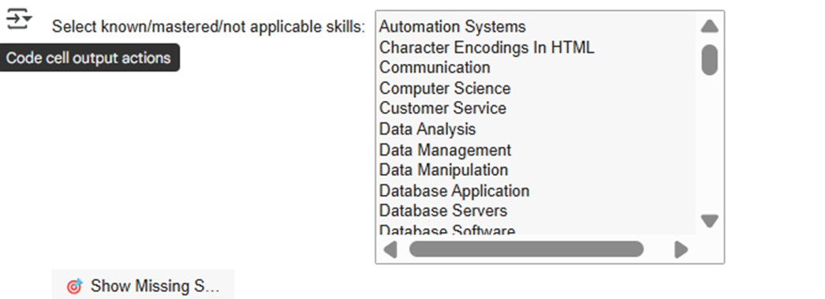
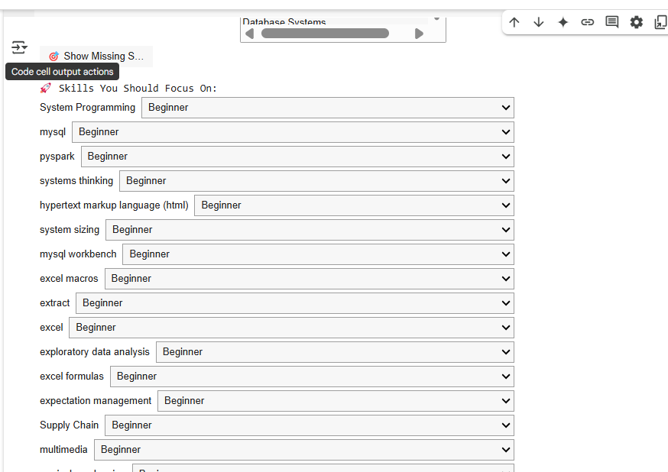
Skill Gap Detection & Self-Assessment.
To help users identify missing skills and assess their proficiency levels for smarter, personalized course recommendations.
Step 1: Skill Review & Selection
User is presented with a ranked list of extracted skills.
They manually mark each skill as:
Known
Mastered
Not Applicable
This filters out already-acquired or irrelevant skills.
Step 2: Show Missing Skills
Once the user confirms, only the relevant missing or weak skills are displayed.
These are the skills the system believes the user should focus on.
Step 3: Self-Assessment
For each missing skill, the user selects their proficiency level: Beginner, Intermediate, Advanced.
This allows the system to recommend courses that match the user’s current skill depth.
Why Self Assessment
User-driven: Empowers users to be honest about their skillset.
Accurate gap analysis: Filters out noise and targets only meaningful upskilling.
Adaptive learning: Helps map the right course level (Beginner/Advanced) to each missing skill.

Slide 10
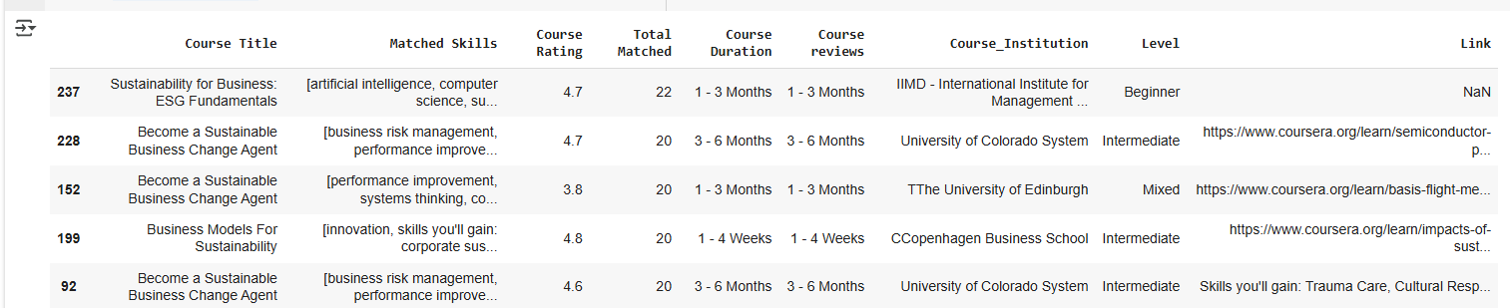
Skill Gap Detection & Self-Assessment.
To recommend the most relevant courses that cover the maximum number of missing skills, aligned with the user's experience level.
Course Matching:
Each course is analyzed to identify how many missing skills it covers.
Courses are prioritized based on:
Number of skills matched
Skill level alignment (Beginner / Intermediate / Advanced)
Course rating and reviews
Course Recommendation Output:
Course title and institution
Energy sector relevance
Learning level & duration
Ratings and reviews
Clickable course link for direct access
Note: This step connects the dots between what the user lacks and how they can address it. We ensure that every course we recommend is targeted, efficient, and directly actionable.

Slide 11
Technical Stack
 | Component | Technology / Library | Purpose
1 | Data Extraction (Jobs) | pandas, read_csv() | Load job dataset with attributes: Title, Company, Location, Description, Skills, Sector, Department, Job Level
2 | Data Extraction (Courses) | pandas, read_csv() | Load course dataset with attributes: Title, Institution, Rating, Level, Duration, Skills, Sector, Department
4 | Data Cleaning & Preprocessing | pandas, string methods, ENGLISH_STOP_WORDS | Clean column names, normalize skills, stopwords
5 | Job Description Generation | transformers, Flan-T5 via Hugging Face Hub | Generate role-specific job descriptions using AI
6 | Skill Extraction | Lightcast (EMSI) API | Extract structured skills from job descriptions
7 | Skill Ranking | EMSI API Confidence Scores | Rank skills by relevance and confidence
8 | Skill Matching (Jobs & Courses) | the fuzz (Fuzzy Matching) | Match job and course titles with user-entered role
9 | User Interaction (Skill Selection) | ipywidgets, Dropdown, VBox, Button | Interactive skill selection and self-assessment
10 | Skill Gap Detection | Custom logic with set comparisons | Identify missing or underdeveloped skills
11 | Course Recommendation Engine | pandas + logic for skill overlap scoring | Rank and recommend courses based on skill match and level
12 | API Authentication | requests, OAuth2 | Connect to Lightcast API using secure token
Data is cleaned using lowercase conversion, delimiter replacement, and stopword removal.
Skill extraction and course matching support scalable updates to datasets.

Slide 12
Achievements So Far
 | Milestones | Description
1 | Job & Course Data Collected | Extracted datasets including job descriptions and course details from the web
2 | Data Cleaning & Preprocessing | Cleaned skill fields, standardized columns, d stopwords, normalized text
3 | EMSI API Integrated | Connected to Lightcast (EMSI) API for extracting and ranking real-world skills
4 | Flan-T5 Model Operational | AI-powered job description generation based on user input (role, sector, etc.)
5 | Multi-Source Skill Extraction | Extracted skills from jobs, courses, EMSI API, and AI-generated descriptions
6 | Skill Ranking System Implemented | Ranked skills based on EMSI confidence scores for smarter recommendations
7 | Skill Gap Detection Module Built | Interactive interface for identifying missing skills by user selection
8 | Self-Assessment Layer Added | Users can rate their proficiency: Beginner, Intermediate, Advanced
9 | Course Recommendation Engine Functional | Suggests best-matching courses based on missing skills and user level
10 | Interactive UI Prototyped (Jupyter) | Skill selectors, dropdowns, and recommendation flow with ipywidgets
11 | Modular Pipeline Designed | Scalable system from input → skill → gap → course recommendation
Working_Colab_Link: https://colab.research.google.com/drive/1z_9opts_M_ihY5RrE8G7oV22wBW1nwpN#scrollTo=VmIfW7KkfeZe

Slide 13
Next Step
 | Task | Responsibility | Timeline
1 | Refine skill-ranking model; add fallback logic when Lightcast doesn't recognize a skill and filter out the courses based on the strong skills and level of confidence | Ashutosh, Prashant | Mar 26 – Apr 10
2 | Design & finalize full UX/UI in Figma | Amrita, Sanjay, Ganga | Mar 26 – Apr 7
3 | Validate tool functionality and usability with peers/stakeholders | Amrita, Sanjay, Ganga | Apr 4 – Apr 10

Slide 14
Thank You ☺
Questions?

Slide 15
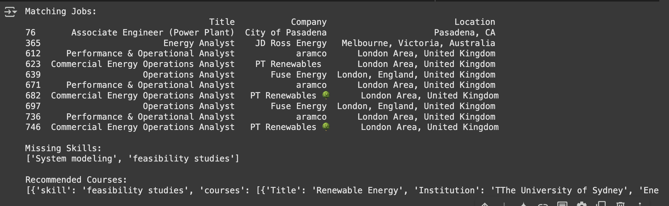
Model 2
Job Matching:
Converts both job skills and user skills into a common text format.
Computes cosine similarity between the user’s skills and each job's required skills.
Returns jobs with a similarity score above a set threshold, ranked by relevance.
Course Recommendation:
Compares the target job's skills with the user's current skills to identify any gaps.
Extracts the missing skills and searches for courses that cover these specific areas.
Provides targeted course recommendations to help the user acquire the missing skills.
Output

