Slide 1




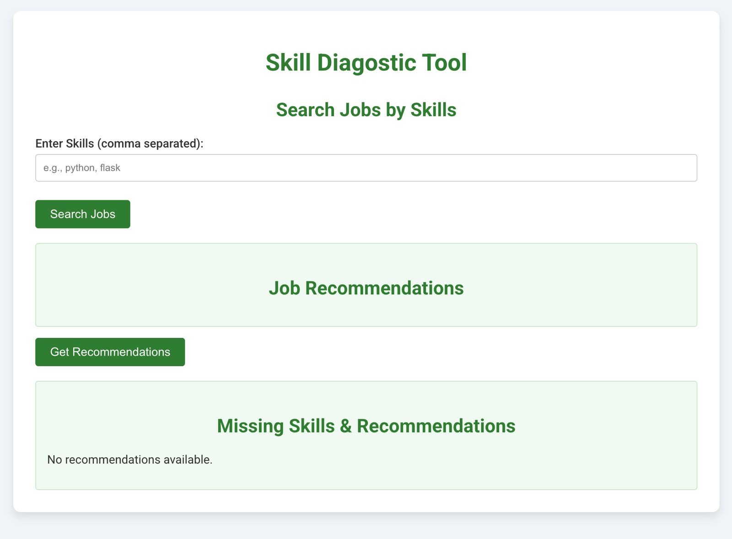
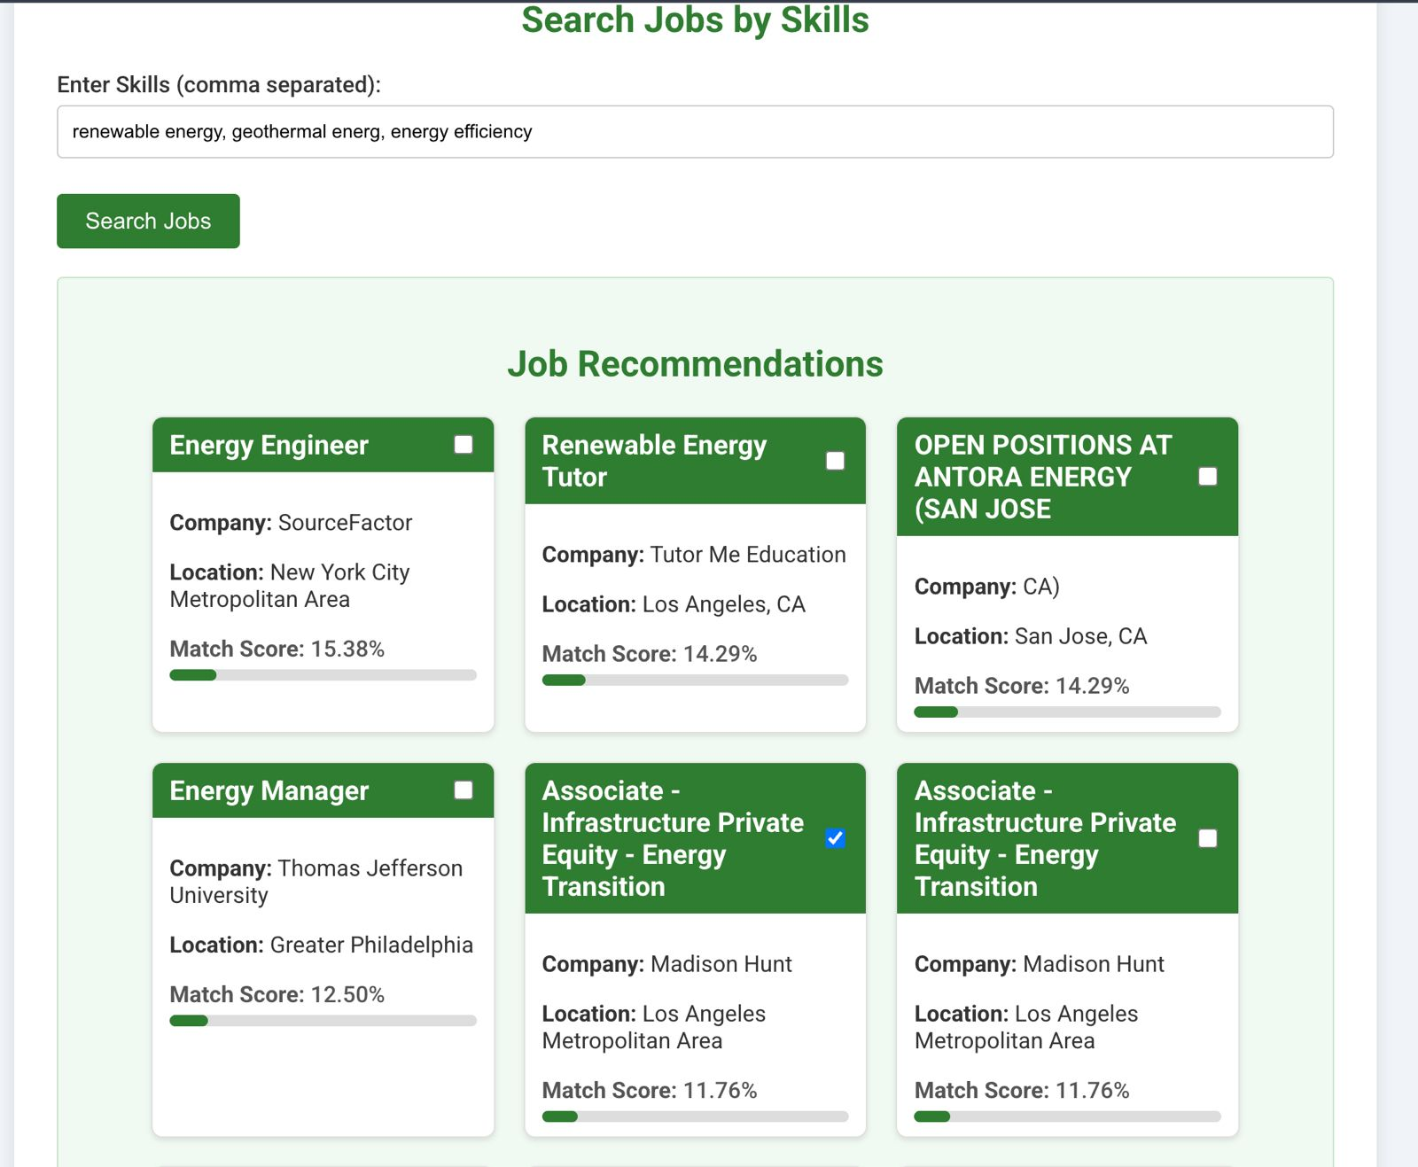
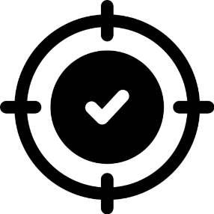



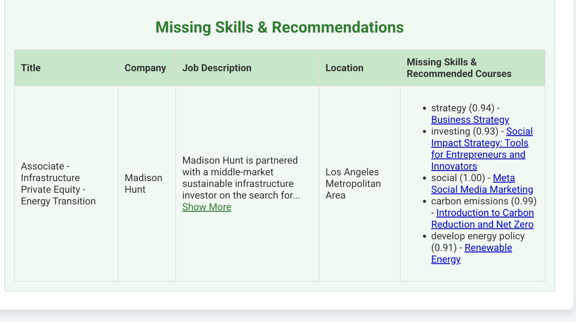

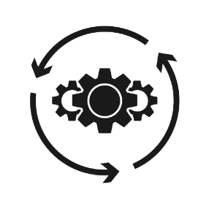



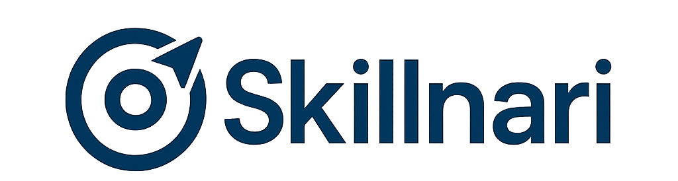
GROUP NUMBER: 12A
Skillnari: A Skill Diagnostic Tool
Ashutosh P, Prashant M, Amrita S, Ganga H, Sanjayan A
School of Business
INTRODUCTION
The renewable energy sector is growing rapidly, but a lack of digital and technical skills continues to slow progress. Workers often don’t know which skills to build or where to start. Skillnari is a diagnostic tool that compares a user’s skills with real job market needs, identifies gaps, and recommends personalized upskilling paths using real-time job data, course platforms, and public skill taxonomies. The tool enables smarter, faster career planning for future-ready professionals.
RESULTS
KPI’s
UX/UI output
600+
Jobs processed
1500+
Courses analysed
OBJECTIVES
Identify Skill Gaps in the Energy Sector
Build a Personalized Skill Matching System
Recommend Targeted Learning Paths
Create a User-Friendly Interface
Improve Recommendation Accuracy
~92% NER
Matching Accuracy
High Precision
Dual Extraction
UX/UI Design
Initial interface of the Skill Diagnostic Tool upon application launch.
Users are prompted to enter their skills in a search box to begin job matching
Job Recommendations Based on Skills
Users input skills (e.g., “renewable energy, energy efficiency”)
System displays top job roles with match score % and location.
<3 Seconds
Matching Speed
~1500
Unique Skills
RECOMMENDATIONS
DATA
Jobs Dataset: 600+ job listings from LinkedIn (attributes: title, company, location, description, skills, level, sector, department).
Course Dataset: 1500+ Coursera courses (attributes: title, level, institution, rating, duration, skills, sector, URL).
ESCO Skill Taxonomy: 800+ standardized skills filtered for renewable energy and smart infrastructure.
Personalized Course Suggestions:
For every missing skill, the tool recommends a relevant course.
Courses are sourced from Coursera.
Each course is matched based on skill relevance and confidence score
2. Confidence-Based Matching
Each recommendation includes a match/confidence score (e.g., 0.91 to 1.00)
Ensures high-quality, meaningful course suggestions.
3. Clickable Course Links
Direct 1-click access to learning platforms (no hunting around)
METHODOLOGY
The Skillnari tool follows 5 main steps to identify missing skills and suggest learning paths:
NEXT STEP
Phase 1
Goal: Replace static datasets with live data
Actions:
Purchase or apply for LinkedIn/Indeed API access for job listings Integrate Coursera or Res4City APIs for dynamic course fetching
Automate skill extraction using these new feeds
Real Time Data Integration
The user types in the skills they already have (e.g., Python, Energy Analysis, Excel).
Phase 2
Goal: Improve recommendations with richer user inputs Actions:
Collect user type: Student, Graduate & Capture context: University, Domain, Experience Level.
Use this data to:
Prioritize skill gaps & Recommend skill levels (Beginner, Intermediate, Advanced)
User Profiling & Personalization
The system compares user skills with cleaned job data and calculates how closely they match using smart text matching.
Phase 3
Goal: Ensure the system is accurate, helpful, and user-friendly. Actions:
Conduct user testing sessions & collect feedback on UI, recommendations, and clarity
Fix bugs, refine UX flows, and document error cases and update the confidence scoring and visual display of matches
Usability & System Validation
Top job roles are shown with a percentage score indicating how well the user's skills align with each job’s requirements.
Goal: Package and showcase Skillnari professionally. Actions:
Deploy as a live web application (Heroku, Vercel, or AWS)
Add login/authentication to track users
Create a portfolio landing page for Skillnari.
Phase 4
Deployment & Portfolio Inclusion
The user selects one or more jobs they are interested in exploring further for personalized upskilling.
LIMITATIONS
No Real-Time Data Sync: Job and course data are collected at intervals rather than through live APIs. As a result, recommendations may become outdated if the data is not refreshed regularly.
Limited User Profiling: The tool currently uses only self-reported skills. It does not yet consider factors like education, experience, certifications, or user preferences, which could improve the accuracy and relevance of recommendations.
Scalability and Performance: The current version is suited for local or small-scale use. Broader deployment will require improvements such as cloud-based infrastructure, database integration, and model optimization.
Missing skills are detected, and suitable online courses are recommended to fill those gaps with links and learning skills.
Profile: Skillnari is a skill diagnostic tool designed to help students, graduates, and professionals identify their skill gaps and discover the right learning paths based on real-time job market demands in the renewable energy, energy management, and smart building sectors.
Vision: To empower users with clarity on what skills they need and how to acquire them through intelligent, accessible, and personalized guidance.
See Your Skills Clearly. Shape Your Future.
Notes:
Still need to update logos

