Slide 1
Distributed crawler for assessing the adoption of web application security countermeasures
Team TrojanHorse
Aashray Arora
Ajay Lakshminarayanrao
Krishna Chaitanya Bandi
Navin Agarwal

Slide 2
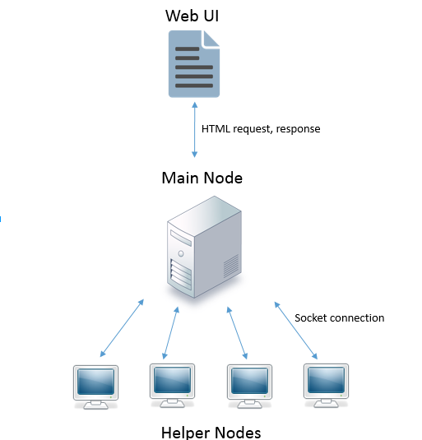
ARCHITECTURE

Slide 3
DESIGN
Web UI
Input – Root URL and Number of links to crawl
Output – Server-set security policies of links in a tabular format
Triggers a XHTTP request upon submit. (Javascript based)
Main Node
This is also the web server (mod_python based)
Crawls upto the given number of URLs from the given root URL
Establishes TCP connection as a client with helper nodes (nodes.conf)
Uniformly distributes the URLs across the helper nodes
Waits for results from the helper nodes
Returns the result to the web UI

Slide 4
DESIGN
Helper Node
Behaves like a server, listening for connections from the master node
Receives a set of URLs to obtain the server-set security policies from
Obtains the presence of the following in web forms in each URL:
HTTP Strict Transport Security (STS)
X-Frame Options
Content Security Policy (CSP)
HTTPOnly and Secure Cookie
Nonce
Returns the results to the main handler

Slide 5
DESIGN
Handling node failure
Node could fail after receiving a request
Main node remembers what set of URLs it sent to which helper node in a map, by its start index from the set of URLs
Response includes the start index
For each response received, delete the corresponding entry from the map.
If all responses not received after a timeout, send current results to web UI, web UI triggers another request for the failure.
Results added to the table
Failure tolerated only once per submission

Slide 6
Demo

