Slide 1
Insurance CLAIMs
Aashri Tandon
Paritosh Arora

Slide 2
Business use case
The application will help Insurance Companies predict which of the claim cases will go into the costly process of multiple verifications and which ones are less resource intensive. Accordingly, the company will be able to allocate resources and re-prioritize the cases.

Slide 3

Goal
Identify which of the following categories the claim lies in:
claims for which approval could be accelerated leading to faster payments
claims for which additional information is required before approval
Data source
The data is sourced from one of the current Kaggle competitions:
https://www.kaggle.com/c/bnp-paribas-cardif-claims-management/data

Slide 4
methodology
Parse & Clean Training Data
Train Spark ML Algo Model
Predict Claim Category
Compute Log Loss Error, Precision, Recall

Slide 5
Analyzing The Data
131 independent variables
Lots of missing feature values, correlated with available feature.
Assumption: Ignored variables with Alphanumeric values.

Slide 6
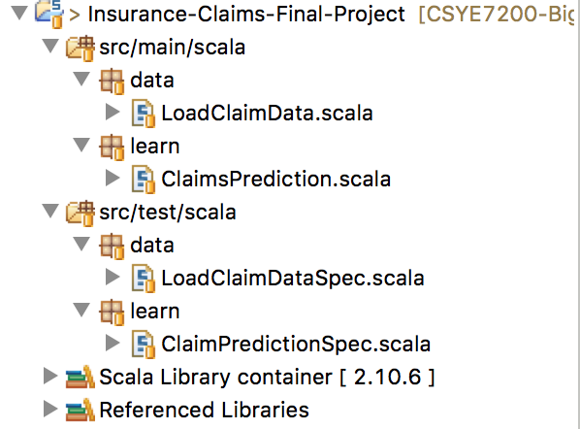
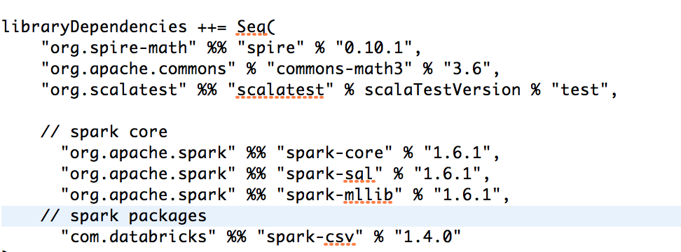
Directory Structure
AWS Spark Submit:
./spark-submit --class ”learn.ClaimsPrediction" --packages com.databricks:spark-csv_2.10:1.4.0 /opt/InsuranceClaims/insurance-claims-final-project_2.10-1.0.0-SNAPSHOT.jar "/opt/InsuranceClaims/train.csv"

Slide 7
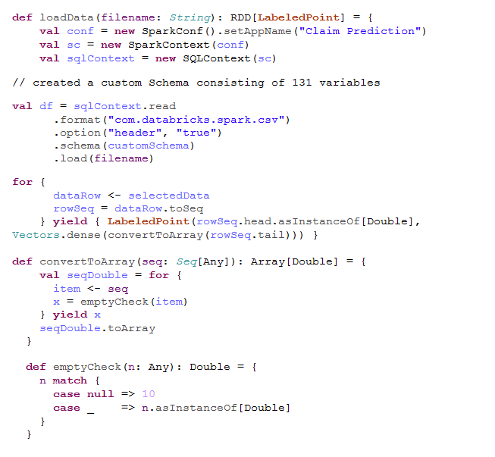
Load & Clean Data
Used CSV Reader provided by Databricks.
Most of missing data had similar avg. values.
Optimum results by replacing missing feature values by avg. value = 10

Slide 8

Principle Component Analysis
PCA is used for Dimensionality Reduction.
Logloss curve as a measure of no. of principal components.

Slide 9
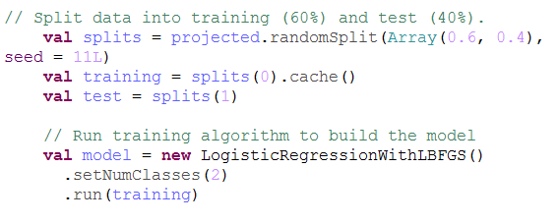
Train algorithm
LogisticRegressionWithLBFGS:
Without Threshold: Real number values of predictions in the range 0 to 1, to compute Log Loss error.
With Threshold: Binary Classification needed to classify the claims.

Slide 10
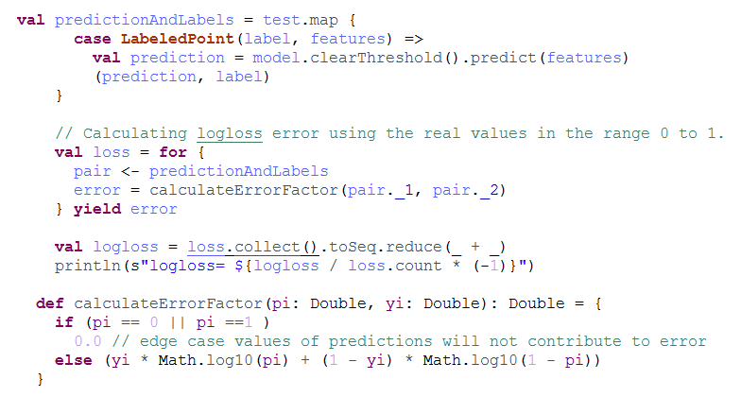
Predict - 1 LOG LOSS COMPUTATION
Kaggle competition benchmark based on real values in the range of 0 to 1.

Slide 11
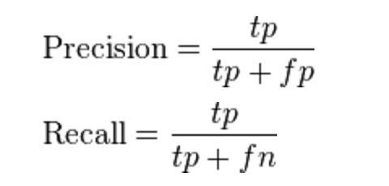
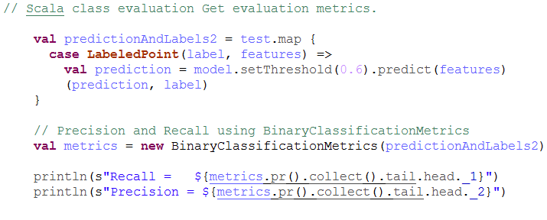
Predict - 2 Compute Precision and Recall
Standard measure of confusion matrix in a classification problem.
PR curve as a measure of varying threshold.

Slide 12
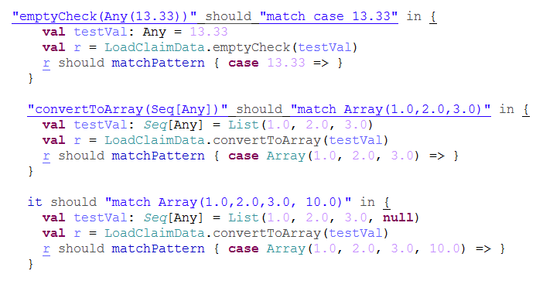
Specification Load_Claim_Data_Spec

Slide 13
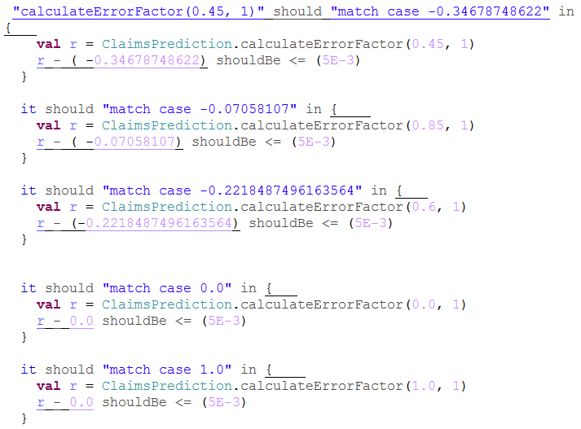
Specification Claim_Prediction_Spec

Slide 14
Acceptance criteria
Targeted Logloss Error value <= 0.7
Precision & Recall > 0.5
Results
AWS and Local Results are in sync:
Log Loss - 0.216458144893427 ( for top 60 principle components)
Precision - 0.79466561100527 ( for Threshold = 0.6)
Recall - 0.923727351164797 ( for Threshold = 0.6)

Slide 15
Thank you!

