Slide 1
SPE Technical Exhibition and Networking Event -
Intermediate Challenge

Slide 2
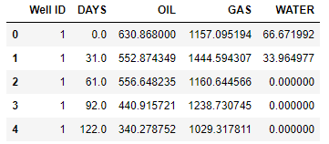
INTRODUCTION
Given: production.csv file of production data (gas,oil,water) for 12 wells along with time stamps for each well, blind forecast results for 6, 12 and 18 months using Arps decline curve analysis
Problem statement: to develop a data-driven time series forecasting model and compare the 6, 12 and 18 months hindcast predictions with the Arps model in terms of average RMSE.

Slide 3
Methodology
Steps involved in the data-driven approach are as follows:
The first 8 wells consist of monthly production data while the remaining 4 wells have the production data reported daily. Two different models are developed for these two scenarios.
The data is restructured as a supervised learning problem where production at next time-step is predicted from production at the previous time step [‘get_history’ function]
The data is then divided into train and test sets, the test set being the time step for which we want to predict the production. Same steps are followed for each of the two above scenarios.

Slide 4
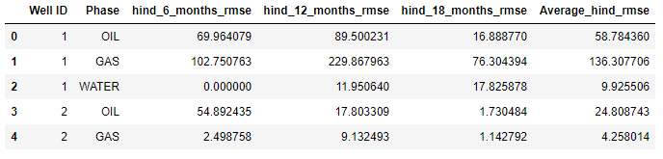
Training model for first 8 wells
Random Forest regressor is used to forecast oil, gas and water production for 6, 12 and 18 months from historical data.
Random Forest is a tree-based method and can handle unscaled data. A total of 1000 decision trees are used to develop a robust regressor.
The prediction production values are compared with the original data and the performance is reported in terms of RMSE.
RMSE values from hindcasting 6 months, 12 months and 18 months production for the first 8 wells

Slide 5
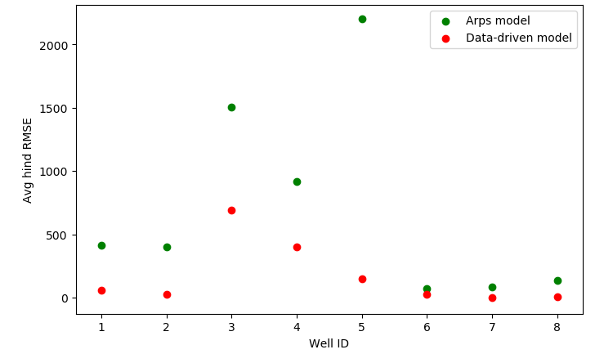
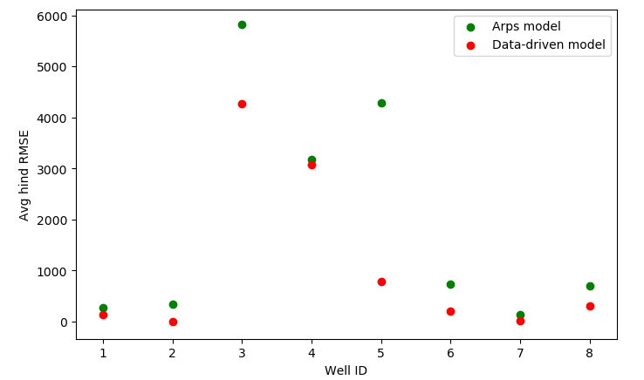
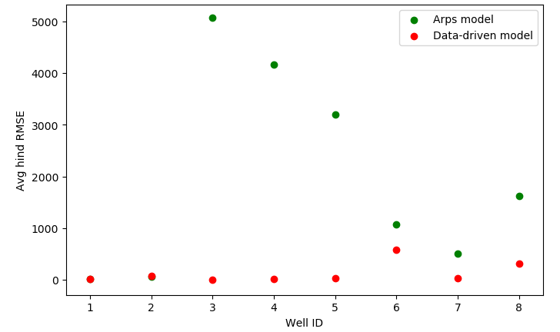
RMSE Comparison for predicted values for first 8 wells between ARPS model and Data-Driven model for:
Oil Phase
Gas Phase
Water Phase
1
For most wells, RMSE values are found to be significantly lower in the data-driven model when compared to arps model
2
3

Slide 6
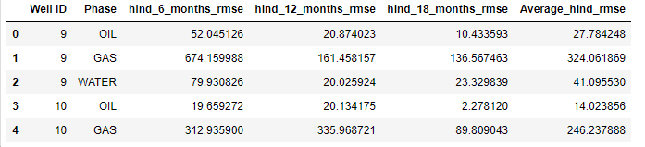
Training model for last 4 wells
The model training follows similar steps as the first 8 wells
30 days are taken as time intervals for obtaining the historical data
Daily production data from first to n-1 month is used to train the model
30-day production data of the nth month is predicted and RMSE is calculated with respect to the original data.
RMSE values from hindcasting 6 months, 12 months and 18 months production for the last 4 wells

Slide 7
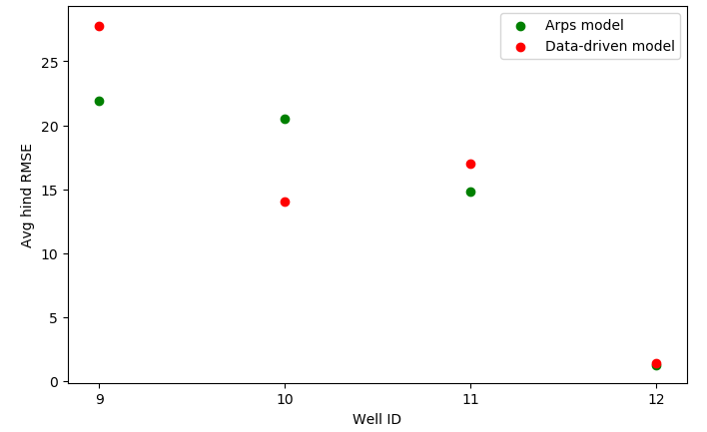
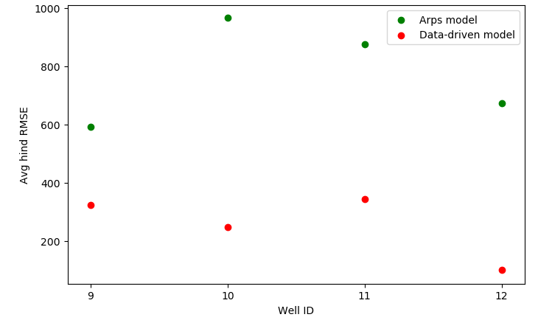
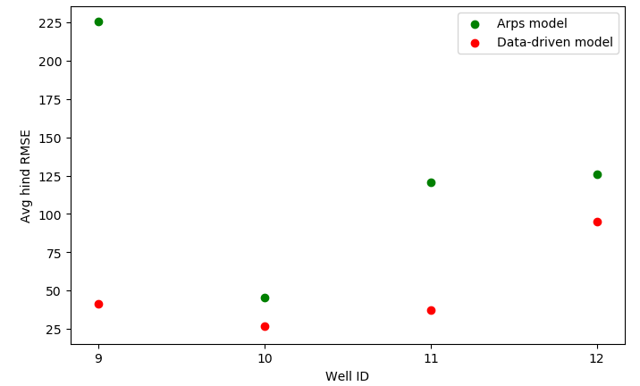
RMSE Comparison for predicted values for last 4 wells between ARPS model and Data-Driven model for:
Oil Phase
Gas Phase
Water Phase
1
2
RMSE for the data-driven model was founds to be lower for gas and water phase and comparable for the oil phase.
3

Slide 8
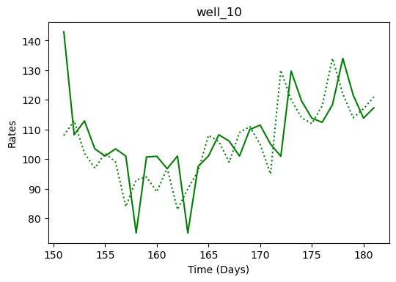
Demo of Well 10 Oil phase production using Random Forest
Key takeaways:
For wells with monthly production data, the variance in the RMSE obtained from the Arps model is considerably higher than the RMSE from Random Forest.
For most cases in this problem, the RF forecast shows significantly better results than the Arps model.
The performance can be improved by tuning the hyper-parameters of the regressor model.
If more data is available, deep learning techniques like RNN, LTSM can be used.

