Slide 1




SMART INDIA HACKATHON 2026
TITLE PAGE
Problem Statement ID – SIH26017
Problem Statement Title - Predictive Analytics System For Early Detection Of Land Acquisition Delays.
Theme- Smart Automation
PS Category- Software
Team ID- Team72
Team Name (Registered on portal) - CODOHOLICS

Slide 2
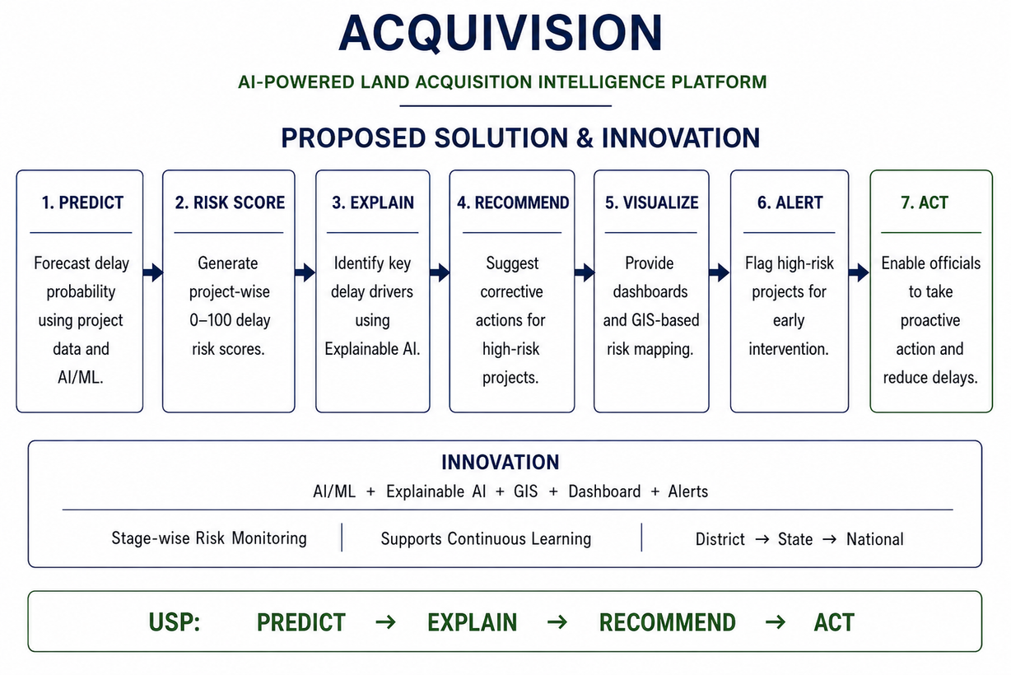
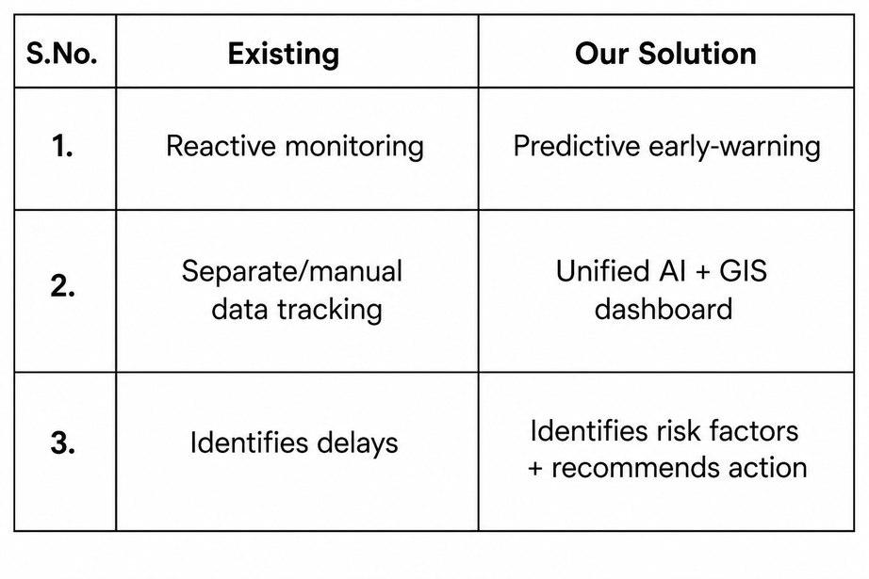
ACQUIVISION
CODOHOLICS
PROBLEM STATEMENT
PROPOSED SOLUTION & INNOVATION
Land acquisition in India is slowed by approvals, legal disputes, R&R, and land ownership issues.
These challenges create bottlenecks, uncertainty, and project delays.
@SIH Idea submission- Template
2

Slide 3
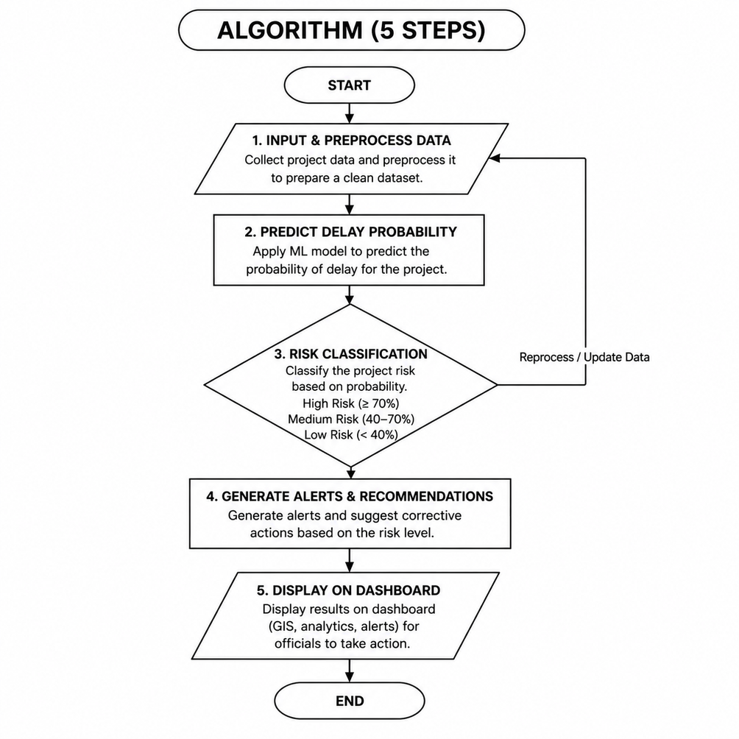
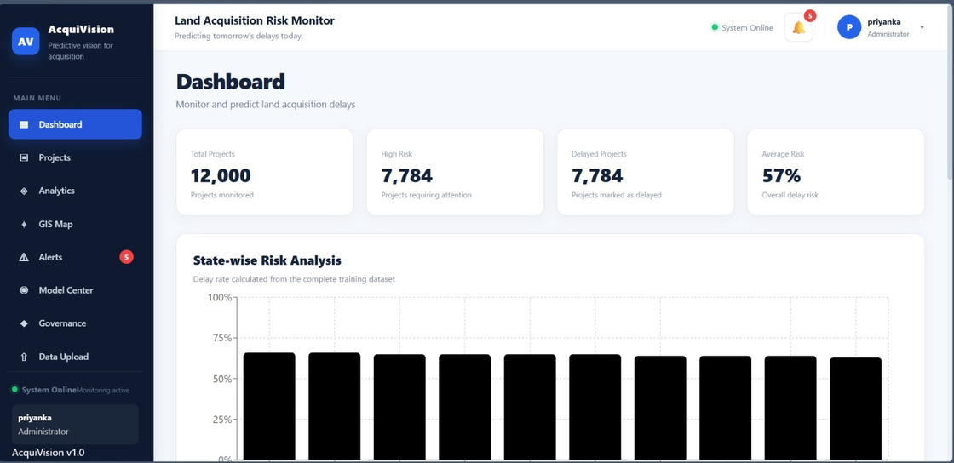
3.AI MODEL
TECHNICAL APPROACH
CODOHOLICS
FRONTEND
React.js
ReactRouter
leaflet/GIS Maps
1.DATA COLLECTION
WORKING PROTOTYPE
2.DATA PROCESSING
Backend
Python
FastAPI
REST APIs
3.AI MODEL
AI/ML
Scikit-learn
Delay Prediction Model
Risk classification
4.RISK CLASSIFICATION
5.OUTPUT & ACTION
@SIH Idea submission- Template
3

Slide 4
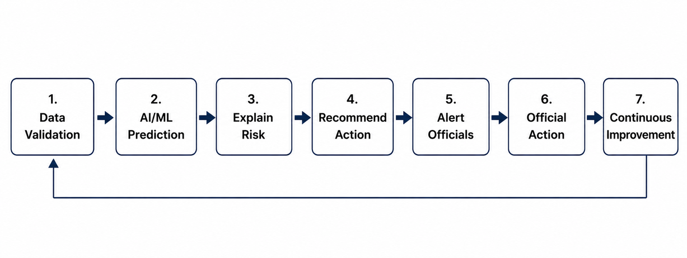
FEASIBILITY AND VIABILITY
CODOHOLICS
Feasibility
Viability
STRATEGIES
Technical Feasibility
Uses proven AI/ML and GIS technologies.
Cloud-ready with no specialized hardware.
Operational Feasibility
Simple dashboard for easy monitoring.
Risk scores and alerts enable early action.
Economic Viability
Open-source technologies reduce costs.
Early intervention reduces delay-related losses.
Sustainability & Scalability
Can continuously improve as new project outcomes become available.
Scales from District → State → National.
Data Quality: Cleaning, validation and regular updates.
Model Accuracy: Continuous testing and model improvement.
Security: Role-based access and secure APIs.
User Adoption: Simple interface and administrator training.
FEASIBILITY FLOW
@SIH Idea submission- Template
4

Slide 5

IMPACT AND BENEFITS
CODOHOLICS
Impact
Benefits
Impact
FASTER PROJECT COMPLETION – Detect delays early and enable timely intervention.
COST SAVINGS – Reduce cost overruns and improve fund utilization.
TARGETED RESOURCE ALLOCATION – Prioritize high-risk projects and optimize resources.
REDUCED DELAYS – Detect risks early and enable timely intervention.
BETTER DECISIONS – Provide explainable, data-driven risk insights.
IMPROVED TRANSPARENCY – Centralized monitoring and risk visibility.
@SIH Idea submission- Template
5

Slide 6
RESEARCH AND REFERENCES
CODOHOLICS
RESEARCH AND REFERENCES
1. Department of Land Resources — LACRRIS
Government of India’s official land-acquisition monitoring system.
Used for project milestones, acquisition timelines, compensation and R&R benchmarks.
References:
• https://larr.dolr.gov.in/
• https://larr.dolr.gov.in/faces/public/projectwise.xhtml
• https://www.larr.dolr.gov.in/faces/pdf/Steps_of_data_entry.pdf
2. Open Government Data Platform — data.gov.in
Government of India open-data platform used for land-acquisition and expenditure-related datasets.
References:
• https://www.data.gov.in/
• NHAI Land Acquisition & Expenditure Data
• District-wise Farmers Affected by Land Acquisition
@SIH Idea submission- Template
6

