Slide 1
DIP PROJECT
HAND AND EYE GESTURE RECOGNITION
SACHIN SHARMA (20161060)
AASHISH KUMAR (20161111)
TEAM NAME - PIXEL_PLAYERS
GROUP ID - 24
MENTOR - ABHIJEET KUMAR

Slide 2
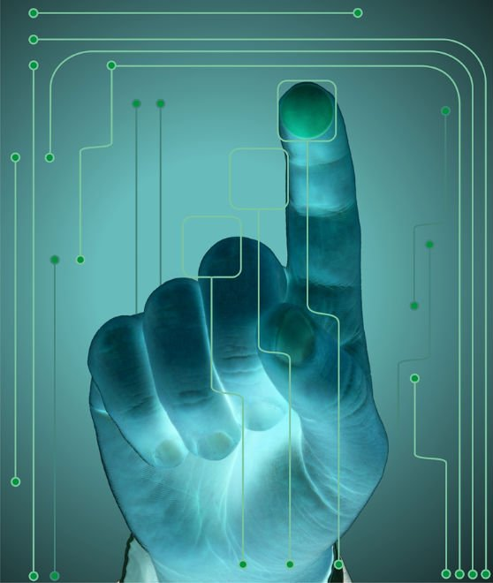
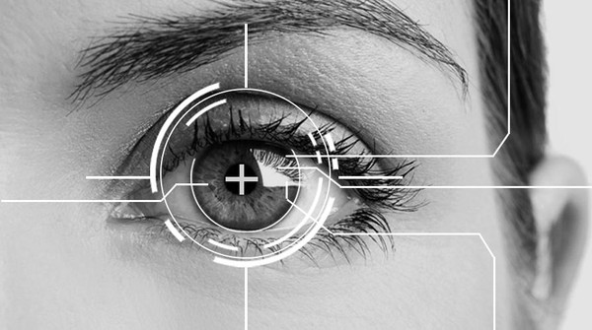

Slide 3
MOTIVATION
Primarily motivation of hand and eye gestures recognition is that they can easily be implemented by machine learning techniques but implementing with image processing is a tough and interesting task.
It is the demand of advanced technology to recognize, classify and interpret various simple hand and eye gestures and use them in wide range of application through computer vision.

Slide 4
HAND DETECTION

Slide 5
INTRODUCTION
The goal of this part of project is to design and implement an algorithm which detects gestures of hand in real time and calculate the number of fingers in a gesture. The main challenge here is to detect all the gestures quickly and efficiently.

Slide 6
OVERVIEW
Input data ​
Taking a recorded video of different hand gestures as input for algorithm. Recorded video has only vertical hand gestures.
Hand detection ​
Detect the hand gestures of input data by the segmentation based on YCbCr.
​Feature extraction ​
Count the number of fingers in hand gesture.
Mapping ​
Map the hand gestures on the basis of count of fingers in images and assigning a particular value to a particular gesture

Slide 7
CONSTRAINTS
Input images required a plain background because hand detection step is very sensitive of background colour.
We implement the algorithm for single hand gestures.

Slide 8
PROCEDURE
INPUT DATA
Recorded a video having different hand gestures and plain background. Colour of background should not be matched to the colour of hand.
Get the frames of recorded video by using VideoReader function and read the frame by using read function.

Slide 9
PROCEDURE
HAND DETECTION
Frames getting in step 2 is passed from the function name grayworld which compensates illumination.
Cb and Cr values for skin is lies in range of (77, 133) and (133, 173) respectively. So if the value of pixels are lying in above range then we assign 1 (white) to that pixel otherwise 0 (black).
Use bwareaopen and imfill functions to make hand gesture more enhanced.

Slide 10
PROCEDURE
FEATURE EXTRACTION
Locate the bounding box by using the function regionprops.
Calculate the centroid (Cx, Cy) of image by using the image moment formula.
Take take radius = 0.7 * (Cx - upper bound).
Now take centroid as centre of circle and calculate the pixel coordinates such that
x=Cy + R*Cos(theta) ; y=Cx - R*Sin(theta)
If img(y, x) changes from 0 to 1 then increase the count by 1.
Update theta by adding pi/36 to current value of theta.

Slide 11
PROCEDURE
MAPPING
Map the value of count to that count image.

Slide 12
OTHER APPROACHES CONSIDERED
In hand gesture detection step we used the laptop webcam and store a image( I1 ) initially and then take snapshot ( i2 )after every pause of 2. (i2 having hand gestures)
Then
if abs( i2(x, y) - i1(x, y) ) < 10 then i(x,y) =0
Else i(x,y) = 1
After this we use function imfill holes and bwareaopen function on image but did not get the good binarize image of hand gesture.

Slide 13
OTHER APPROACHES CONSIDERED
For feature extraction process, we create edge image of binarize hand image and then try to find out the pixel coordinates of local maxima but got more than 5 maximas due to rough boundary of image. Then we did not figure out the correct maxiamas.

Slide 14
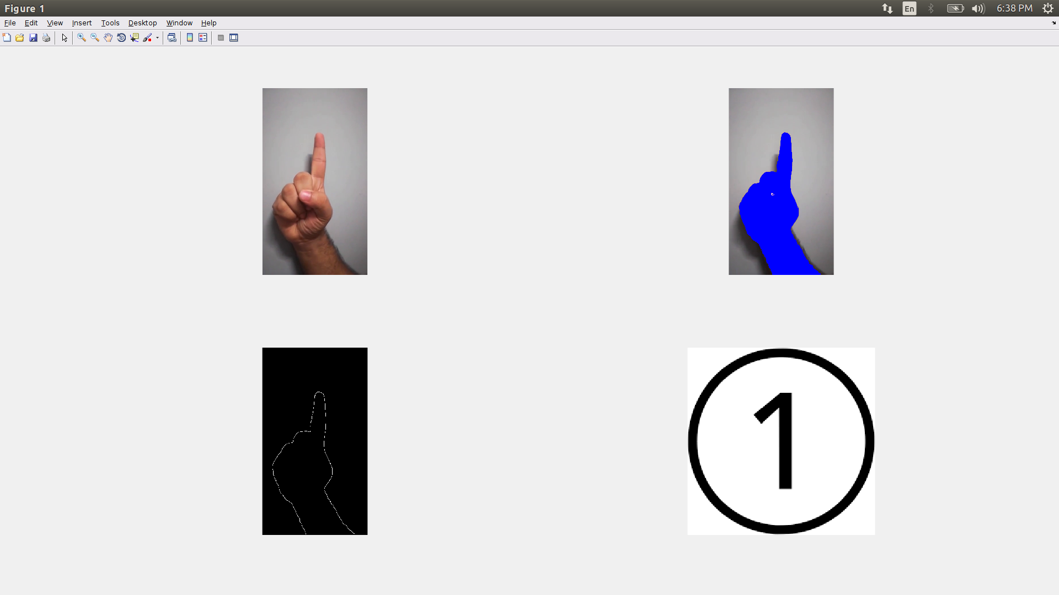
RESULTS

Slide 15
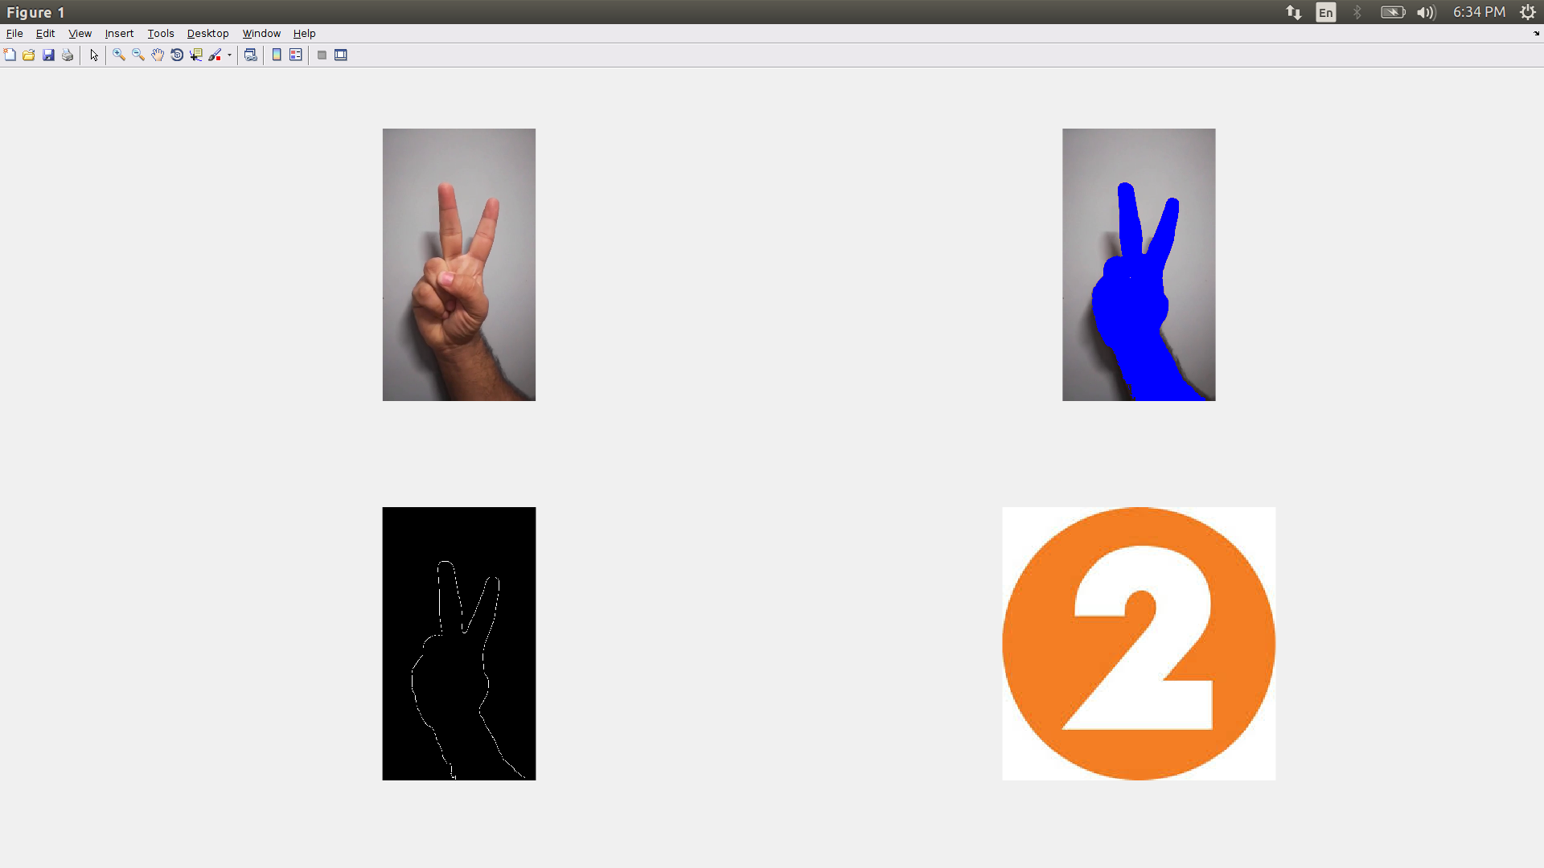

Slide 16
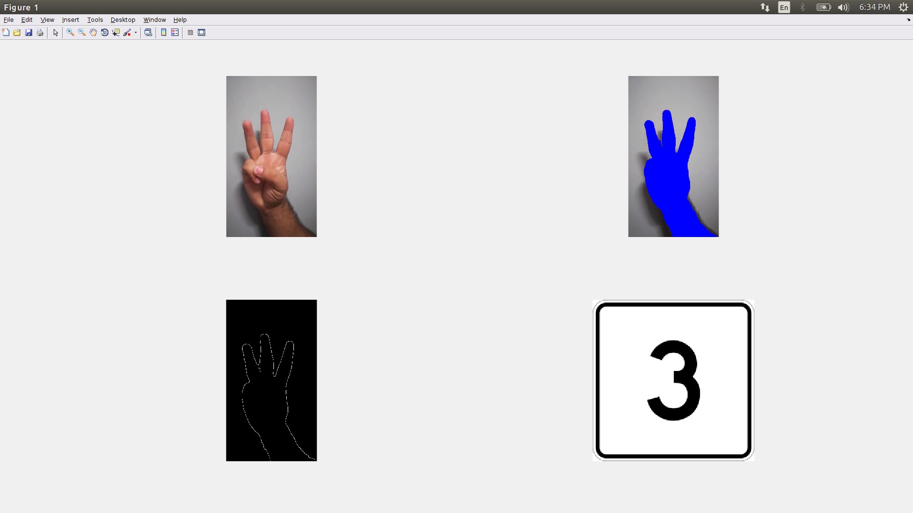

Slide 17
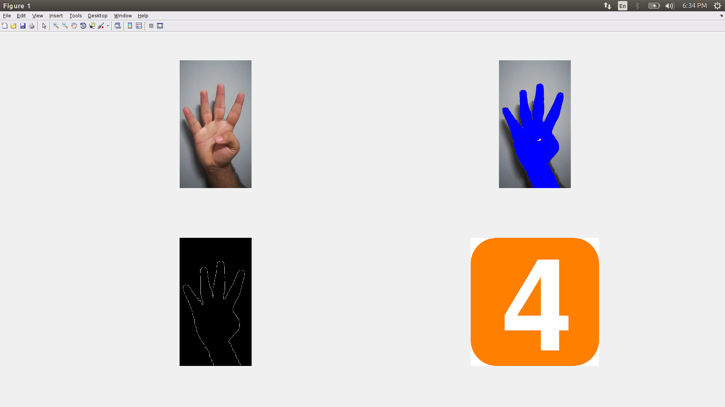

Slide 18
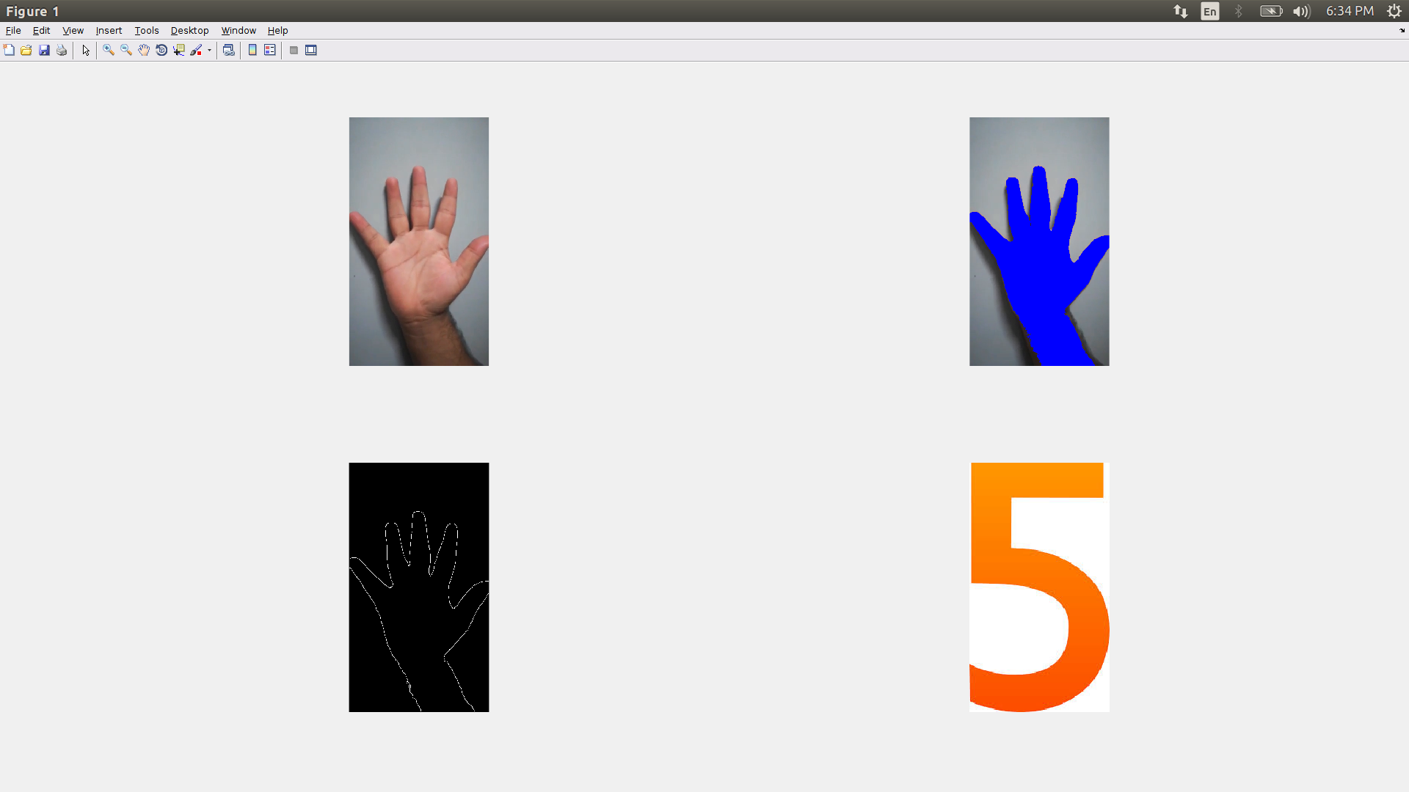

Slide 19
LIMITATIONS
We are considering only vertical hand images.
We are getting same results for same count of fingers using different fingers for that count.

Slide 20
EYE DETECTION

Slide 21
INTRODUCTION
The goal of the project is to design and implement an algorithm which detects gestures of eye in real time. The main challenge here is to detect all the gestures quickly and efficiently.

Slide 22
OVERVIEW
The basic steps followed are as follow:
Face Detection: We detected the face using cascade object detector in matlab which uses Viola-Jones algorithm to detect face and its components(eye ,nose etc).
Pupil Detection: After successfully detecting the eye, find the circle in eye region using imcircle function in matlab which uses Hough Transform to detect circles.
Gesture Recognition: Now checking distance of centre of eye ball from ends of edge of eye to find left,right and centre.

Slide 23
BASIC PIPELINE
Create webcam object to get the real time live input.
Create detector for face and eye pair vision cascade object detector to detect eye pair and face using Viola- Jones algorithm..
Take snapshot and create bounding box of face and eye pair using detector.
If face exist the extract the face and find the biggest face.
If eyepair available find the biggest eye pair available.
Find the circle in eye pair region using hough transform.
Check distance of centre of pupil from edges of eye. And detect left,right,straight position.

Slide 24
OVERVIEW
The basic steps followed are as follow:
Face Detection: We detected the face using cascade object detector in matlab which uses Viola-Jones algorithm to detect face and its components(eye ,nose etc).
Pupil Detection: After successfully detecting the eye, find the circle in eye region using imcircle function in matlab which uses Hough Transform to detect circles.
Gesture Recognition: Now checking distance of centre of eye ball from ends of edge of eye to find left,right and centre.

Slide 25
ALGORITHMS USED
VIOLA JONES ALGORITHM
This algorithm is used to detect face and eye pair in real time.
This mainly involves 4 steps:
1. Haar feature calculation: First we need to calculate haar feature(weak classifier) for detection window of image.
Each Haar feature is the weighted sum of 2-D integrals of small rectangular areas attached to each other. The weights may take values ±1.

Slide 26
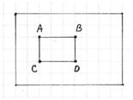

2. Integral image:
The integral image allows integrals for the Haar extractors to be calculated by adding only four numbers. For example, the image integral of area ABCD is calculated as II(yA,xA) – II(yB,xB) – II(yC,xC) + II(yD,xD).
3. CASCADING:

Slide 27
CIRCLE HOUGH TRANSFORM
This method is used to detect circles in images.Here we used hough transform to detect pupil.
A circle can be described completely with three pieces of information: the center (a, b) and the radius. (The center consists of two parts, hence a total of three)
x = a + Rcosθ
y = b + Rsinθ
When the θ varies from 0 to 360, a complete circle of radius R is generated.
So with the Circle Hough Transform, we expect to find triplets of (x, y, R) that are highly probably circles in the image. That is, we want to find three parameters

Slide 28
Assuming R is known.
a = x1 - Rcosθ
b = y1 - Rsinθ
for a particular point (x1, y1). And θ sweeps from 0 to 360 degrees.
So, the flow of events is something like this:
Load an image
Detect edges and generate a binary image
For every 'edge' pixel, generate a circle in the ab space
For every point on the circle in the ab space, cast 'votes' in the accumulator cells
The cells with greater number of votes are the centers(a,b).

Slide 29
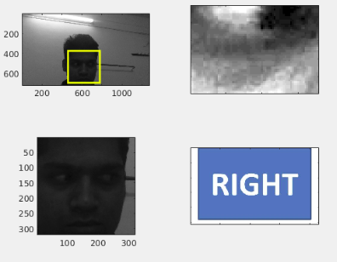
OUTPUTS

Slide 30
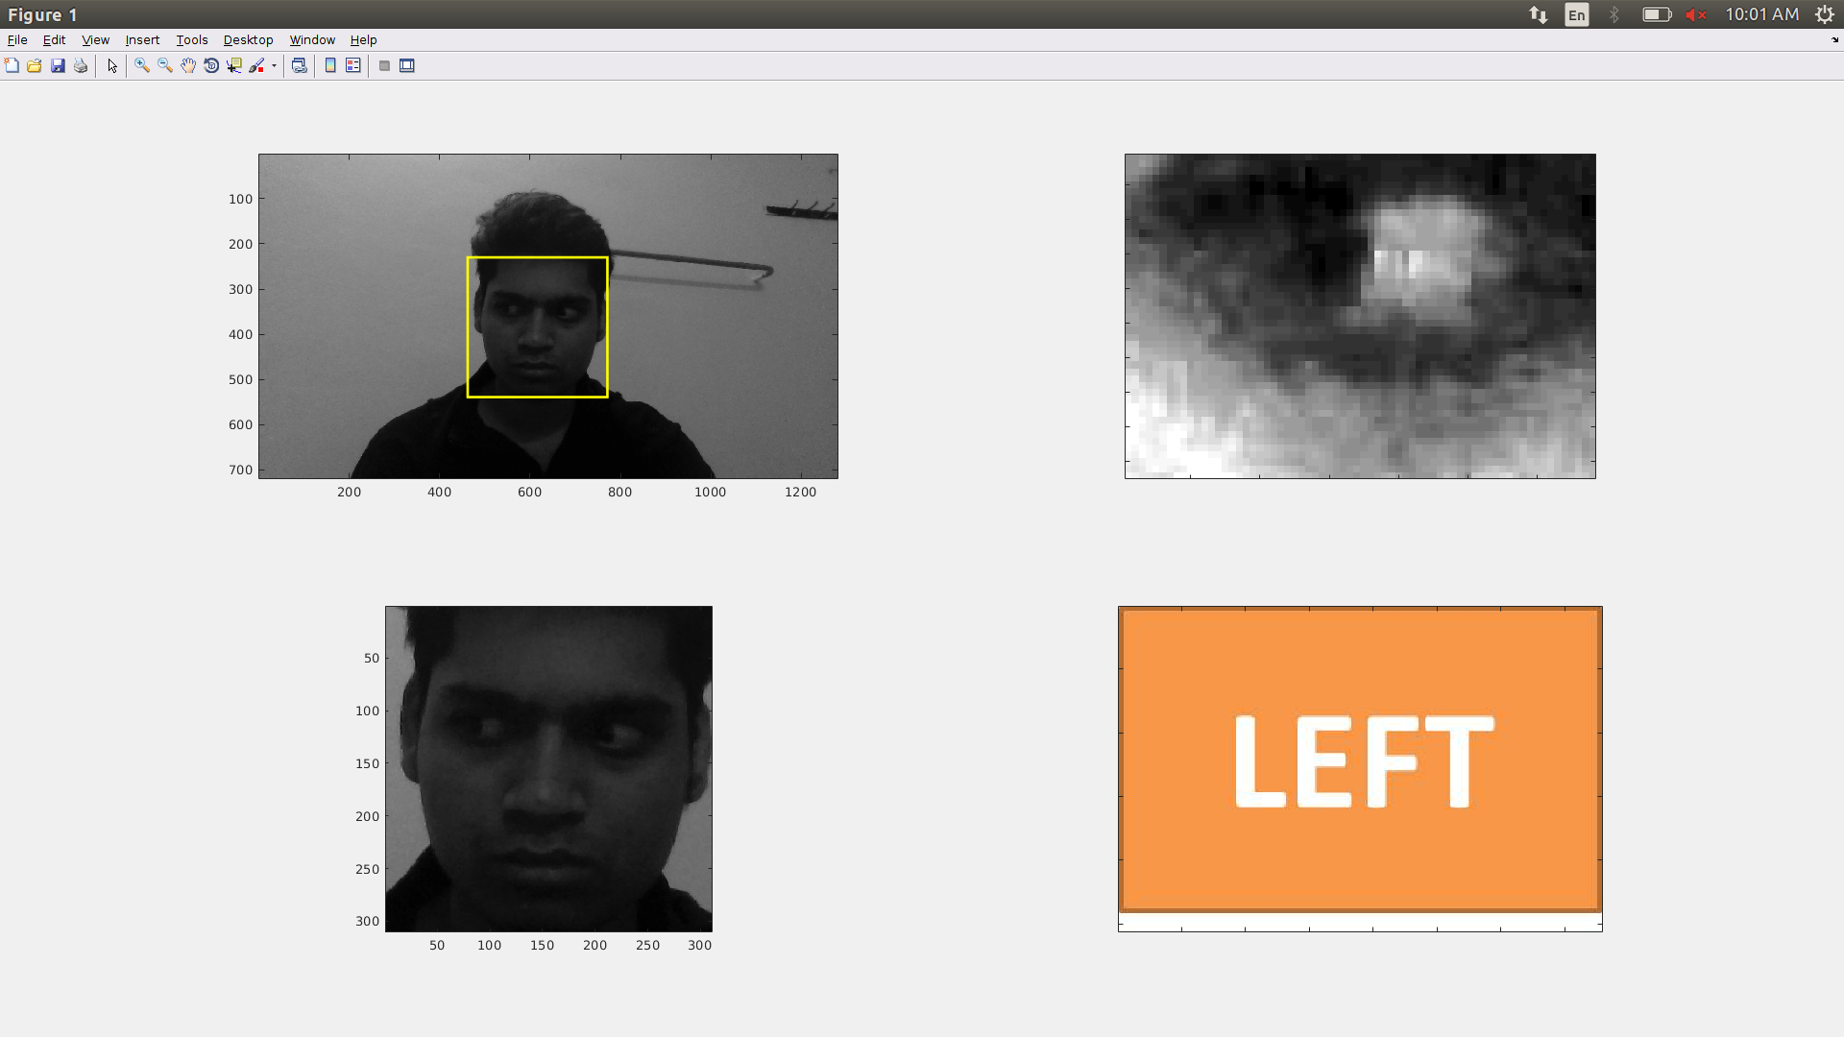

Slide 31
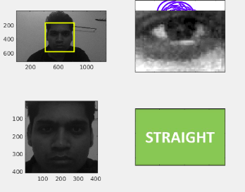

Slide 32
CONSTRAINTS AND LIMITATION
CONSTRAINTS
Face needs to be still.
Face must be near to webcam for better result.
LIMITATION
Cannot detect blink.
Have fewer gesture as eyeball is very small.

Slide 33
THANK YOU

