Slide 1
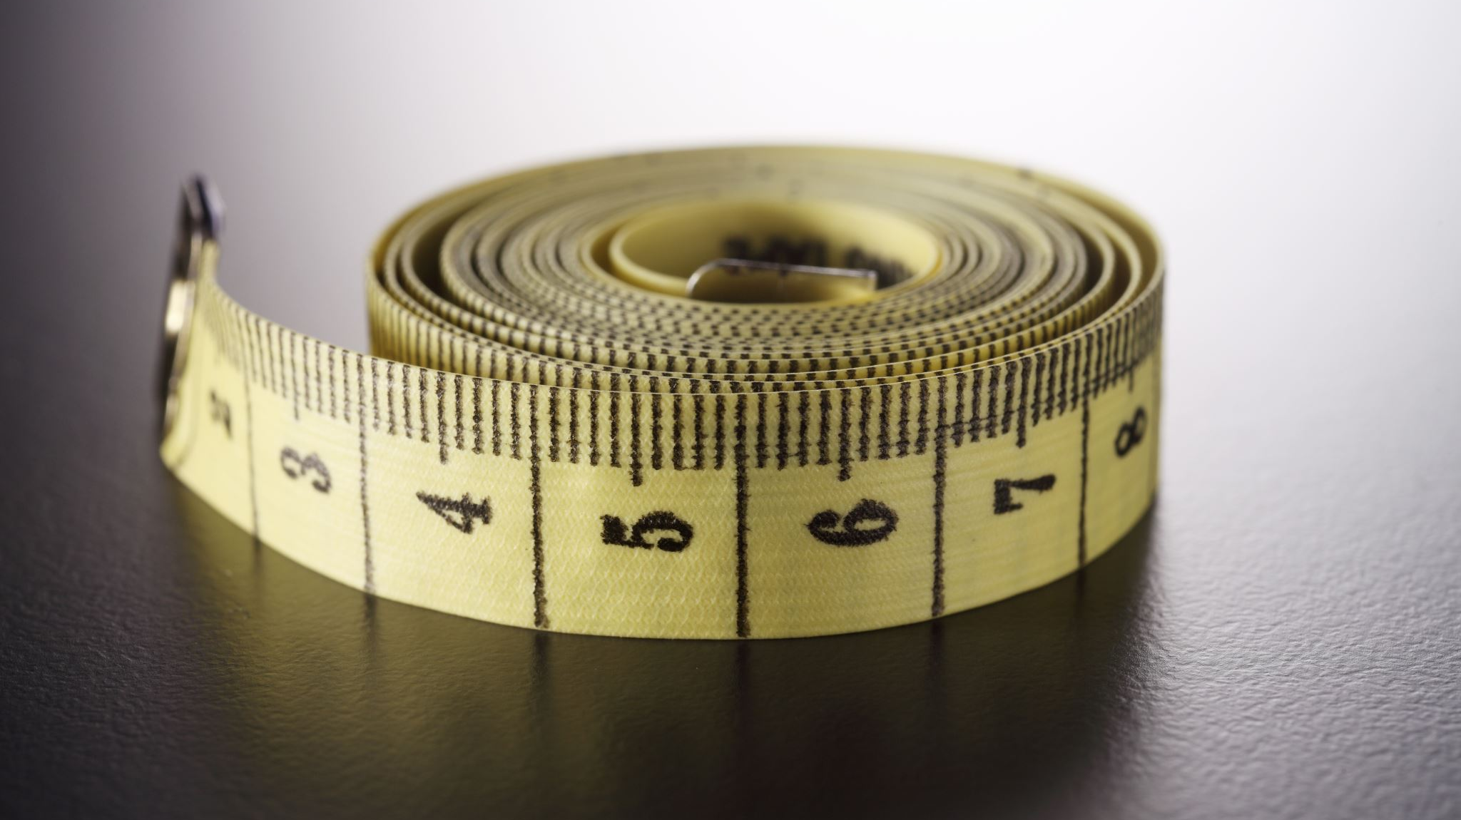
Body Fat Study

Slide 2
Data Cleaning
Original dataset contains 252 samples.
Make unit measurement consistent. inch->cm, pound->kg.
We deleted three individuals.
Cleaned dataset contains 249 samples.
Individual (IDNO) | Reason
186 | Body fat is 0%
42 | Height is 42cm
216 | Body fat is too high, 45.1%

Slide 3
Finding Best Model
We’ll define the “best” model based on the R square.
Initial model with 5 predictors:
BODY FAT ~ AGE + NECK + ABDOMEN + FOREARM + WRIST

Slide 4
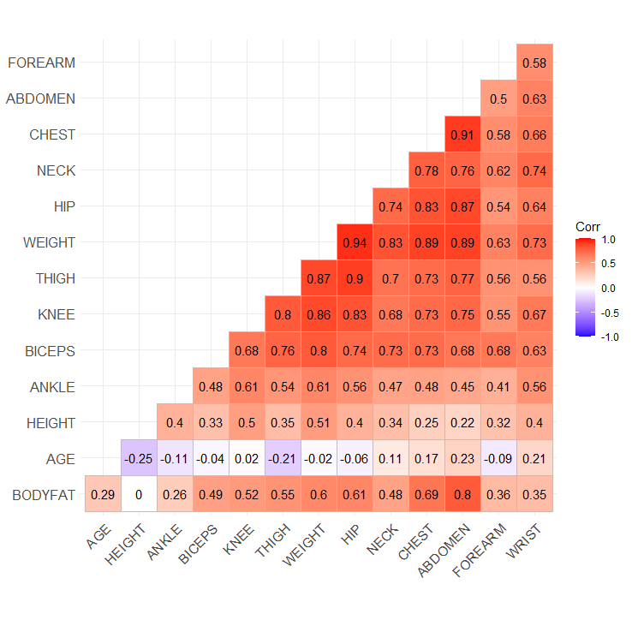
Visualizing Data
Candidate Models: Linear models with at most 3 predictors.
BODY FAT ~ ABDOMEN
BODY FAT ~ ABDOMEN + HEIGHT
BODY FAT ~ ABDOMEN + HEIGHT + AGE

Slide 5
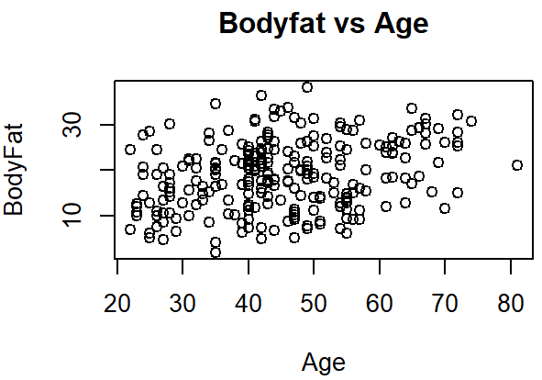
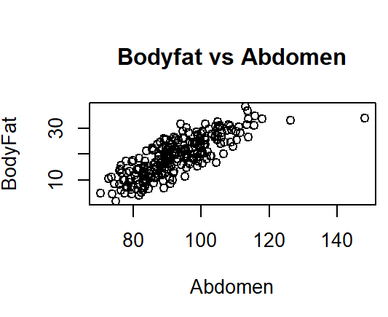
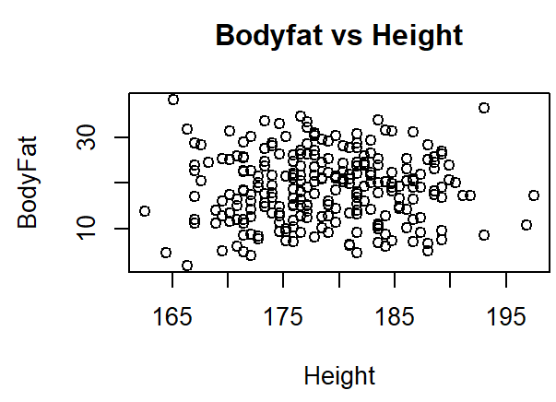
Visualizing Data

Slide 6
Results
Model | R-squared | Std. Error | P-values (t-test)
BODYFAT~ABDOMEN | 0.64 | 4.47 | <2e-16
BODYFAT ~ABDOMEN+HEIGHT | 0.68 | 4.28 | < 2e-16 1.7e-06
BODYFAT~ABDOMEN+HEIGHT+AGE | 0.68 | 4.27 | < 2e-16 4.17e-05 0.11

Slide 7
Comparison
METRICS | BODYFAT~ABDOMEN+HEIGHT | BODYFAT~ AGE+NECK+ABDOMEN+FOREARM+WRIST
R-Square | 0.68 | 0.71
Std. Error | 4.27 | 4.05
Advantage: | Simple | Better Accuracy (by 3%)

Slide 8
Final Model
As men’s height increases by 10 cm, he is expected to decrease about 2.1 % in body fat.
As men’s abdomen (waist) increases by 2cm , he is expected to gain about 1.2% of body fat.
Body Fat% = 0.78 + 0.60*Abdomen(cm)-0.21*Height(cm)
Range of Body Fat %
Athletes | Fit | Average | Obese
6~14% | 14%~18% | 18% ~25% | 25%+

Slide 9
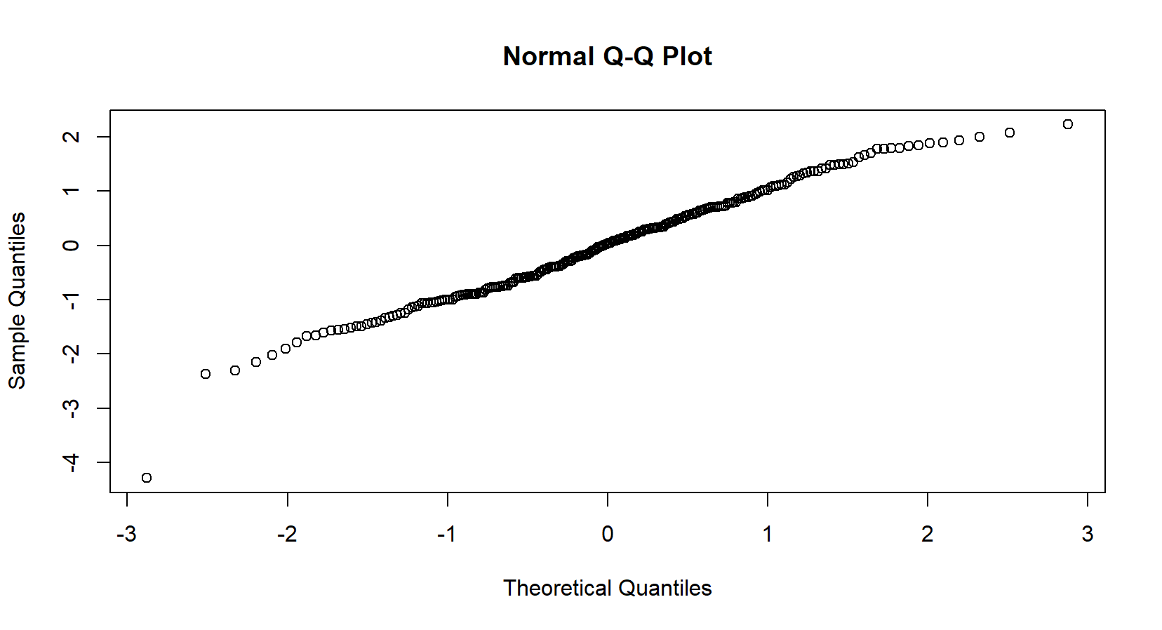
Model Diagnostics(Normality)

Slide 10
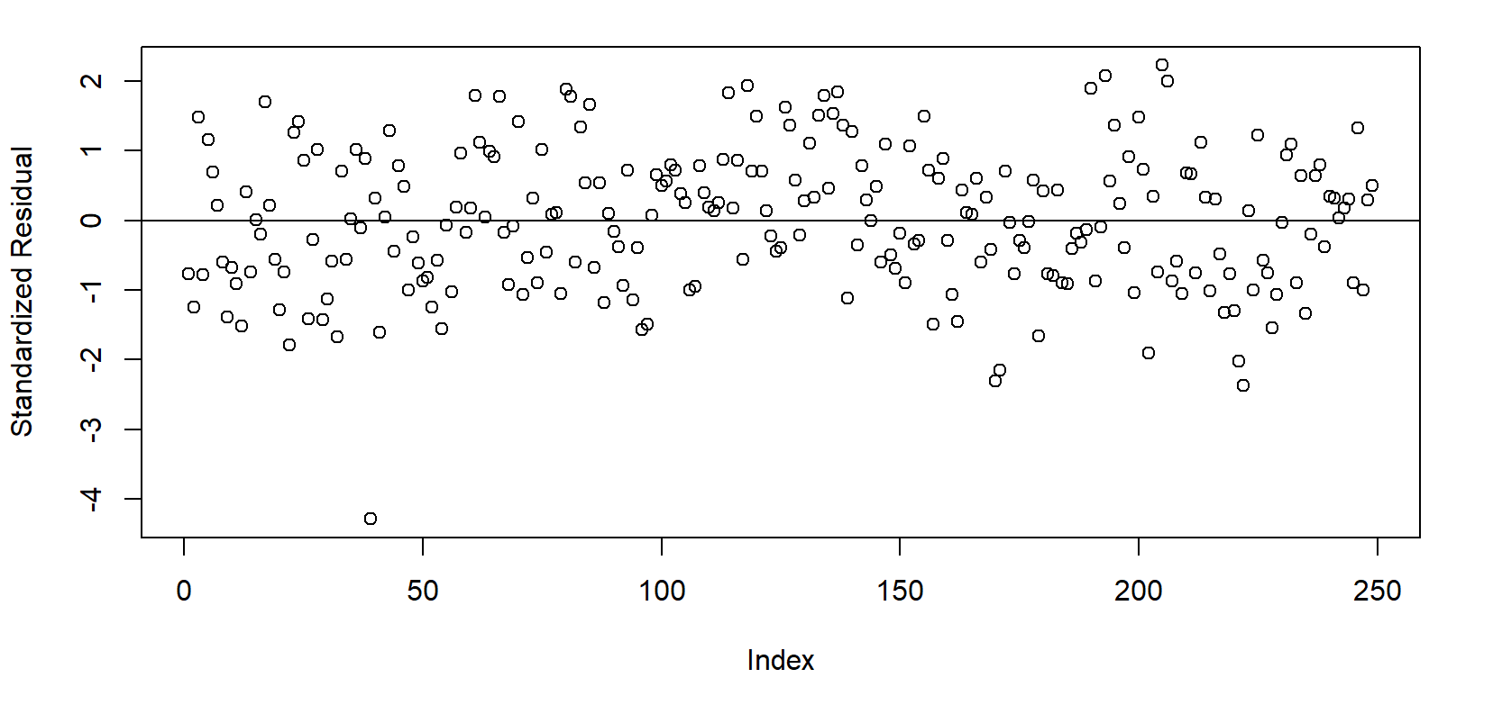
Independence, Homoscedasticity, Linearity

Slide 11
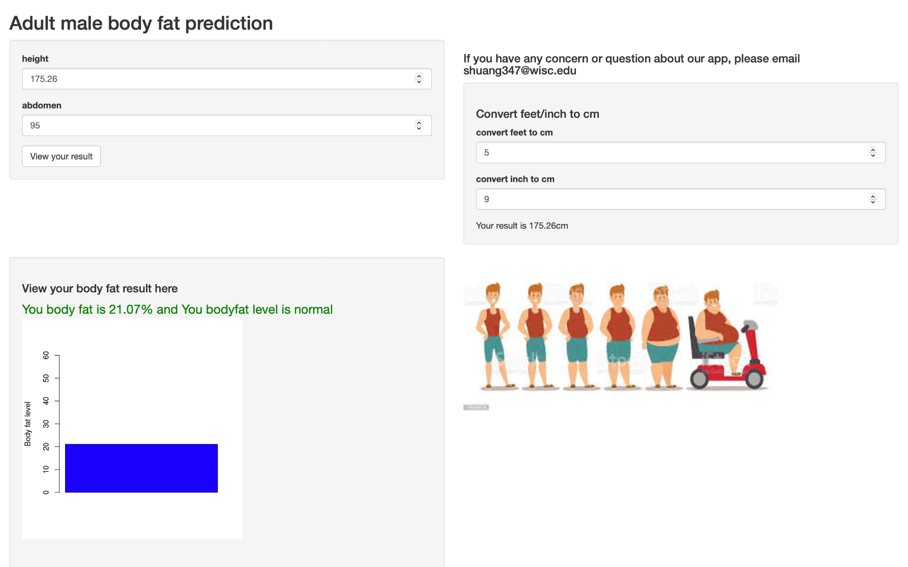
Shiny App
175.26
Key features:
Metric conversion (feet/inch to cm)
Predict adult male body fat
Show result both digitally and graphically
95
5
9
175.26
21.07%

Slide 12
Conclusion
Body Fat(%) = 0.78 + 0.60*Abdomen(cm)-0.21*Height(cm)
Linear model assumptions obey.
Only two features, easy to understand.
Trade-off between accuracy and simplicity.

Slide 13
Thank you!
Q&A

