Slide 1
Storyboarding

Slide 2
It is observed that selling price of house is expected to be dependent on many factors, we will explore whether this belief is strongly supported by the outcome of an analysis or is it the opposite and only few factors impact the final price at which the house is sold.

Slide 3
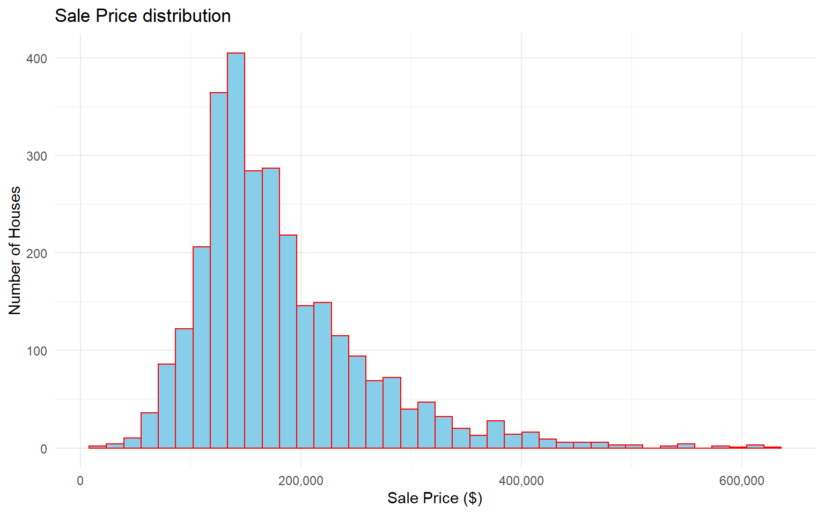
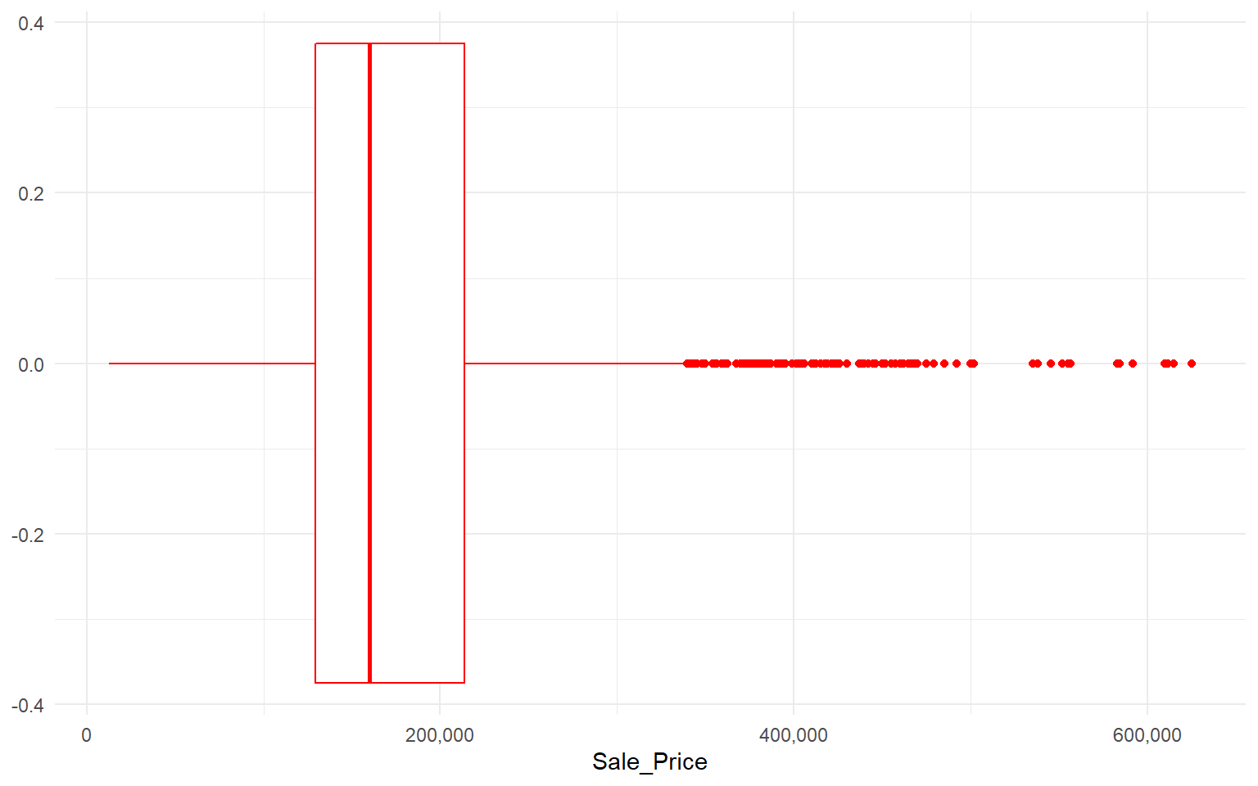
There are more inexpensive houses than expensive ones. The mean sale price is 180411.6

Slide 4
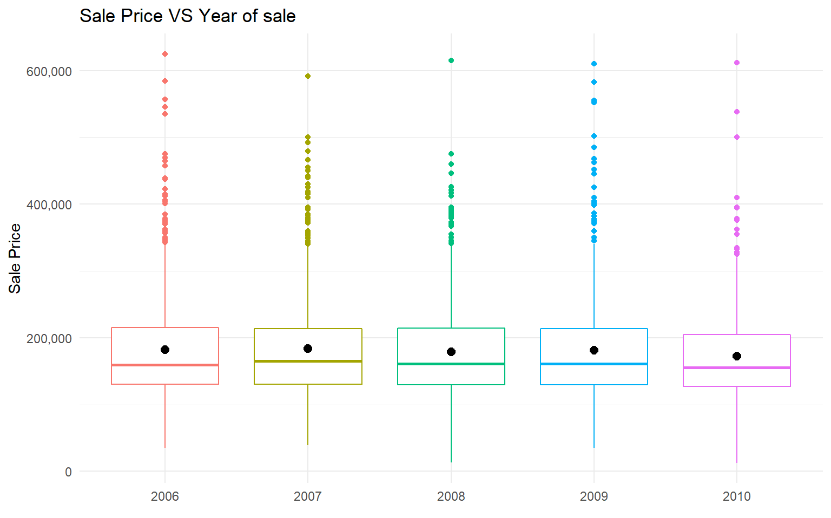
Similar pattern can be seen in all the years for Sale Price. The average sale price is almost below 200,000 which represented by a black dot on the plot.

Slide 5
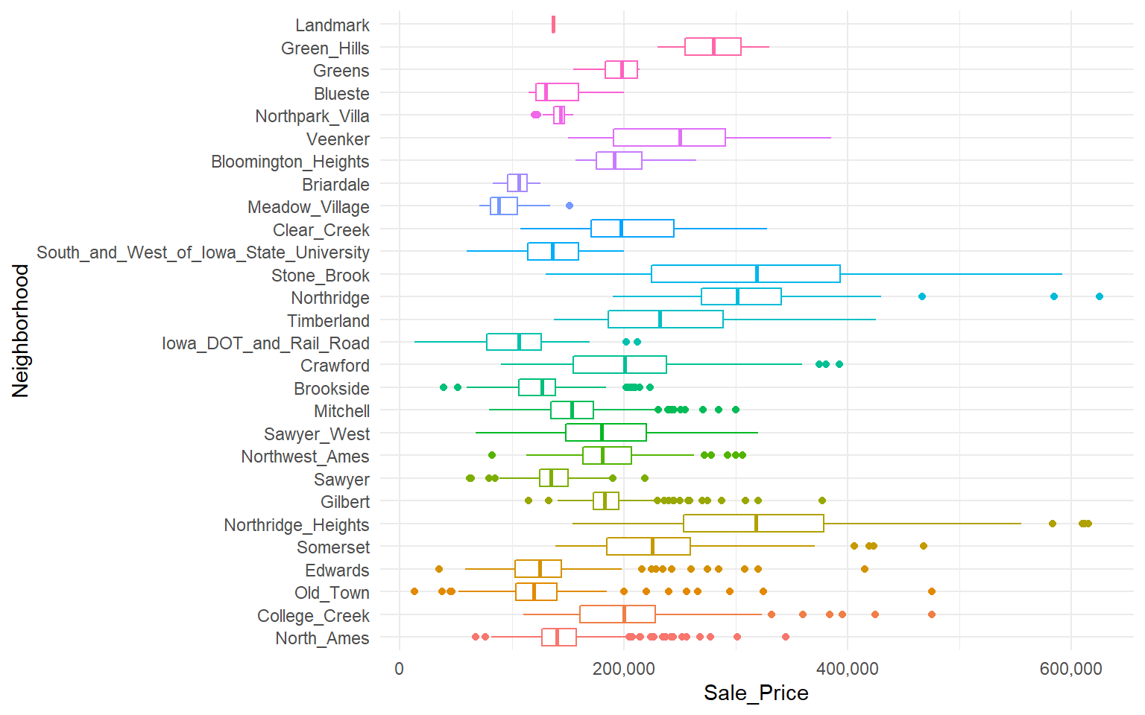
It is seen that Northridge Heights and Stony Brook are the most expensive neighborhoods. Neighborhood has a significance on the sale price of the houses.

Slide 6
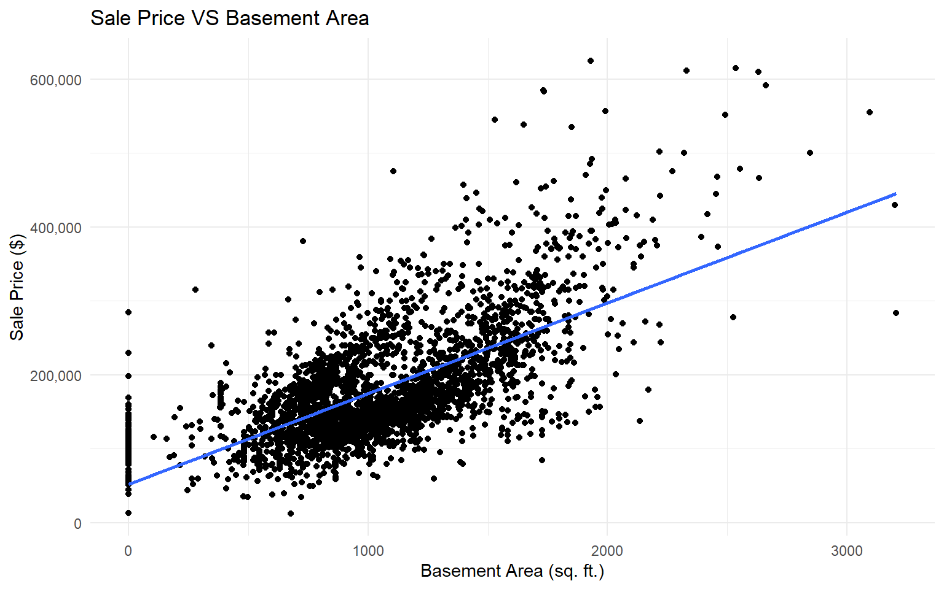
As Basement Area of houses increases, their Sale Price also increases.

Slide 7
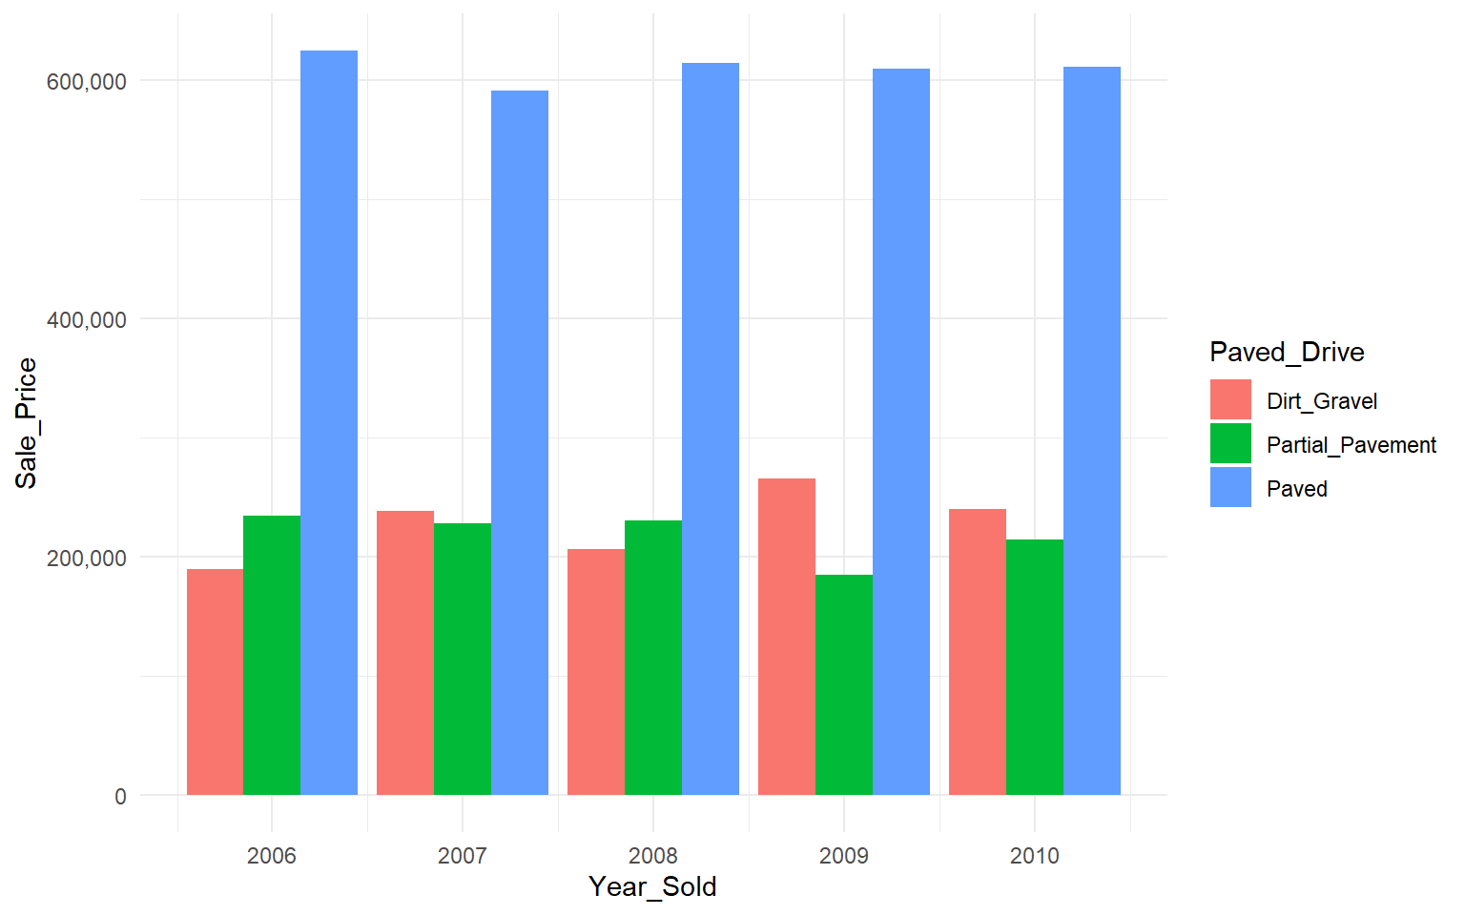
Mostly expensive houses had paved driveway for all the given years in which they were sold. Houses with price range around $200,000 were connected to partial pavement and Dirt Gravel, similar price pattern can be seen for all properties for all years.

Slide 8
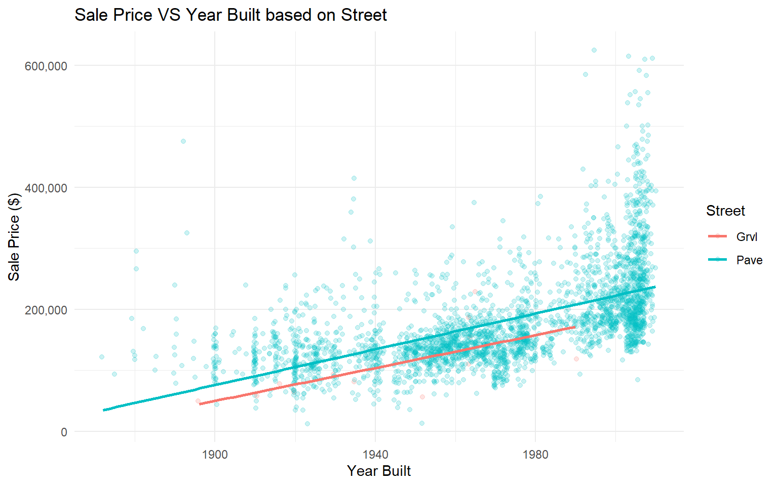
Newer houses are sold at higher prices and houses built in the earlier years were sold for lesser prices and almost all houses were connected with paved streets and only few were with gravel streets.

Slide 9
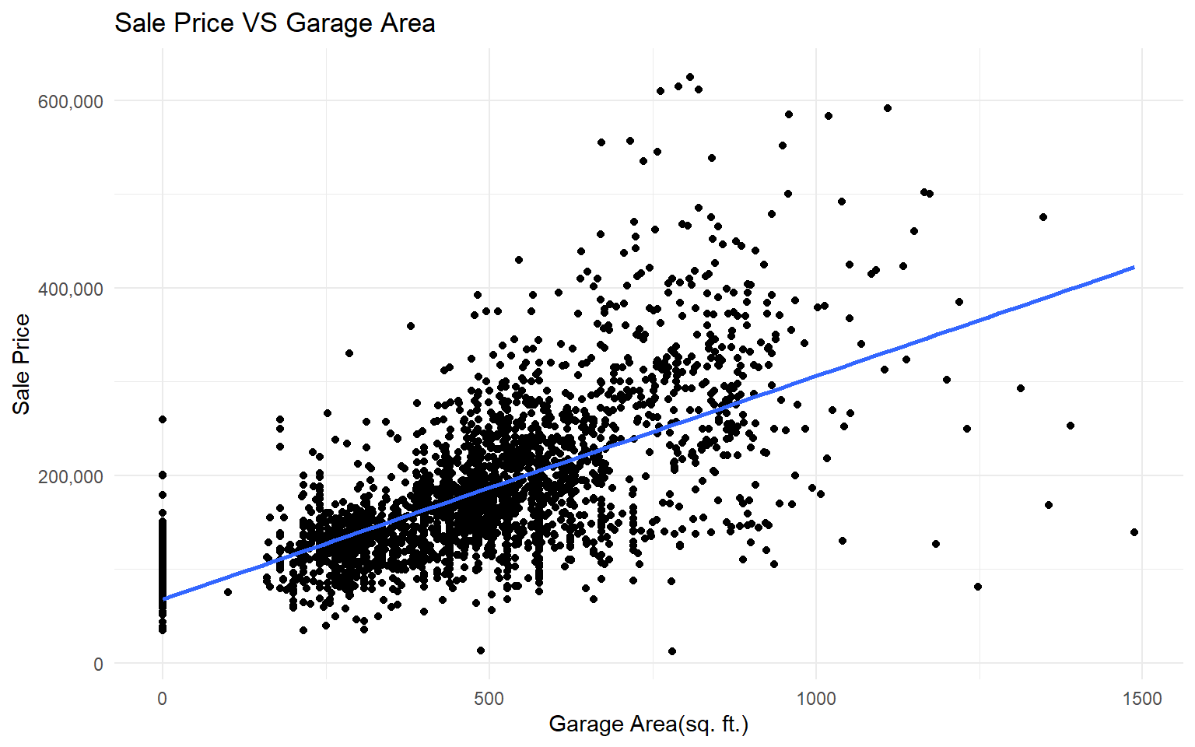


As Garage Area of houses increases, their Sale Price also increases.
Strong Correlation
42% Variability Explained

Slide 10
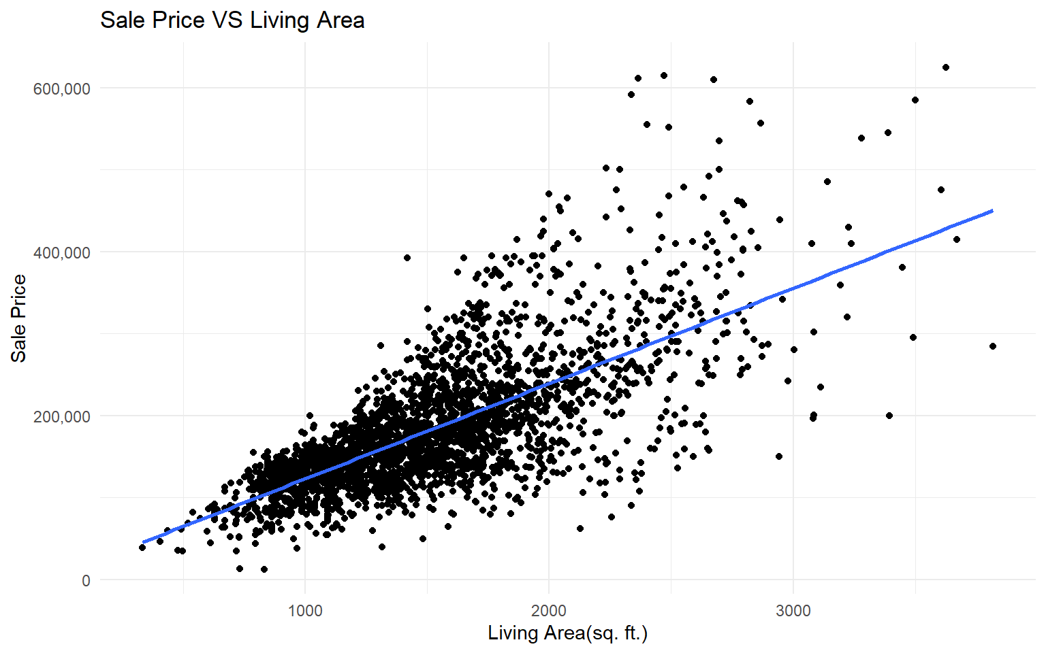


As Living Area of houses increases, their Sale Price also increases.
Strong Correlation
51% Variability Explained

Slide 11
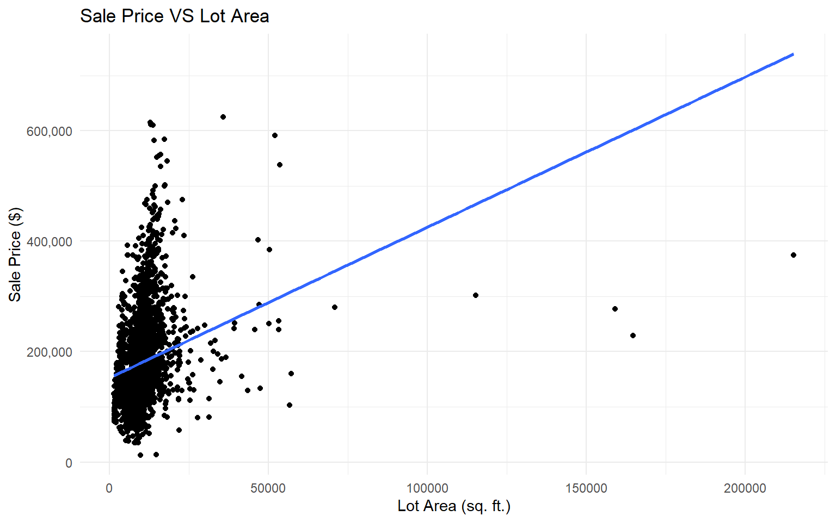


Lot Area of houses doesn’t seems to have a major impact on their Sale Price.
Weak Correlation
7% Variability Explained

Slide 12
At the end of our story, we conclude that Garage Area, Living Area, Basement Area, Neighbourhood, Driveway, Street Type, Years after which it is sold all have a significant impact on the final price at which the house is sold. However certain factors what everyone considers expects to be important like Lot Size and Year in which the house was built are evidently not seen to have such a strong correlation with Sale Price.

