Slide 1



Dab 103 Cryptocurrencies: An Infographic
Group: 002
SUBMITTED BY:
AASHUTOSH SEHGAL
IMAN FATIMA
JASMINE RUBALDEEP KAUR UMAIR NABEEL

Slide 2
PROPOSAL AND EXPLORATORY DATA ANALYSIS (EDA)

Slide 3
Introduction
Over the last decade, an increasing number of people from all over the world are investing in cryptocurrency. Cryptocurrency is s a type of decentralized, distributed currency that is used to make transactions over the internet, same as you would with normal currency but without any intermediary bank.
The most commonly used Cryptocurrency is powered by the “Blockchain” technology which first came to light in 2008. Blockchain is essentially a digital ledger that keeps record of transactions and helps tracking assets. The legitimacy of every transaction is verified through the distributed peer-to-peer system and then added to the ledger and once added, it is immutable, which accounts for security. Blockchain facilitates an entirely different perspective, which is that no one is a trusted user.

Slide 4
Introduction (Contd.)
Bitcoin was blockchain's first trial run that made out into this world in 2009, as of May 2021, 10,115 different cryptocurrencies exist according to Google and the number is still on the rise. A money system with nobody in control, no laws, and no regulations. That was rather a wild experiment which turned into a revolution. Businesses began creating their own cryptocurrencies and selling the coins as a way to raise money, like shares on a stock market. And people treated cryptocurrencies like a stock market too, investing in different ones, trying to buy low and sell high.
Cryptocurrencies are generally measured in “COINS” and new ones are added to the system through “MINING” which is a process of solving complex mathematical problems with help of computer programs. Mining requires lots of hardware and processing power.

Slide 5
Inspiration
The force that motivated us to pursue this amazing journey of understanding the world of Cryptocurrency is the dynamic behavior of this industry, the fluctuations can be observed every second, a “Coin” that was booming an hour ago can be seen to plummet within minutes or vice- versa.
Even though the nature of this market is agile, it is safe to say that cryptocurrency’s market is rapidly increasing, as the market capitalization briefly reached more than 1,000 billion USD. Even though, it may seem like an elusive subject to potential buyers or amateur crypto enthusiasts, with this project we hope to provide some insights into the crypto-world to get them started.
We aim to provide a detailed descriptive analysis of some major cryptocurrencies in the market today namely Bitcoin, Ethereum and Dogecoin, over the period of 2017-21.

Slide 6
Problem Statement
Cryptocurrencies like Bitcoin, Ethereum and others gained a lot of attention in 2017 when they reached new heights, Whereas Dogecoin gained attention in 2021. Cryptocurrencies are volatile as there is speculation whether they are good investment or not. Given the high variance in prices, can data and statistical analytics methods can be used to understand the market dynamics?

Slide 7
High Level Project Goal
Analyze the trading data of cryptocurrencies using traditional and statistical metrics.
Compare cryptocurrency with other markets and check volatility between the two.
Analyze the energy consumption of mining bitcoin with energy consumption of different countries.

Slide 8
Questions Our Project Would Answer
1) Why bitcoin became famous and what heights did it reached during its peak?
2) Are other Cryptocurrencies prices dependent on Bitcoin, are the major peaks and crashes co-related?
3) What is expected ROI (Return on Investment) when investing in Cryptocurrencies for a long term? How did Dogecoin which started as joke and ended up being worth half billion dollars? Did Twitter influence it?
4) How volatile is Bitcoin compared to gold? Does investing in volatile cryptocurrency really good investment?

Slide 9
dataset
Our dataset is collected from a Cryptocurrency exchange known as Gemini and for Dogecoin and NYSE (New York Stock Exchange) dataset we have used Yahoo Finance.
Gemini Exchange Link
DogeCoin Data By Yahoo Finance
NYSE Exchange Data By Yahoo Finance
Bitcoin Energy Consumption Data By Digiconomist
Banks Market capital by relbanks
Cryptocurrency market capital by yahoo finance
Gold Market Dataset By Yahoo Finance

Slide 10
EDA
We have used 11 datasets in our project, from which 6 are related to cryptocurrencies, 2 are for energy consumptions for countries and bitcoin mining and a dataset for banks market capital in year 2017.
Vol. column of btc, eth and doge have “K”, “M”, “B” which makes the values invalid for analysis, Market Cap column in banks data is in Billions and needs correction which we will do in later stage. Date of information column is irrelevant and region should be converted to category data type to reduce space.
Energy consumption for bitcoin has estimated and minimum units per year in (Twh) which should be converted into (Kwh) per year for comparison sake.
Stocks of s&p500 and dji, btc, eth and doge 1 year market capital dataset needs no correction.

Slide 11
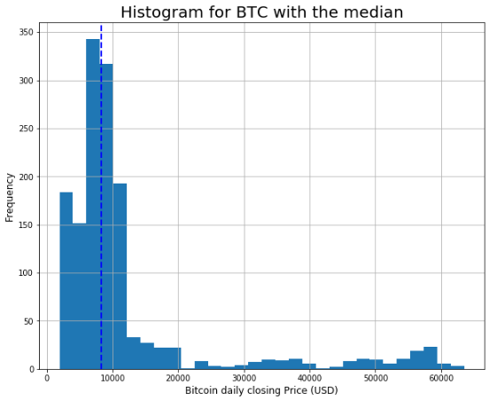
EDA (Contd.)
From the histogram, it can be observed that the data has certain outliers, those are peak values or crash that are significant and will be further analyzed, interpretation and description. This dashed line denotes median of price (around 8000$) and 50% of time the price of bitcoin was below median.

Slide 12
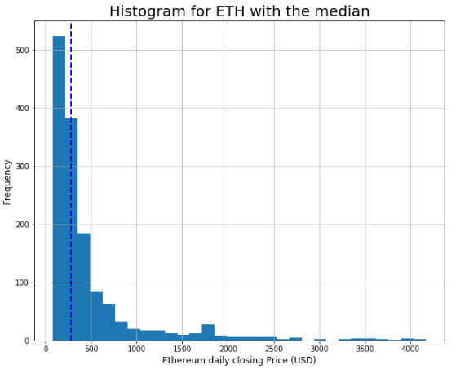
EDA (Contd.)
From the histogram, it can be observed that the data has certain outliers, those are peak values or crash that are significant and will be further analyzed. This dashed line denotes median of price (around 300$) and 50% of data is below 300$ for Ethereum.

Slide 13
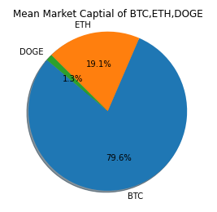
EDA (Contd.)
The pie chart explains the obvious fact that bitcoin being the oldest has the maximum share in market capital of 79.6%, whereas Ethereum has 19.1% and the most recent dogecoin has 1.3% which is still quite significant despite been in market for shorter span of time.

Slide 14
DATA CLEANING/TRANSFORMATION AND DATA ANALYSIS

Slide 15
Description
In this project, our focus is on two major cryptocurrencies and a meme coin, we will through our data cleaning and transformation and with the analysis of data answer the questions in our proposal. Data cleaning/transformation includes finding and removing missing values if any, transforming columns to make them compatible for analysis.
Later while answering questions, we will take individual question explain its' key points through appropriate plots also we will see the volatility of the cryptocurrency as compared to gold and based on all these analysis we will provide our audience with suggestions giving them a brief and thorough idea about cryptocurrencies before entering into its world.

Slide 16
We are describing basic statistics for various cryptocurrencies using boxplot and histogram.

Slide 17
Histogram with median for btc
The closing price was noticed to be below 20000 for many days, the plot is right skewed as we can see a tail at the right side of the plot. The dashed line shows the median representing half of the closing prices were under $8300.

Slide 18
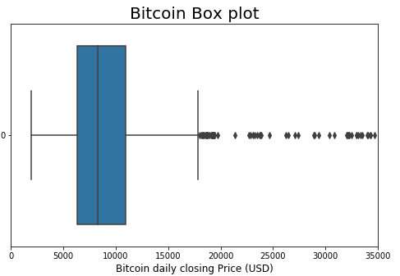
Boxplot for btc
The closing price was noticed to be below 20000 for many days, the plot is right skewed as we can see a tail at the right side of the plot. The dashed line shows the median representing half of the closing prices were under $8300.

Slide 19
Histogram with median for eth
The closing price was noticed to be below 1000 for many days, the plot is right skewed as we can see a tail at the right side of the plot. The dashed line shows the median representing half of the closing prices were under 278.4.

Slide 20
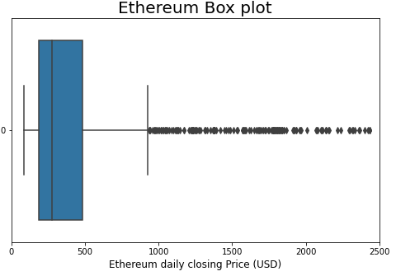
Boxplot for eth
The below box plot depicts that the closing price was mostly in between 300 and 500 in the last 3 years. All values that lies above 18000 are outliers.

Slide 21
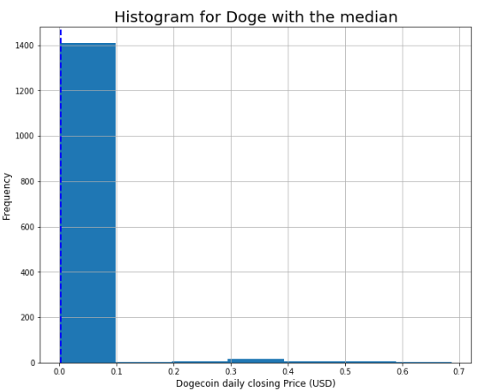
Histogram with median for doge
The closing price was noticed to be below 0.1 for many days, the plot is right skewed as we can see a tail at the right side of the plot. The dashed line shows the median representing half of the closing prices were under 0.003.

Slide 22
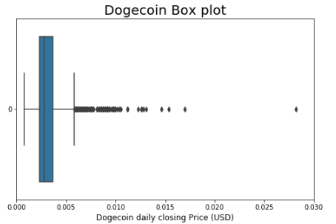
Boxplot for doge
On the box plot above, we see that Dogecoin closing price was most of the time between 0.002 and 0.004 in the last 3 years. All values over 0.0006 are outliers (using IQR). Outliers are specific to this data sample.

Slide 23
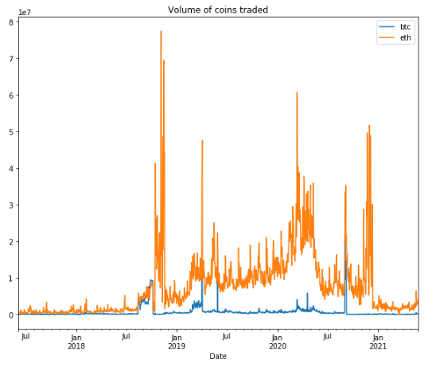
Volume of coins traded
Volume indicates how many shares or currencies are bought and sold during given period of time.
Volume of Ethereum traded on daily basis is much higher than the bitcoin as shown in the graph. Moreover, the bitcoin is more expensive.

Slide 24
Data Cleaning
There are no missing value in the dataset, therefore, we need not to perform any data cleaning.
We can check any available null values in the dataset using isnull() method present in Python.

Slide 25
Data Transformation
Converted Volume column from character to integer and millions(M) to zeros.
Converted Vol. column to float in all dataset
Added suffix for merging dataset
Merged all three crypto datasets

Slide 26
Answers to questions

Slide 27
1) Why bitcoin became famous and what heights did it reached during its peak?
For this we will use Candlestick charts which provide an easy-to-interpret picture of price action.
The filled portion of the candlestick is called the body. The lines above and below the body represent the high/low range and are called shadows (or “wicks” or “tails”). The high is marked by the top of the upper shadow and the low by the bottom of the lower shadow.

Slide 28
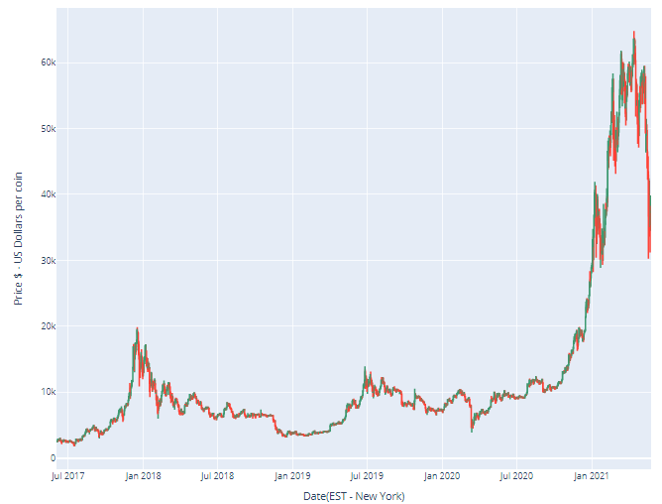
As can be seen from the chart there are two distinguished peaks first in Dec 2017 where price surged close to 20K dollars and next one is recent where price surged to more than 60K dollars per coin.

Slide 29
Even the most casual observer of the digital currency scene will be aware that 2017 was a record year in terms of price movement. Bitcoin was the marquee attraction for new giant investors and corporations given its incredible rise from 900 dollars in January 2017 to 20,000 dollars by December 2017. source “https://www.financialexpress.com/market/india-is-the-reason-for-bitcoins-price-surge-heres-why/1616145/ ".
In early 2021 Recently, there has been a trend where public companies are converting their cash treasuries into cryptocurrency. Square, an American payments company, bought 50 million dollar worth of Bitcoins.

Slide 30
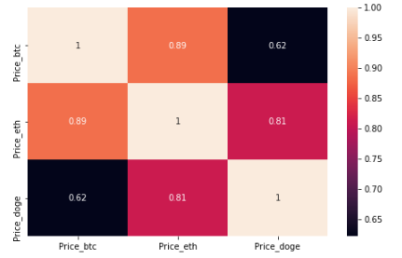
2) Are other Cryptocurrencies prices dependent on Bitcoin, are the major peaks and crashes co-related?
Next we will look at dependency of Ethereum and Dogecoin on Bitcoin. Also as dogecoin is called Meme coin because it was started as a joke and to mock the bitcoin.

Slide 31
We calculate the Pearson correlation between the closing prices of BTC, ETH, and LTC. Pearson correlation is a measure of the linear correlation between two variables X and Y. It has a value between +1 and −1, where 1 is the total positive linear correlation, 0 is no linear correlation, and −1 is the total negative linear correlation.
(BTC, ETH) and (ETH,DOGE) were highly correlated as per the data. This means, when BTC closing price increased, ETH prices followed. Similarly is it safe to say that when prices of ETH increased DOGE followed.
BTC and Doge have high positive relationship correlated with 0.62 Pearson correlation coefficient.
The knowledge of the correlation coefficient helps to determine in percentage the influence of Bitcoin over Dogecoin. The share of BTC price affecting trend in Dogecoin is the most important factor. The other part covers all the other things, such as media, events or regulations.

Slide 32
3) What is expected ROI (Return on Investment) when investing in Cryptocurrencies for a long term? How did Dogecoin which started as joke and ended up being worth half billion dollars?
Expected rate of return for different cryptocurrencies
Buy and hold is a passive investment strategy in which an investor buys a cryptocurrency and holds it for a long period, regardless of fluctuations in the market. Let’s analyze returns using the Buy and hold strategy for the past 3 years. We calculate the return percentage, where t represents a certain period and price0 is the initial closing price.
return(t,0) = price(t)-price(0)/price(0)
or
ROI = (Present Value of Investment - Initial value of investment) / Initial Value of Investment

Slide 33
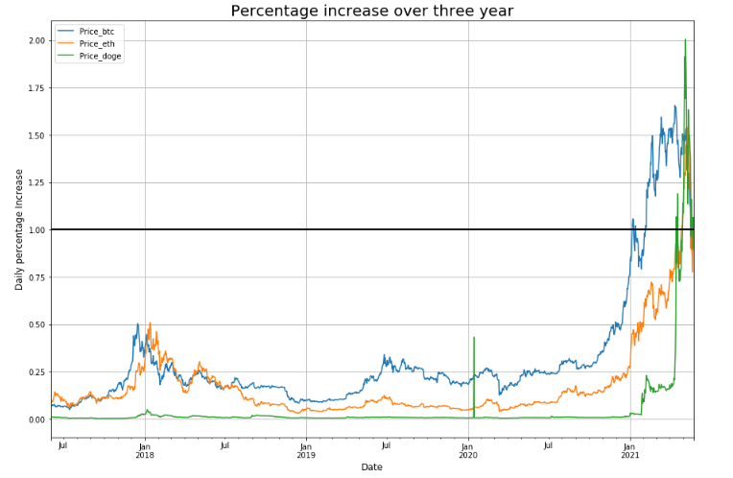
We can see that DOGE was the most profitable for the month of Apr'21. Other two currencies also returned high amount during the same period. All three cryptocurrencies fluctuated a lot but all gained if compared to year 2017.

Slide 34
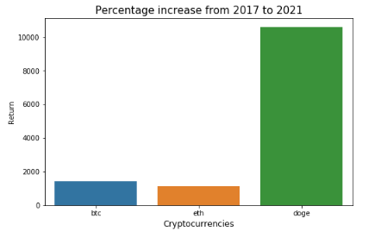
Depicting percentage increase in 2017-2021

Slide 35
4) How volatile is Bitcoin compared to gold? Does investing in volatile cryptocurrency really good investment?
The question that we are going to answer here is "How volatile is Bitcoin compared to gold? And which one of them is a better investment?". Since both are assets that people regularly invest in, we thought it would be interesting to perform an analysis and see which one has more returns and less risks or vice versa.
Based on the time-frame we selected the annual return of gold is 9.5% while that of bitcoin is 66.8%. While bitcoin has a higher return, it has more risks which can be visualized through volatility, which represents the degree of variability in returns of our assets.

Slide 36
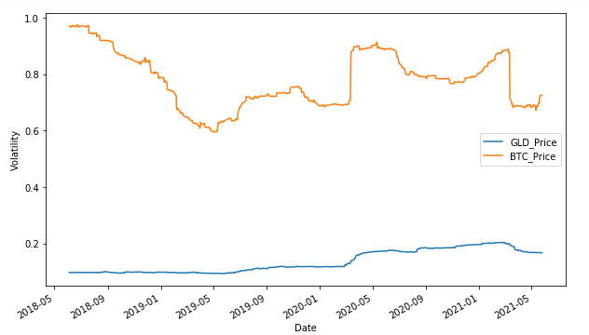
The formula for volatility is
return = logarithm(current closing price / previous closing price) volatility = standard deviation(sum(return)) * Square root(trading days)

Slide 37
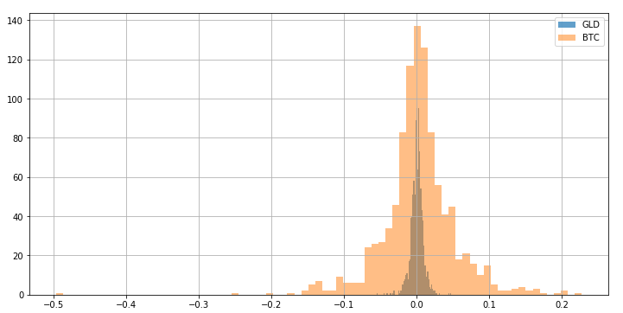
The daily returns of gold and bitcoin can be calculated by dividing the price today by the price yesterday. However, we will be using log returns. This article [https://quantivity.wordpress.com/2011/02/21/why-log-returns/] explains why log returns are better than average returns.

Slide 38
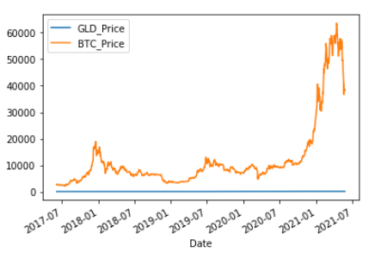
Compared to Bitcoin, gold prices are a flat line! Are gold price returns really that far from bitcoin? Gold is steady compared to bitcoin because gold is an $11 trillion dollar regularized market while cryptocurrency market is only 600 billion dollars that relies heavily on technology and 'word-of-mouth'. Let's explore this further with volatility.

Slide 39
Conclusion
We found out that cryptocurrencies are trend creators and trend followers their prices are highly influenced by trends on social media and competition amongst major companies. The crash of Wall Street in 2009 pushed BTC.
(BTC, ETH) and (ETH,DOGE) were highly correlated as per the data. This means, when BTC closing price increased, ETH prices followed. Similarly is it safe to say that when prices of ETH increased DOGE followed.
We can see that DOGE was the most profitable for the month of Apr'21. Other two currencies also returned high amount during the same period. All three cryptocurrencies fluctuated a lot but all gained if compared to year 2017.
Compared to Bitcoin, gold prices are a flat line! Are gold price returns really that far from bitcoin? Gold is steady compared to bitcoin because gold is an $11 trillion dollar regularized market while cryptocurrency market is only 600 billion dollars that relies heavily on technology and 'word-of-mouth'. it is clear now that while gold has smaller returns , it does not have high risks like bitcoin whose volatility.

Slide 40
Conclusion (Contd.)
Compared to Bitcoin, gold prices are a flat line! Are gold price returns really that far from bitcoin? Gold is steady compared to bitcoin because gold is an $11 trillion dollar regularized market while cryptocurrency market is only 600 billion dollars that relies heavily on technology and 'word-of-mouth'. it is clear now that while gold has smaller returns , it does not have high risks like bitcoin whose volatility.

Slide 41
Recommendation
Our suggestion for crypto enthusiasts is that instead of reading a few positive or negative articles or tweets about crypto-world, they should for resources that elaborates trends not just stating them. From our thorough analysis we found the following:
For long term investing in cryptocurrencies is a safe bet but not for short term, gold on the other hand is a safer investment for both short and long term than bitcoin because gold's volatility is more or less a straight line meaning it is a steady market which includes fewer risks and fewer jumps.
The price of bitcoin is largely derived by trends, so you are at more risk of losing your investment for short term investment and that is evident by the high volatility.

Slide 42
References and Resources
https://www.nyse.com/market-data/historical
https://www.nasdaq.com/market-activity/quotes/historical
https://finance.yahoo.com/quote/%5EGSPC/history?period1=1221404400&period2=1230649200&interval=1d&filter=history&frequency=1d
https://opendata.stackexchange.com/questions/11955/total-cryptocurrency-market-cap-over-time
https://www.blockchain.com/charts/market-cap
https://cbeci.org/
https://allstarcharts.com/u-s-stock-market-bottomed-2008-march-2009/

Slide 43
References and Resources
Formula for Volatility was taken from [http://techflare.blog/how-to-calculate-historical-volatility-and-sharpe-ratio-in-python/ ]
https://www.investopedia.com/articles/technical/02/010702.asp
https://quantivity.wordpress.com/2011/02/21/why-log-returns/
https://economictimes.indiatimes.com/markets/stocks/news/5-reasons-why-bitcoin-cryptocurrency-prices-are-on-the-rise/articleshow/80764149.cms?from=mdr

Slide 44
Thank You

