Slide 1

Atal Bihari Vajpayee- Indian Institute of Information Technology and Management Gwalior
NLP Lab : 03
Heap’s Law & Regular Expression
Instructor – Dr. Sunil Kumar
Assistant Professor @ Dept. of Information Technology, ABV-IIITM Gwalior
Teaching Assistants (TAs)
Meher (PhD Scholar) | Sheel Patel & Radhika [M.Tech IT] | Group-01
Shalmon Titre (MTech) | Lokesh Jain (MTech) | Group-02

Slide 2
Objectives
To understand the use of regular expressions for pattern matching in textual data.
To extract specific linguistic patterns such as capitalized words, punctuation marks, quoted text, and repeated words using regular expressions.
To identify sentence-level and word-level patterns in a given corpus.
To analyze vocabulary growth by computing the number of tokens and unique word types in a corpus.
To verify Heap’s Law by studying the relationship between vocabulary size and corpus size.
To plot and compare actual vocabulary growth with the predicted Heap’s Law curve.

Slide 3
Assignment 1
Question 1 :-
One fine morning, Tom! Tom! was walking along the Riverside, thinking about everything and nothing. Suddenly, he shouted: "What are you doing here?" The boy, smiling, kept running, running, and laughing! Sarah asked politely, "Could you please explain?" but no one responded. Meanwhile, a Flying bird was singing near the School. The teacher said, "Morning is always the best time for Reading and Writing." Children were playing, dancing, and enjoying the sunshine. "Really?" asked John. The girl looked back, wondering, "Why, why would anyone do that?" After all, caring, sharing, and loving bring meaning to life. Books, music, and games—these things matter!
Aim: To study and implement regular expressions.
Use a regular expression to extract all words that begin with an uppercase letter in the corpus.
Write a regular expression to find all punctuation marks in the text (e.g., . , " : ? !).
Use a regular expression to extract sentences that end with a ?.
Extract all words that end with ing (e.g., "punching").

Slide 4
Use a regular expression to find all words that are exactly 5 characters long.
Write a regular expression to find all text enclosed in double quotes (`"...").
Find all words that are immediately followed by a punctuation mark (e.g., boy,, heart,).
Use a regular expression to extract all sentences where the word "Morning" appears (case-sensitive).
Write a regular expression to locate instances where the same word appears twice in a row (e.g., "Tom! Tom!").
Write a regular expression that matches words in the corpus, ignoring their case and punctuation, to create a set of unique words.
Using regular expressions, remove all the function words
Perform the following tokenization using regex:
            a. Tokenize at uni-gram
            b. Tokenize at bi-gram
            c. Tokenize at tri-gram
            d. Tokenize at sentence level

Slide 5
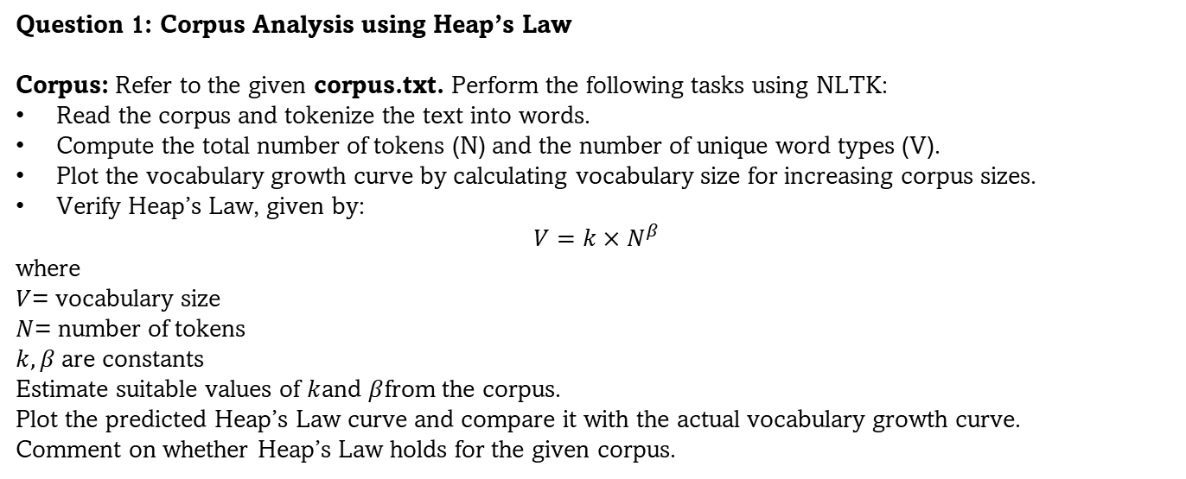
Assignment-2
Question 1: Corpus Analysis using Heap’s Law
Corpus: Refer to the given corpus.txt. Perform the following tasks using NLTK:
Read the corpus and tokenize the text into words.
Compute the total number of tokens (N) and the number of unique word types (V).
Plot the vocabulary growth curve by calculating vocabulary size for increasing corpus sizes.
Verify Heap’s Law, given by:
$$V=k×N^{β}$$
where
$V$= vocabulary size
$N$= number of tokens
$k,β$are constants
Estimate suitable values of $k$and $β$from the corpus.
Plot the predicted Heap’s Law curve and compare it with the actual vocabulary growth curve.
Comment on whether Heap’s Law holds for the given corpus.

Slide 6
Thank you !

