Slide 1

Atal Bihari Vajpayee- Indian Institute of Information Technology and Management Gwalior
NLP Lab : 04
Introduction to Finite State Automata for Morphological Parsing
( openfst-python library )
Instructor – Dr. Sunil Kumar
Assistant Professor @ Dept. of Information Technology, ABV-IIITM Gwalior
Teaching Assistants (TAs)
Meher (PhD Scholar) | Sheel Patel & Radhika [M.Tech IT] | Group-01
Shalmon Titre (MTech) | Lokesh Jain (MTech) | Group-02

Slide 2
Objectives
The objective of this lab is to understand how Finite State Automata (FSA) can be used for morphological parsing, i.e., analyzing words into their smallest meaningful units such as roots, prefixes, and suffixes.

Slide 3
Introduction to Morphology
Morphology is the branch of linguistics that studies the internal structure of words.
Basic Terms
Morpheme: Smallest meaningful unit of a word
  Example: unhappiness → un + happy + ness
Root/Stem: Core part of a word
Prefix: Added before the root (un-, re-)
Suffix: Added after the root (-ed, -ing, -s)
What is Morphological Parsing?
Morphological parsing is the process of:
Breaking a word into morphemes
Identifying grammatical features such as tense, number, gender, or case

Slide 4
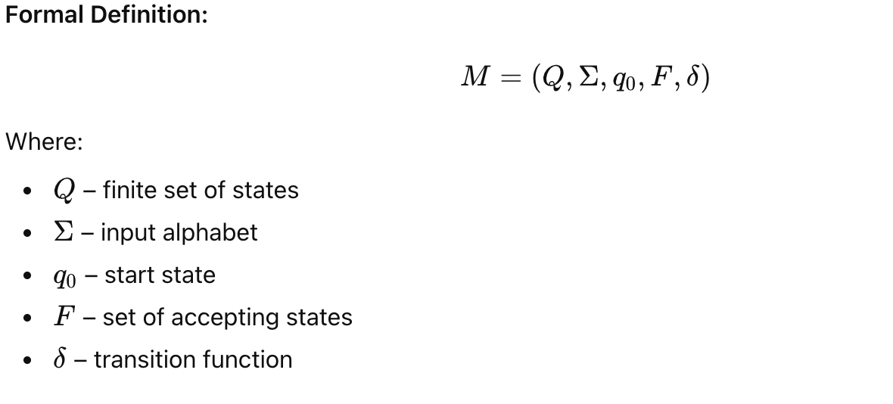
Finite State Automata (FSA)
A Finite State Automaton is a formal model used to recognize strings belonging to a regular language.

Slide 5
Deterministic vs Non-Deterministic FSA
Deterministic FSA (DFA): One transition per input symbol
Non-Deterministic FSA (NFA):
Multiple transitions for same input
ε (epsilon) transitions allowed

Slide 6
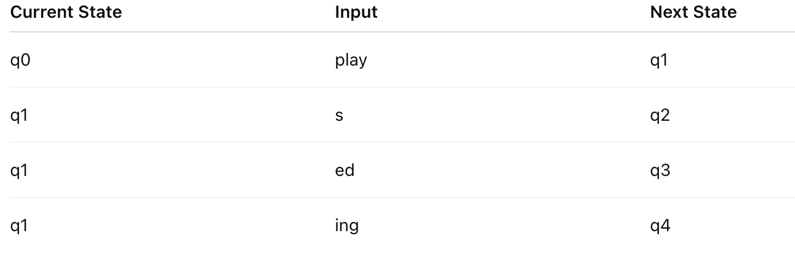
Example: Simple English Verb FSA
Words Covered
play
plays
played
playing
States Explanation
q0 – start
q1 – after root
q2 – plural/3rd person (s)
q3 – past tense (ed)
q4 – continuous (ing)
State Transition Table

Slide 7
Assignment- 1
Using openfst-python library, implement the following:
Q1. Write a program using Finite State Automata (FSA) to recognize singular and plural noun forms such as: cat, cats, dog, dogs, fox, foxes
Q2. Implement an FSA-based program to recognize verb inflections: walk, walks, walking, walked
Q3. Extend the verb FSA program to also accept: jump, jumps, jumping, jumped
Q4. Using the implemented FSA, check whether the following words are ACCEPTED or REJECTED: cats, foxes, foxs, walking, walkes
Q5. Write a program that outputs the stem and suffix for every accepted word.

Slide 8
Assignment- 1
Using openfst-python library, implement the following:
Q6.Create a program that takes a word as user input and validates whether it is a morphologically valid noun or verb using FSA logic.
Q7.Write a single program that combines noun and verb FSA and classifies the input word accordingly.
Q8.Display the results of morphological parsing in the format:
word → stem + suffix
Q9.Modify the program to handle multiple input words and print the result for each.
Q10.Write an FSA-based program to reject invalid morphological forms such as:foxs, walkes, jumpings

Slide 9
Thank you !

