Slide 1

Atal Bihari Vajpayee- Indian Institute of Information Technology and Management Gwalior
NLP Lab : 05
Edit distance
Instructor – Dr. Sunil Kumar
Assistant Professor @ Dept. of Information Technology, ABV-IIITM Gwalior
Teaching Assistants (TAs)
Meher (PhD Scholar) | Sheel Patel & Radhika [M.Tech IT] | Group-01
Shalmon Titre (MTech) | Lokesh Jain (MTech) | Group-02

Slide 2
Objectives
After this lab, students will be able to:
Understand the concept of Edit Distance
Compute minimum edit distance between two strings
Identify the sequence of edit operations used
Customize edit operation costs

Slide 3
What is Edit Distance?
Edit Distance measures how dissimilar two words are
It is defined as the minimum cost required to convert one word into another
Conversion is done using a set of edit operations
Widely used in:
Spell checking
Speech recognition
Machine translation
Information retrieval

Slide 4
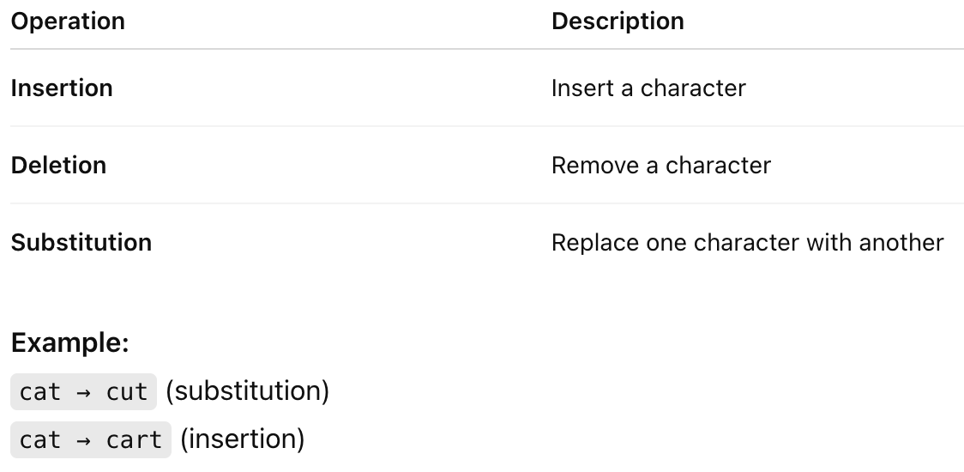
Edit Operations
The basic edit operations are:

Slide 5
Why Edit Distance is Important in NLP
Natural language contains errors and variations
Edit Distance helps in:
Correcting spelling mistakes
  Matching similar words
  Measuring string similarity
Provides a numerical similarity score

Slide 6
How Edit Distance is Computed
Computed using Dynamic Programming
A 2D matrix (DP table) is constructed
Each cell represents the minimum cost to convert:
Prefix of word1 → prefix of word2
Final edit distance is found in the last cell of the matrix

Slide 7
Example – Edit Distance Computation
Input Words : word1 = "cat", word2 = "cut"
Allowed operations:
Insertion
Deletion
Substitution
(All with cost = 1)

Slide 8
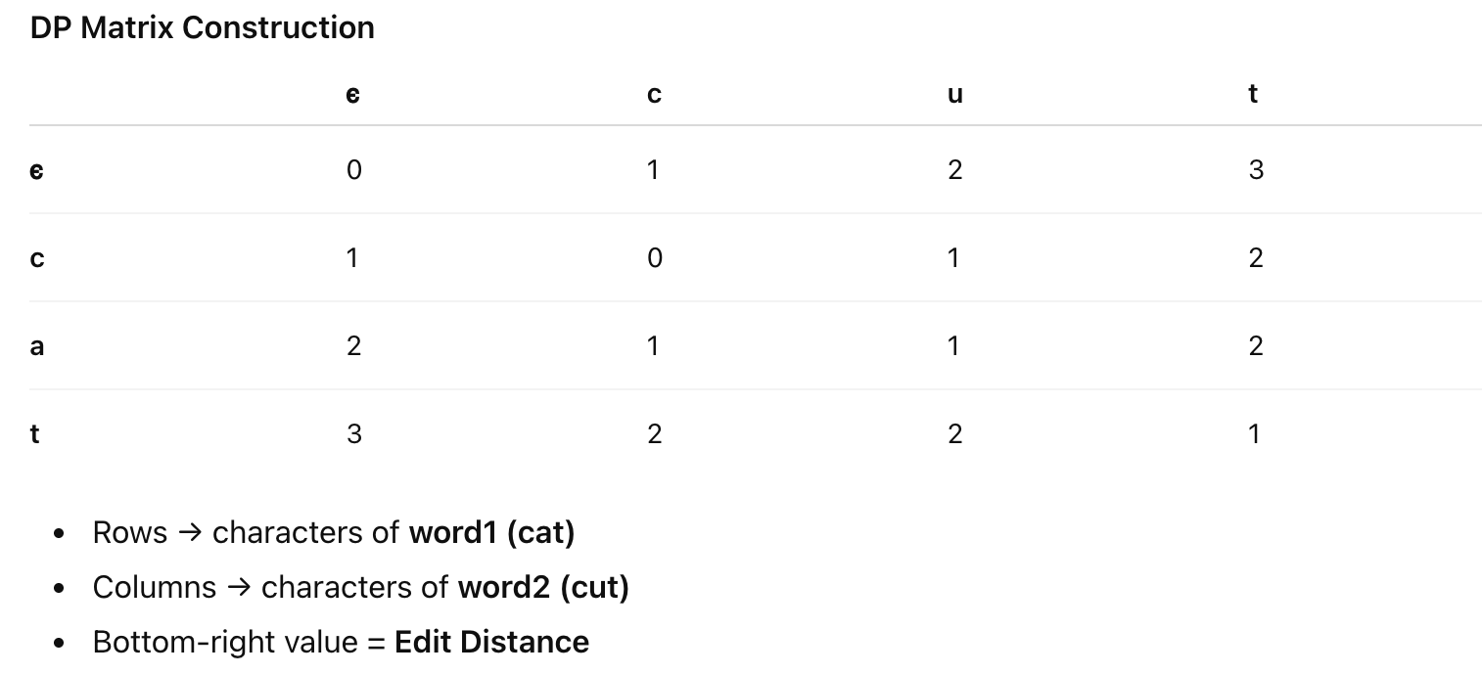
Example – Edit Distance Computation

Slide 9
Assignment 1
Question 1 :- Given two input strings, compute the minimum number of edit operations (Insertion, Deletion, Substitution) required to convert the first word into the second word.
Instructions
Use Dynamic Programming
Assume equal cost (1) for all operations
Display the final edit distance
Sample Input
word1 = "intention"
word2 = "execution"

Slide 10
Assignment 2
Question 2 :- For two given words, compute the edit distance and display the actual edit operations used to transform word1 into word2.
Instructions
Compute the DP matrix
Trace back from the last cell to the first
Print the operations in order:
Insert, Delete, Substitute
Sample Input
word1 = "plane"
word2 = "plans"

Slide 11
Assignment 3
Question 3 :- Modify the edit distance algorithm to support different costs for edit operations.
Given Costs (Example)
Insertion = 1, Deletion = 1, Substitution = 2
Instructions
Update the DP recurrence with given costs
Compute the final edit distance
Compare the result with uniform-cost edit distance
Sample Input
word1 = "book"
word2 = "back"

Slide 12
Thank you !

