Slide 1
Technology Bucket: Healthcare & Biomedical Devices
Device Category: Software
Ministry: Ministry of Health and Family Welfare
Problem Code: SS45
Team Leader: Pratibha Shrivastava
College Code:
Abstract/Idea/Solution:
A safe and efficient way to store medical records by using a decentralised datastore instead of a centralised database which is prone to data breach.
Blockchain facilitates data storage in transparent yet secure fashion enhancing patient’s privacy and data security.
With this data storage we can make use of patient’s data not only during emergencies but also during routine checkups for better medical analysis.
On top of our blockchain infrastructure we aim to provide web and cross-platform mobile application to manage transactions between hospital,doctor and the patient -
      Remote appointment booking
      Digital prescription
      Timely medical check up notifications
      Patient’s identification using Aadhar in case of emergency

Slide 2
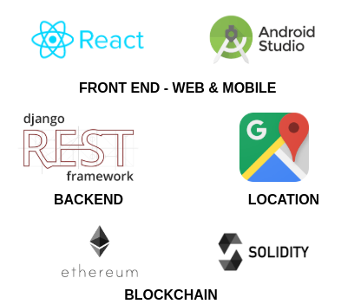
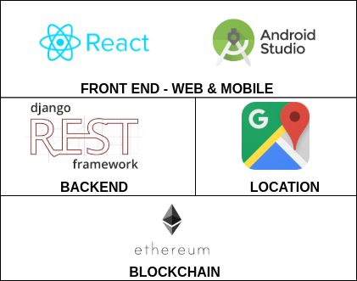
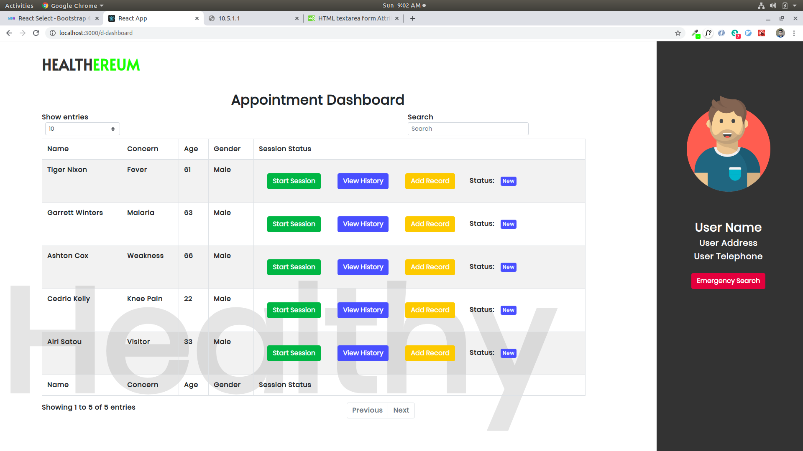
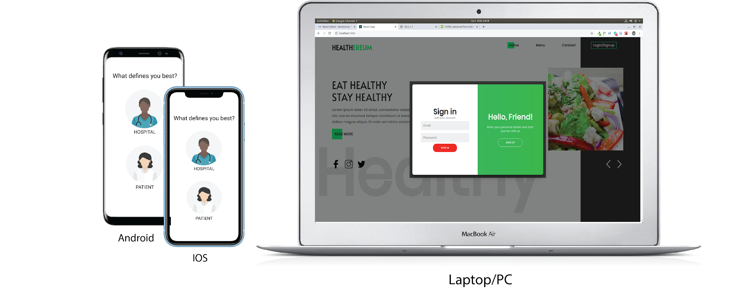
Tech Stack-
React.js for web front-end.
React-Native for mobile (Android & iOS) front-end.
Django Rest-framework for REST APIs (Backend).
Google Maps for nearby Hospital Lookups.
Ethereum and Solidity for blockchain transactions.

Slide 3
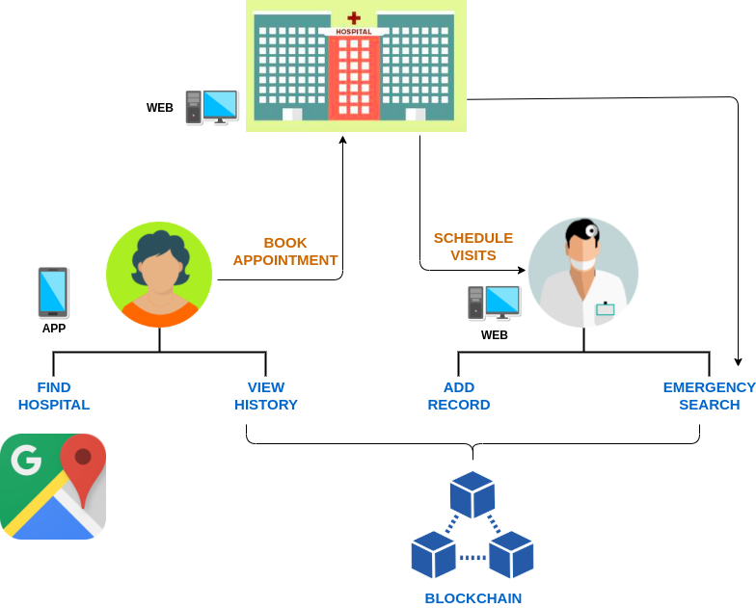
Use Cases -
Expected users are-
Hospitals – Regulate the appointments between patient and doctor.
Doctors – Efficiently diagonise patients with the help of EHR.
Patients - Easily scroll through hospitals and select the one best suited to him/her and keep track of his/her EHR.
Show Stopper -
A decentralised blockchain infrastructure facilitating simple yet secure medical transactions between the users with an easy to use GUI.

