Slide 1
Git – Fast Version Control
INT-GIT-22
Daniel Summerer
27.04.2022

Slide 2

About Me
Joined Eurac Research in February 2020
Solution Architect at Information Technologies
Technologies:
Dynamics 365, Power Platform

Slide 3
About you

Slide 4
Objectives
Understand the basics of Git
Get familiar with the Git command line
Learn about branching and merging
Resolve merge conflicts
Set up projects on GitHub or GitLab
Collaborate on and maintain projects using GitHub or GitLab

Slide 5
Agenda
09:00 – 09:45 Introduction to Git
09:45 – 10:00 Break
10:00 – 11:00 Working with Git
11:00 – 12:30 Remote Repositories and GitLab
12:30 – 13:30 Lunch Break
13:30 – 15:00 Branching and Merging
15:00 – 15:15 Break
15:15 – 16:00 Hands-On Exercises
16:00 – 17:00 Advanced Features + Q&A

Slide 6
Version Control

Slide 7
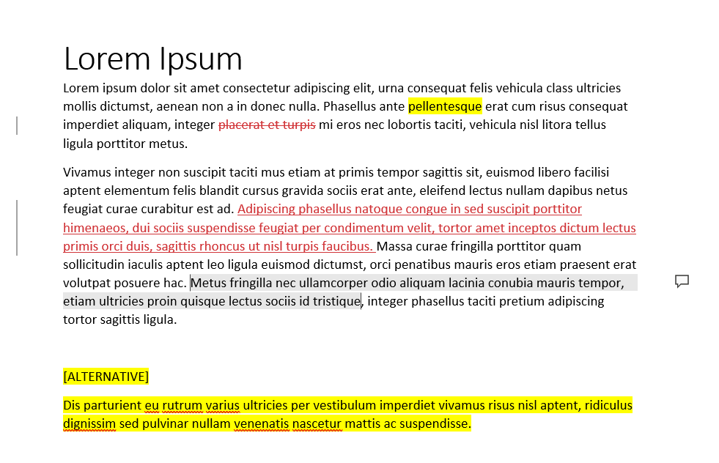
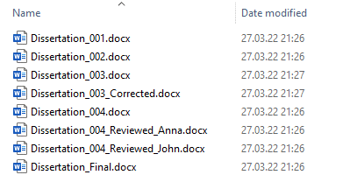
Basic Version Control

Slide 8
Basic Version Control
These approaches have some flaws:
Changes are not visible
Tracking changes is not possible
Different versions cannot be compared
Restoring previous versions is not possible
Collaboration is difficult

Slide 9
Definition
Version control is a set of systems responsible for managing changes to computer programs, documents and files in general.
Version control is a part of software configuration management (SCM).

Slide 10
Benefits
Backup
View change history of a file
Work in parallel on the same files, avoiding conflicts
Review and merge changes made by different people
View and restore previous versions
Distributed work

Slide 11
Use Cases
Papers, dissertations, publications
Data analysis, statistics
Software development
Task automation
Issue tracking
Basic project management

Slide 12
Version Control vs. Versioning
Version Control
Track changes to files
Enables collaboration and avoids conflicts
Software development
Versioning
Track stages of a software program or project
Identify different versions of a program
Software release and distribution

Slide 13
Git Overview

Slide 14

What is Git
Git is a version control system
Free and open source
Distributed
Multi-platform

Slide 15
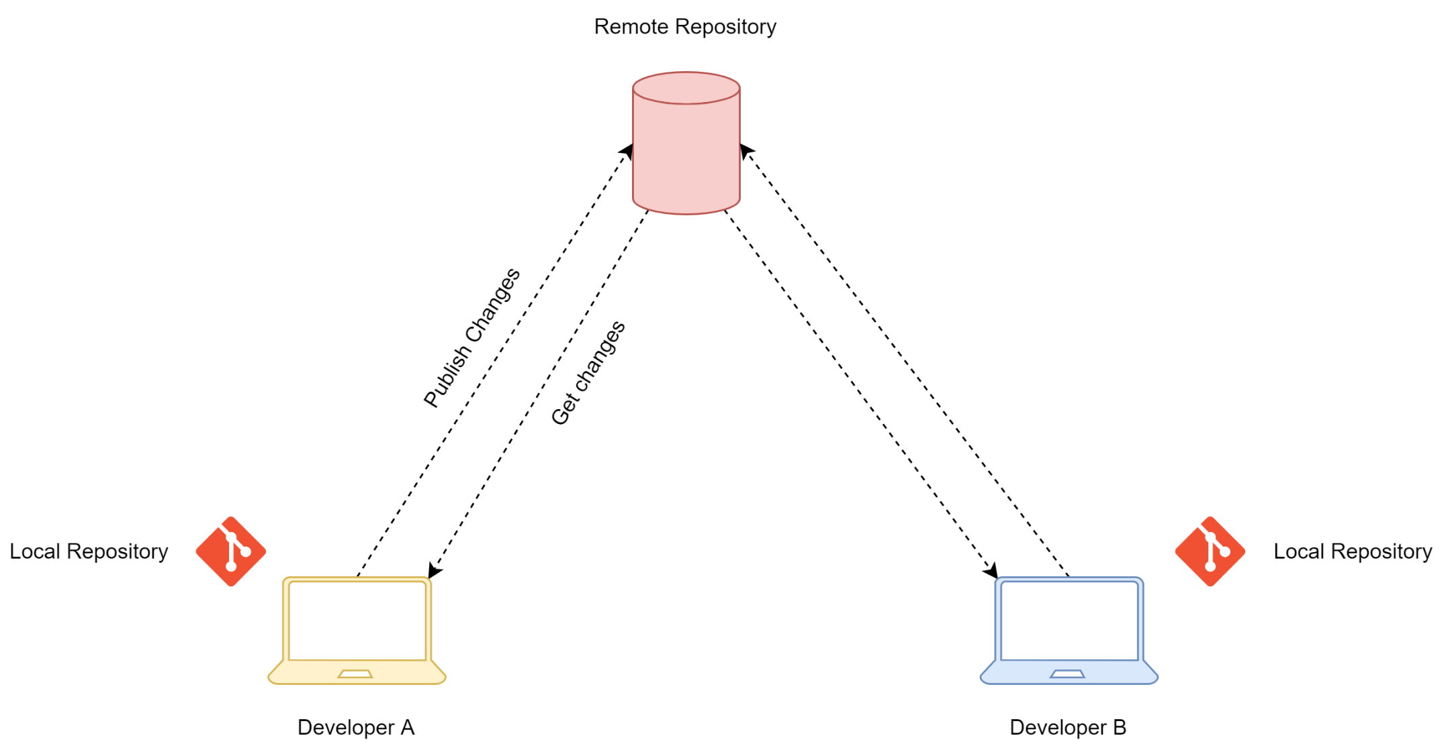
Basic Architecture

Slide 16
Basic Architecture
Repository
Basic element, used to manage projects with Git
Local Repository
Folder on the local PC, used to work on the files
Remote Repository
Repository on a file server, shared with all contributors

Slide 17
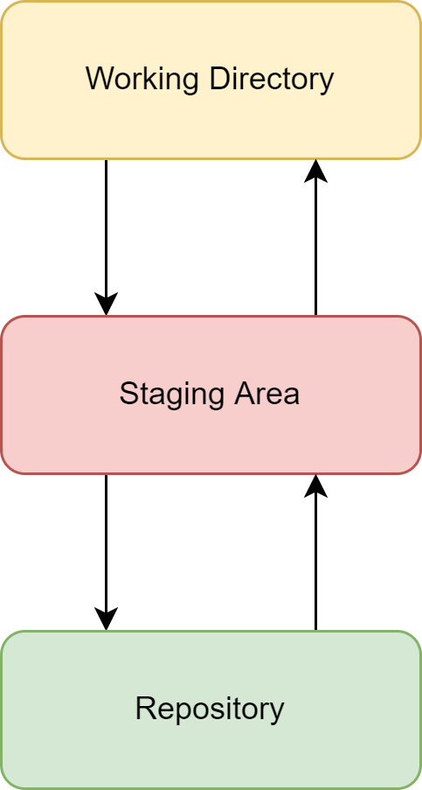
Basic Architecture
A local repository consists of 3 main components
Working Directory
Staging Area
Repository

Slide 18
Working Directory
Folder on the local computer.
Specific structure
Recognized by Git as part of a repository
Files managed in the working directory are read and tracked by Git

Slide 19
File Tracking
Files in a local Git repository folder can be in 2 states:
Tracked Changes to these files are tracked by Git
Untracked Files are present in the repository, but changes to these files are not tracked by Git
New files are always untracked. They need to be added to the staging area, to track them.

Slide 20
Staging Area
Intermediate step before a commit.
Use cases:
Validation
Review
Correction
Partial Commits

Slide 21
Commit
Snapshot of the changes staged in the staging area.
Unique number (called commit hash)
Message
Saved to commit history
Repository can be viewed at and restored to a commit
Git does not store a copy of the file, but only the changes applied to the file.

Slide 22
Supported file types
Git supports any type of file.
However, you get the best experience with text files, because they allow for change tracking.
Examples of text files: plaintext, HTML, LaTex, source code.

Slide 23


Competitors
Mercurial
Distributed model
Fewer commands
Subversion
Centralized model
Low adoption rate

Slide 24
Let’s get started!

Slide 25
Installation
Download Git from the following website and install it on your machine
https://git-scm.com/downloads

Slide 26
Git CLI
Git is a command-line tool.
You can use any CLI you like. For this workshop, we are going to use:
Windows: Git Bash
Mac OS: Terminal
Linux: Terminal

Slide 27
Command Line Interface

Slide 28
Basic Commands
ls
List items in the current folder
Options
-a: Show all elements
-l: Show elements with details
-t: Order elements by modified time
Example
$ | ls
$ | ls –al

Slide 29
Basic Commands
cd
Change directory to the specified path
Path shortcuts:
. → Current folder
.. → Upper folder
~ → Home folder
/ → Root folder
Example
$ | cd Documents
$ | cd ..

Slide 30
Working with Git

Slide 31
Git Version
First, let’s check if Git is properly installed
$ | git --version
> | git version 2.35.1.windows.2

Slide 32
Basic Configuration
After the installation, it is necessary to configure the following information:
Name
Email address
This information is added to every commit to identify the user who created the commit.
$ | git config --global user.name "Summerer Daniel"
$ | git config --global user.email "daniel.summerer@eurac.edu"

Slide 33
Create your first repository
Now, we are ready to create our first repository.
Create a folder on your desktop and call it MyRepository.
Open the CLI and navigate to this folder
Run the following command to initialize the MyRepository folder as a Git repository
$ | git init
> | Initialized empty Git repository in C:/Users/dasummerer/Desktop/MyRepository/.git/

Slide 34
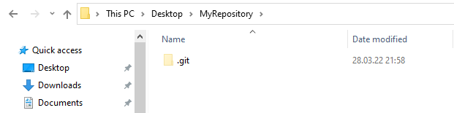
Repository Structure
The MyRepository folder contains a hidden folder called .git.
This folder is used by Git to store information about your repository, such as the commit history, file changes, etc.

Slide 35
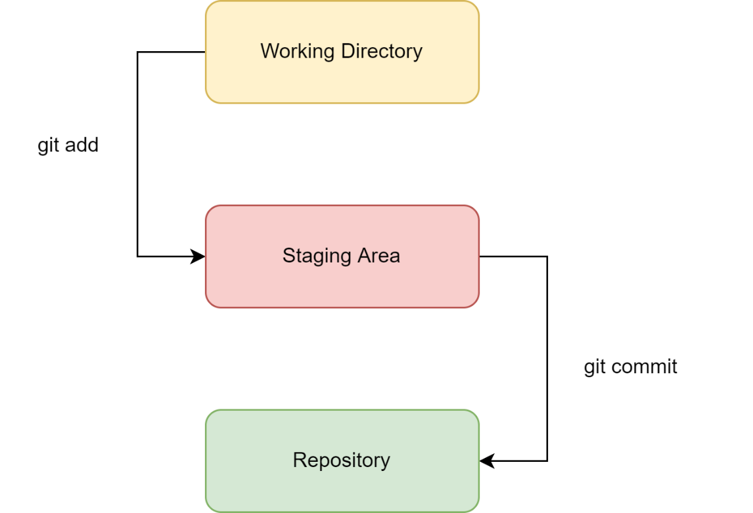
Basic Workflow
Create a repository, by initializing it locally or cloning it from a Git server.
Every time you add, edit or delete files in your repository, Git considers them modified.
Select the modified files to add to the staging area.
Commit your staged files, thereby creating a permanent snapshot of the files.

Slide 36
Basic Workflow
git status
Informs you about the status of the repository:
Untracked files
Changed files
Change types
Staged files
Unpublished commits
$ | git status

Slide 37
Basic Workflow
git add
Adds a file or change to the staging area.
This also enables tracking for untracked files.
Example
$ | git add <file>
$ | git add File01.txt

Slide 38
Basic Workflow
git add
To add all files in the current directory, use the --all option
Or specify the current directory as a path
$ | git add --all
$ | git add .

Slide 39
Basic Workflow
git commit
Creates a commit for all staged files
This opens a text editor, where you need to specify the commit message.
Add the -m option to specify the commit message directly in the commit statement
$ | git commit
$ | git commit –m "My message"

Slide 40
Basic Workflow
git log
Shows the commit history, including
Commit hash
Message
Author
Date
$ | git log

Slide 41
Hands-On
Create a text file in the MyRepository folder
Stage it and commit it
Apply changes to the file
Use git status to see what has changed
Stage and commit your changes
Use git log to see the commit history

Slide 42
Analyzing Differences

Slide 43
Differences
Git stores the changes associated to every commit. You can use this information to see what has changed between two commits.
A change is also called a difference.

Slide 44
Command
git diff
Difference between working directory and last commit
Difference between working directory and a specific commit
Difference between two commits
$ | git diff
$ | git diff <hash>
$ | git diff <hash-A> <hash-B>

Slide 45
Analyzing the Output
Git diff produces an output that shows:
Lines that were added
Lines that were deleted
Modified lines are shown as a combination of insertion and deletion.
The output is truncated only to the lines that changed.

Slide 46
Hands-On
Apply changes to the text file in your repository
Analyze changes in the working directory
Analyze changes between two commits

Slide 47
Revert Commits

Slide 48
Motivation
After analyzing the differences, you may decide to undo your changes. This is done by reverting a commit.
To revert a commit, Git applies your changes “backwards” and creates a new commit.

Slide 49
Revert
git revert
Revert the changes of last commit
Revert the changes of a specific commit
Revert changes of N-th last commit (numbers start at 0)
$ | git revert HEAD
$ | git revert <commit-hash>
$ | git revert HEAD~<N>

Slide 50
Hands-On
Change the file, and commit your changes
Revert the changes applied in your last commit

Slide 51
Remote Repositories

Slide 52
Recap
So far, we have been working on a local repository.
To enable collaboration, we need a remote repository, accessible by all project contributors.
The remote repository will keep the common code base.
Every contributor works on their local repository.
Local changes are pushed to the remote repository.

Slide 53
Distributed Model
Git is a distributed version control system
Single remote repository
Multiple local repositories
Every local repository is a copy of the remote repository
Advantages with respect to centralized model:
Independent development
Flexible workflows
No single point of failure

Slide 54



Remote Repository
A remote repository can be created on any server that runs git.
It is recommended to use DevOps platforms.

Slide 55
Remote
A remote is a connection to a remote repository.
Your local repository needs a remote to know where to publish your local changes.

Slide 56
Specifying Remotes
Cloning (Recommended)
Remote repository created before the local repository
Remote is set by cloning the repository
Manual Setting
Local repository created before remote one
Remote is set by adding a reference through a command

Slide 57
Work with Remote Repository
git clone
Initializes a local repository as a clone of the remote repository.
Depending on the authentication type enabled/configured on the remote server, you can clone it via HTTPS or via SSH.
Via SSH (Recommended)
Via HTTPS
$ | git clone git@gitlab.inf.unibz.it:daniel.summerer/my-repository.git
$ | git clone https://gitlab.inf.unibz.it/daniel.summerer/my-repository.git

Slide 58
Work with Remote Repository
git push
Pushes your local commits to the remote repository
You can set the local branch to automatically track a remote branch, by executing
The next time, you can push by simply writing
$ | git push origin <remote-branch>
$ | git push --set-upstream origin <branch>
$ | git push

Slide 59
Work with Remote Repository
git pull
Retrieves the latest changes from the remote repository
$ | git pull

Slide 60
GitLab

Slide 61
Introduction to GitLab
Local GitLab server:
https://gitlab.inf.unibz.it/
Login selecting “ScientificNet”. Your account will be automatically unlocked after 5 minutes.

Slide 62
GitLab Basics
Repositories are called projects.
Groups are collections of projects. Projects can be created under the personal profile or in a group.
The visibility level determines who can view the repository
Private → Access must be granted explicitly
Internal → Any user with access to the server
Public → Accessible from the outside

Slide 63
GitLab Basics
A person working on a GitLab project is called project member or contributor.
Contributors have different roles (permissions) in the project:
Maintainer
Developer
Reporter
Guest

Slide 64
Set Up SSH
Before we can start using our local GitLab instance, SSH must be configured:
Generate SSH Key (Link)
Add SSH Key to the GitLab account (Link)
Verify your setting (Link)

Slide 65
Hands-On
Create a project on GitLab
Clone it to your local computer
Create a text file in your local repository
Commit your changes and push them to the remote repository

Slide 66
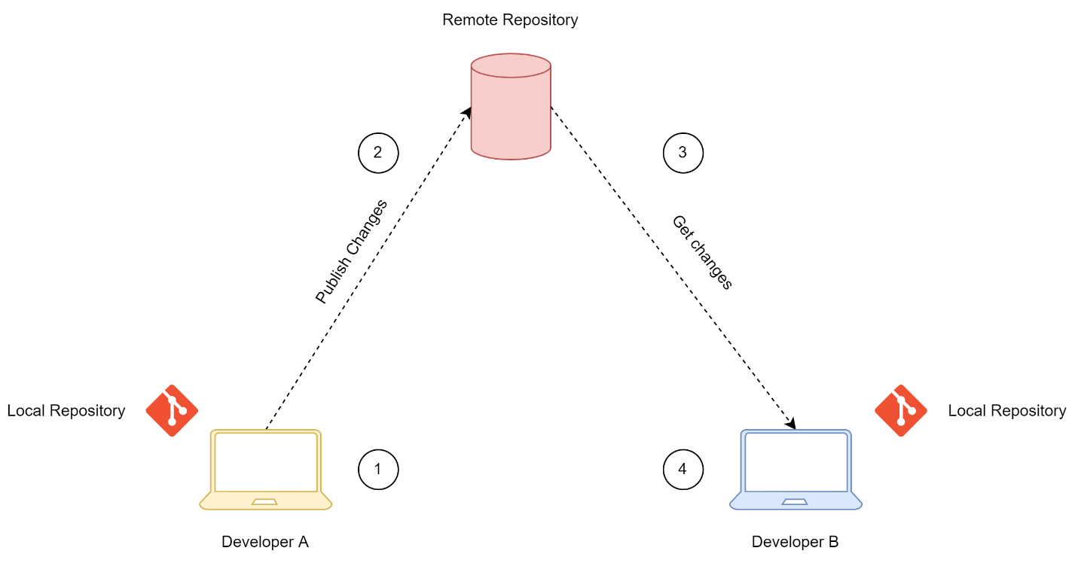
Enabling Collaboration
Multiple users can work on the same remote repository
Work on local repository
Push changes to remote repository
Other contributors pull changes from the remote repository

Slide 67
Enabling Collaboration
To collaborate on a project, contributors must have access to the remote repository
→ Permissions
Changes to the same file are possible, but could lead to conflicts
→ Merge Conflicts

Slide 68
Hands-On
Clone the sample repository
Person A changes a file and pushes their changes
Person B pulls changes
Person B changes another file and pushes their changes
Person A pulls changes
Person A and person B could also work on different files simultaneously.

Slide 69
Branching and Merging

Slide 70
Motivation
So far, every commit was sequential.
This could lead to problems
Work on different parts of the project simultaneously
Fix a bug while you are making changes
Testing
Different deployment environments

Slide 71
Branch
A branch is a separate version of the main repository.
Changes in one branch do not affect other branches
Commits are independent from those in other commits
Multiple branches are possible
Every repository has at least one branch: the master branch.

Slide 72
Master or Main?
Historically, the default branch in a repository was called master. However, this term is considered offensive and antiquated.
As of 2022, GitHub and GitLab call the default branch main.

Slide 73
Merge
When the work on one branch is completed, a branch can be merged into another branch.
This integrates the changes of one branch with the changes on the other branch
Merge ≠ Overwrite

Slide 74
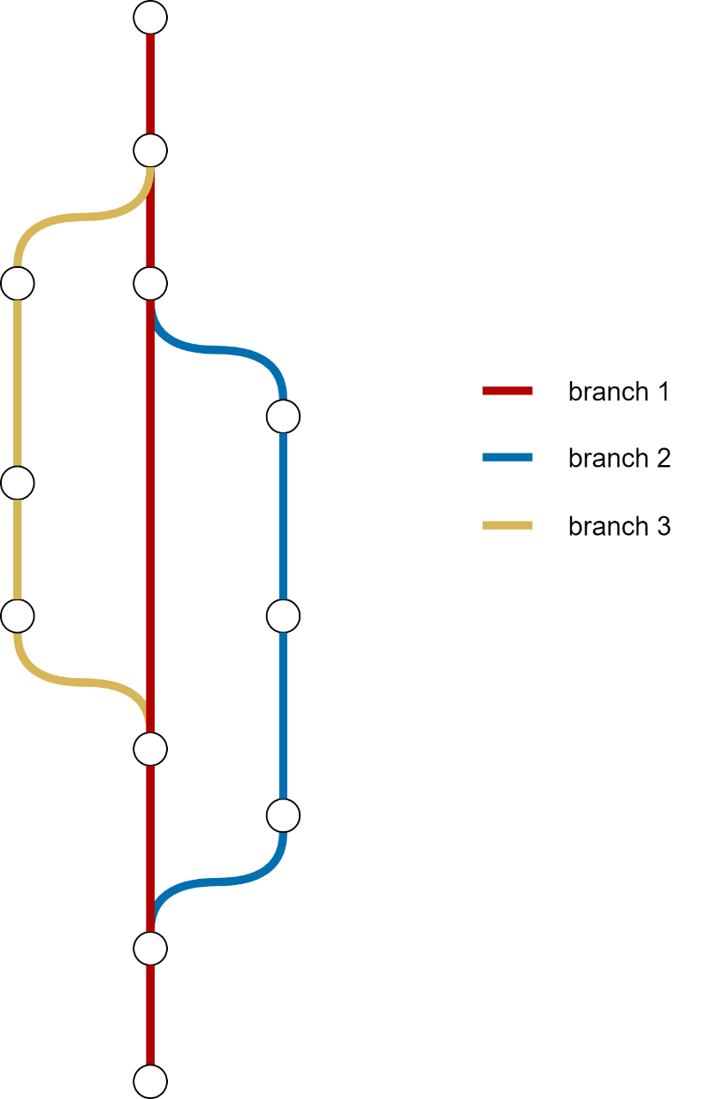
Representation
Commit history is represented using line diagrams
Lines → Branches
Nodes → Commits

Slide 75
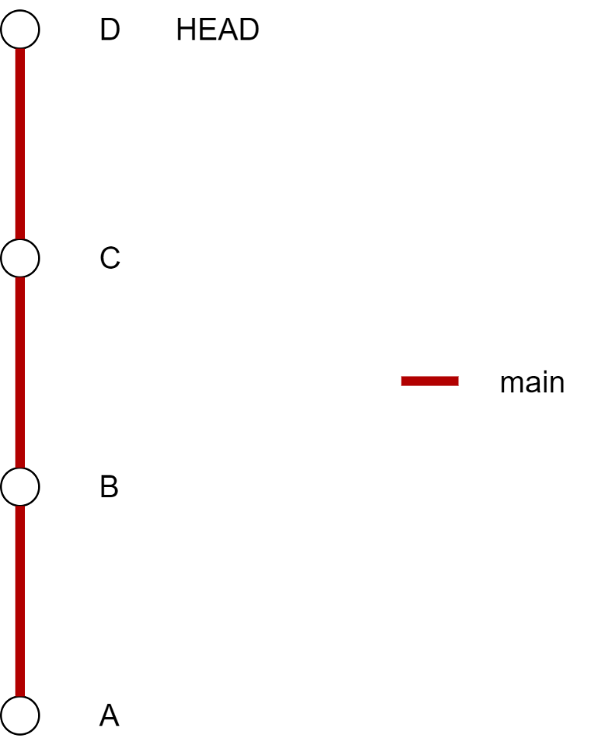
Examples
1 branch
Sequential commits
HEAD Reference to the last commit on the current branch

Slide 76
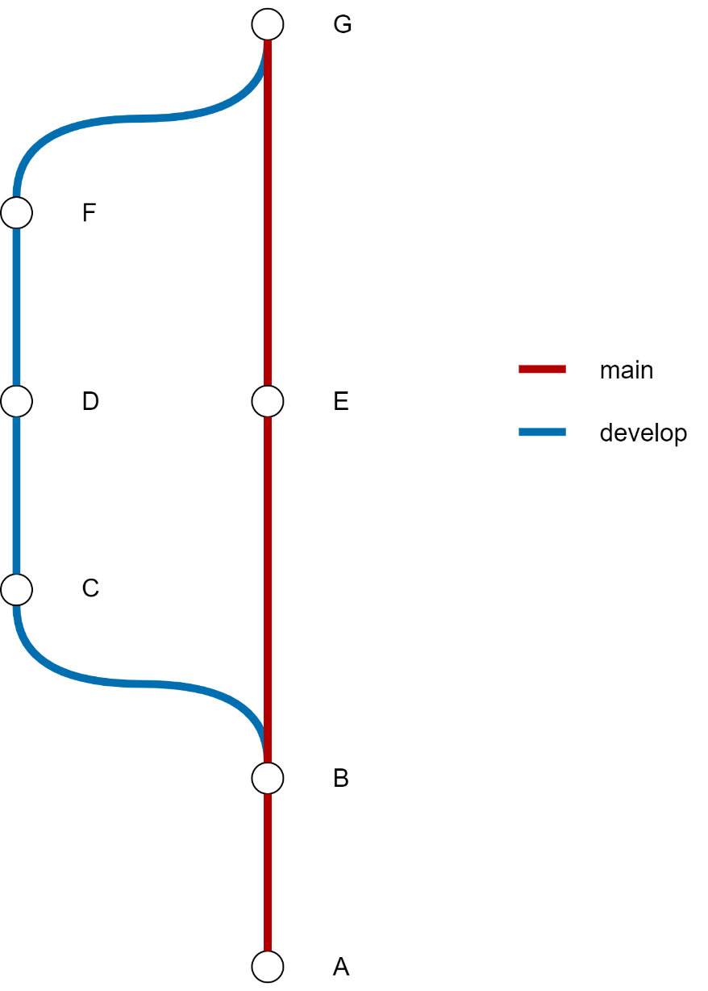
Examples
2 branches
Branch develop created from commit B
Branch develop merged into branch main with commit G

Slide 77
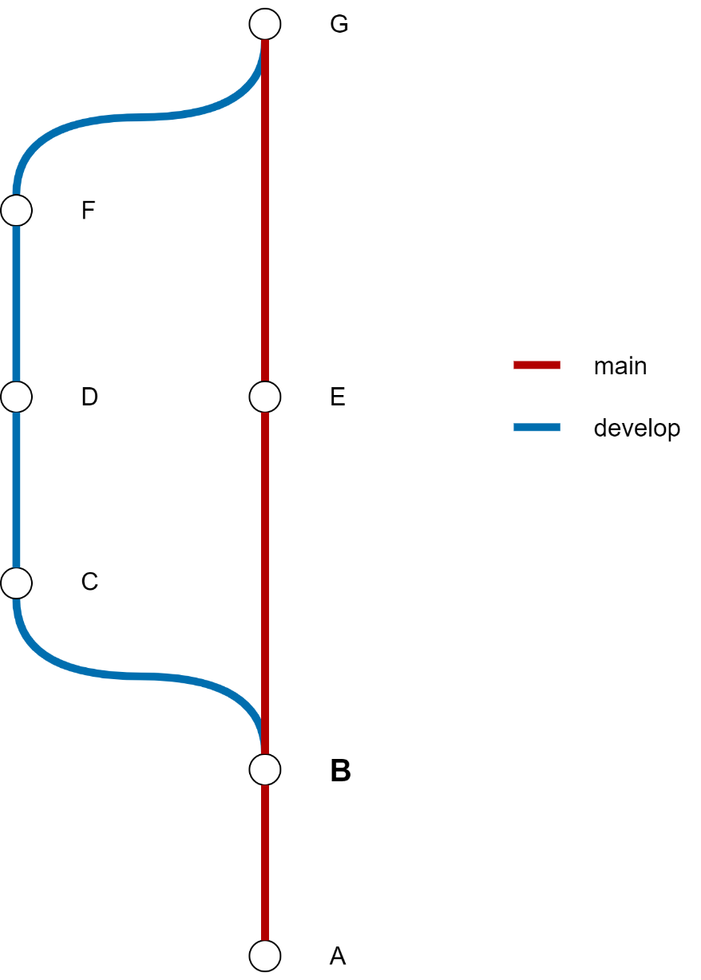
Creating Branches
A new branch is created from an existing branch.
The new branch “starts” from the last commit of this branch.
Example
Branch develop starts from commit B

Slide 78
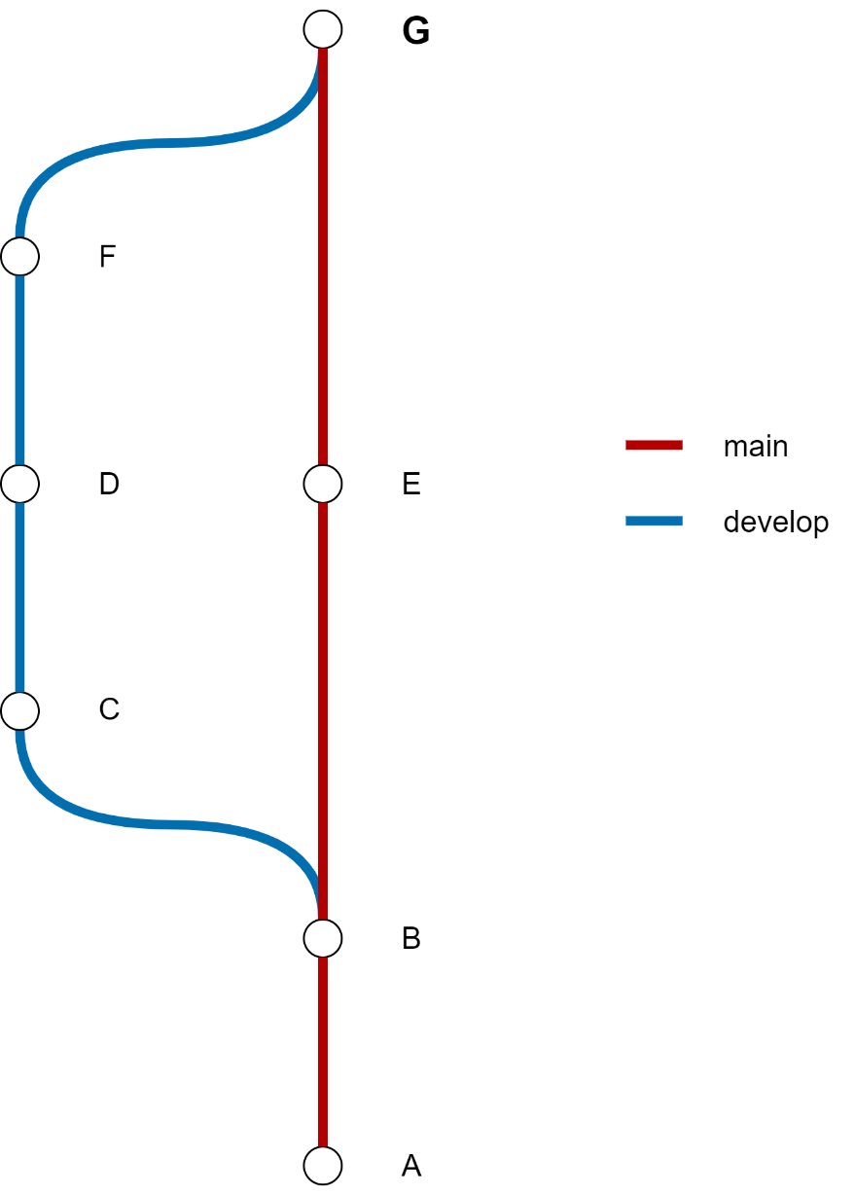
Merging Branches
Branches are merged with a merge commit.
This commit applies all changes from the source branch on the target branch.
Example
Branch develop is merged into branch main with commit G

Slide 79
Working with Branches
git branch
Creates a new branch, based on the last commit of the current branch
To start working on the new branch, you will have to move to the new branch.
$ | git branch <branch-name>

Slide 80
Working with Branches
git checkout
Move to a specified branch
To create a branch and immediately move to it, use the -b option
$ | git checkout <branch-name>
$ | git checkout –b <branch-name>

Slide 81
Working with Branches
git merge
Merge a branch into the current branch
To use the command effectively:
Move to the branch you want to merge the changes into (target branch)
Run the merge command
$ | git merge <branch-name>
$ | git checkout <target-branch>
$ | git merge <source-branch>

Slide 82
Hands-On
Create a second branch, called “develop”
Push the branch to the remote repository
Apply changes on the develop branch
Merge the develop branch back into the main branch

Slide 83
Merge Conflicts

Slide 84
Problem
Git’s merge algorithm is very powerful:
Changes from different files
Changes in different parts of a file
Renamed files
But what if 2 contributors changed the same part of the same file?
→ Merge Conflict

Slide 85
Merge Conflict
A merge conflict originates when Git is not able to automatically merge two branches.
Git augments the files that cannot be merged with text information. The contributor should resolve the conflict by their own.
This works for text files only.
Tip
Code editors provide tools to resolve merge conflicts

Slide 86
Merge Conflict
Conflict information is just plain text
Accept incoming change
Accept local change
Change the part completely
After all conflicts are resolved, stage and commit your changes
Git is a free, open-source, distributed version control system
Git is available on multiple platforms
<<<<<<< HEAD
Git is great!
=======
Git is a really great tool!
>>>>>>> develop
Change on current branch
Incoming change

Slide 87
Hands-On
Create a file on the main branch and add some lines of text
Commit and push your changes
Create a new branch “develop”, based on the main branch
Modify a line in the file on the develop branch
Modify the same line on the main branch
Merge the develop branch into the main branch
Solve the merge conflict

Slide 88
Advanced Topics

Slide 89
Organizing Branches
Branches can be named and organized at wish.
Yet, a consistent and clean structured branching system helps organize the project better.
→ Git Flow (Link)

Slide 90
GitLab Features
Merge Requests
Change Comparison
Repository Graph
Issue Tracker
CI/CD Pipelines

Slide 91
Contacts
Daniel Summerer
daniel.summerer@eurac.edu

Slide 92
Thank you

