Slide 1
CS 6476 Project 2
Warning: Do not delete slides. This includes extra credit slides and any problems you do not complete. All problems, including extra credit, must be assigned to a slide on Gradescope. Failure to follow this will result in a penalty.
Venkata Aashutosh Aripirala
av84@gatech.edu
av84
904173725

Slide 2
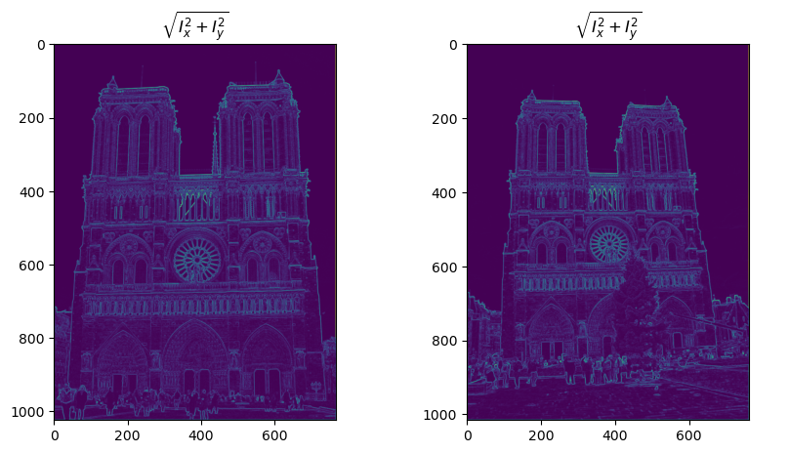
Part 1: Harris corner detector
[insert visualization of \sqrt(I_{x}² + I_{y}²) for Notre Dame image pair from proj2.ipynb here]
[Which areas have highest magnitude? Why?]
Corners have the highest magnitude of the \sqrt(I_{x}² + I_{y}²). This is because corners have gradient changes in all directions, unlike edges, which have a flat gradient in one direction, therefore have the magnitude only in one direction, or a flat region, which has close to 0 gradients. In context of the image, the flat regions that have small magnitudes are regions like the sky etc. which don’t have inherent texture, as we move across pixels in the neighborhood.
[Briefly explain what this value represents and why we need it for the Harris corner detector.]
\sqrt(I_{x}² + I_{y}²) shows the magnitude of the gradients at a pixel. It depicts the strength of local intensity change, and the magnitude of the gradient vector.

Slide 3
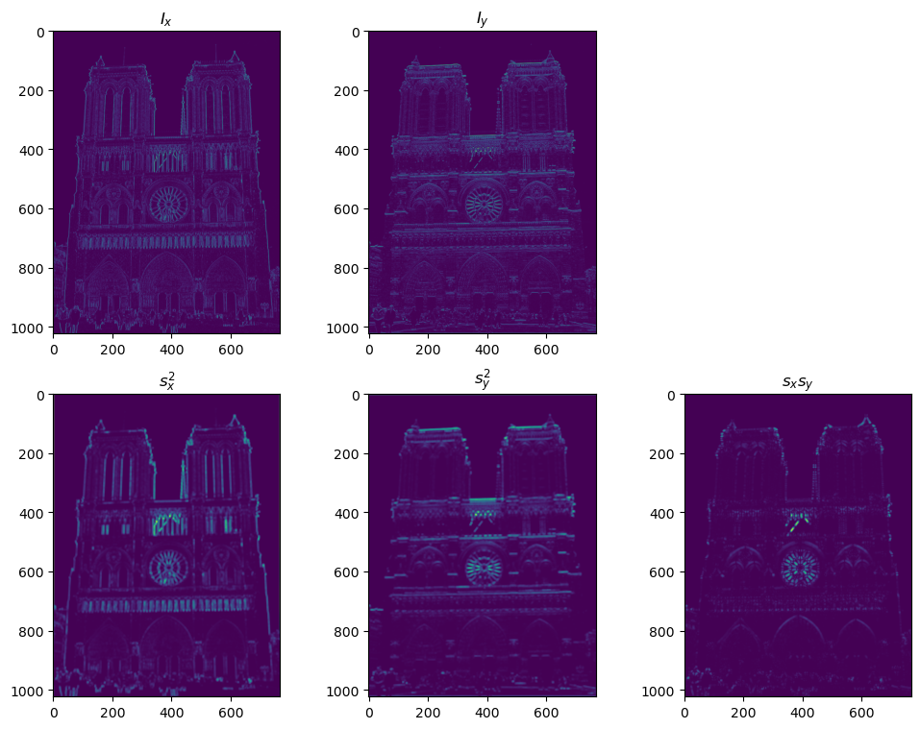
Part 1: Harris corner detector
[insert visualization of I_{x}, I_{y}, s_{x}², s_{y}², s_{x}s_{y} for Notre Dame image pair from proj2.ipynb here]
[Briefly explain what these values represent and why we need them for the Harris corner detector.]
Sx^2, sy^2 and sxsy are the second moment matrix values. Sx^2 represents the square of the horizontal gradient smoothed by a gaussian filter, sy^2 the square of the vertical gradient(smoothed by gaussian), and sxsy the product of the 2. They build the Harris matrix, who’s eigen values determine the strength of cornerness of the pixel(both small – flat region, both large – corner, one small, one large – edge.

Slide 4
Part 1: Harris corner detector
[Why do we convolve the image with a Gaussian filter?]
We convolve the image with a Gaussian Filter because the Harris detector’s goal is to analyse regions(patches) of the image, not individual pixels. By the convolution, we’re essentially blending information of the neighborhood into the pixel(since it acts like a weighted average). We also want to improve robustness to noise. A single noisy pixel can produce a strong gradient, and smoothening it with a Gaussian ensures that the entries going into the Harris Matrix are stable, and represent the underlying structure of the image, rather than being skewed by random noise of intensities.

Slide 5
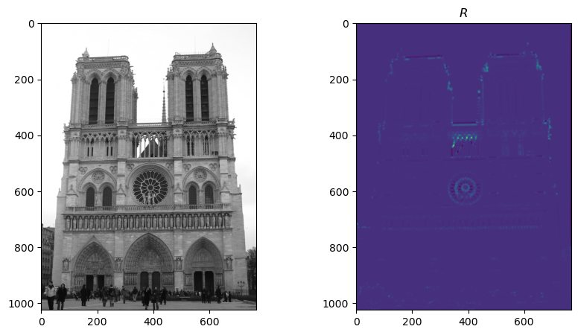
Part 1: Harris corner detector
[insert visualization of corner response map of Notre Dame image from proj2.ipynb here]
[Are gradient features invariant to both additive shifts (brightness) and multiplicative gain (contrast)? Why or why not? See Szeliski Figure 3.2]
Gradient Features are invariant to additive shifts, since adding a constant c to I doesn’t change dI/dx, since d(I+c)/dx = dI/dx + dc/dx = dI/dx + 0.
Multiplicative Gain multiplies each pixel by a constant factor “k”. I => kI
d(kI)/dx = k * dI/dx. Here the gradient is also scaled by the multiplicative gain.

Slide 6
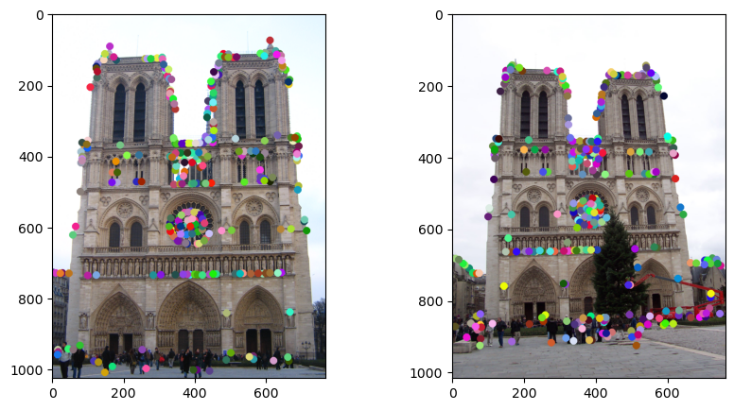
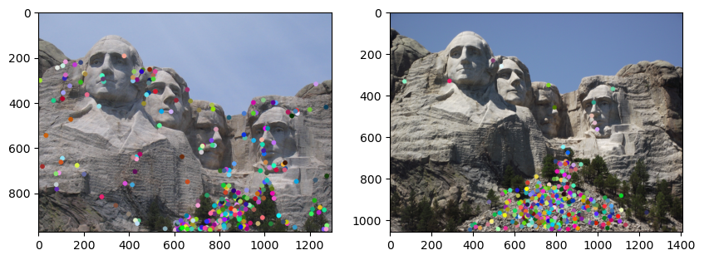
Part 1: Harris corner detector
[insert visualization of Notre Dame interest points from proj2.ipynb here]
[insert visualization of Mt. Rushmore interest points from proj2.ipynb here]

Slide 7
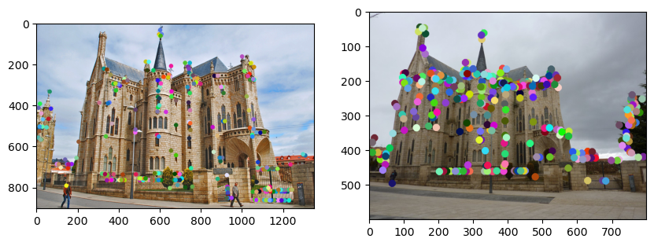
Part 1: Harris corner detector
[insert visualization of Gaudi interest points from proj2.ipynb here]
[What are the advantages and disadvantages of using maxpooling for non-maximum suppression (NMS)?]
Using maxpooling for NMS offers the primary advantage of efficiency, as it is highly optimizable and parallelizable, well suited for GPU operations. Its key disadvantage is imprecision, as it only finds local maxima in the pixel grid, and performance is subjective to kernel size. It also handles plateaus of identical values poorly by keeping all of them. This can lead to multiple detections of a single feature. It trades higher-precision and robustness for significant improvement in speed.

Slide 8
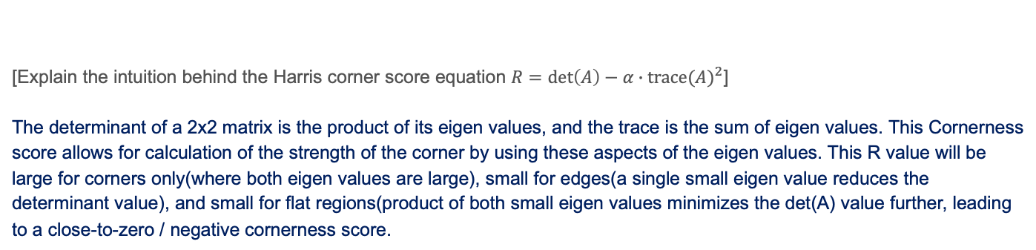
Part 1: Harris corner detector
[Explain the intuition behind the Harris corner score equation $R=\det\left(A\right)−α∙{trace(A)}^{2}$]
The determinant of a 2x2 matrix is the product of its eigen values, and the trace is the sum of eigen values. This Cornerness score allows for calculation of the strength of the corner by using these aspects of the eigen values. This R value will be large for corners only(where both eigen values are large), small for edges(a single small eigen value reduces the determinant value), and small for flat regions(product of both small eigen values minimizes the det(A) value further, leading to a close-to-zero / negative cornerness score.
[What is your intuition behind what makes the Harris corner detector effective?]
The intuition behind the Harris Corner detector is that the corners are information dense, as they have strong 2 dimensional structure. Unlike an edge, which is information-dense only in one direction(perpendicular to the edge) or flat regions(which aren’t informative), a corner possesses strong intensity change in multiple directions, an idea used by the Harris Corner detector for finding features. This allows us to map corners as regions of importance, for tracking, stitching, and recognition.

Slide 9
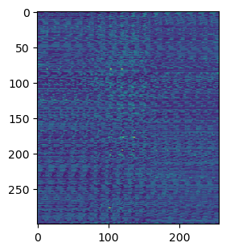
Part 2: Normalized patch feature descriptor
[insert visualization of normalized patch descriptor from proj2.ipynb here]
[Why aren't normalized patches a very good descriptor?]
While easy to compute, normalized patch descriptors are sensitive to geometric and illumination changes. Its very fragile to small shifts / rotations. This causes an issue with matching patches which are slightly rotated, as the Euclidean distance between the vector is increased in magnitude almost across all dimensions. Also, normalizing the patch can handle global shifts across the whole image, but fails in cases like occurrence of shadows, highlights in a part of the image. The descriptor also encodes raw pixel intensities, unlike SIFT which captures local gradients, which is much more resilient to exact brightness and color that form the feature (say a shape).

Slide 10
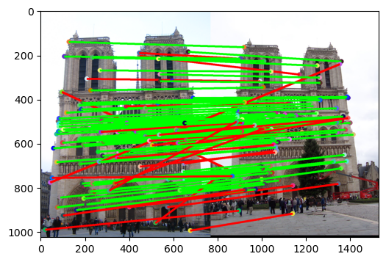
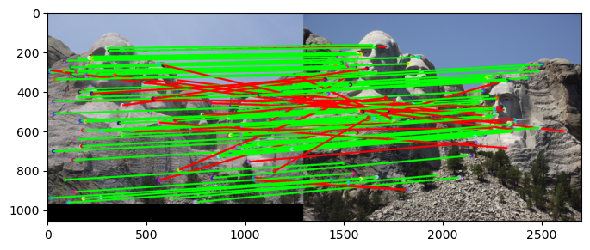
Part 2: Feature matching
[insert visualization of matches (with green/red lines for correct/incorrect correspondences) for Notre Dame image pair from proj2.ipynb here]
# matches (out of 100): [110]
Accuracy: [0.754545]
[insert visualization of matches for Mt. Rushmore image pair from proj2.ipynb here]
# matches: [104]
Accuracy: [0.740385]

Slide 11
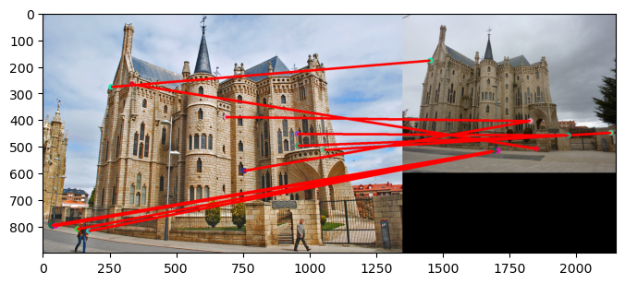
Part 2: Feature matching
[insert visualization of matches for Gaudi image pair from proj2.ipynb here]
# matches: [11]
Accuracy: [0.00]
[How does your implementation of match_features_ratio_test filter and structure feature matches? What is the significance of the confidence score?]
While the first 2 images (Notre Dam and Mount Rushmore) have decent accuracies, the Gaudi Image fails in the Harris Corner Detector method. What we can infer from the confidence score (accuracy) is that the Harris Corner Detector isn’t scale-invariant. The first 2 images work decently because there isn’t much of a difference in the view-point and scale in them. The low accuracy (0.00) in the Gaudi image corresponds to what is a significant difference in camera zoom, size of features, etc.

Slide 12
Part 2: Feature matching
[Why do feature matches that easily pass the nearest neighbor distance ratio (NNDR) test tend to be more accurate?]
Feature Matches that easily pass the NNDR test tend to be more accurate because the test is a good measure of the feature’s uniqueness and distinctiveness. If the ratio is very low, it implies the next closest match is much further away, allowing us to finalise a match without much contention from the next neighbors. By acting as a confidence filter, NNDR discards ambiguous matches, while keeping only the most reliable correspondences, which drastically increases the overall accuracy of the final set of matches.

Slide 13
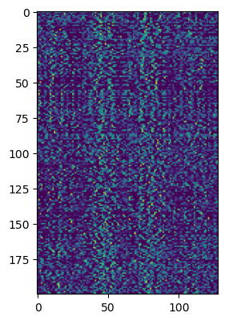
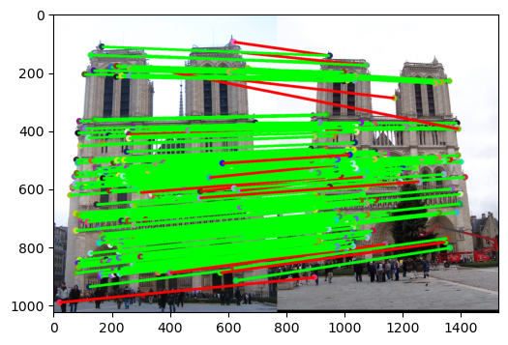
Part 3: SIFT feature descriptor
[insert visualization of matches (with green/red lines for correct/incorrect correspondences) for Notre Dame image pair from proj2.ipynb here]
# matches (out of 100): [191]
Accuracy: [0.926702]
[insert visualization of SIFT feature descriptor from proj2.ipynb here]

Slide 14
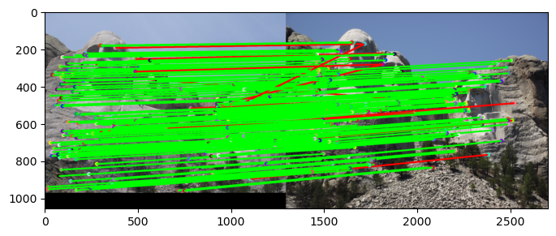
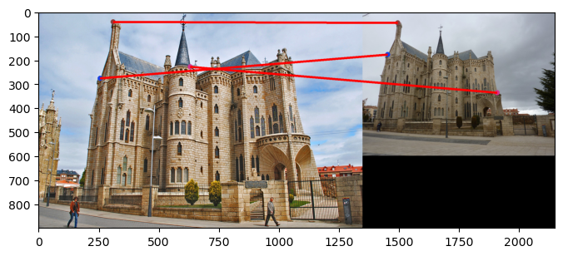
Part 3: SIFT feature descriptor
[insert visualization of matches for Mt. Rushmore image pair from proj2.ipynb here]
# matches: [182]
Accuracy: [0.934066]
[insert visualization of matches for Gaudi image pair from proj2.ipynb here]
# matches: [3]
Accuracy: [0.00]

Slide 15
Part 3: SIFT feature descriptor
[Explain how gradient histograms are constructed in the SIFT descriptor. What role do they play in the overall process?]
[Why are SIFT features better descriptors than the normalized patches?]
[What is the advantage of Square-Root SIFT?] (1.5)

Slide 16
Part 3: SIFT feature descriptor
[Why does our SIFT implementation perform worse on the given Gaudi image pair than the Notre Dame image and Mt. Rushmore pairs?]

Slide 17
Part 3: SIFT feature descriptor
[Why aren't our version of SIFT features rotation- or scale-invariant? What would you have to do to make them so?]

Slide 18
Part 4 (Extra Credit): : Projection matrix
[insert visualization of projected 3D points and actual 2D points for the first CCB image we provided here]
[insert visualization of camera center for the first CCB image here]

Slide 19
Part 4 (Extra Credit): : Projection matrix
[insert visualization of projected 3D points and actual 2D points for the first Argoverse image we provided here]
[insert visualization of camera center for the first Argoverse image here]

Slide 20
Part 4 (Extra Credit): : Projection matrix
[What two quantities does the camera matrix relate?]
[What quantities can the camera matrix be decomposed into?]
[List any 3 factors that affect the camera projection matrix.]

Slide 21
Part 5 (Extra Credit): Fundamental matrix
[insert visualization of epipolar lines on the Gaudi image pair]

Slide 22
Part 5 (Extra Credit): Fundamental matrix
[insert visualization of epipolar lines on the Notre Dame image pair]

Slide 23
Part 5 (Extra Credit): Fundamental matrix
[Why is it that points in one image are projected by the fundamental matrix onto epipolar lines in the other image?]
[What happens to the epipoles and epipolar lines when you take two images where the camera centers are within the images? Why?]

Slide 24
Part 5 (Extra Credit): Fundamental matrix
[What does it mean when your epipolar lines are all horizontal across the two images?]
[Why is the fundamental matrix defined up to a scale?]
[Why is the fundamental matrix rank 2?]

Slide 25
Part 6: RANSAC
[insert visualization of correspondences on Notre Dame without RANSAC]

Slide 26
Part 6: RANSAC
[insert visualization of correspondences on Notre Dame with RANSAC]

Slide 27
Part 6: RANSAC
[How many RANSAC iterations would we need to find the homography with 99.9% certainty for your Notre Dame SIFT results? Assume a hypothetical inlier ratio (correspondence accuracy) of 90% and that you are using the minimal sample size of 4 points]
[One might imagine that if we have many correct matches, it would be better to use more than the minimum number of points to compute the homography in each sample. Investigate this by finding the number of RANSAC iterations you would need if you used a sample size of 8 points instead of 4 (keeping the same 99.9% certainty and 90% inlier ratio).
[If our dataset had a lower point correspondence accuracy (i.e., a lower inlier ratio), say 70%, what is the minimum number of RANSAC iterations needed to find the homography with 99.9% certainty? Remember to use the minimal sample size of 4 points in your calculation.]

Slide 28
Part 6: Performance comparison
[insert visualization of the warped and blended image pair without RANSAC]
[insert visualization of the warped and blended image pair using RANSAC]

Slide 29
Part 6: Performance comparison
[Describe the different performance of the two methods.]
[Why do these differences appear?]
[Which one should be more robust in real applications? Why?]

Slide 30
Conclusion
[What made the RANSAC-based homography estimation significantly more effective than the naive homography estimation? In your answer, discuss the role of outliers in the initial SIFT matches and explain how the two methods differ in handling them.]

