Slide 1
Project Presentation of CO-OP Project at Industry (Module-2) (22CS421)
On
Consumer Behavior On Q-Commerce
Tisha (2210992465)
Kamaljeet Kaur (2210990470)
Aashwin Garg (2210991125) Saurabh Abrol (2201992268)
Supervised By
Supervised By : Dr. Monika Aggarwal
Department of Computer Science and Engineering,
Chitkara University, Punjab

Slide 2
Introduction
Quick Commerce (Q-commerce) enables delivery of essentials within minutes
Rapid growth driven by convenience, urban lifestyles, and digital adoption
Platforms like Blinkit, Zepto, and Swiggy Instamart are reshaping shopping behavior
Study focuses on key factors: convenience, pricing, delivery speed, and availability
Analyzes consumer preferences, usage patterns, and loyalty drivers
Objective: derive insights to improve customer experience and business strategies
2

Slide 3
Research Objective
Understand consumer behavior on Q-commerce platforms
Identify key factors influencing purchase decisions (price, speed, convenience)
Analyze usage patterns and order frequency
Evaluate impact of discounts, offers, and promotions
Study customer satisfaction and loyalty drivers
Provide insights to improve marketing and growth strategies

Slide 4
Findings
Convenience and fast delivery are the primary drivers of usage
Consumers prefer Q-commerce for urgent and top-up purchases
Discounts and offers significantly influence platform choice
Product availability directly impacts customer satisfaction
High frequency of small basket orders observed
Brand loyalty is low; users switch platforms based on price and speed
Peak usage seen during evenings and weekends
User experience (app ease, delivery reliability) is critical for retention

Slide 5
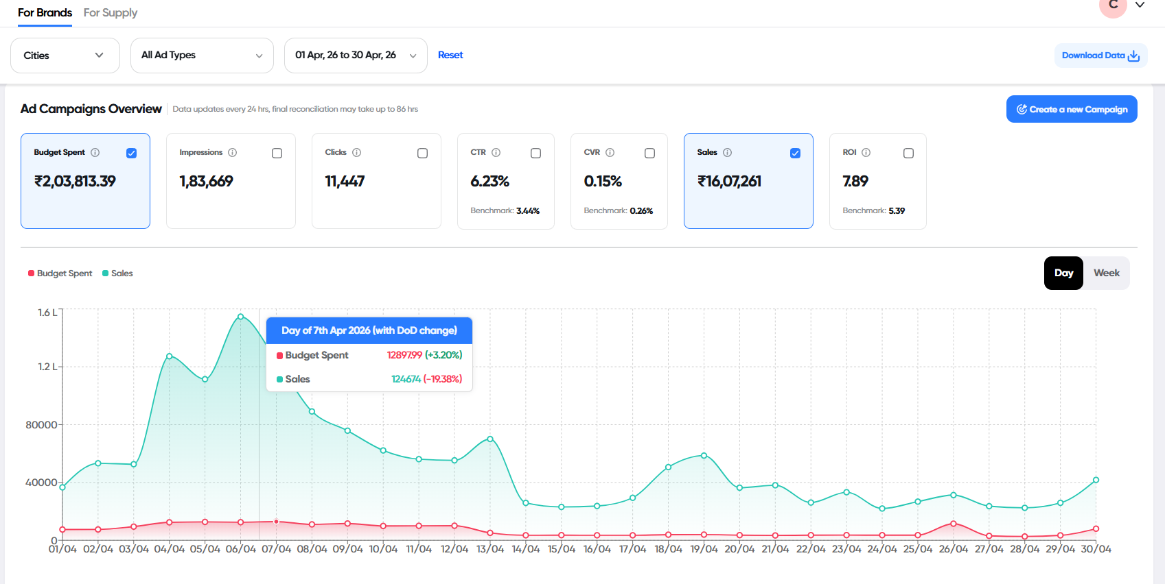
Swiggy Instamart

Slide 6
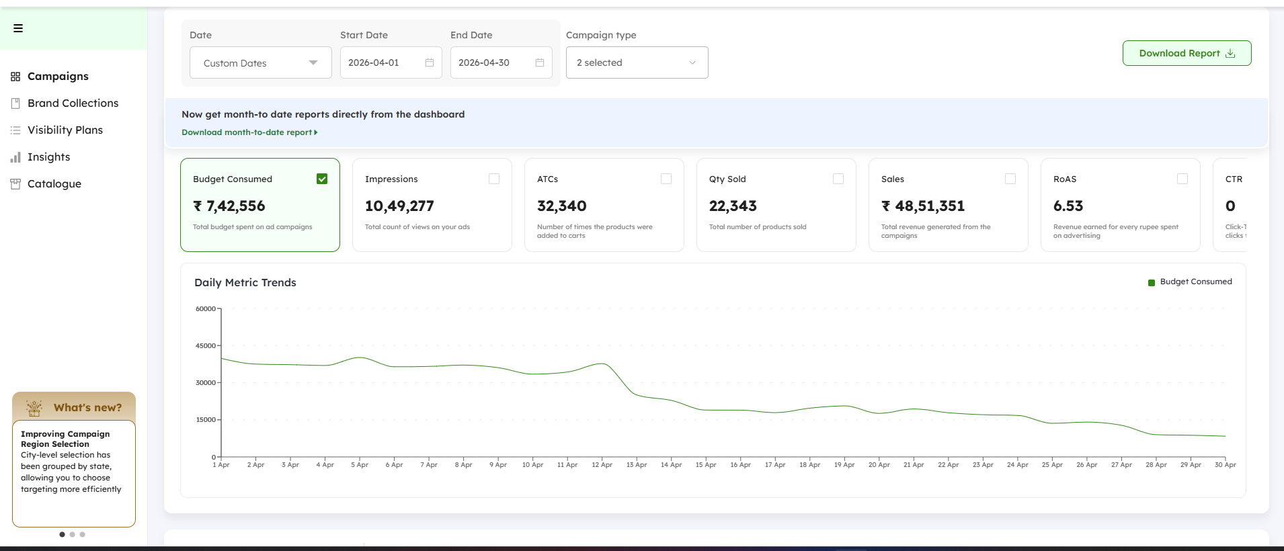
Blinkit

Slide 7
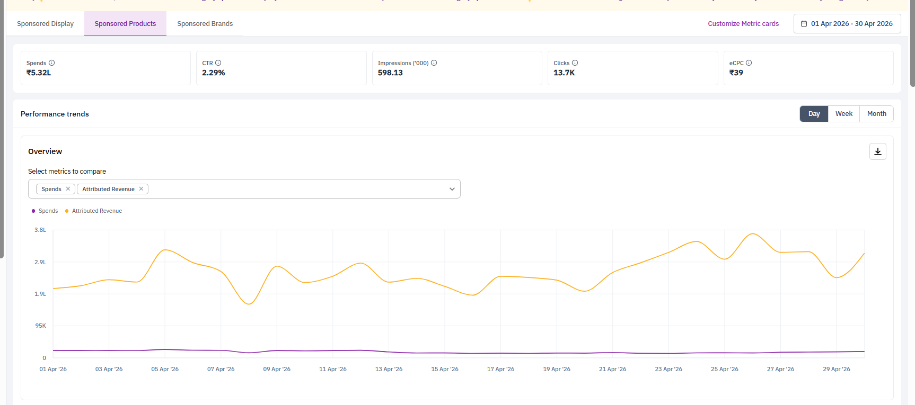
Zepto

Slide 8
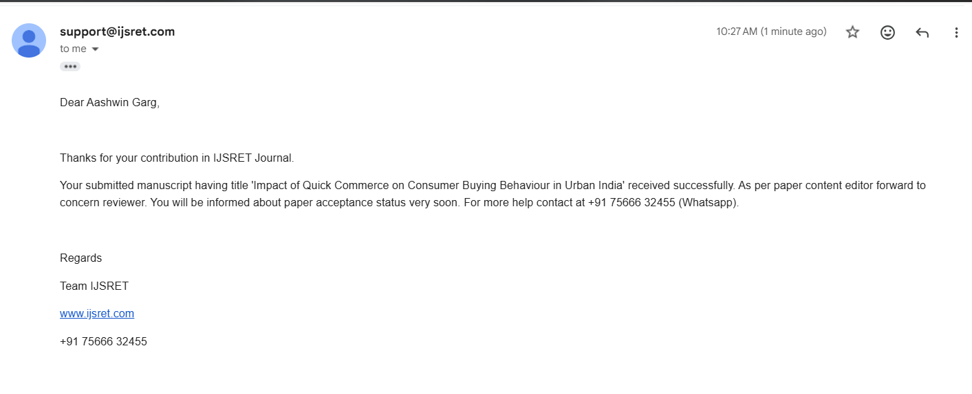
A Milestone Achieved

Slide 9
Thank You
9

