Slide 1
IBM
University Engagement Program
IBM University Engagement
Project Submission
VendorSaathi AI
Street Vendor Digitalization Agent • AICTE Problem Statement No. 29
"Exploring the Power of Agentic AI with IBM Granite and LangFlow"
Built with IBM Granite (ibm/granite-4-h-small) · IBM watsonx.ai · Streamlit · Local RAG
Domain: MSMEs | Street Vendors | Fintech | Digital Inclusion
Live Demo: https://vendorsaathi-ai.streamlit.app
GitHub: https://github.com/aashya-madhan/VendorSaathi_AI
IBM University Engagement Program · 2026

Slide 2

IBM University Engagement | VendorSaathi AI
Project Title & Student Details
02
Project Title – VendorSaathi AI — AI-Powered Growth Copilot for Street Vendors in India
Domain of Project – MSMEs / Street Vendors / Digital Inclusion / Fintech
Student Name
Email ID
Mobile [WhatsApp]
Institution
Aashya Madhan
aashya05@gmail.com
7538847929
SRM Institute of Science and Technology
Recent Passport Photo
2

Slide 3
IBM University Engagement | VendorSaathi AI
Problem Statement
03
AICTE IBM SkillsBuild 2026 • Problem Statement No. 29 • Street Vendor Digitalization Agent
The Challenge
The Objective
• India has 10M+ street vendors who are digitally excluded from the formal economy.
• No professional digital business identity, online presence, or business profile.
• Cannot leverage Local SEO to attract nearby customers via Google Search.
• No access to curated, verified guidance on government schemes — PM SVANidhi, Udyam, GeM, BHIM.
• Unable to create promotional content for WhatsApp or social media.
• No structured digital onboarding path — information scattered across unreliable sources.
• Critical government scheme details inaccessible due to language and literacy barriers.
Build VendorSaathi AI — a single AI workspace providing:
AI Copilot: Free-form Q&A from 9 official government PDFs (RAG)
Business Profile: Factual digital business description generator
Local SEO Kit: Location-aware keywords + Google Business content
Promo Studio: WhatsApp / social media promotional messages
Digitalization Checklist: 5–7 practical digital onboarding steps
Government Schemes: PM SVANidhi, Udyam, GeM, BHIM answers
Multilingual output: English, Tamil (Unicode), Hindi (Devanagari)
Impact: 10M+ Indian street vendors can access AI-powered business tools grounded in verified government information
Why current solutions don't work:
Generic chatbots lack grounding in official Indian government documents. Existing apps are too complex for micro-entrepreneurs with limited digital literacy. No single tool combines business profiling, local SEO, scheme guidance, and multilingual support grounded in official government PDFs.
3

Slide 4
IBM University Engagement | VendorSaathi AI
Proposed Solution
04
A 7-tool AI workspace — all grounded in the vendor's saved Business Profile and official government PDFs
🤖 AI Copilot
👤 Business Profile
🔍 Local SEO Kit
Free-form Q&A via local RAG pipeline. Cites source PDF + page for every scheme answer.
Generates a factual, validation-checked digital business description from saved vendor data.
Location-aware keywords, Google Business listing text, and 5 visibility action steps.
📢 Promo Studio
✅ Digitalization Checklist
🏛 Government Schemes
WhatsApp & social media promo messages. Supports occasion-based and general promotions.
5–7 practical digital steps tailored to the vendor type. Ethical, conditional phrasing.
PM SVANidhi · Udyam · GeM · BHIM answers sourced from 9 official PDFs. Blocks hallucinations.
📚 Knowledge Sources
Validation Layer: 4 dedicated validators block fabricated product claims,
invented quality assertions, unsupported customer-sentiment language.
Browse all 9 indexed government PDFs with source metadata and date notes.
4

Slide 5
IBM University Engagement | VendorSaathi AI
Application Features
05
📊 Overview Dashboard
🤖 AI Copilot
Welcome screen showing vendor profile completion status, tool quick-access cards, and AI configuration status.
RAG-powered chat. Retrieves passages from 9 government PDFs using TF-IDF; sends grounded context to IBM Granite. Cites source PDF + page number.
👤 Business Profile
🔍 Local SEO Kit
Collects vendor name, type, location, products, language. Generates a 30–50 word factual business description validated for accuracy.
4-section output: business description, 8–12 search keywords, Google Business listing title + description, 5-step visibility action plan.
📢 Promo Studio
✅ Digitalization Checklist
Generates 50–80 word WhatsApp/social media messages. Supports general or occasion-specific promotions. Saves to history.
5–7 numbered digital onboarding steps tailored to vendor type. Uses conditional phrasing; never assumes unconfirmed tools or services.
🏛 Government Schemes
📚 Knowledge Sources
Answers questions on PM SVANidhi, Udyam, GeM, BHIM from official PDFs. Blocks out-of-scope queries. Cites document + date.
Browse all 9 indexed PDFs (PM SVANidhi, Udyam, GeM, BHIM) with source names, page counts, and currency date notes.
5

Slide 6
IBM University Engagement | VendorSaathi AI
System Architecture
06
LAYER 1 — PRESENTATION
Streamlit Web App (app.py)
Sign In · Register · Overview Dashboard · 7 AI Tool Pages
Chat History · Saved Promotions · Knowledge Sources · Dark-Green CSS Theme
▼
LAYER 2 — AI TOOLS (7 Specialized Tools)
AI Copilot · Business Profile · Local SEO Kit · Promo Studio
Digitalization Checklist · Government Schemes · Knowledge Sources
▼
LAYER 3 — AI ENGINE
IBM Granite (ibm/granite-4-h-small) via IBM watsonx.ai ModelInference
5 Prompt Builders (prompts.py) + Local RAG Pipeline (rag.py)
pypdf + HashingVectorizer TF-IDF · 9 Official Government PDFs
▼
LAYER 4 — DATA
SQLite (vendor_users.db)
Tables: users · business_profiles · chat_sessions · chat_messages · saved_promotions
PBKDF2-SHA256 auth · Per-user isolation · Profile persistence
VALIDATION LAYER (cross-cutting) — 4 validators run after every AI generation: business_profile_validation · local_seo_validation · checklist_validation · scheme_answer_validation
6

Slide 7
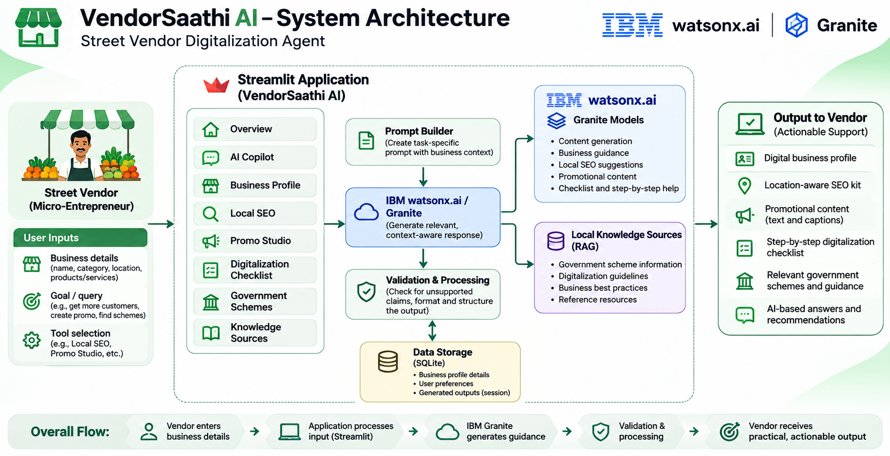
System Architecture Diagram

Slide 8
IBM University Engagement | VendorSaathi AI
Technology Used
07
1
IBM watsonx.ai
Core AI platform for model deployment and API access. All IBM Granite API calls route through watsonx.ai. Provides scalable, governed model inference (ModelInference client).
2
IBM Granite — ibm/granite-4-h-small
Foundation language model powering all 7 AI tools: business profiles, SEO kits, promo messages, digitalization checklists, scheme Q&A. Parameters: max_tokens=500, repetition_penalty=1.1.
3
Local RAG Pipeline (rag.py)
Fully offline retrieval — pypdf + scikit-learn HashingVectorizer (TF-IDF, bigrams). Indexes 9 official government PDFs. No external vector DB, no embedding API required. Returns top-K passages with source citation and date note.
4
Streamlit (app.py)
Full-stack web UI with dark green workspace theme, custom CSS (DM Sans + Manrope), multi-page sidebar navigation, chat history, saved promotions, and Knowledge Sources browser.
5
SQLite (vendor_users.db)
Local account system with PBKDF2-SHA256 salted password hashing. 5 tables: users · business_profiles · chat_sessions · chat_messages · saved_promotions.
6
Validation Framework (4 modules)
business_profile_validation · local_seo_validation · checklist_validation · scheme_answer_validation. Each module blocks fabricated claims, invented products, unsupported quality assertions, hallucinated URLs.
7
Python + Libraries
python-dotenv (env management) · pypdf (PDF text extraction) · scikit-learn (TF-IDF vectorization) · ibm-watsonx-ai (IBM SDK) · pytest (195 tests).
7

Slide 9
IBM University Engagement | VendorSaathi AI
Key Components Used
08
Streamlit replaces LangFlow as the orchestration layer. Component roles mapped below.
1 Chat Input — st.chat_input()
Interface where vendors type questions to the AI Copilot. Supports text queries about government schemes, business advice, and general vendor topics.
2 IBM watsonx.ai Agent — llm.py
ModelInference client wrapping ibm/granite-4-h-small. TextChatParameters: max_tokens=500, repetition_penalty=1.1. Returns (text, error) tuple.
3 IBM Granite Model — ibm/granite-4-h-small
Fast, efficient model for real-time NL generation. Powers all 7 AI tools. Handles English, Tamil (Unicode-only), and Hindi (Devanagari-only).
4 Chat Output — st.chat_message()
Renders AI responses with role-based styling. Appends source citations (PDF filename + page number) after every scheme answer.
5 RAG Document Store — rag.py LocalRetriever
Indexes 9 official government PDFs using pypdf + HashingVectorizer (TF-IDF, unigrams+bigrams). Returns top-K passages with scores and date notes.
6 Prompt Builders — prompts.py (5 builders)
build_profile_prompt · build_promo_prompt · build_checklist_prompt · build_scheme_qa_prompt · build_local_seo_prompt. Each injects vendor context, RAG passages, language directive, and safety rules into the Granite prompt.
8

Slide 10
IBM University Engagement | VendorSaathi AI
Application Workflow
09
1
2
3
4
User Input
Profile Lookup
RAG Retrieval
Prompt Builder
Vendor enters query or fills Business Profile form via Streamlit UI
›
Business Profile loaded from SQLite for context injection
›
Local RAG searches 9 government PDFs via TF-IDF cosine similarity
›
prompts.py injects vendor context + RAG passages into structured prompt
↓
5
6
7
8
IBM Granite
Validation
Output + Citations
Persisted
ibm/granite-4-h-small generates grounded response via watsonx.ai
‹
4 validators block fabricated claims before display
‹
Response shown with source PDF + page number references
‹
Chat history & promotions saved to SQLite for future sessions
9 Official PDFs indexed by RAG: PM SVANidhi Guidelines 2025 · PM SVANidhi Loan Guidelines 2025 · Udyam Official Information · Benefits of Udyam · Udyam Application Form · GeM Seller Prerequisites · GeM Seller Manual · BHIM FAQs · BHIM UPI Merchant QR Guidelines 2026
Token Usage Summary (Estimated per session)
AI Copilot (RAG + Scheme Q&A)
~350–450 input
~150–280 output
Business Profile Generator
~180–240 input
~60–100 output
Local SEO Kit
~280–350 input
~300–450 output
Promo Studio
~160–220 input
~80–130 output
Digitalization Checklist
~500–650 input
~200–350 output
Total estimated token usage per full session: ~11,761 tokens | Model: ibm/granite-4-h-small | Platform: IBM watsonx.ai
9

Slide 11
IBM University Engagement | VendorSaathi AI
Role of Agentic AI in VendorSaathi
10
VendorSaathi AI demonstrates Agentic AI as a goal-driven, context-aware system that autonomously orchestrates multiple tools to achieve vendor-specific outcomes.
1 Context Awareness
2 Autonomous Tool Selection
Reads each vendor's saved Business Profile (name, type, location, products, language) and injects it into every prompt. Each output is uniquely tailored — not generic.
Each of 7 tools has a dedicated prompt builder + validator. The system routes to the correct agent logic based on user intent and tool selection. No manual switching needed.
3 Proactive RAG Retrieval
4 Validation Agent (Safety)
Before answering any scheme question, the RAG agent retrieves ranked passages from 9 government PDFs. Filters low-confidence results and blocks out-of-scope queries.
A dedicated validation layer acts as an autonomous safety checker — blocking fabricated claims, invented quality assertions, unsupported outcomes, and hallucinated URLs.
5 Multilingual Adaptation
6 Session Memory & Persistence
Autonomously adapts output language (English / Tamil / Hindi) from the vendor's profile. Tamil prompts enforce Unicode-only script; Hindi prompts enforce Devanagari-only.
Chat sessions, business profiles, and saved promotions are stored in SQLite. The AI references the vendor's full profile history across sessions.
Result: An intelligent, autonomous, profile-grounded AI copilot — not a static chatbot
10

Slide 12
IBM University Engagement | VendorSaathi AI
Novelty and Uniqueness
11
VendorSaathi AI is not another chatbot — it is a production-grade multi-tool workspace combining IBM Granite, local RAG, a validation layer, and multilingual support.
No External Vector DB Required
7 AI Tools in One Grounded Workspace
RAG runs entirely on pypdf + scikit-learn TF-IDF. No Chroma, Pinecone, or FAISS required. Retrieval works fully offline on any machine.
Business Profile, SEO Kit, Promo Studio, Checklist, Gov. Schemes, AI Copilot, Knowledge Sources — all driven from a single saved vendor profile.
Hallucination Blocked by Design
Profile-Grounded Generation
4 dedicated validators block fabricated product claims, invented quality assertions, unsupported outcomes, hallucinated URLs, and invented scheme details.
Every AI output is grounded in the vendor's saved profile. The system refuses to invent products, addresses, services, or customer reviews not in the profile.
Native Multilingual AI (EN / Tamil / Hindi)
195-Test Production Quality
Generates complete outputs in Tamil (Unicode-only) and Hindi (Devanagari-only). Script-quality rules enforced in each prompt.
195 pytest tests cover all 4 validators and the RAG regression suite (all 9 PDFs). 193/195 pass. Production-grade code quality.
A smart, ethical, production-ready digital copilot — not a prototype
11

Slide 13
IBM University Engagement | VendorSaathi AI
GitHub Repository
12
https://github.com/aashya-madhan/VendorSaathi_AI
Live Demo: https://vendorsaathi-ai.streamlit.app/
Repository Requirements: Public repository · README enabled at creation
1
app.json
Application configuration file
2
VendorSaathi_Problem_Statement.pdf
Full AICTE problem statement document
3
VendorSaathi_AI_Final_Submission.pptx
This project presentation
4
app.py · llm.py · rag.py · prompts.py
Full application source code
5
requirements.txt · .env.example · README.md
Setup and documentation files
6
data/government_docs/ (9 PDFs)
PM SVANidhi · Udyam · GeM · BHIM official documents
7
tests/ (195 pytest tests)
Validators + RAG regression suite — 193/195 pass
12

Slide 14
IBM University Engagement | VendorSaathi AI
Future Scope
13
1 Voice Input & Regional Language Expansion
2 Live Government Scheme Data Sync
Add speech-to-text input so vendors can speak queries in Tamil, Hindi, or other Indian languages. Expand multilingual support to Marathi, Bengali, and Telugu.
Connect the RAG pipeline to live government APIs (pmsvanidhi.mohua.gov.in, udyamregistration.gov.in) so the knowledge base stays current automatically.
3 LangFlow Multi-Agent Orchestration
4 WhatsApp Business API Integration
Migrate the orchestration layer to LangFlow to enable visual agent workflow design, automated tool routing, and persistent multi-agent memory.
Integrate with WhatsApp Business API to deliver AI-generated promo messages, scheme answers, and checklist updates directly to the vendor's phone number.
5 GeM Direct Onboarding Workflow
6 Vendor Analytics Dashboard
Add a guided GeM onboarding flow that walks vendors step-by-step through seller registration, product listing, and order management on Government e-Marketplace.
Build a dashboard showing digital progress metrics — tools used, checklist completion rate, promotions saved, and scheme questions asked.
13

Slide 15
IBM University Engagement | VendorSaathi AI
Responsible AI, Limitations & Ethical Use
14
Responsible AI Principles
Current Limitations
• AI-generated content is advisory only. Vendors must verify scheme eligibility on official portals.
• Government scheme information is sourced from bundled PDFs. Verify current rules on official sites.
• Business information is never fabricated — the validation layer blocks all unsupported claims.
• API credentials stored as environment variables only — never hardcoded or logged.
• Account passwords hashed with PBKDF2-SHA256 (240,000 iterations). Not plain-text.
• Not intended as legal, financial, or regulatory advice.
• RAG pipeline is lexical (TF-IDF); semantic vector search could improve retrieval quality.
• Offline PDF knowledge base — no live government data feed yet.
• Single-user SQLite database; not designed for multi-user production deployment.
• No voice input — text only in current version.
• Government scheme PDF documents have date cutoffs; newer policy changes not reflected.
• LangFlow orchestration not yet implemented (future scope).
How does VendorSaathi AI ensure ethical and responsible use?
No Hallucination
Source Citations
Conditional Language
No Credential Exposure
4 validators block every category of fabricated output before display to the user.
Every scheme answer cites the source PDF + page number. Users can verify independently.
Digitalization checklist never guarantees outcomes; uses 'could/may/might' throughout.
API keys read from environment variables; never logged, printed, or displayed.
The distinction between existing (current) and planned (future) functionality is clearly maintained throughout this submission.
14

Slide 16
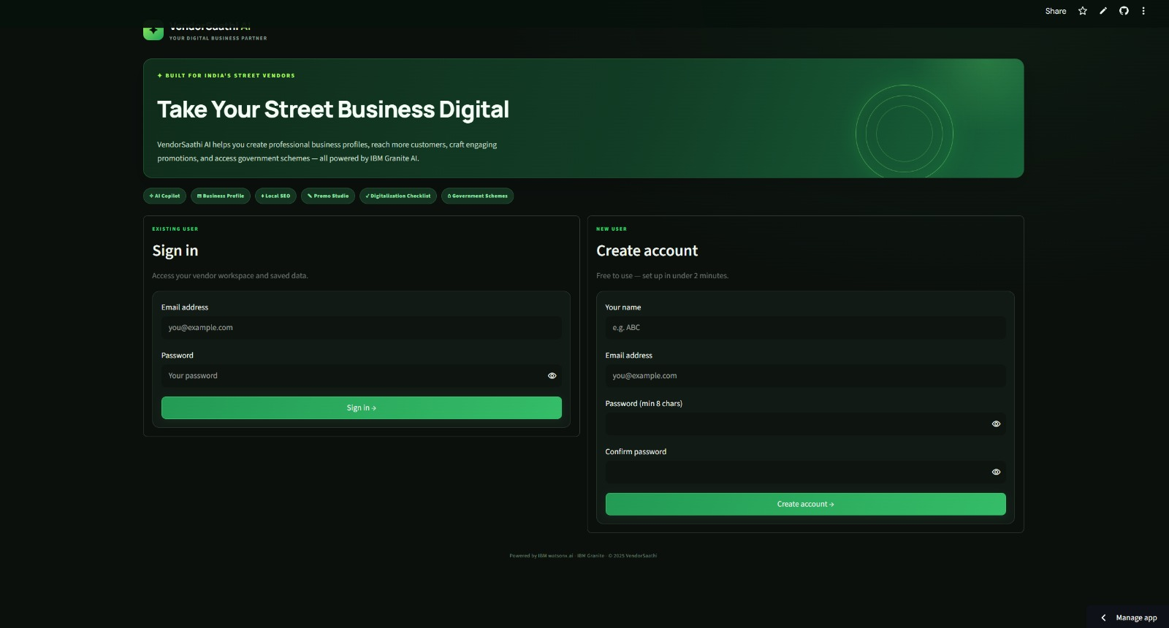
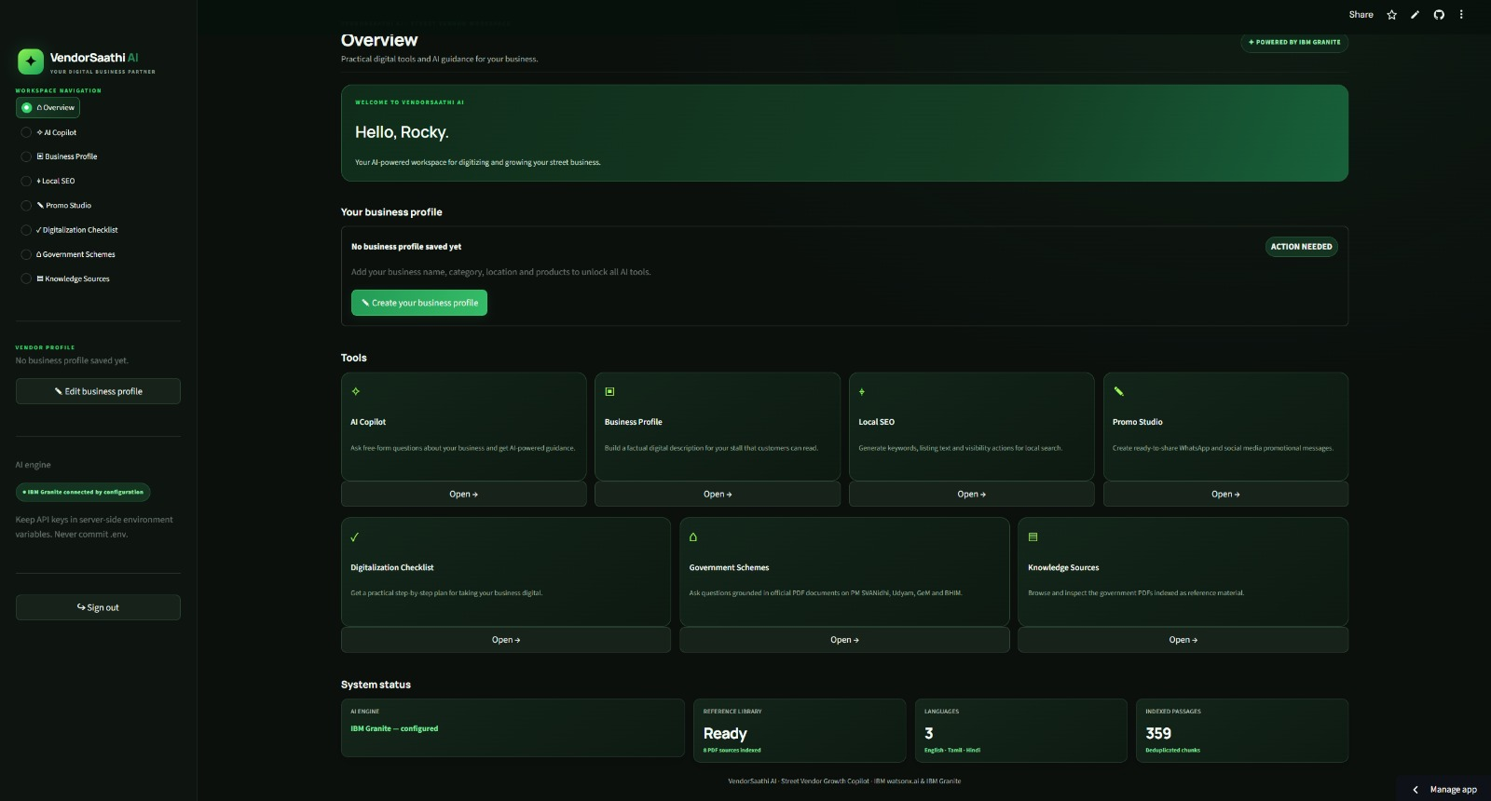
Project Screenshots

Slide 17
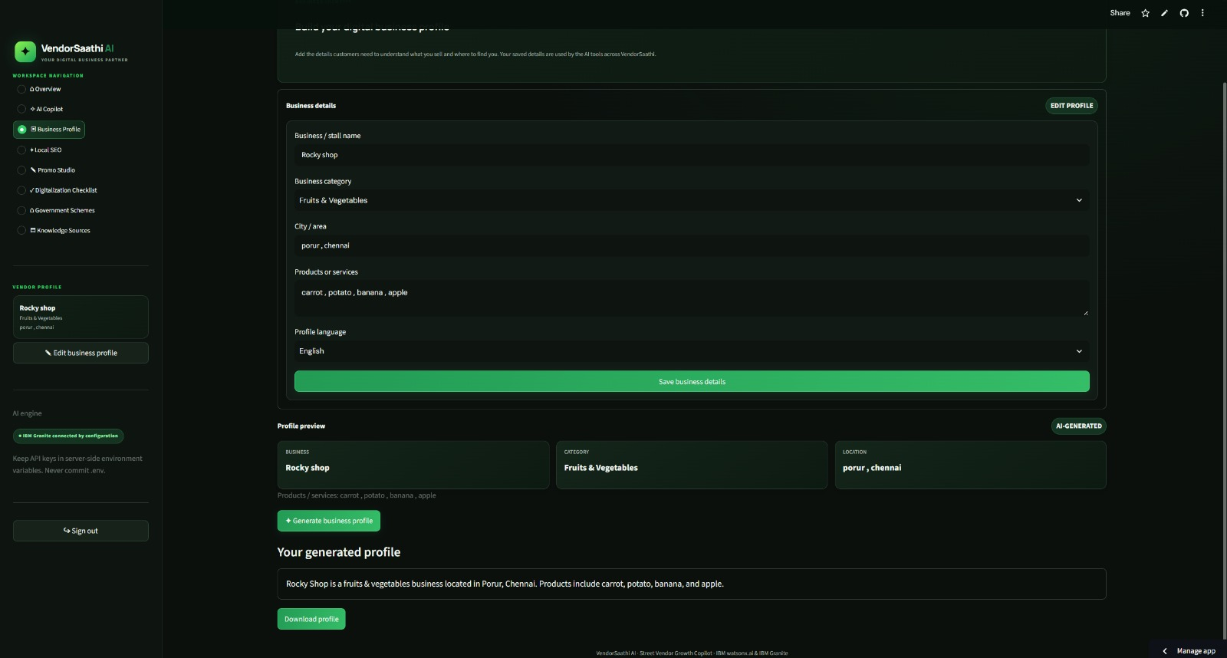
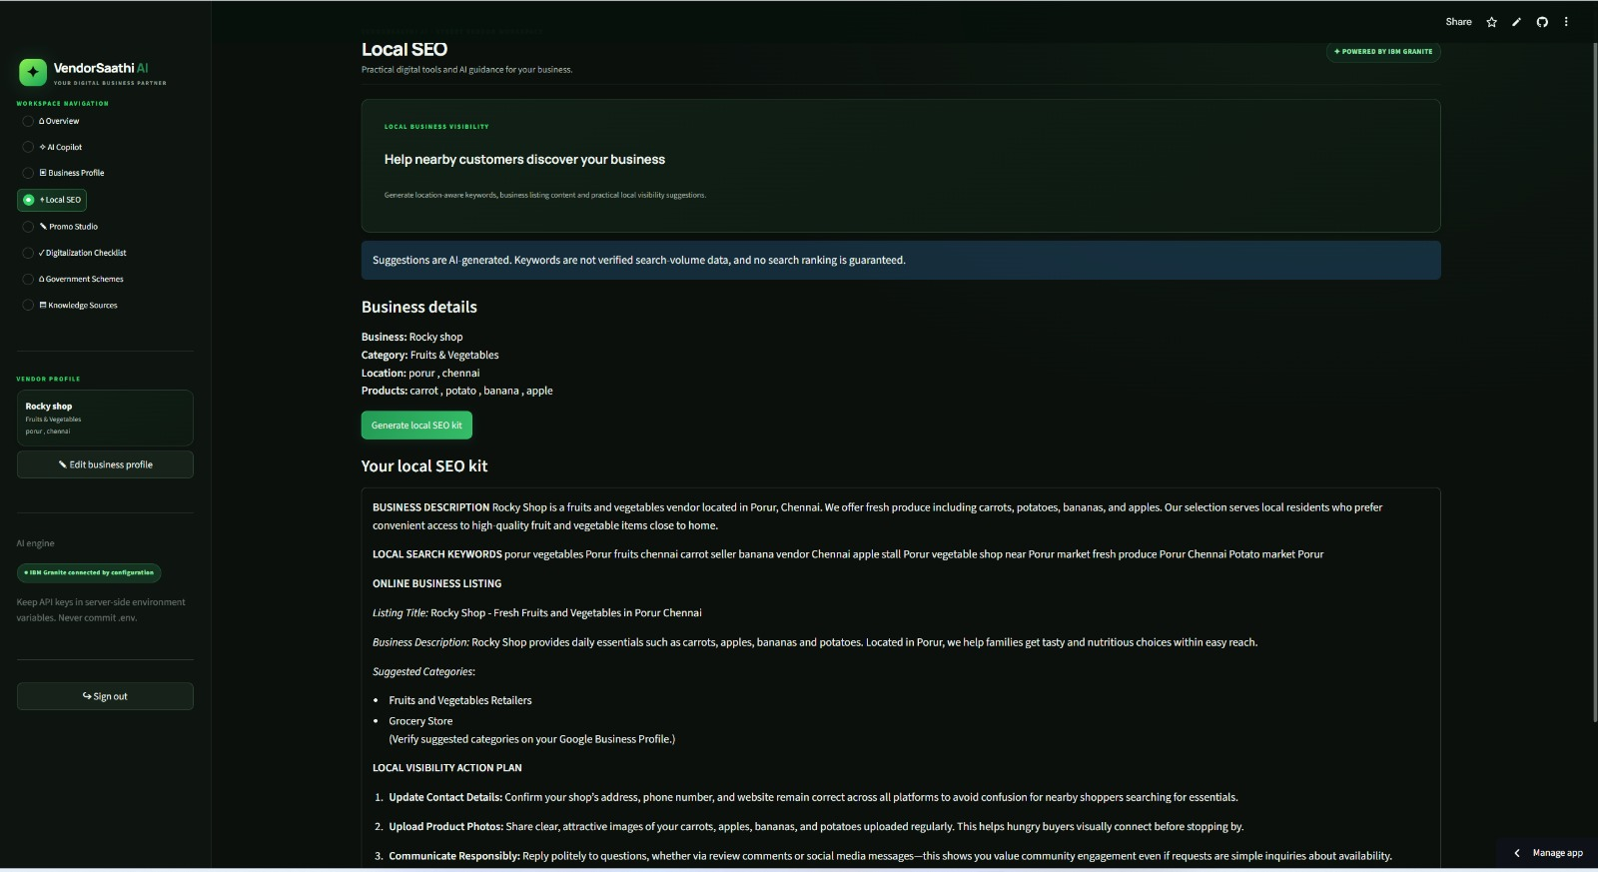
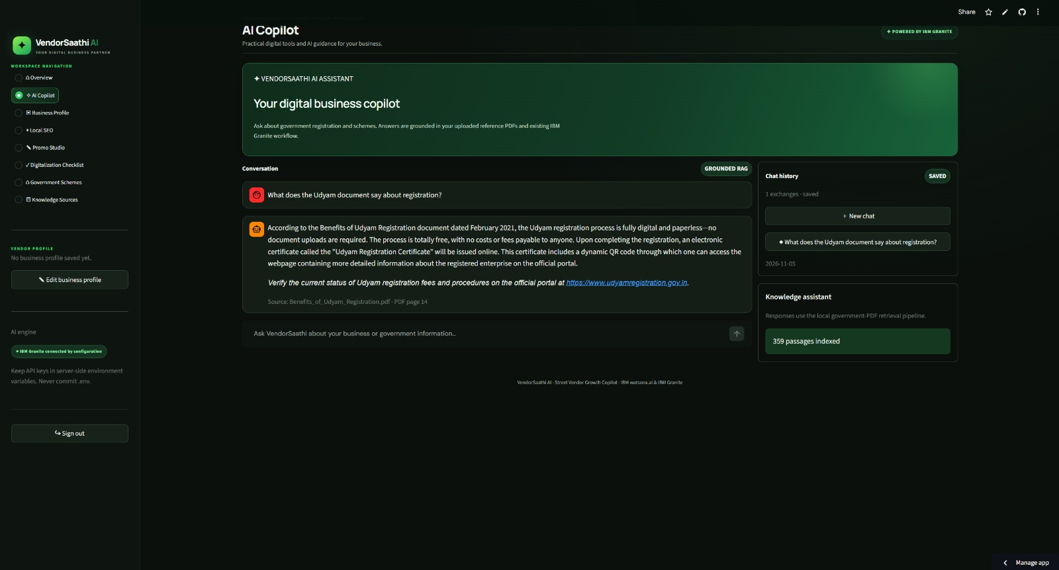
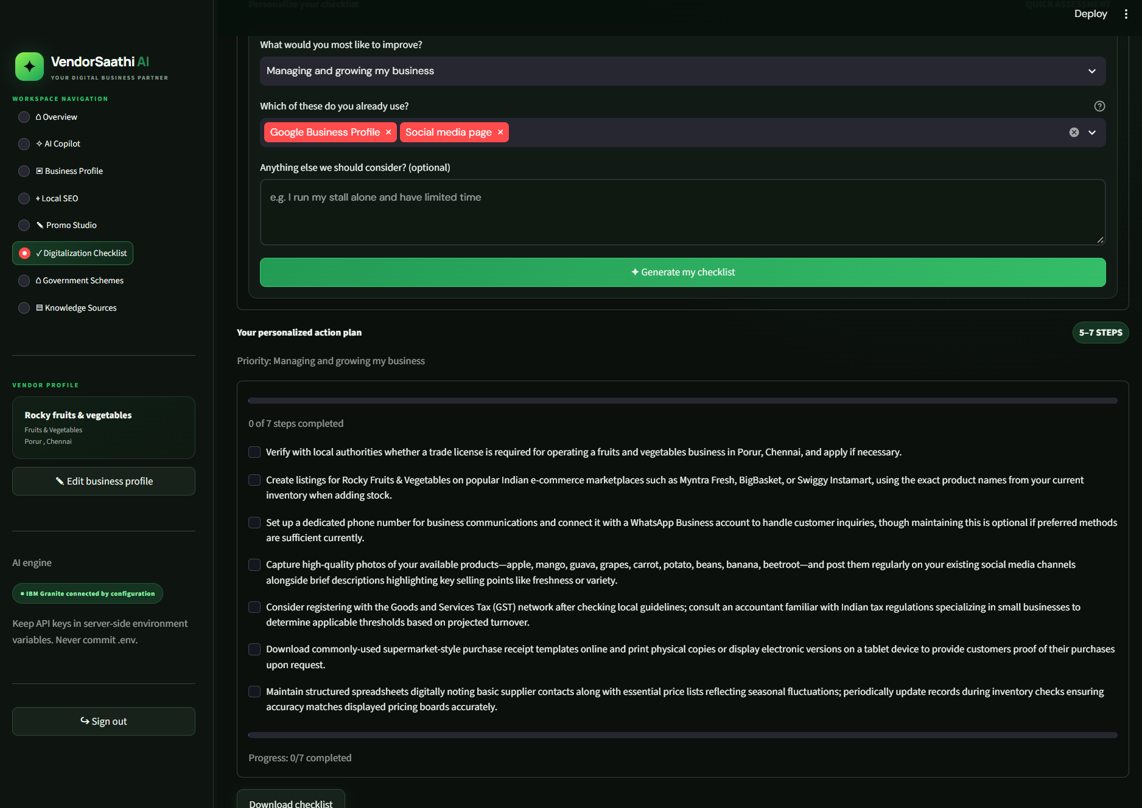

Slide 18
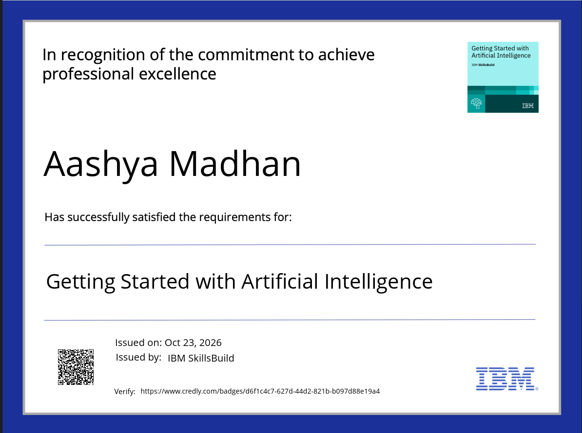
IBM University Engagement | VendorSaathi AI
Certificates Earned
15
15

Slide 19
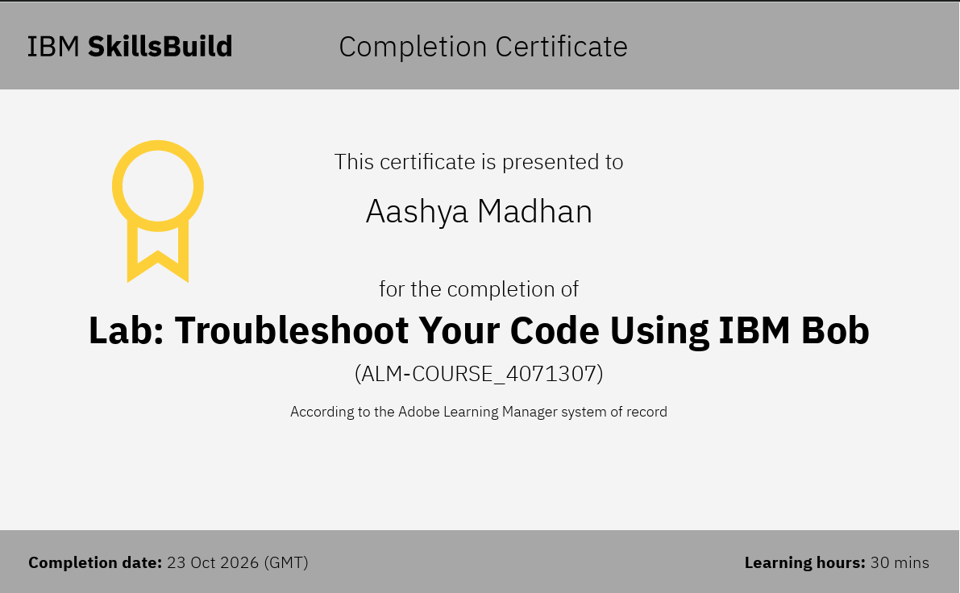
IBM University Engagement | VendorSaathi AI
Certificates Earned
16
16

Slide 20
IBM University Engagement | VendorSaathi AI
Conclusion
17
India's 10M+ street vendors are digitally excluded — no online presence, no access to government scheme guidance, no promotional tools, no digitalization roadmap.
The Problem:
VendorSaathi AI addresses AICTE Problem Statement No. 29 by delivering a 7-tool AI workspace powered by IBM Granite (ibm/granite-4-h-small) via IBM watsonx.ai.
The Solution:
Business Profile Generator · Local SEO Kit · Promo Studio · Digitalization Checklist · Government Schemes Q&A (RAG) · AI Copilot · Knowledge Sources Browser — all live at https://vendorsaathi-ai.streamlit.app/
What's Implemented:
IBM Granite model powers all 7 tools via IBM watsonx.ai ModelInference. Local RAG pipeline (pypdf + TF-IDF) retrieves from 9 official government PDFs with no external vector database.
IBM Technology Integration:
195 pytest tests · 4 validation modules · PBKDF2-SHA256 auth · Multilingual (EN/Tamil/Hindi) · Validated anti-hallucination design · Open source on GitHub.
Production Quality:
Street vendors and micro-entrepreneurs gain an accessible, AI-powered digital growth copilot that guides them from digital invisibility to verified online business presence.
Expected Benefit:
17

Slide 21
Thank You!
Thank you for your time and interest.
IBM University Engagement Program · AICTE-2026 · Problem Statement No. 29

