Slide 1
IBM
University Engagement Program
IBM University Engagement
Project Submission
VendorSaathi AI
An AI-Powered Growth Copilot for Street Vendors in India
Built with IBM Granite & Streamlit
Domain: MSMEs | Street Vendors | Fintech | Digital Inclusion
Notes:
Slide 1 — Title slide. VendorSaathi AI is an AI-powered multi-tool workspace for Indian street vendors.

Slide 2

IBM University Engagement | VendorSaathi AI
02
Project Overview & Student Details
Student Details
Name: Aashya Madhan
Email: aashya05@gmail.com
Mobile: 7538847929
WhatsApp: 7538847929
Institution: SRM institute of science and technology
Domain of Project
MSMEs / Street Vendors / Digital Inclusion / Fintech
Project Title
VendorSaathi AI — AI-Powered Growth Copilot for Street Vendors (IBM Granite + Streamlit)
Tech Stack
IBM Granite 4 · IBM watsonx.ai · Streamlit · Local RAG (pypdf + TF-IDF) · SQLite
GitHub
https://github.com/aashya-madhan/VendorSaathi_AI
7 AI Tools Included:
AI Copilot (RAG + Scheme Q&A) Business Profile Generator
Local SEO Kit Promo Studio (WhatsApp / Social)
Digitalization Checklist Government Schemes (PM SVANidhi, Udyam, GeM, BHIM)
Knowledge Sources Browser
Passport
Photo
195 Tests
193/195 Pass
Multilingual
EN · Tamil · Hindi
Validation
4 Validators
Local RAG
No Vector DB
Notes:
Slide 2 — Project overview and student details. Replace all [placeholder] fields and add passport photo.

Slide 3
IBM University Engagement | VendorSaathi AI
03
Problem Statement
The Challenge
The Objective
India has 10M+ street vendors who are digitally excluded:
• No professional digital business identity or online presence
• Cannot leverage local SEO for customer discoverability
• No access to curated, verified guidance on government schemes (PM SVANidhi, Udyam, GeM, BHIM)
• Unable to create promotional content for WhatsApp or social media
• No structured digital onboarding path
• Critical information scattered across unreliable sources in inaccessible language
Build VendorSaathi AI — a single AI workspace providing:
• AI Copilot: Free-form Q&A from official government PDFs
• Business Profile: Factual digital business descriptions
• Local SEO Kit: Location-aware keywords + Google Business content
• Promo Studio: WhatsApp / social media promotional messages
• Digitalization Checklist: Step-by-step digital onboarding plan
• Government Schemes: PM SVANidhi, Udyam, GeM, BHIM answers
• Multilingual: English, Tamil, Hindi
Impact: 10M+ Indian street vendors can now access AI-powered business tools grounded in verified government information — in their own language
Notes:
Slide 3 — Problem Statement. Two-column layout: challenge on left, objective on right.

Slide 4
IBM University Engagement | VendorSaathi AI
04
Proposed Solution
A 7-tool AI workspace — all grounded in the vendor's saved Business Profile and official government PDFs
AI Copilot
Free-form Q&A via local RAG pipeline. Cites source PDF + page for every answer.
Business Profile
Generates a factual, validation-checked digital business description from saved vendor data.
Local SEO Kit
Location-aware keywords, Google Business listing text, and 5 visibility action steps.
Promo Studio
WhatsApp & social media promo messages. Supports occasion-based and general promotions.
Digitalization Checklist
5–7 practical digital steps tailored to the vendor type. Ethical, conditional phrasing.
Government Schemes
PM SVANidhi, Udyam, GeM, BHIM answers sourced from 9 official PDFs. Blocks hallucinations.
Knowledge Sources
Browse all 9 indexed government PDFs with source metadata.
Validation Layer: 4 dedicated validators block fabricated product claims, invented quality assertions, unsupported customer-sentiment language, and hallucinated government scheme details across all tools
Notes:
Slide 4 — Proposed Solution. 7 tool cards in a 3×2+1 grid, plus validation layer strip at bottom.

Slide 5
IBM University Engagement | VendorSaathi AI
05
Technology Used
IBM watsonx.ai
Streamlit (app.py)
Core AI platform for model deployment, API access, and AI governance. All IBM Granite API calls go through watsonx.ai using Credentials + ModelInference SDK. Configured via environment variables (WATSONX_API_KEY, WATSONX_PROJECT_ID, WATSONX_URL).
Full-stack web UI with dark green workspace theme, custom CSS (DM Sans + Manrope fonts), multi-page sidebar navigation, hero cards, metric badges, and responsive layout. Handles auth pages, chat display, form inputs, and download buttons.
IBM Granite — ibm/granite-4-h-small
SQLite Authentication
Fast, efficient foundation model for all natural language tasks: business profile writing, SEO content, promo messages, digitalization checklists, government scheme Q&A, and multilingual responses (EN / Tamil / Hindi). Uses TextChatParameters (max_tokens=500, repetition_penalty=1.1).
Local account system with PBKDF2-SHA256 salted password hashing (240,000 iterations). 5 tables: users, business_profiles, chat_sessions, chat_messages, saved_promotions. Provides per-user session isolation and profile persistence.
Local RAG Pipeline (rag.py)
Validation Framework (4 modules)
Fully offline retrieval using pypdf + scikit-learn HashingVectorizer (TF-IDF, bigrams). Indexes 9 official government PDFs. Returns top-K passages with source filename, page number, and publication date note. No external vector DB or embedding API needed.
business_profile_validation · local_seo_validation · checklist_validation · scheme_answer_validation. Each module blocks fabricated claims, hallucinated government facts, and unsupported assertions. Tested by a 195-test pytest suite (193/195 pass).
Notes:
Slide 5 — Technology stack. 2-column layout with 3 rows each. All 6 core components detailed.

Slide 6
IBM University Engagement | VendorSaathi AI
06
Key Components Used
Streamlit replaces LangFlow as the orchestration layer. Component roles mapped below.
1 Chat Input — st.chat_input()
4 Chat Output — st.chat_message()
Interface where users type questions to the AI Copilot. Supports text queries about government schemes, business advice, and digital onboarding. Session-persistent history stored in SQLite.
Renders AI responses with role-based styling (user / assistant). Appends source citations (PDF filename + page number) after government scheme answers. Displays full session history on reload.
2 IBM watsonx.ai Agent — llm.py
5 RAG Document Store — rag.py LocalRetriever
ModelInference client wrapping ibm/granite-4-h-small. TextChatParameters: max_tokens=500, repetition_penalty=1.1. Returns text via chat() API. Credentials loaded from .env (API key, Project ID, URL).
Indexes 9 official government PDFs using pypdf + HashingVectorizer (TF-IDF, unigrams+bigrams). Returns top-K passages with source, page, and date note. Min-score threshold (0.12) filters irrelevant hits. Fully local — no embedding API.
3 IBM Granite Model — ibm/granite-4-h-small
6 Prompt Builders — prompts.py (5 builders)
Fast, efficient model for real-time NL generation. Powers all 7 AI tools. Handles English, Tamil (Unicode), and Hindi (Devanagari) with script-quality enforcement rules in each prompt.
build_profile_prompt · build_promo_prompt · build_checklist_prompt · build_scheme_qa_prompt · build_local_seo_prompt. Each injects vendor context, safety rules, language directive, and retrieved RAG passages into the prompt before calling Granite.
Notes:
Slide 6 — Components. 2-column, 3 rows per side. Each component has a coloured header + body box.

Slide 7
IBM University Engagement | VendorSaathi AI
07
Application Workflow
1
User Input
(Streamlit Chat
or Form)
2
Business Profile
Lookup
(SQLite DB)
3
Local RAG
Retrieval
(pypdf + TF-IDF)
4
Prompt Builder
(prompts.py)
Injects context
5
IBM Granite
ibm/granite
-4-h-small
>
>
>
>
^
v
9 Official PDFs
(PM SVANidhi · Udyam
GeM · BHIM)
8
Persisted to
SQLite DB
(sessions + promos)
7
Chat Output
+ Source Citations
(st.chat_message)
6
Validation Layer
(4 Validators)
Blocks hallucinations
<
<
Notes:
Slide 7 — Workflow diagram. Steps flow left→right on top row, then right→left on bottom row. Government PDFs feed into RAG (Step 3).

Slide 8
IBM University Engagement | VendorSaathi AI
08
Architecture Blueprint
LAYER 1 — PRESENTATION
Streamlit Web App (app.py)
Sign In / Register Pages · Sidebar Navigation · Overview Dashboard · 7 AI Tool Pages
Chat History · Saved Promotions · Knowledge Sources · Dark Green Custom CSS Theme
v
LAYER 2 — AI TOOLS (7 Specialized Tools)
AI
Copilot
Business
Profile
Local
SEO Kit
Promo
Studio
Digitalization
Checklist
Gov.
Schemes
Knowledge
Sources
v
LAYER 3 — AI ENGINE
IBM Granite (ibm/granite-4-h-small)
IBM watsonx.ai ModelInference
5 Prompt Builders (prompts.py)
Local RAG Pipeline (rag.py)
pypdf + HashingVectorizer (TF-IDF)
9 Official Government PDFs
v
LAYER 4 — DATA
SQLite (vendor_users.db)
users · business_profiles · chat_sessions · chat_messages · saved_promotions
PBKDF2-SHA256 Auth · Per-user session isolation · Profile persistence
VALIDATION LAYER (cross-cutting) — 4 validators run after every AI generation to block fabricated claims before display
Notes:
Slide 8 — Architecture Blueprint. 4 horizontal layers stacked with arrows. Validation runs cross-cutting across all tools.

Slide 9
IBM University Engagement | VendorSaathi AI
09
Role of Agentic AI in VendorSaathi
VendorSaathi AI demonstrates Agentic AI by acting as a goal-driven, context-aware system that autonomously orchestrates 7 specialized tools — not a simple chatbot. Powered by IBM Granite via watsonx.ai.
1 Context Awareness
2 Autonomous Tool Selection
3 Proactive RAG Retrieval
Reads each vendor's saved Business Profile (name, type, location, products, language) and injects it into every prompt. Every output is personalized — no generic responses.
Each of 7 tools has a dedicated prompt builder + validator. The system routes to the correct agent logic based on user intent — the user never specifies a model or prompt manually.
Before answering any scheme question, the RAG agent retrieves ranked passages from 9 government PDFs. It filters low-confidence hits (score < 0.12) and passes only verified context to Granite.
4 Validation Agent (Safety)
5 Multilingual Adaptation
6 Session Memory & Persistence
A dedicated validation layer acts as an autonomous safety checker — blocking fabricated claims, invented quality assertions, customer-sentiment language, and hallucinated government details before output is shown.
Autonomously adapts output language (English / Tamil / Hindi) from the vendor's profile. Tamil prompts enforce Unicode-only script; Hindi prompts enforce Devanagari-only — preventing code-mixing or romanization.
Chat sessions, business profiles, and saved promotions are stored in SQLite. The AI references the vendor's full profile history across sessions — demonstrating agent-level memory and continuity.
Result: An intelligent, autonomous, profile-grounded AI copilot — not a static chatbot
Notes:
Slide 9 — Role of Agentic AI. 6 properties in a 3x2 grid: context awareness, tool selection, RAG retrieval, validation, multilingual, memory.

Slide 10
IBM University Engagement | VendorSaathi AI
10
Token Usage
Model: ibm/granite-4-h-small · Platform: IBM watsonx.ai · Parameters: max_tokens=500, repetition_penalty=1.1
Tool
Input Tokens (Before Prompt)
Output Tokens (After Prompt)
AI Copilot (RAG + Scheme Q&A)
~350–450 tokens
(System rules + vendor context + RAG passages + question)
~150–280 tokens
(Grounded answer + source citation)
Business Profile Generator
~180–240 tokens
(Prompt rules + vendor details)
~60–100 tokens
(30–50 word business description)
Local SEO Kit
~280–350 tokens
(Extended rules + vendor context)
~300–450 tokens
(4-section kit: description + keywords + listing + action plan)
Promo Studio
~160–220 tokens
(Promo rules + vendor context + occasion)
~80–130 tokens
(50–80 word WhatsApp / social message)
Digitalization Checklist
~500–650 tokens (LARGEST)
(Extensive safety rules + RAG context + vendor details)
~200–350 tokens
(5–7 numbered steps)
Total Estimated Token Usage — Single Full Session: ~11,761 tokens
Notes:
Slide 10 — Token Usage. Table with 5 rows. Checklist has largest input (~650 tokens). Total ~11,761 tokens per full session.

Slide 11
IBM University Engagement | VendorSaathi AI
11
Novelty and Uniqueness
VendorSaathi AI is not another chatbot — it is a production-grade multi-tool workspace combining IBM Granite, local RAG, and multi-layer validation, built specifically for India's street vendor ecosystem.
No External Vector DB Required
7 AI Tools in One Grounded Workspace
Hallucination Blocked by Design
RAG runs entirely on pypdf + scikit-learn TF-IDF. No Chroma, Pinecone, or FAISS. Retrieval works fully offline on any machine with zero cloud dependency for the knowledge layer.
Business Profile, SEO Kit, Promo Studio, Checklist, Gov. Schemes, AI Copilot, and Knowledge Sources — all driven from a single saved Business Profile, ensuring consistent, grounded output.
4 dedicated validators (profile, SEO, checklist, scheme) block fabricated product claims, invented quality assertions, unsupported sentiment, and hallucinated government details. Output is never shown unvalidated.
Profile-Grounded Generation
Native Multilingual AI (EN / Tamil / Hindi)
195-Test Production Quality
Every AI output is grounded in the vendor's saved profile. The system refuses to invent products, addresses, services, or quality claims not in the profile — enforced across all 5 prompt builders with explicit prohibition rules.
Generates complete outputs in Tamil (Unicode-only script) and Hindi (Devanagari-only). Script-quality rules in each prompt prevent romanization, code-mixing, and broken script output — not just translation.
195 pytest tests cover all 4 validators and the RAG regression suite (all 9 PDFs). 193/195 pass. The 2 skipped tests require python-dotenv in the test env — they pass under streamlit run.
A smart, ethical, production-ready digital copilot — not a prototype
Notes:
Slide 11 — Novelty. 6 unique points in a 3x2 grid. Coloured headers + white body boxes.

Slide 12
IBM University Engagement | VendorSaathi AI
12
GitHub Repository
https://github.com/aashya-madhan/VendorSaathi_AI
Repository Requirements
Public repository (README enabled at creation)
Required Files Uploaded
1 app.json
Application configuration file
2 VendorSaathi_Problem_Statement.pdf
Full problem statement document
3 VendorSaathi_AI_Presentation.pptx
This project presentation
4 app.py · llm.py · rag.py · prompts.py
Full application source code
5 requirements.txt · .env.example · README.md
Setup and documentation files
6 data/government_docs/ (9 PDFs)
PM SVANidhi · Udyam · GeM · BHIM official documents
7 tests/ (195 pytest tests)
Validators + RAG regression suite — 193/195 pass
Live demo - https://vendorsaathiai-3vkutcv2g8ly7dsgwv8txg.streamlit.app/
Notes:
Slide 12 — GitHub. URL in prominent box. Requirements listed. Files listed as two-column table rows.

Slide 13
IBM University Engagement | VendorSaathi AI
13
Future Scope
1 Voice Input & Regional Language Expansion
2 Live Government Scheme Data Sync
Add speech-to-text input so vendors can speak queries in Tamil, Hindi, or other Indian languages. Expand multilingual support to Bengali, Telugu, Kannada, and Marathi for wider reach across all Indian states.
Connect the RAG pipeline to live government APIs (pmsvanidhi.mohua.gov.in, udyamregistration.gov.in) so the knowledge base stays current automatically — replacing manual PDF updates with real-time data.
3 LangFlow Multi-Agent Orchestration
4 WhatsApp Business API Integration
Migrate the orchestration layer to LangFlow to enable visual agent workflow design, automated tool routing, and persistent agent memory. Non-technical administrators could customize behavior without code changes.
Integrate with WhatsApp Business API to deliver AI-generated promo messages, scheme answers, and checklist updates directly on WhatsApp — the most-used communication platform among India's street vendors.
5 GeM Direct Onboarding Workflow
6 Vendor Analytics Dashboard
Add a guided Government e-Marketplace (GeM) onboarding flow that walks vendors step-by-step through seller registration, document upload, and first product listing — directly within the app.
Build a dashboard showing digital progress metrics — tools used, checklist completion rate, promotions saved, and scheme Q&A history — to gamify the digital onboarding journey and drive engagement.
Notes:
Slide 13 — Future Scope. 6 directions in a 2-column, 3-row grid. Each has a coloured header.

Slide 14
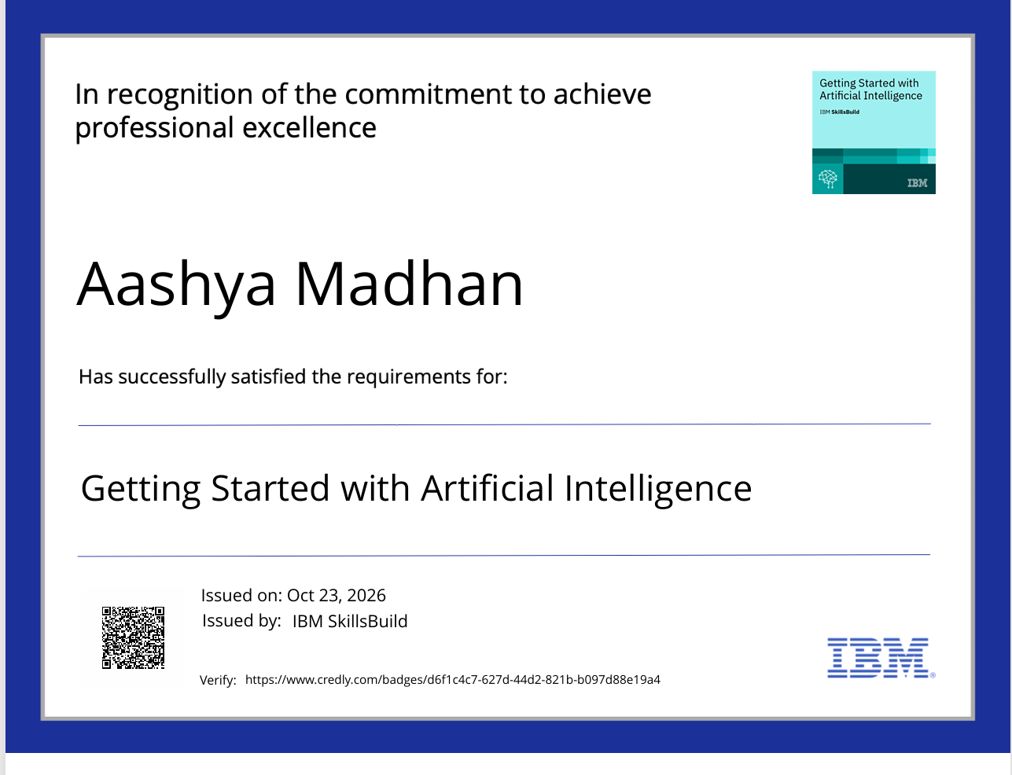
IBM University Engagement | VendorSaathi AI
14
Certificates Earned
IBM Credly Badges
Notes:
Slide 14 — Credly certificates. Two equal-width placeholder boxes side by side.

Slide 15
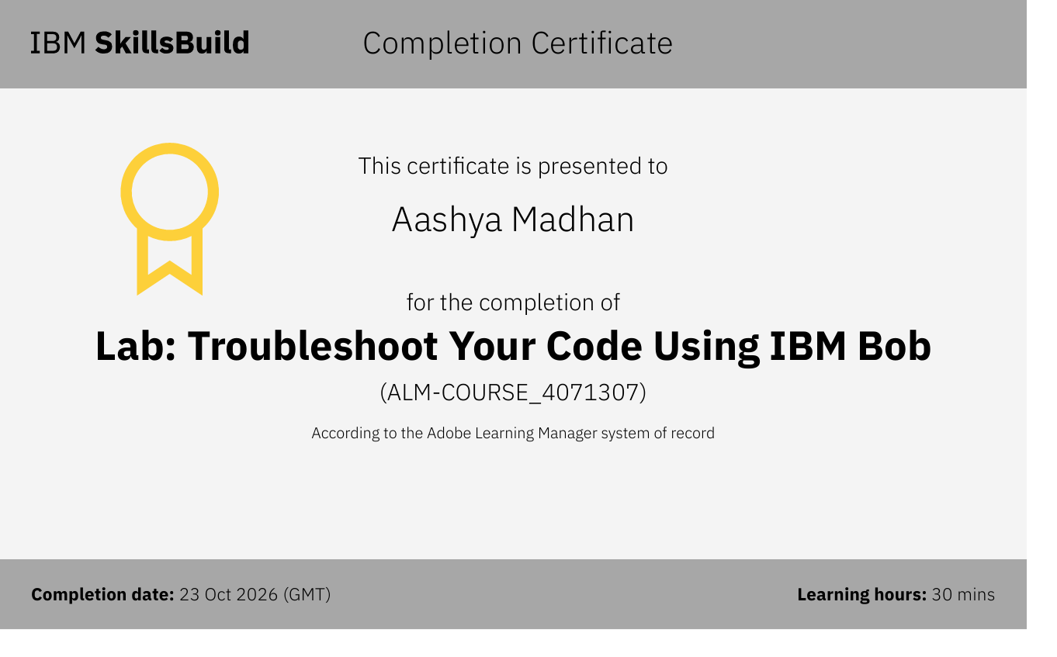
IBM University Engagement | VendorSaathi AI
15
Certificates Earned
IBM BOB Certificate
Notes:
Slide 15 — IBM BOB Certificate. Single centred placeholder for the BOB certificate screenshot.

Slide 16
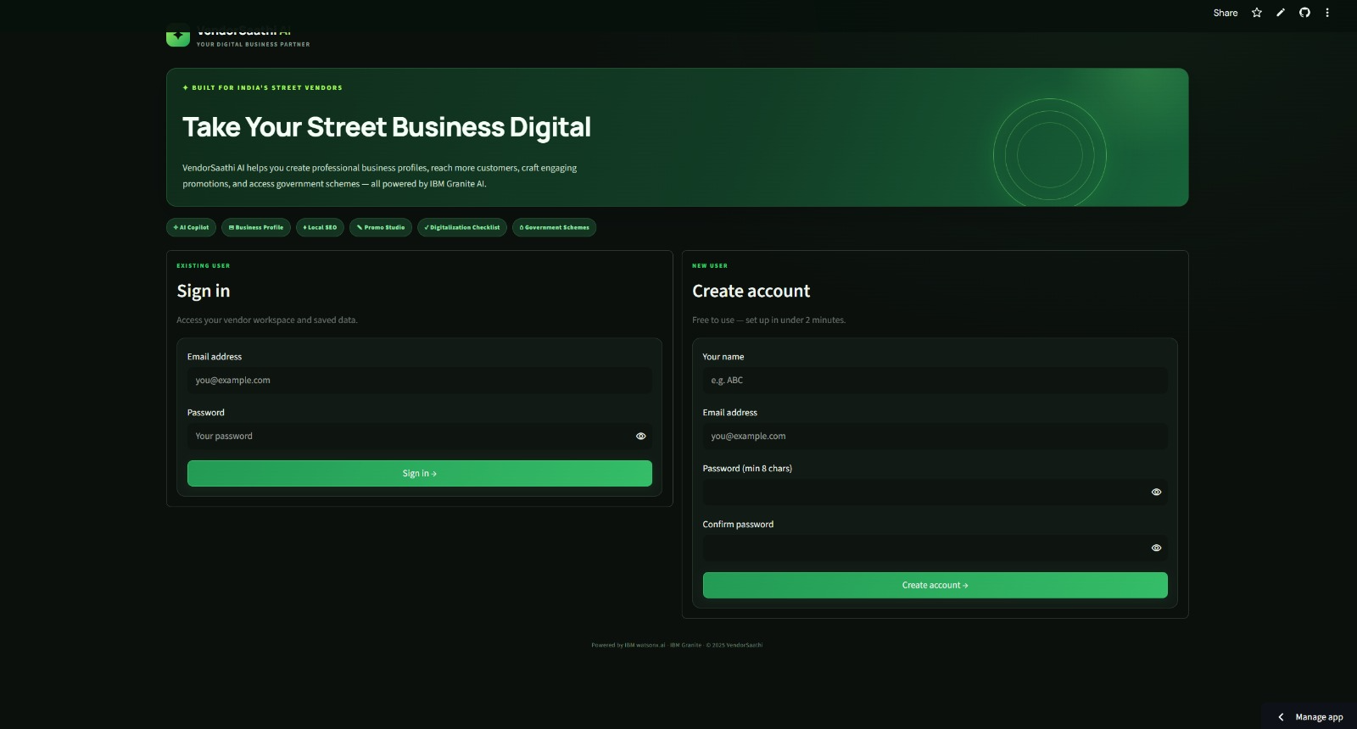
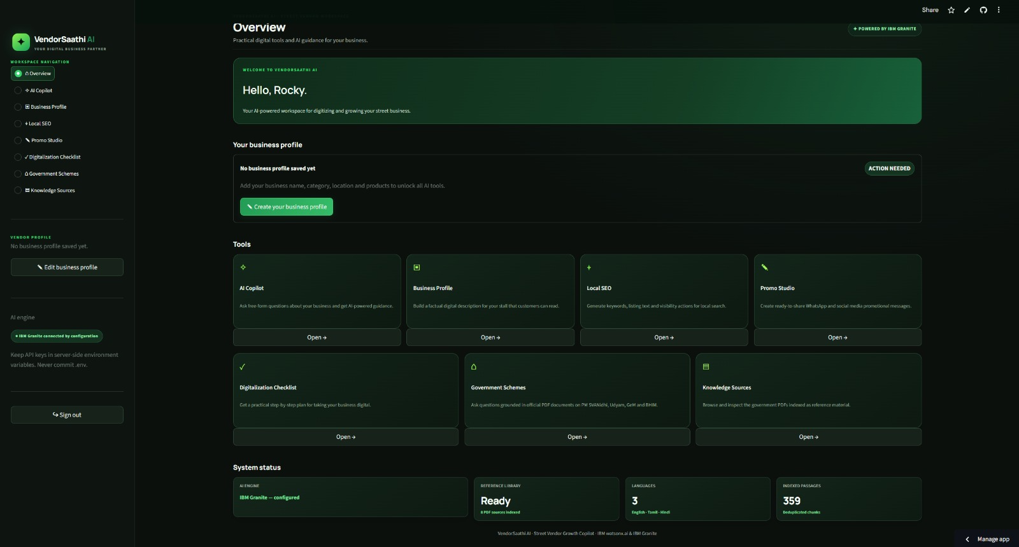

Slide 17
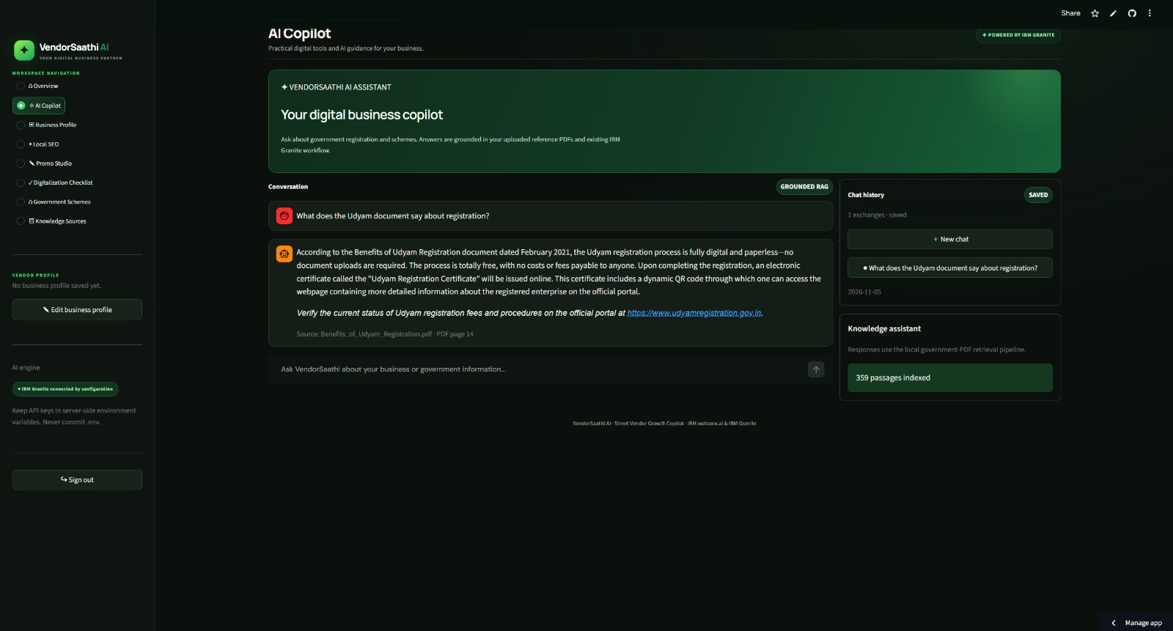
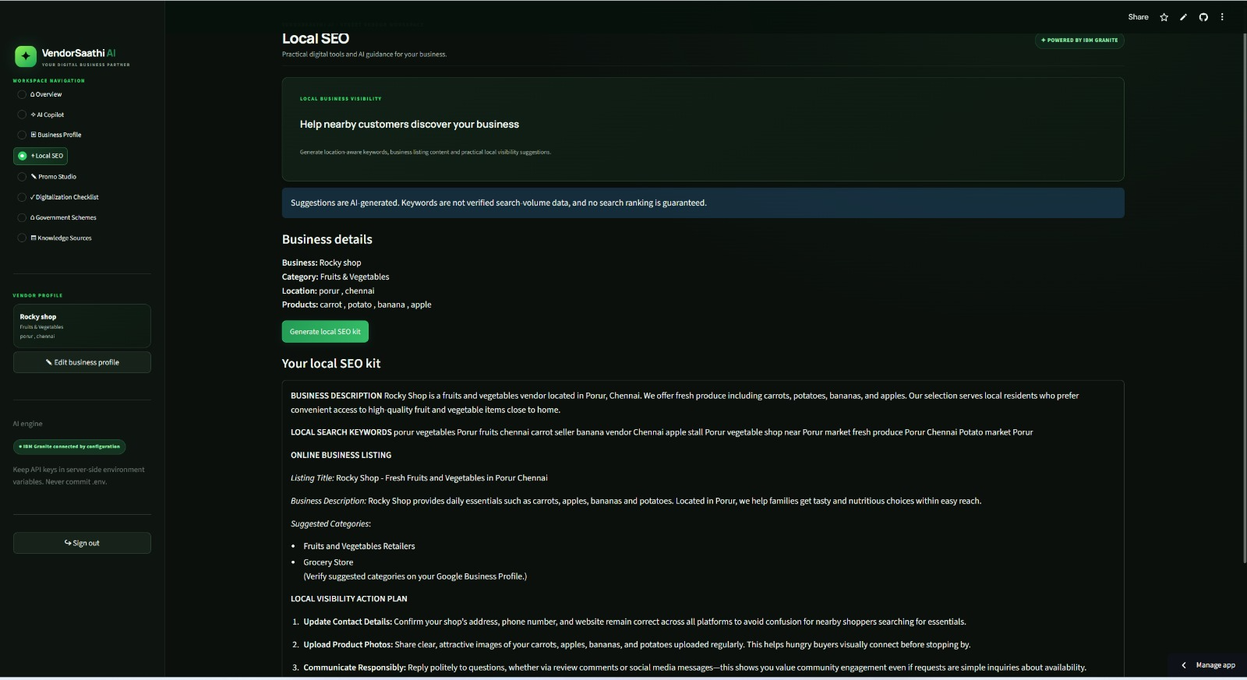

Slide 18
Thank You
VendorSaathi AI
An AI-Powered Growth Copilot for Street Vendors in India
IBM Granite (ibm/granite-4-h-small) · IBM watsonx.ai · Streamlit · Local RAG (pypdf + TF-IDF) · SQLite
github.com/aashya-madhan/VendorSaathi_AI
IBM University Engagement Program · 2025
Notes:
Slide 16 — Thank You. Dark blue background. Large white text. Project name, tagline, tech stack, and GitHub link.

