Slide 2










$$α_{3}$$
$$C_{3}=cone\{ℰ_{3}\}$$
$${−C}_{1}$$
$𝓔_{3}=\{δ_{3}:f_{3}\left(β_{3}^{∗}+δ_{3}\right)≤$ $f_{3}\left(β_{3}^{∗}\right)\}$
$$α_{2}$$
$$o$$
$𝓔_{2}=\{δ_{2}:f_{2}\left(β_{2}^{∗}+δ_{2}\right)≤$ $f_{2}\left(β_{2}^{∗}\right)\}$
$𝓔_{1}=\{δ_{1}:f_{1}\left(β_{1}^{∗}+δ_{1}\right)≤$ $f_{1}\left(β_{1}^{∗}\right)\}$
$$C_{2}=cone\{ℰ_{2}\}$$
$$C_{1}=cone\{ℰ_{1}\}$$

Slide 3


$${−C}_{1}$$
$$C_{3}=cone\{ℰ_{3}\}$$
$$o$$
$𝓔_{3}=\{δ_{3}:f_{3}\left(β_{3}^{∗}+δ_{3}\right)≤$ $f_{3}\left(β_{3}^{∗}\right)\}$
$𝓔_{2}=\{δ_{2}:f_{2}\left(β_{2}^{∗}+δ_{2}\right)≤$ $f_{2}\left(β_{2}^{∗}\right)\}$
$𝓔_{1}=\{δ_{1}:f_{1}\left(β_{1}^{∗}+δ_{1}\right)≤$ $f_{1}\left(β_{1}^{∗}\right)\}$
$$C_{2}=cone\{ℰ_{2}\}$$
$$C_{1}=cone\{ℰ_{1}\}$$

Slide 4









$$α_{4}$$
$$C_{4}$$
$$α_{3}$$
$$C_{3}$$
$${−C}_{0}$$
$$α_{1}$$
$$α_{2}$$
$$C_{1}$$
$$o$$
$$C_{2}$$
$$C_{0}$$

Slide 5





$${−C}_{0}$$
$$C_{4}$$
$$C_{3}$$
$$α_{1}$$
$$o$$
$$C_{2}$$
$$C_{1}$$
$$C_{0}$$

Slide 6





$${−C}_{0}$$
$$o$$
$$C_{4}$$
$$C_{3}$$
$$C_{1}$$
$$C_{2}$$

Slide 7



$${−C}_{0}$$
$$C_{1}$$
$$C_{4}$$
$$o$$
$$C_{3}$$
$$C_{2}$$

Slide 8




$$θ_{4}$$
$$C_{4}$$
$$θ_{3}$$
$$C_{3}$$
$${−C}_{0}$$
$$θ_{1}$$
$$C_{1}$$
$$θ_{2}$$
$$o$$
$$C_{2}$$
$$C_{0}$$

Slide 9

$${−C}_{0}$$
$$C_{4}$$
$$C_{3}$$
$$θ_{1}$$
$$o$$
$$C_{2}$$
$$C_{1}$$
$$C_{0}$$

Slide 10
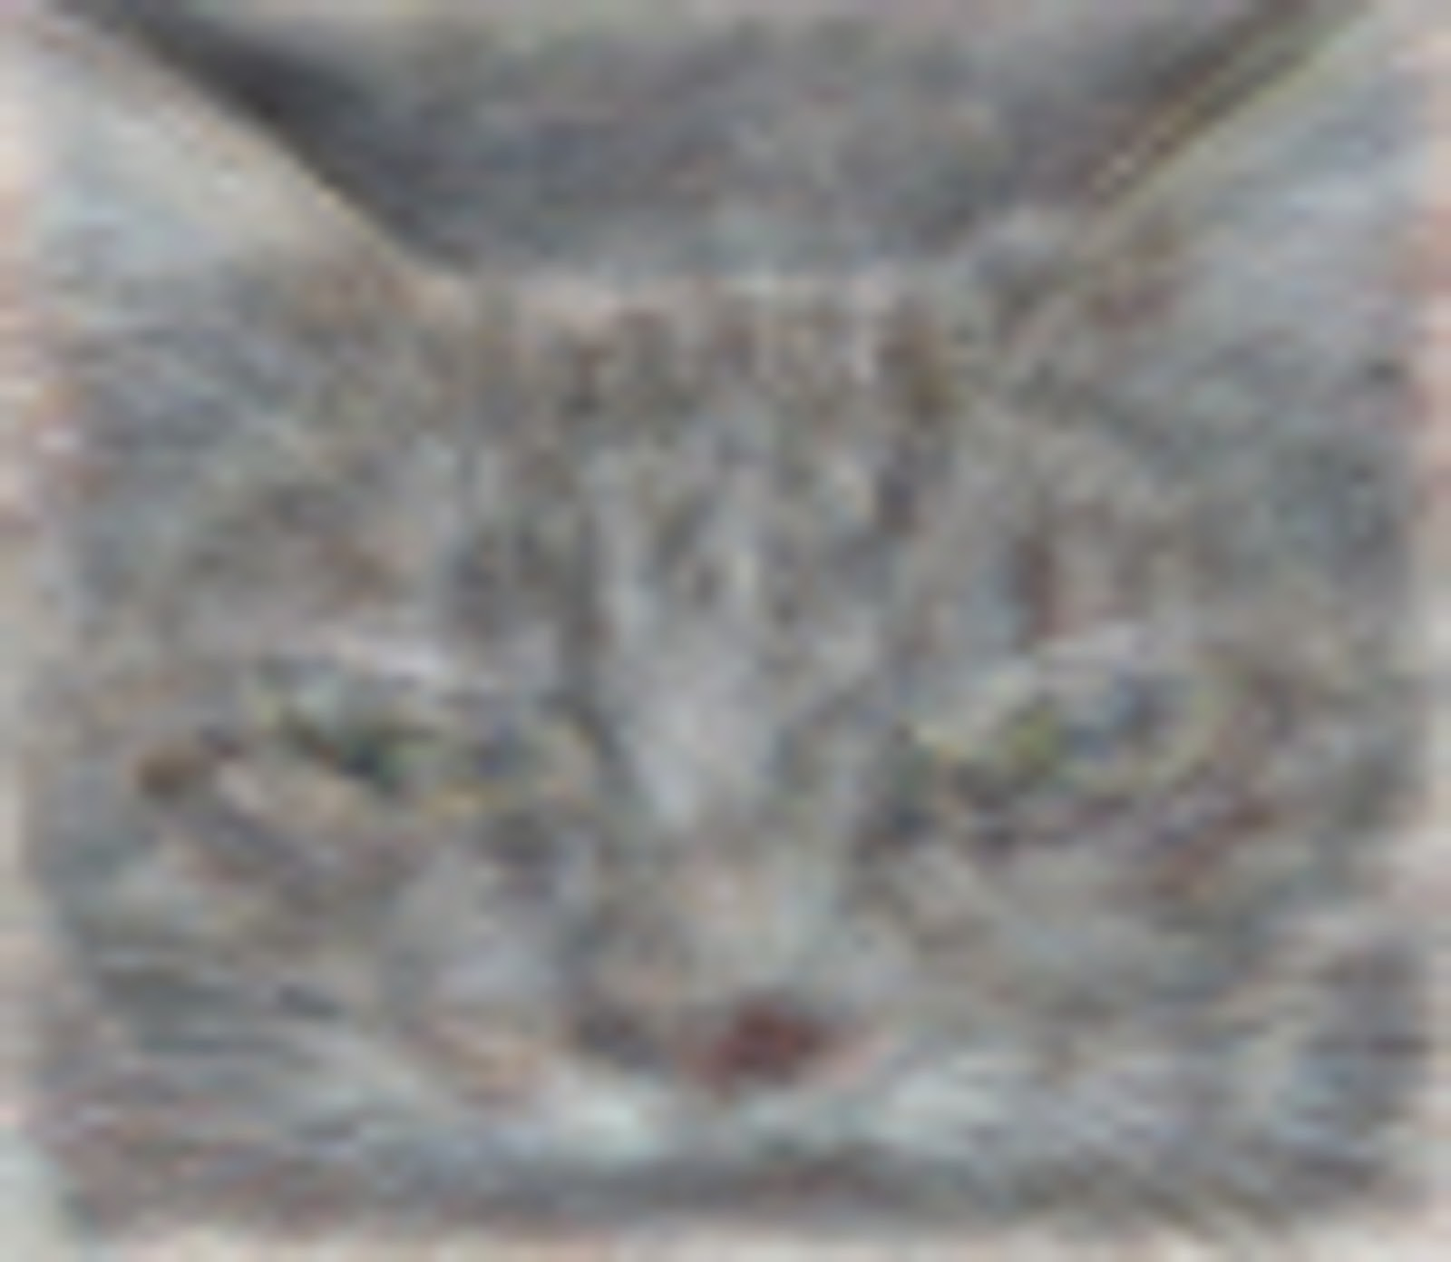

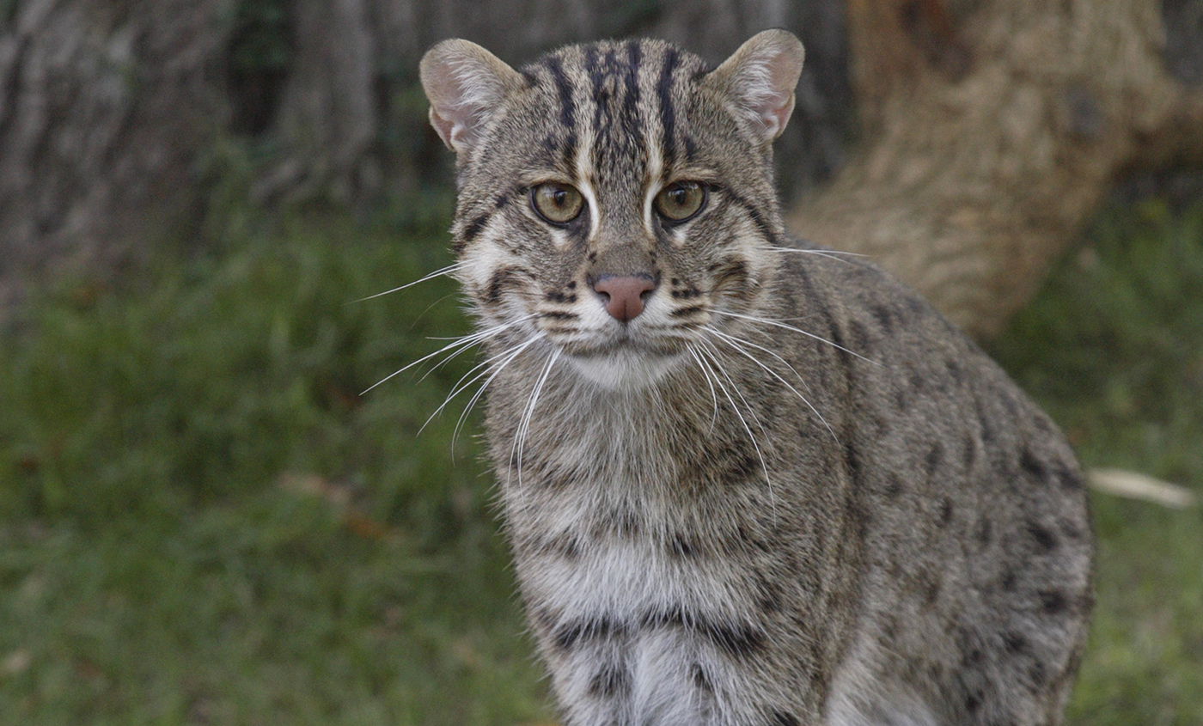
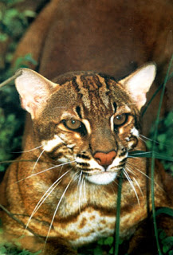


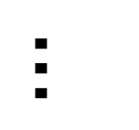


$$β_{1}$$
$$β_{2}$$
$$…$$
$$β_{G}$$
$$β_{0}$$

Slide 11
$${−C}_{1}$$
$$C_{3}=cone\{ℰ_{3}\}$$
$$o$$
$𝓔_{3}=\{δ_{3}:f_{3}\left(β_{3}^{∗}+δ_{3}\right)≤$ $f_{3}\left(β_{3}^{∗}\right)\}$
$𝓔_{2}=\{δ_{2}:f_{2}\left(β_{2}^{∗}+δ_{2}\right)≤$ $f_{2}\left(β_{2}^{∗}\right)\}$
$𝓔_{1}=\{δ_{1}:f_{1}\left(β_{1}^{∗}+δ_{1}\right)≤$ $f_{1}\left(β_{1}^{∗}\right)\}$
$$C_{2}=cone\{ℰ_{2}\}$$
$$C_{1}=cone\{ℰ_{1}\}$$

Slide 12
$${−C}_{0}$$
$$C_{4}$$
$$C_{3}$$
$$α_{1}$$
$$o$$
$$C_{2}$$
$$C_{1}$$
$$C_{0}$$

