Slide 2
















MRSA
$$y_{11}$$
$$x_{11}$$
$$y_{21}$$
$$x_{12}$$
Surgery
…
…
$$y_{21}$$
$$x_{21}$$
$$y_{22}$$
$$x_{22}$$
Central Line
…
…
$$y_{31}$$
$$x_{31}$$
$$y_{32}$$
$$x_{32}$$
Urinary Catheter
…
…
$$y_{41}$$
$$x_{41}$$
$$y_{42}$$
$$x_{41}$$
Ventilator
…
…
$$y^{M}$$

Slide 3
Single Pathogen Multiple HAI
Pathogens can cause different HAI types.
Previous studies: Most infectious disease studies focus on patients with an HAI and find risk factors.
Look at all patients that had surgery and predict general infection risk
Look at all patients and predict risk of MRSA infection.
We put together all types of HAI and predict one pathogen
This is exactly data sharing
The problem is we have overlapping group: patients with urinary catheter in usually have also blood catheter in

Slide 4
SSI Risk Factors
Patient history
include existing infection, low serum albumin concentration, older age, obesity, smoking, diabetes mellitus, and ischemia secondary to vascular disease or irradiation.
Surgical
include prolonged procedures and inadequacies in either the surgical scrub or the antiseptic preparation of the skin.
Physiological states
trauma, shock, blood transfusion, hypothermia, hypoxia, and hyperglycemia.
Others
include abdominal surgery, a contaminated or dirty operation, and more than three diagnoses at the time of discharge.
Many MDRO can cause SSI

Slide 5
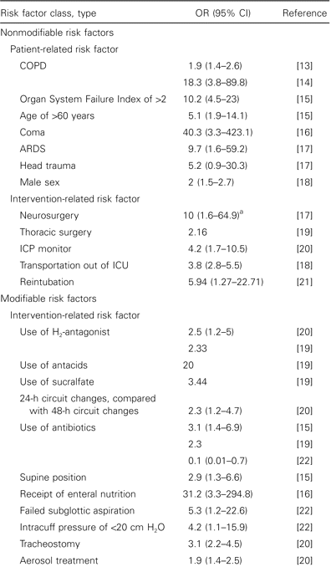
VAP Risk Factors
VAP is defined as pneumonia occurring ⩾48 h after intubation and the start of mechanical ventilation.

Slide 6
CAUTI
Most common but easy to treat
On univariate analysis purpose for urine catheterization, place of catheterization, breach in the closed system of drainage, duration of catheterization, hemoglobin value less than 10, raised renal parameters with serum creatinine more than 1.5 were all significantly associated with development of CAUTI
On multivariate analysis, age, catheter size, diabetes, duration of catheterization, a breach in the closed system of catheter drainage and sex were found to be the significant risk factors associated with CAUT

Slide 7

















































GNB
CDI
VRE
MRSA
$$y_{11}^{G}$$
$$y_{11}^{C}$$
$$y_{11}^{V}$$
$$y_{11}^{M}$$
$$x_{11}$$
$$y_{12}^{G}$$
$$y_{12}^{C}$$
$$y_{12}^{V}$$
$$y_{12}^{M}$$
$$x_{12}$$
Surgery
…
…
…
…
…
$$x_{ij}^{G}$$
$$y_{21}^{G}$$
$$y_{21}^{C}$$
$$y_{21}^{V}$$
$$y_{21}^{M}$$
$$x_{21}$$
$$y_{22}^{G}$$
$$y_{22}^{C}$$
$$y_{22}^{V}$$
$$y_{22}^{M}$$
$$x_{22}$$
$$y_{ij}^{G}$$
$$y_{ij}^{M}$$
Central Line
…
…
…
…
…
$$y_{31}^{V}$$
$$y_{ij}^{C}$$
$$y_{ij}^{V}$$
$$y_{31}^{G}$$
$$y_{31}^{C}$$
$$y_{31}^{M}$$
$$x_{31}$$
$$y_{32}^{G}$$
$$y_{32}^{C}$$
$$y_{32}^{V}$$
$$y_{32}^{M}$$
$$x_{32}$$
Urinary Catheter
…
…
…
…
…
$$y_{41}^{G}$$
$$y_{41}^{C}$$
$$y_{41}^{V}$$
$$y_{41}^{M}$$
$$x_{41}$$
$$y_{42}^{G}$$
$$y_{42}^{C}$$
$$y_{42}^{V}$$
$$y_{42}^{M}$$
$$x_{41}$$
Ventilator
…
…
…
…
…
$$y^{G}$$
$$y^{C}$$
$$y^{V}$$
$$y^{M}$$

Slide 8
CDI risk factors
increasing age (excluding infancy), severity of underlying diseases, non-surgical gastrointestinal procedures, presence of a nasogastric tube, anti-ulcer medications, stay on ITU, duration of hospital stay, duration of antibiotic course, administration of multiple antibiotics.

Slide 9
MRSA risk factors
Independent risk factors for MRSA-C/I in ICU were:
age>65, trauma or medical patient, high APACHE-II score, admitted from a long-term care facility, urinary catheter, previous antibiotic treatment and skin-soft tissue or post-surgical superficial skin infections. Colonisation with several different MDRs significantly increased the risk of MRSA-C/I.
Risk factors on ICU admission were:
male gender, trauma critical patient, urgent surgery, admitted from other ICUs, hospital ward or long-term facility, immunosuppression and skin-soft tissue infection.

Slide 10
VRE risk factors
Risk factors for VRE bacteremia include
hemodialysis; organ transplantation; receipt of corticosteroids, chemotherapy, or parenteral nutrition; surgery; severe illness; long-term antibiotic administration; indwelling urinary catheters; neutropenia; and mucositis

Slide 11
GNB risk factors
Risk factors for colonization and infection with an MDR gram-negative bacterium include age greater than 65 years, antibiotic exposure within the preceding 90 days, hospital admission for at least 2 days in the preceding 90 days, residence in a nursing home, having an indwelling catheter (central venous, arterial, or urinary), mechanical ventilation, tube feeding, hepatic failure, and long-term hemodialysis

Slide 12









CDI
$$y_{1}^{C}$$
$$x_{1}$$
$$x_{11}$$
$$y_{2}^{C}$$
$$x_{2}$$
Unit 1
$$x_{12}$$
…
…
Unit 2
$$x_{31}$$
$$x_{32}$$
Unit 3
…
…
Unit 8
$$x_{91}$$
$$x_{92}$$
Unit 9
…
$$y^{C}$$
Features shared by all facilities

Slide 13











CDI
$$y_{1}^{C}$$
$$x_{1}$$
$$x_{11}$$
$$y_{2}^{C}$$
$$x_{2}$$
Unit 1
$$x_{12}$$
…
…
Floor 1
Unit 2
$$x_{31}$$
$$x_{32}$$
Unit 3
Facility 1
…
…
Floor 2
Unit 8
$$x_{91}$$
$$x_{92}$$
Unit 9
Floor 3
…
$$y^{C}$$
Features shared by all facilities

Slide 14
























GNB
CDI
VRE
MRSA
$$y_{11}^{C}$$
$$y_{11}^{V}$$
$$x_{1}$$
$$y_{11}^{G}$$
$$y_{11}^{M}$$
$$x_{11}$$
$$y_{12}^{C}$$
$$y_{12}^{V}$$
$$x_{2}$$
Unit 1
$$y_{12}^{G}$$
$$y_{12}^{M}$$
$$x_{12}$$
…
…
…
…
…
Floor 1
Unit 2
$$y_{21}^{G}$$
$$y_{21}^{C}$$
$$y_{21}^{V}$$
$$y_{21}^{M}$$
$$y_{22}^{G}$$
$$y_{22}^{C}$$
$$y_{22}^{V}$$
$$y_{22}^{M}$$
$$x_{31}$$
…
…
…
…
$$x_{32}$$
Unit 3
Facility 1
…
…
Floor 2
$$y_{31}^{G}$$
$$y_{31}^{C}$$
$$y_{31}^{V}$$
$$y_{31}^{M}$$
$$y_{32}^{G}$$
$$y_{32}^{C}$$
$$y_{32}^{V}$$
$$y_{32}^{M}$$
Unit 8
…
…
…
…
$$y_{41}^{G}$$
$$y_{41}^{C}$$
$$y_{41}^{V}$$
$$y_{41}^{M}$$
$$x_{91}$$
$$y_{42}^{G}$$
$$y_{42}^{C}$$
$$y_{42}^{V}$$
$$y_{42}^{M}$$
$$x_{92}$$
Unit 9
Floor 3
…
…
…
…
…
$$y^{G}$$
$$y^{C}$$
$$y^{V}$$
$$y^{M}$$
Features shared by all facilities

Slide 15

Hierarchy in Facilities
Six intensive care units (ICUs): surgical (SICU), medical (MICU), cardiac care (CCU), and three trauma (TICU)
Patients in same units are similar that is captured by the fixed effect
The care is different in each unit and captured by the random effect
$X_{u}β_{0}+β_{unit}+β_{floor}+…$

Slide 16
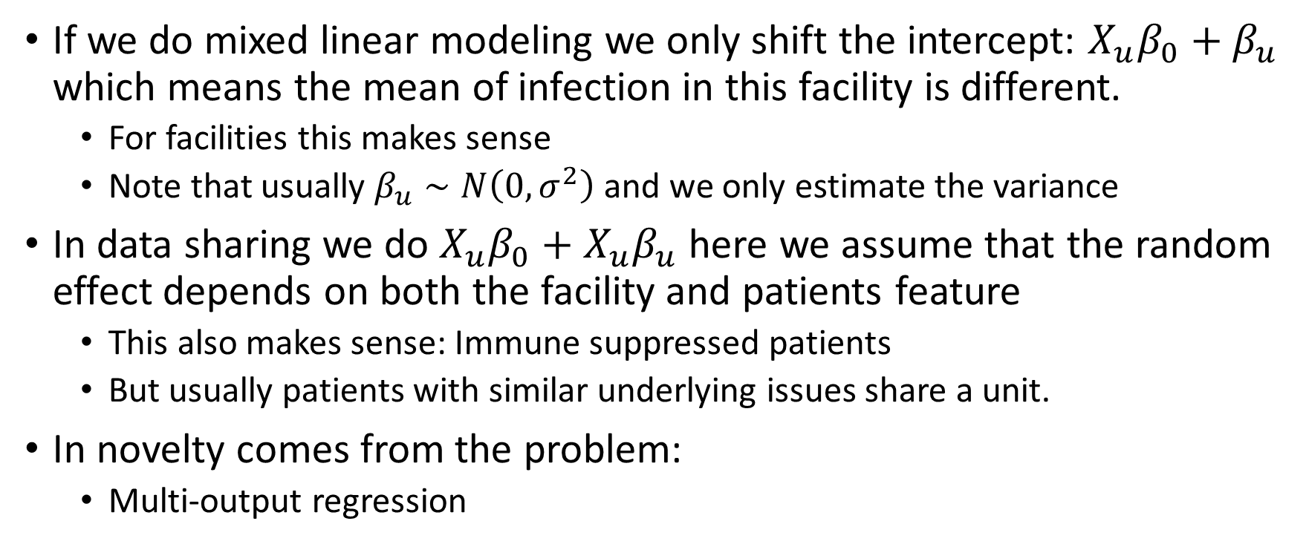
Facility and Unit Modeling
If we do mixed linear modeling we only shift the intercept: $X_{u}β_{0}+β_{u}$ which means the mean of infection in this facility is different.
For facilities this makes sense
Note that usually $β_{u}∼N\left(0, σ^{2}\right)$ and we only estimate the variance
In data sharing we do $X_{u}β_{0}+X_{u}β_{u}$ here we assume that the random effect depends on both the facility and patients feature
This also makes sense: Immune suppressed patients
But usually patients with similar underlying issues share a unit.
In novelty comes from the problem:
Multi-output regression

Slide 17


CDI
$$y_{1}^{C}$$
$$x_{1}$$
$$x_{11}$$
$$y_{2}^{C}$$
$$x_{2}$$
$$x_{12}$$
…
…
…
Facility 1
$$x_{21}$$
$$x_{22}$$
…
Facility 2
$$x_{31}$$
$$x_{32}$$
Facility 3
…
$$y^{C}$$
Features shared by all facilities
Shared by each two facility
Specific for each

Slide 18
Why do we want the time?

Slide 19
What is y?

Slide 22
