Slide 2
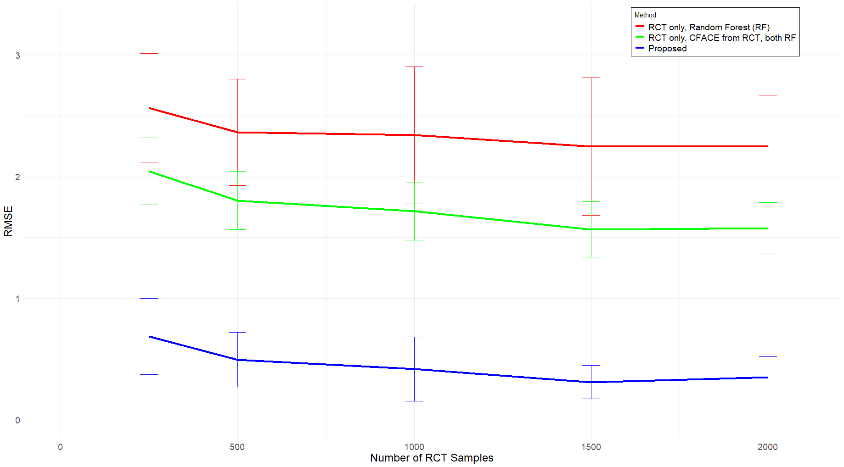
RMSE
Number of RCT Samples

Slide 3
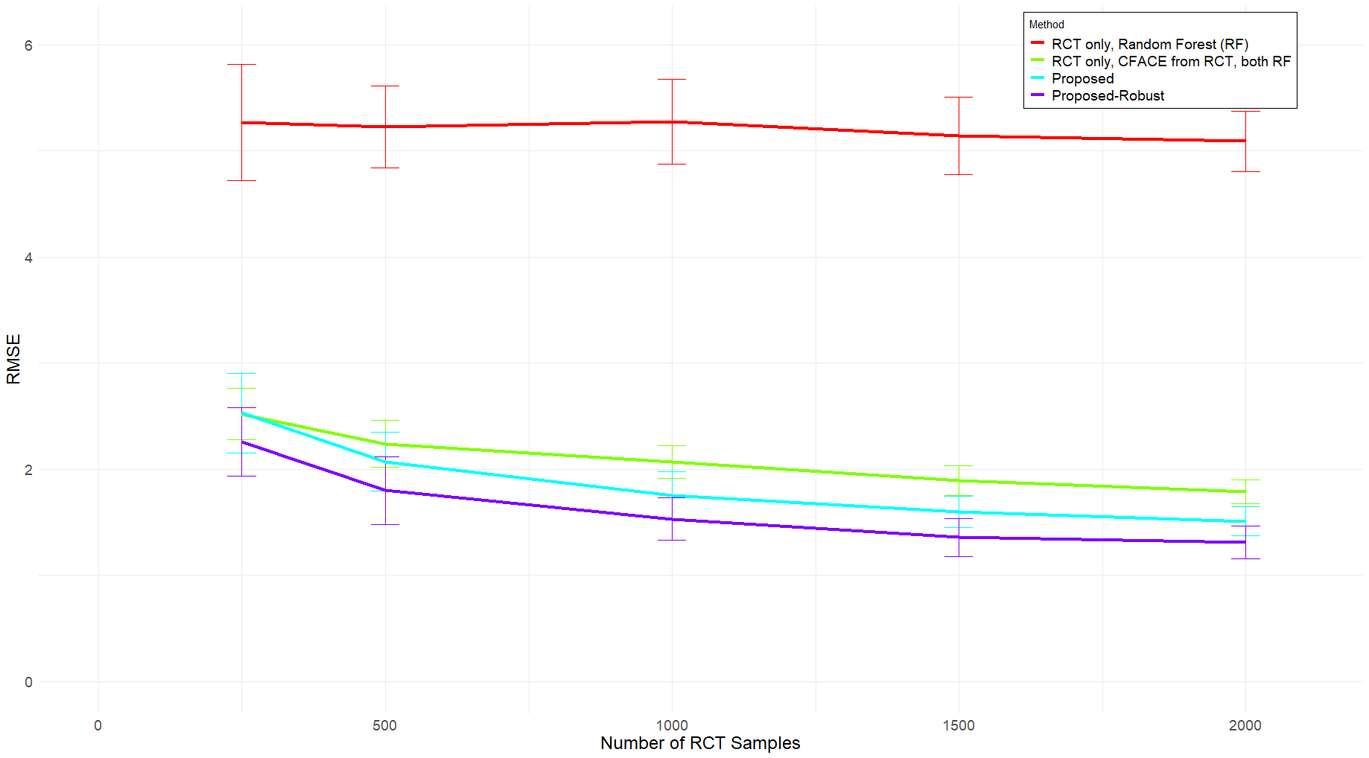
RMSE
Number of RCT Samples

Slide 4
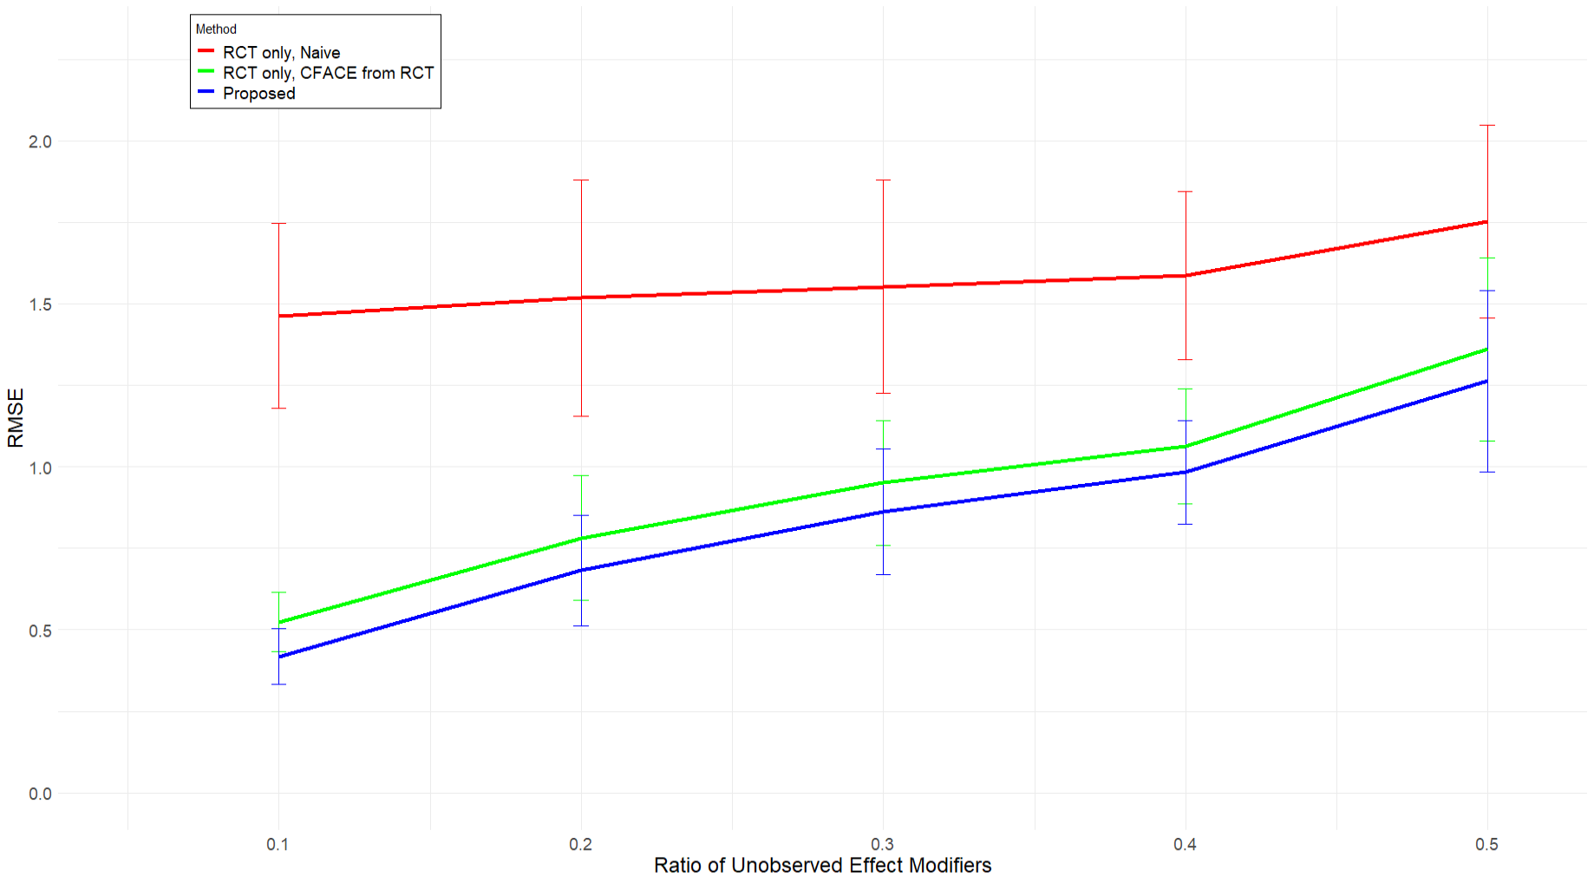
RMSE
Ratio of Unobserved Effect Modifiers

Slide 5
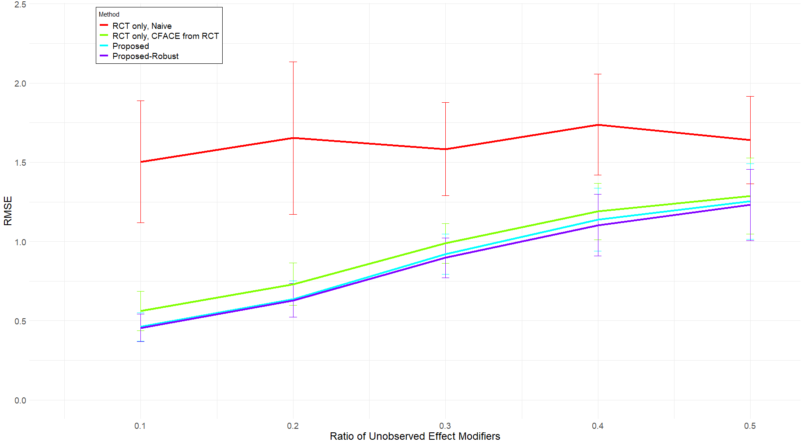
RMSE
Ratio of Unobserved Effect Modifiers

