Slide 1
Hierarchical clustering
methods that represent clusters using trees
Trees called dendrograms -
which are defined in terms of a distance measure

Slide 2
Types
Agglomerative Hierarchical Clustering
Divisive Hierarchical Clustering

Slide 3
Agglomerative Hierarchical Clustering
It's a “bottom-up” approach: each observation starts in its own cluster, and pairs of clusters are merged as one moves up the hierarchy.
Make each data point a single-point cluster → forms N clusters
Take the two closest data points and make them one cluster → forms N-1 clusters
Take the two closest clusters and make them one cluster → Forms N-2 clusters.
Repeat step-3 until you are left with only one cluster.

Slide 4
Sample Dendogram
A dendrogram of domain set fx1; : : : ; x8g. The horizontal lines represent levels
and every leaf is associated with an element of the domain.

Slide 5
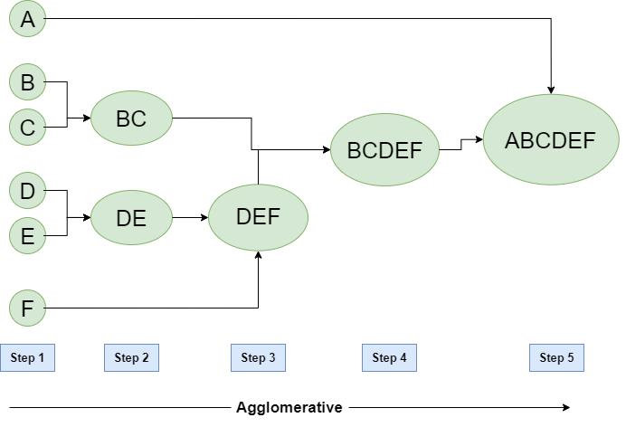

Slide 7
The tree shows that the three logical methods at the top form a strong cluster.
If we wanted three clusters, we get the logical cluster, a second small cluster {GMM,naive Bayes}, and the remainder.
If we wanted four clusters, we would separate GMM and naive Bayes, as the tree indicates this cluster is the least tight of the three
If we wanted five clusters, we would construct {Linear Regression,LinearClassifier} as a separate cluster
doesn’t require fixing the number of clusters in advance.

Slide 8
Distance between data points represents dissimilarities.
Height of the blocks represents the distance between clusters.

Slide 9
Dendrogram - definition
Given a data set D, a dendrogram is a binary tree with the elements of D at its leaves.
An internal node of the tree represents the subset of elements in the leaves of the subtree rooted at that node.
The level of a node is the distance between the two clusters represented by the children of the node. Leaves have level 0.

Slide 10
Linkage function - Definition
During of hierarchical clustering, the distance between two sub-clusters needs to be computed.
The different types of linkages describe the different approaches to measure the distance between two sub-clusters of data points
linkage function L : 2^{X} ×2^{X} → R calculates the distance between arbitrary subsets of the instance space, given a distance metric Dis :X ×X →R

Slide 11
most common linkage functions
Single linkage
defines the distance between two clusters as the smallest pairwise distance between elements from each cluster.
Complete linkage
defines the distance between two clusters as the largest pointwise distance.
Average linkage
defines the cluster distance as the average pointwise distance.
Centroid linkage
defines the cluster distance as the point distance between the cluster means.

Slide 12
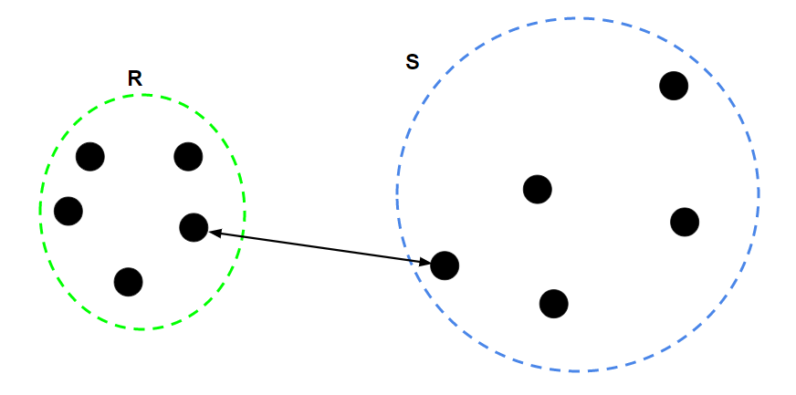
Single Linkage
For two clusters R and S, the single linkage returns the minimum distance between two points i and j such that i belongs to R and j belongs to S.

Slide 13
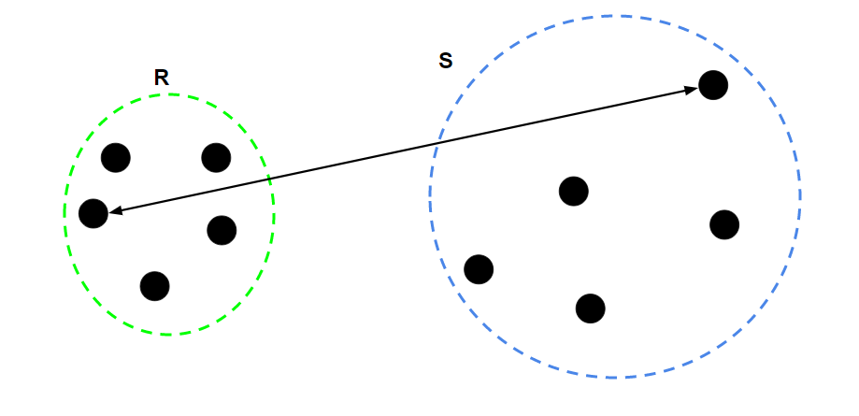
Complete Linkage
Complete Linkage: For two clusters R and S, the single linkage returns the maximum distance between two points i and j such that i belongs to R and j belongs to S.

Slide 14
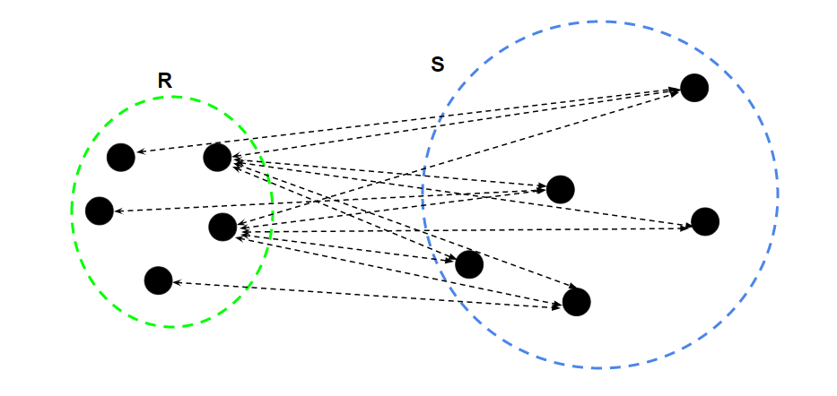
Average Linkage
Average Linkage: For two clusters R and S, first for the distance between any data-point i in R and any data-point j in S and then the arithmetic mean of these distances are calculated. Average Linkage returns this value of the arithmetic mean

Slide 15
Mathematical representation of linkage functions

Slide 16
Clearly, all these linkage functions coincide for singleton clusters: L({x}, {y}) = Dis(x, y).
For example, suppose Dis(x, y) < Dis(x, z), then the linkage between {x} and {y, z} is different in all four cases:
L_{single}({x}, {y, z}) = Dis(x, y)
L_{complete}({x}, {y, z}) = Dis(x, z)
L_{average}({x}, {y, z}) = Dis(x, y)+Dis(x, z)/2
L_{centroid}({x}, {y, z}) = Dis(x, (y +z)/2)

Slide 17
Hierarchical clustering using single linkage can essentially be done by calculating and sorting all pairwise distances between data points, which requires O(n²) time for n points.
The other linkage functions require at least O(n² logn).

Slide 18
Algorithm HAC(D,L) – Hierarchical agglomerative clustering

