Slide 1

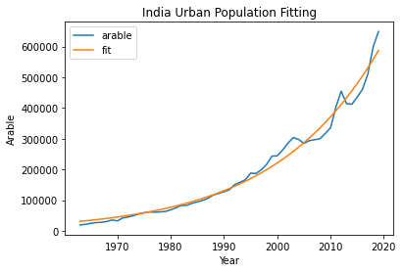
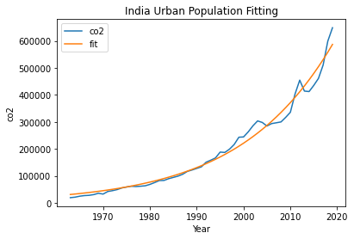
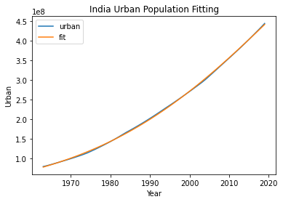
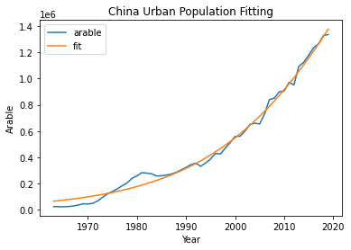
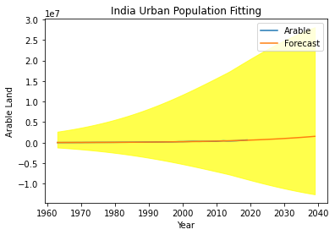
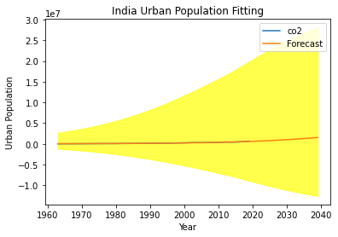
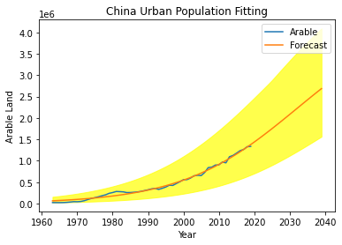
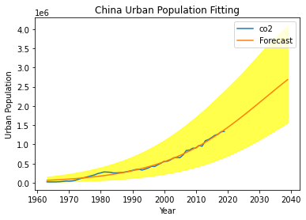
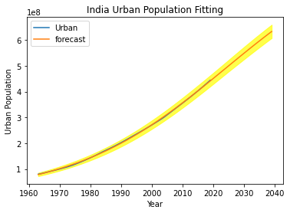
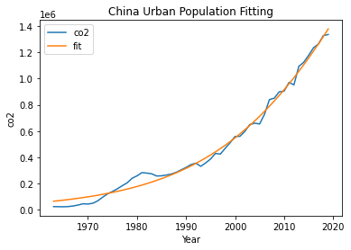
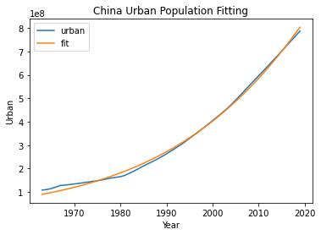
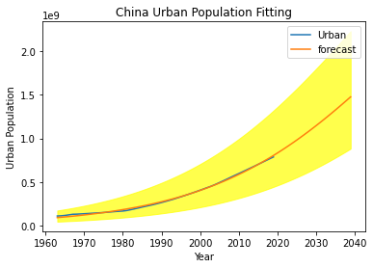
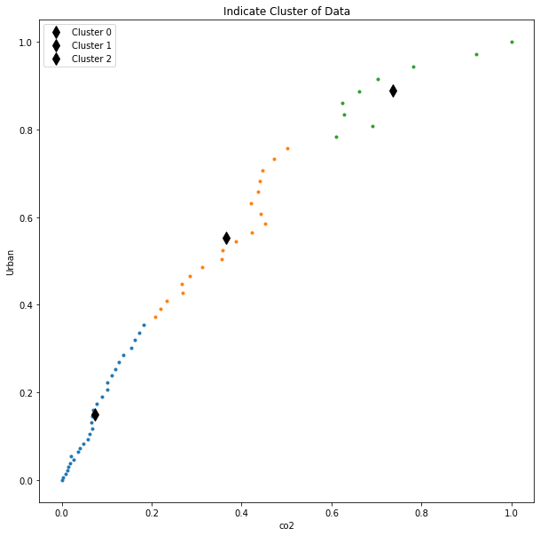
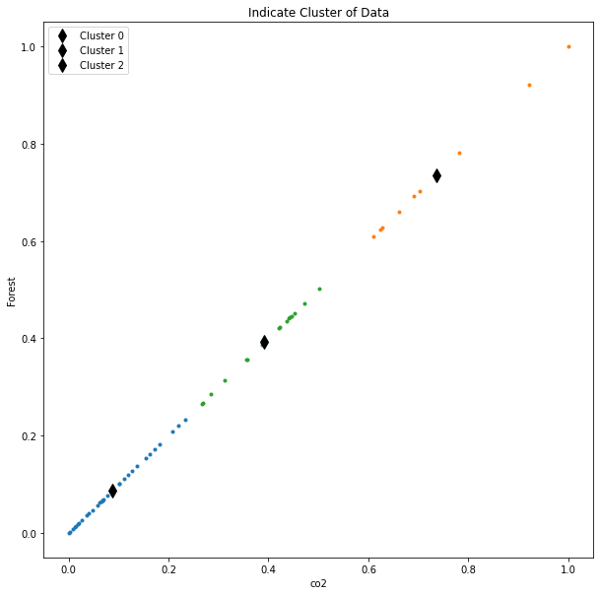
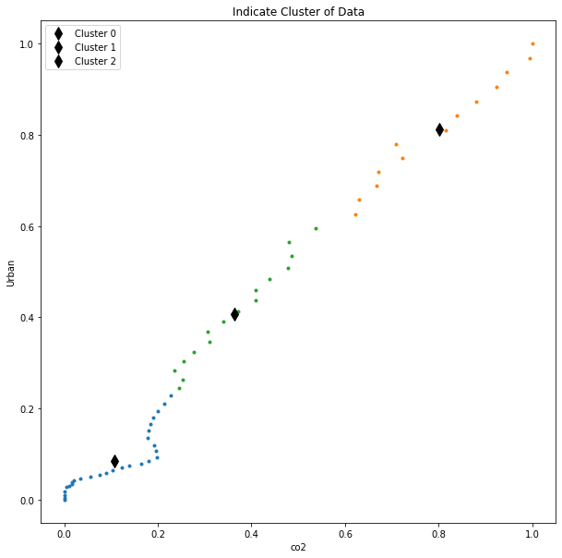
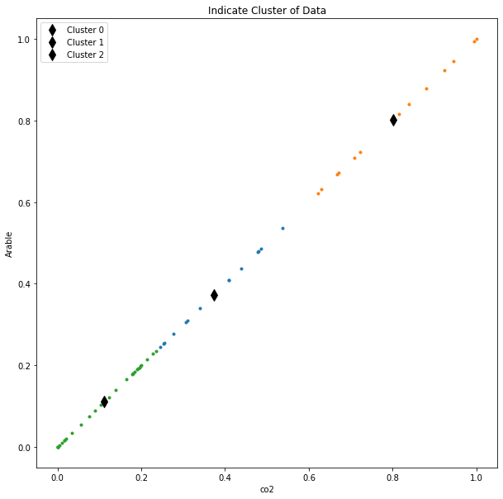
Clustering and Fitting (World Development Indicators)
Student: Aasim Ghaffar (21084757) Teacher: Ralf Napiwotzki
Introduction
In the research, we seem to be at the carbon emission(co2) impact on international warming and how it is affecting the ozone layer we test the relation of carbon emission with GDP and various elements that make bigger carbon emission and the cause for ozone depletion which motives international warming.
Background
In the latest researches suggests that the temperature on earth is consistently growing with the common of 1 diploma centigrade in decade and this common will expand from 1 to 1.14 in some upcoming years if price continue to be equal then planet will now not continue to be livable.
Overview
Reasons
CO2 Emission
Deforestation
Industrialization
Burning fossil fuel
Population Boom
Solutions
Global warming can be decreased through tree plantation and the usage of inexperienced power as a substitute of burning fossils Fuels and Recycling.
Description
Major countries of south Asia are affected by the global warming especially India and Pakistan The Industrialization and deforestation is the main cause of global warming. These countries don’t produce too much CO2, but they are most effected by the global warming glaciers are melting is this region and these countries also effected by water scarcity.
Methodology
We used the local weather alternate information to evaluation for world warming records is accumulated from the world financial institution. To analyze the data, We used ok ability for Data clustering which is unsupervised studying algorithm. We additionally exhibit correlation between the unique indications the usage of correlation and then plot on warmth map.
Conclusion
Consequences
Temperature Increasing
Ozone Depletion
Melting Glaciers
Drought
Solutions
Tree Plantation
Reduction of CO2
Use Biofuel
Stop Fossils Fuel

