Slide 1
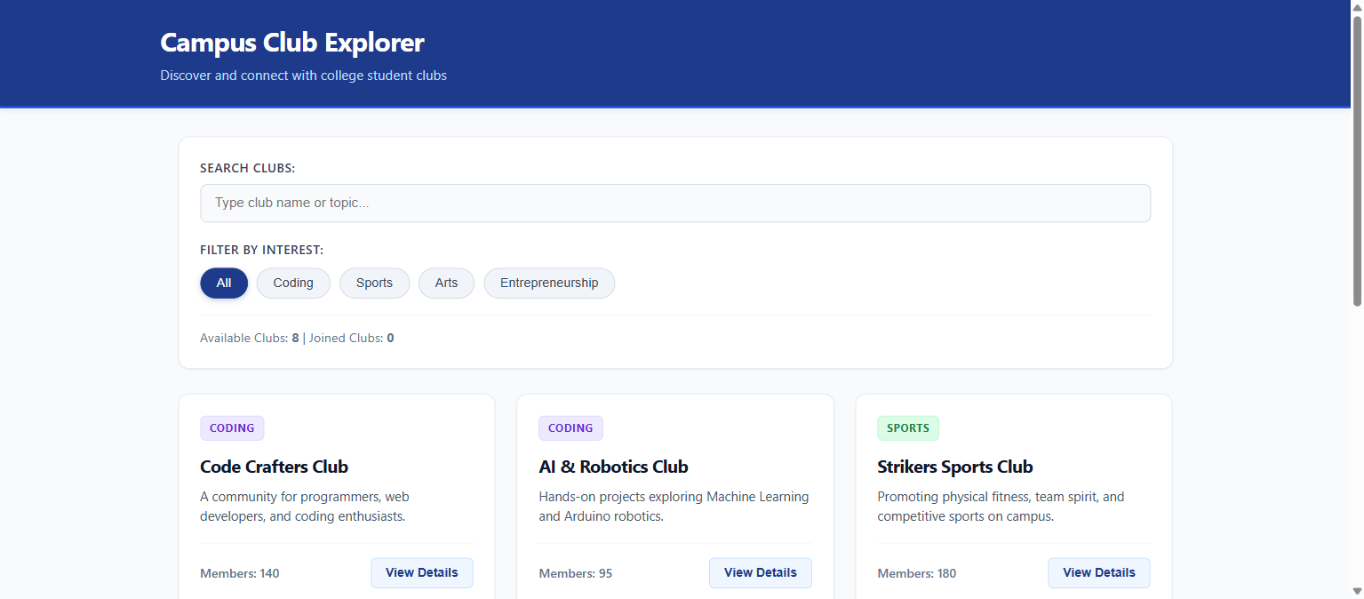
CAMPUS CLUB EXPLORER
React Web Application Project
A React-Based Web Application for College Club Discovery & Management
Project Highlights & Assessment Info:
• Department of Computer Science & Engineering
• College Lab Training Assessment Project
• Built with React 18, Vite & Solid-Color CSS3
• Features: Props • Lists & Keys • Filters • Conditional Rendering
Notes:
Respected Sir and faculty members, this is my React training assessment project titled 'Campus Club Explorer'. It is a single-page web portal designed for college students to discover clubs, filter by domain, search by keywords, view meeting details, and manage club memberships.

Slide 2
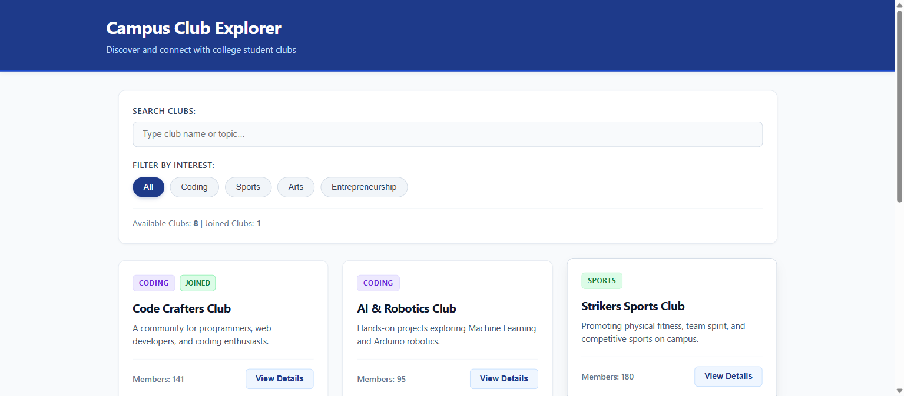
Problem Statement & Solution Architecture
Slide 2 / 6
1. Campus Problem
Club activities and meeting schedules are fragmented across noticeboards and chat groups, leading to low student awareness and participation.
2. Project Solution
A centralized, interactive web application allowing students to browse clubs across Coding, Sports, Arts, and Entrepreneurship.
3. Technology Stack
React 18 for component architecture, Vite for sub-second hot reloading, and solid-color CSS3 for clean aesthetics.
4. Unidirectional Architecture
App.jsx serves as the central state hub, passing data down via props and receiving user events via callback functions.
Live Dashboard with Category Filters & Club Cards
Notes:
Sir, on our campus students often miss club meetings because info is scattered. Campus Club Explorer centralizes all information. Architecturally, App.jsx manages state and passes data down to child components following React's unidirectional flow.

Slide 3
React Concepts 1 & 2: Props, Reuse, Lists & Keys
Slide 3 / 6
1. Props (Data Passing)
Props are read-only inputs passed from App.jsx to ClubCard (club, isJoined, onViewDetails). This decouples UI from state.
2. Component Reuse
The ClubCard component is authored once and dynamically reused across all 8 campus clubs with zero duplicate markup.
3. Lists Rendering (.map)
JavaScript's .map() loops through the filtered clubs array and returns a <ClubCard /> for every matched item.
4. The Unique 'key' Prop
Each item receives key={club.id}. This enables React's Virtual DOM reconciliation engine to track item updates efficiently.
Component Reuse: 8 Clubs Rendered via .map() with unique keys
Notes:
Sir, here are two major concepts: Props and Lists. Instead of writing 8 separate cards, we created one reusable ClubCard component. We map over the array using club.id as the key, which lets React re-render only the exact card that changes.

Slide 4
React Concept 3: Dynamic Search & Category Filtering
Slide 4 / 6
1. Controlled Form Inputs
searchQuery and selectedCategory are maintained in React state using the useState hook.
2. Simultaneous Dual-Predicate Filter
The filtering function evaluates category matching ('All' or exact) AND keyword matching (.includes()) together on every keystroke.
3. Zero Page Reloads
Filtered results update reactively in real time without refreshing the browser.
4. User Ergonomics
Includes an instant 'Clear' search button and active category pill buttons with visual state highlights.
Search Bar & Category Pills (Coding, Sports, Arts, E-Cell)
Notes:
Our search and filter UI evaluates both the active category button and the search text simultaneously. When a student selects 'Coding' and types 'AI', it filters instantly without page reloads using clean array methods.

Slide 5
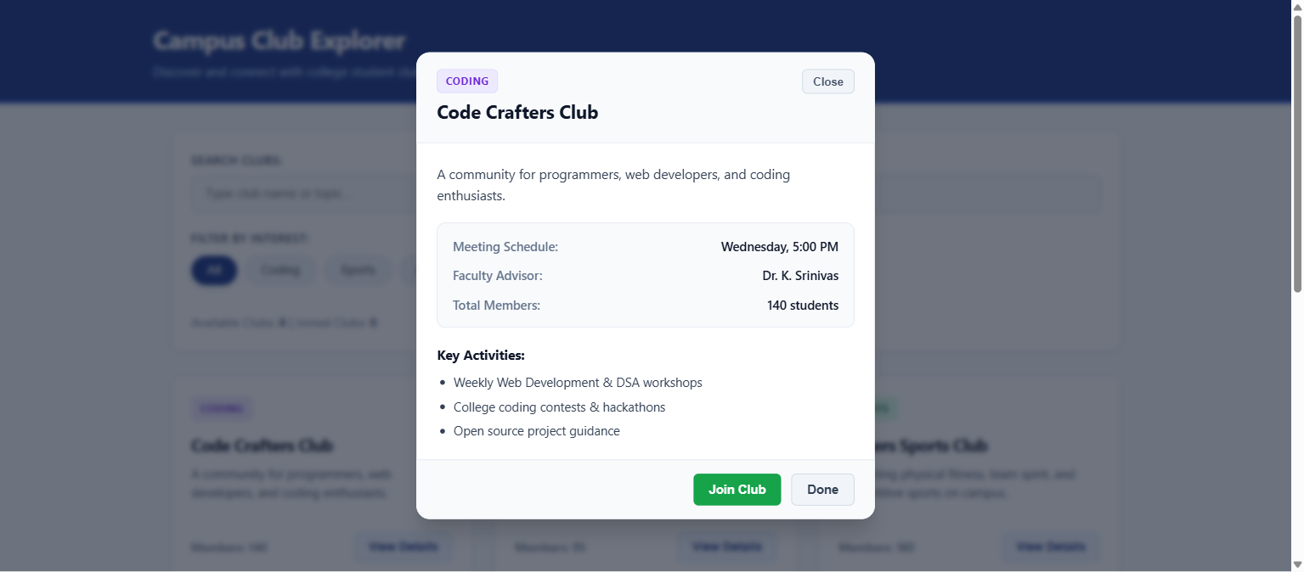
React Concept 4: Conditional Rendering & Modal Dialog
Slide 5 / 6
1. Short-Circuit Modal Rendering
{selectedClub && <ClubModal ... />} ensures zero modal DOM overhead until a club is clicked.
2. Empty State Fallback
Ternary operator renders the club grid when items exist, or a friendly 'No clubs found' box with a 'Reset Filters' button.
3. Comprehensive Club View
Modal displays meeting schedule, faculty coordinator advisor, member count, and bulleted activities list.
4. Accessible Interaction
Modal closes gracefully on clicking the 'Close' button, 'Done' button, or tapping the darkened background.
Interactive Club Details Modal with Advisor & Meeting Schedule
Notes:
Sir, we demonstrated Conditional Rendering in multiple places: showing the modal only when selectedClub is not null, showing an empty state message if no clubs match, and closing the modal cleanly on background click.

Slide 6
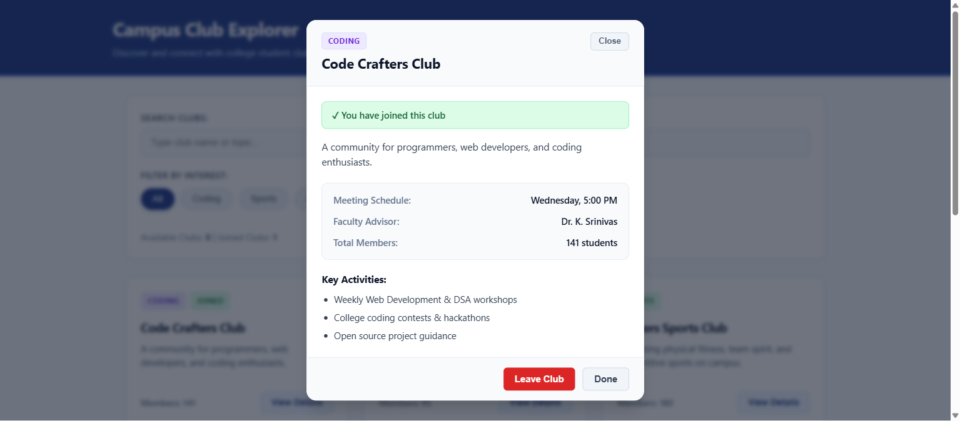
Interactive Membership, Test Verification & Conclusion
Slide 6 / 6
1. Interactive Join / Leave
Clicking 'Join Club' toggles membership, increments member count, and changes button to 'Leave Club'.
2. Persistent 'JOINED' Tag
Card immediately displays a green 'JOINED' badge on the dashboard, tracking student membership.
3. Real-Time Popup Alerts
Displays green toast alert: 'Success: You have joined [Club]!' auto-dismissed in 3 seconds.
4. Test Verification & Build
All 8 test cases PASS. Production build completes with zero errors in under 500ms via Vite.
Live Joined Status Banner, Leave Button & Real-Time Feedback
Notes:
Finally, we implemented interactive membership tracking. When you join, it shows a popup message, updates member count, and marks the card with a JOINED badge. All test cases passed with zero build errors. Thank you, Sir!

