Slide 1
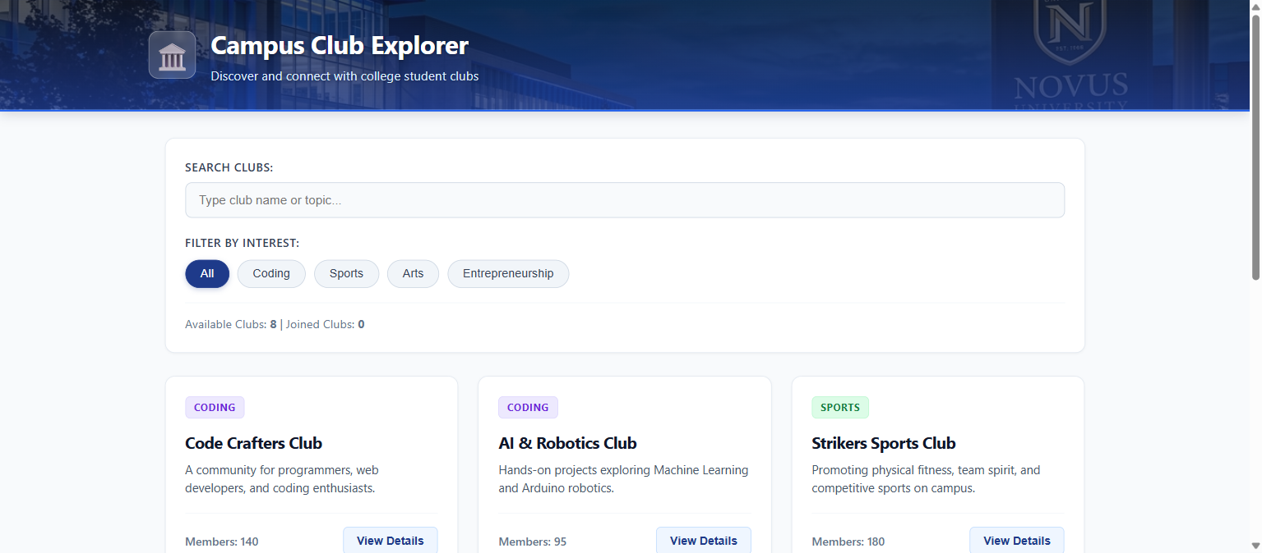
COLLEGE TRAINING LAB ASSESSMENT
Campus Club Explorer
An Interactive React Web Application for Discovering and Managing College Student Clubs
————————————————————————————
Department: Computer Science & Engineering
Key Topics: Props • Lists & Keys • Search/Filter UI • Conditional Rendering • Component Reuse
Tech Stack: React 18 • Vite Engine • Vanilla CSS3 (Solid Palette)
LIVE WEB APP PREVIEW (REACT + VITE)
Notes:
Good morning respected faculty members and sir. Today I am presenting my React project, 'Campus Club Explorer'. This is a responsive single-page application built to help college students easily discover, filter, and join campus clubs that match their passions.

Slide 2
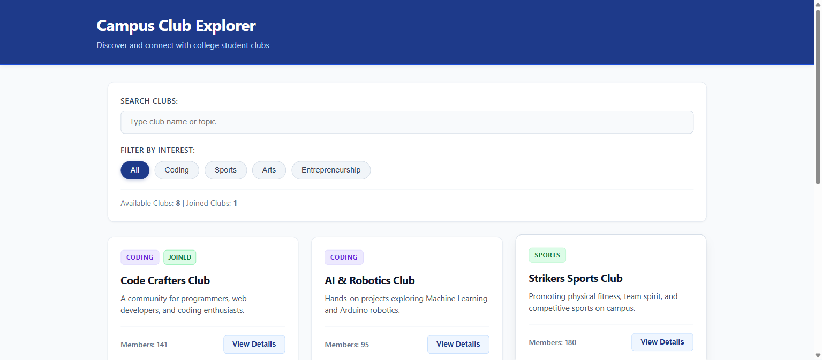
PROJECT BACKGROUND & ARCHITECTURE
Problem Statement & Solution Architecture
2 of 6
1. The Campus Problem
Student club schedules, advisor details, and event updates are fragmented across noticeboards and chat groups, causing low student awareness and participation.
LIVE DASHBOARD SHOWCASE
2. The Engineering Solution
A centralized, single-page application categorizing clubs into Coding, Sports, Arts, and Entrepreneurship with real-time interactive search.
3. Unidirectional Data Architecture
App.jsx serves as the single source of truth, managing reactive state and passing data down to child components via props.
4. High-Performance Front-End
Built with React 18 functional components and Vite bundler for sub-500ms hot module replacement with zero build errors.
Club Directory with Search Bar, Filter Pills & Membership Count
Notes:
Sir, in college campuses, students frequently miss club meetings because info is scattered. Campus Club Explorer centralizes all information. Architecturally, App.jsx manages state and passes data down to child components following React's unidirectional flow.

Slide 3
CORE REACT CONCEPTS
Props, Component Reuse, Lists & Keys
3 of 6
1. Props (Properties)
Read-only arguments passed from parent (App.jsx) to child (ClubCard.jsx). ClubCard receives the club object, isJoined flag, and click handlers cleanly.
COMPONENT REUSE IN ACTION
2. Component Reuse
A single ClubCard component is authored once and dynamically reused across all 8 campus clubs with zero duplicate markup.
3. Array Mapping (.map)
JavaScript's .map() iterates through the filtered clubs array, returning a <ClubCard /> for each matching club record.
4. The Unique 'key' Prop
Each item receives key={club.id}. This enables React's Virtual DOM reconciliation engine to track item updates efficiently without redrawing the entire page.
8 Dynamic Club Cards Rendered using .map() and unique keys
Notes:
Sir, here are two major concepts: Props and Lists. Instead of writing 8 separate cards, we created one reusable ClubCard component. We map over the array using club.id as the key, which lets React re-render only the exact card that changes.

Slide 4
DYNAMIC INTERACTION
Search & Category Filter UI
4 of 6
1. Controlled Form State
searchQuery and selectedCategory are maintained in React state using the useState hook, making inputs fully controlled.
SEARCH & FILTER CONTROLS
2. Dual-Predicate Filter Logic
The filter function evaluates category matching ('All' or exact match) AND keyword matching (.toLowerCase().includes()) together on every keystroke.
3. Zero Page Reloads
Filtered results update reactively in real time without refreshing the browser, providing a seamless user experience.
4. Ergonomic Controls
Includes active category pill indicators, an instant 'Clear' button in the search bar, and dynamic club counters.
Instant Search Bar & Category Pills (Coding, Sports, Arts, E-Cell)
Notes:
Our search and filter UI evaluates both the active category button and the search text simultaneously. When a student selects 'Coding' and types 'AI', it filters instantly without page reloads using clean array methods.

Slide 5
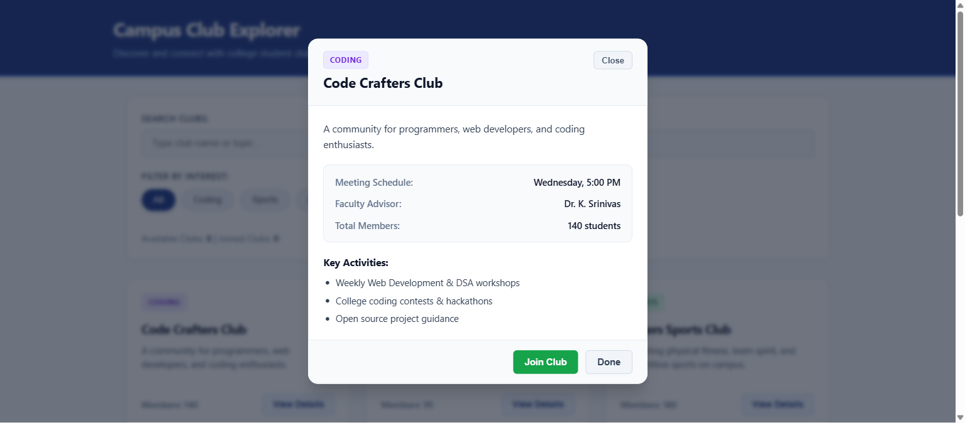
ADVANCED UI LOGIC
Conditional Rendering & Interactive Modal
5 of 6
1. Short-Circuit Evaluation
{selectedClub && <ClubModal ... />} ensures zero modal DOM overhead until a user clicks 'View Details' on a club card.
MODAL DIALOG POPUP
2. Empty State Fallback
A ternary operator renders the club grid when items exist, or a friendly 'No clubs found' box with a 'Reset Filters' button.
3. Comprehensive Club Modal
Displays weekly meeting schedule, faculty coordinator advisor, active member counts, and bulleted activity items.
4. Accessible Dismissal
Modal closes gracefully on clicking the 'Close' button, the 'Done' button, or tapping the darkened background.
Details Popup Showing Advisor, Meeting Day & Activities
Notes:
Sir, we demonstrated Conditional Rendering in multiple places: showing the modal only when selectedClub is not null, showing an empty state message if no clubs match, and closing the modal cleanly on background click.

Slide 6
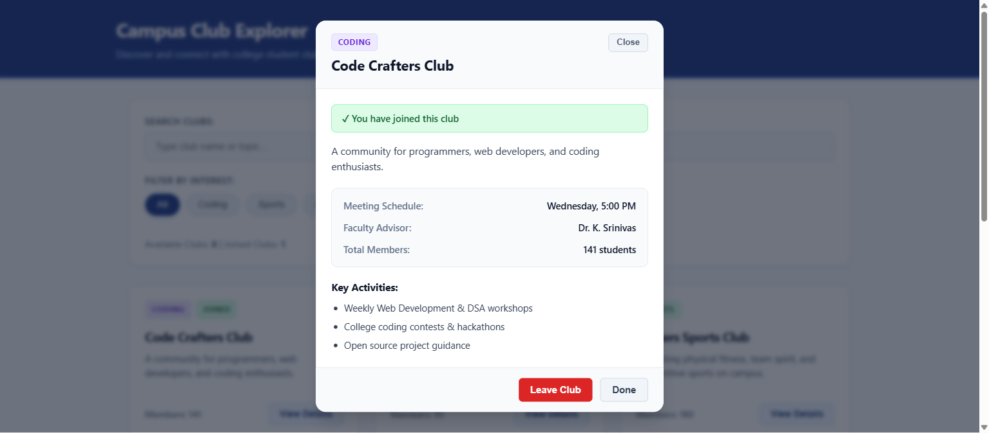
EVALUATION SUMMARY & RESULTS
Membership Tracking, Testing & Conclusion
6 of 6
1. Interactive Join / Leave
Clicking 'Join Club' toggles membership, increments member count, and changes button to 'Leave Club'.
LIVE MEMBERSHIP STATUS
2. Persistent 'JOINED' Tag
Card immediately displays a green 'JOINED' badge on the dashboard, tracking student membership across views.
3. Real-Time Popup Alerts
Displays a green toast alert: 'Success: You have joined [Club]!' auto-dismissed in 3 seconds.
4. Rigorous Verification
All 8 functional test cases PASS with 0 errors. Full alignment with college lab evaluation criteria.
Joined Status Banner, Leave Button & Live Member Count
Notes:
Finally, we implemented interactive membership tracking. When you join, it shows a popup message, updates member count, and marks the card with a JOINED badge. All test cases passed with zero build errors. Thank you, Sir!

