Slide 1
AI-Powered Email Classifier
Review-1
Team Members:
Aasish Chand Narra - 2320030298
Sree Ram Vaddi - 2320030221
Prithvi Teja - 2320030297

Slide 2
Problem Statement
Faculty members and institutional staff routinely encounter high volumes of academic, administrative, and personal email communication.
Manual inbox triage is time-consuming, prone to inconsistency, and often inadequate for identifying urgent or high-priority messages in a timely manner.
Existing mailbox tools provide limited support for integrated classification, topic-level organization, and analytical visibility into communication patterns.
Accordingly, there is a need for a scalable email intelligence platform capable of mailbox integration, automated classification, and dashboard-based decision support.

Slide 3
ABSTRACT
This project presents an AI-powered email classification system intended for faculty and personal inbox management.
The proposed platform integrates Gmail and Outlook mailboxes, ingests incoming messages, classifies them as spam or legitimate email, and enriches them with topic and urgency labels.
The implementation employs a FastAPI backend for authentication, synchronization, analytics, and service endpoints, together with a React-based frontend for visualization and interaction.
In addition, the architecture incorporates an extensible big-data pathway using Spark, Kafka, MinIO, and Airflow to support scalable analytics and future model-driven enhancements.

Slide 4
Introduction
Email remains a primary communication medium in academic environments, where users must process messages relating to administration, coursework, research, events, and personal matters.
As inbox volume increases, conventional rule-based filtering approaches become insufficient for maintaining efficiency, prioritization, and situational awareness.
This project brings together mailbox integration, automated email classification, and analytical dashboards within a unified software platform.
The resulting framework supports both operational productivity in day-to-day use and architectural extensibility for large-scale analytical processing.

Slide 5
Objective
To classify incoming emails into meaningful categories such as spam, ham, topic, and urgency.
To integrate real Gmail and Outlook inboxes and synchronize recent messages into the application environment.
To provide analytical dashboards presenting email volume, spam ratio, temporal trends, and topical distribution.
To incorporate user feedback through reclassification mechanisms for subsequent improvement of classification quality.
To design an extensible system architecture capable of scaling through Kafka, Spark, MinIO, and Airflow-based components.

Slide 6
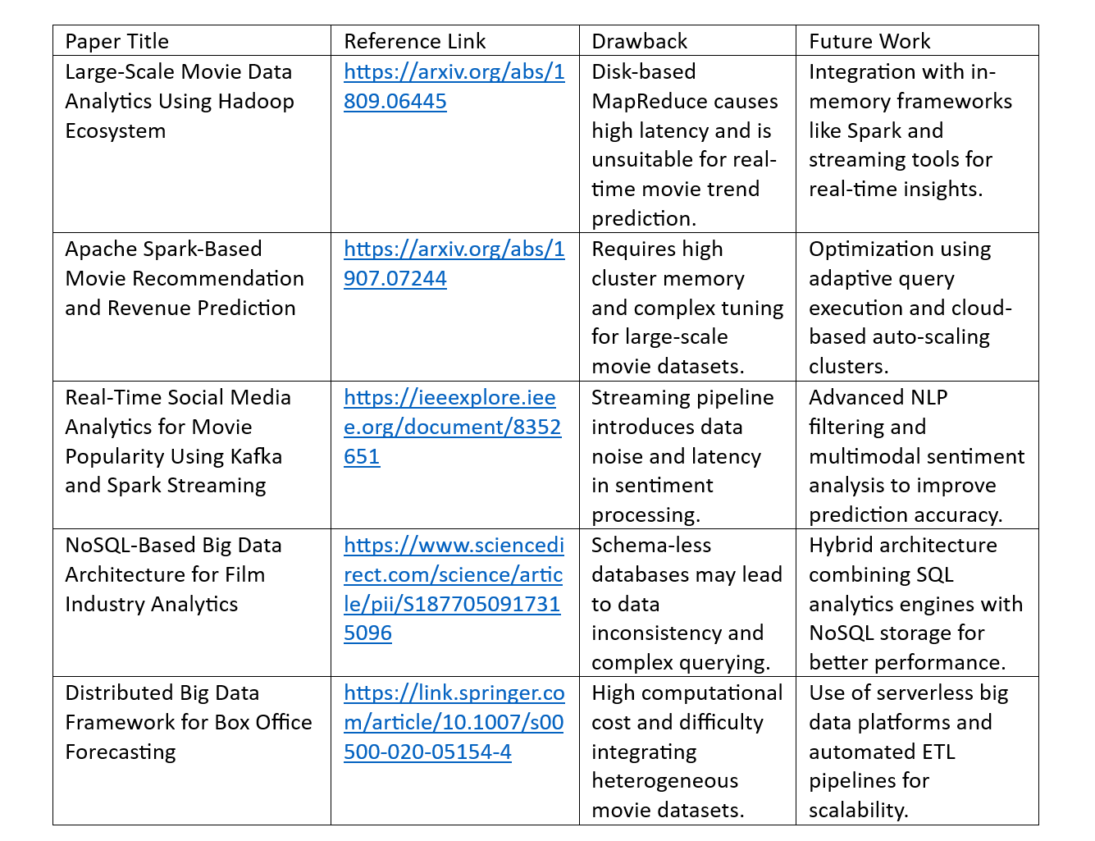
Literature Survey
Conventional email clients predominantly rely on keyword filters and folder rules, offering limited adaptability and minimal analytical support.
Research in spam detection establishes the effectiveness of machine learning; however, many approaches remain restricted to binary classification tasks.
Existing enterprise monitoring solutions provide communication metrics, yet they rarely unify mailbox synchronization, topical categorization, and user feedback in a single workflow.
Studies on big-data analytics indicate that Spark-based processing frameworks are well suited for scalable trend analysis, model lifecycle management, and historical reporting.

Slide 7
THANK YOU
AI-Powered Email Classifier | Review-1

