Slide 1
AI-Powered Email Classifier
Review-2
Team Members:
Aasish Chand Narra - 2320030298
Sree Ram Vaddi - 2320030221
Prithvi Teja - 2320030297

Slide 2
Work Completed
A React-based user interface has been implemented with dedicated pages for Login, Dashboard, Emails, Analytics, Settings, Big Data Analytics, and Pipeline monitoring.
A FastAPI backend has been developed to provide authentication, dashboard metrics, email APIs, mailbox synchronization, WebSocket integration, and big-data service endpoints.
Mailbox connectivity has been established through IMAP and Gmail-based synchronization, enabling the ingestion of real user emails beyond static demonstration data.
Analytical services have been implemented to compute email trends, spam percentage, topical distribution, and estimated productivity-related indicators.

Slide 3
System Workflow
Mailbox Gmail / Outlook
Sync Layer IMAP / Gmail API
Backend FastAPI + DB
Analytics Rules + Services
Dashboard React + Charts
→
→
→
→
Optional scale-out pathway: Kafka -> MinIO -> Spark -> Airflow -> Big Data Analytics interface

Slide 4
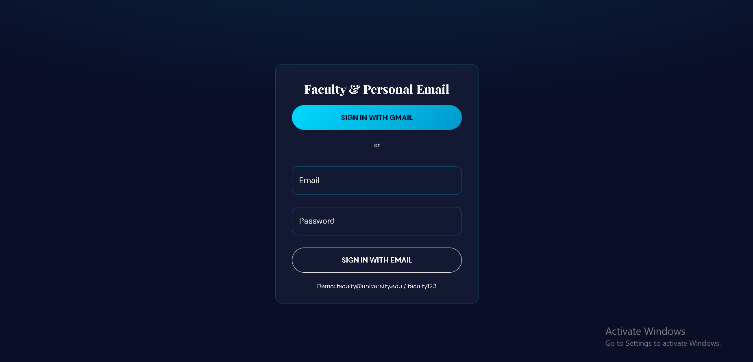
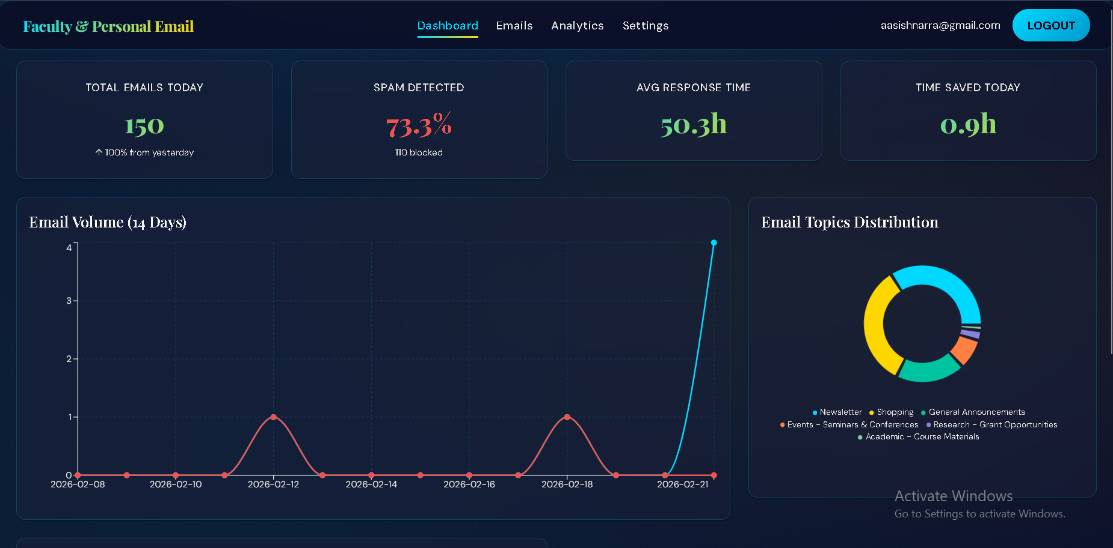
User Interface Demonstration
Login Interface
Dashboard Interface

Slide 5
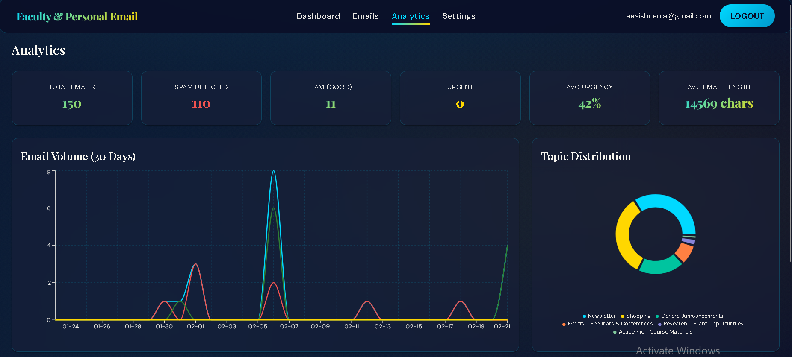
Analytics and Big Data Support
The Analytics page presents 30-day trends for total, legitimate, and spam email traffic.
The Dashboard summarizes key performance indicators including email volume, spam ratio, and estimated time savings.
The Big Data Analytics view exposes pipeline status, model metadata, partition information, and refresh controls.
The overall architecture supports Spark, Kafka, MinIO, and Airflow for large-scale data processing and historical analysis.
Analytics Interface

Slide 6
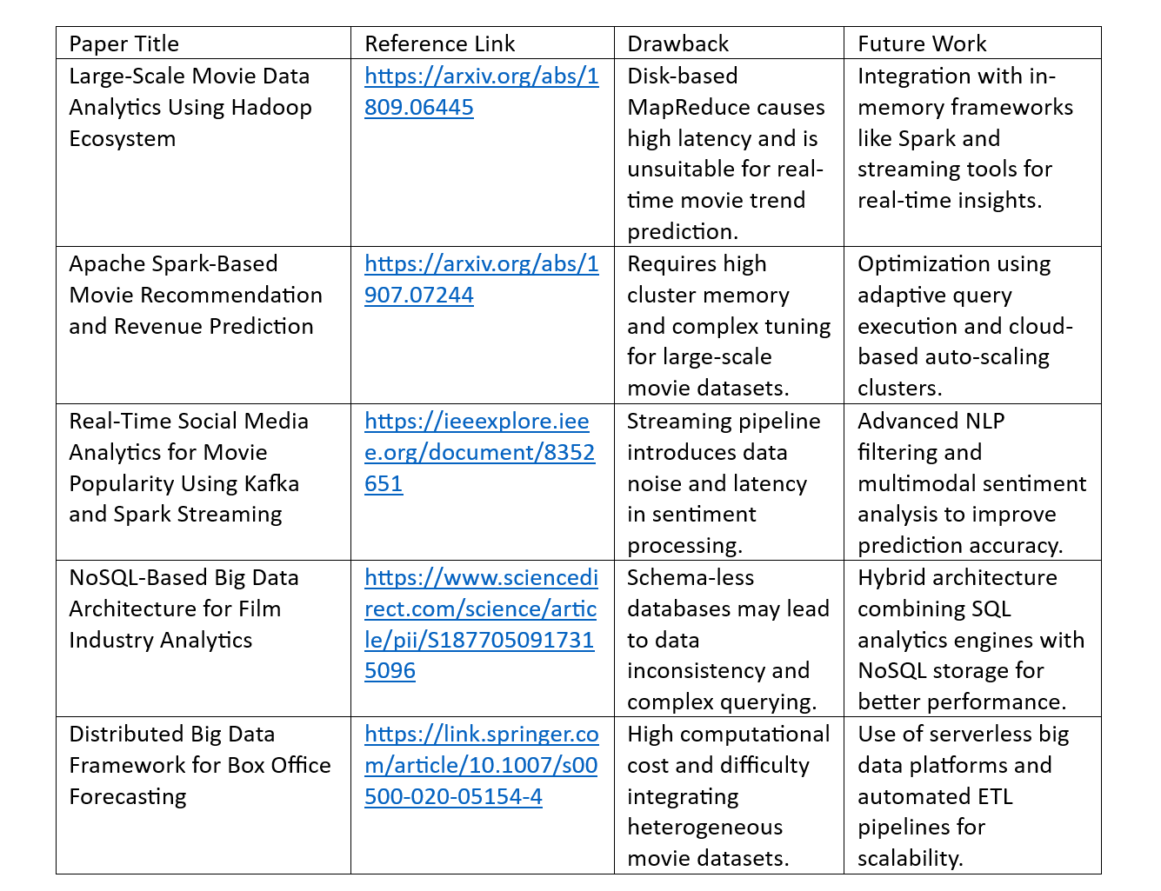
Current Outcome and Future Scope
The present implementation demonstrates a complete end-to-end workflow from authentication to synchronized and classified email visualization.
The platform enhances inbox visibility, prioritization, and spam awareness through an integrated analytical dashboard.
Future work may include more robust machine learning models, stronger feedback incorporation, richer evaluation metrics, and deployment hardening for production environments.
The big-data extension provides a foundation for scaling ingestion, analytics, and model lifecycle management for institutional or enterprise workloads.

Slide 7
THANK YOU
AI-Powered Email Classifier | Review-2

