Slide 1
AI-Powered Email Classifier
Review-3
Team Members:
Aasish Chand Narra - 2320030298
Sree Ram Vaddi - 2320030221
Prithvi Teja - 2320030297

Slide 2
Methodology
The proposed system follows a layered methodology comprising mailbox acquisition, message preprocessing, classification, storage, and analytical presentation.
Incoming emails are collected through Gmail or Outlook connectivity, after which metadata and content are processed for spam detection, topic assignment, and urgency estimation.
The backend services expose structured APIs for synchronization, analytics, and dashboard communication, while the frontend presents the processed results through interactive views.
An extensible big-data pathway has also been defined to support distributed ingestion, batch analytics, and future model enhancement.

Slide 3
Implementation Highlights
The frontend has been implemented using React, TypeScript, Material UI, and charting components for a modern analytical interface.
The backend has been developed using FastAPI, asynchronous database access, authentication services, mailbox synchronization modules, and analytics services.
Dedicated modules support dashboard metrics, email listing, mailbox configuration, analytics views, and optional pipeline monitoring capabilities.
The implementation therefore demonstrates a complete full-stack prototype aligned with the project objectives established in earlier reviews.

Slide 4
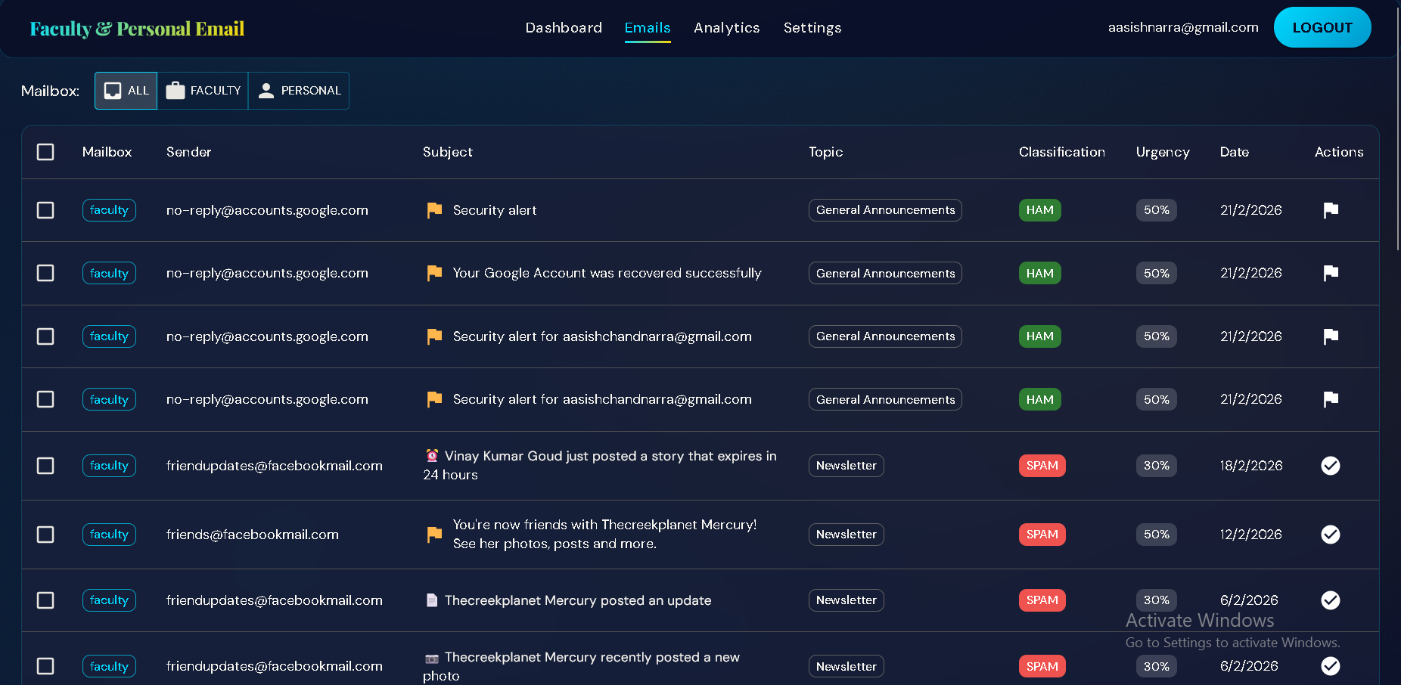
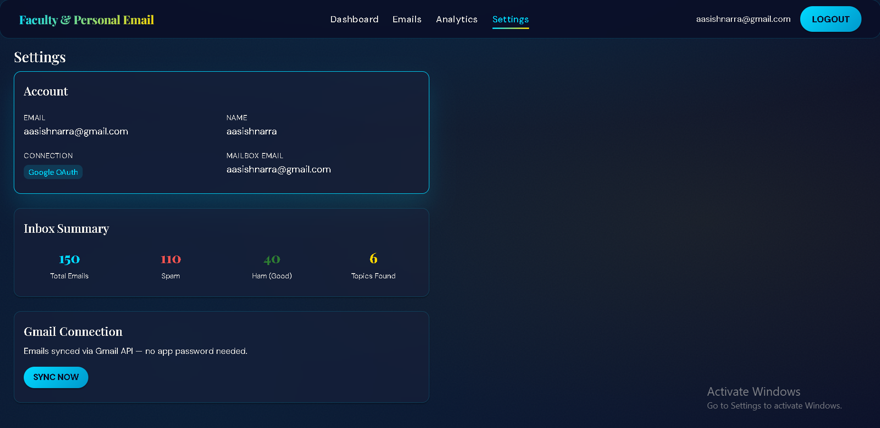
Experimental Demonstration
Email Classification Interface
Mailbox Configuration Interface

Slide 5
Observations and Results
The system is able to demonstrate end-to-end email synchronization, classification, and dashboard visualization in an integrated workflow.
Analytical views provide measurable indicators such as email volume, spam proportion, topic trends, and productivity-oriented summaries.
The interface design supports usability by allowing users to review classified messages, inspect trends, and manage mailbox connectivity within a single platform.
These observations indicate that the implemented system is functionally suitable as a foundation for further intelligent email management research.

Slide 6
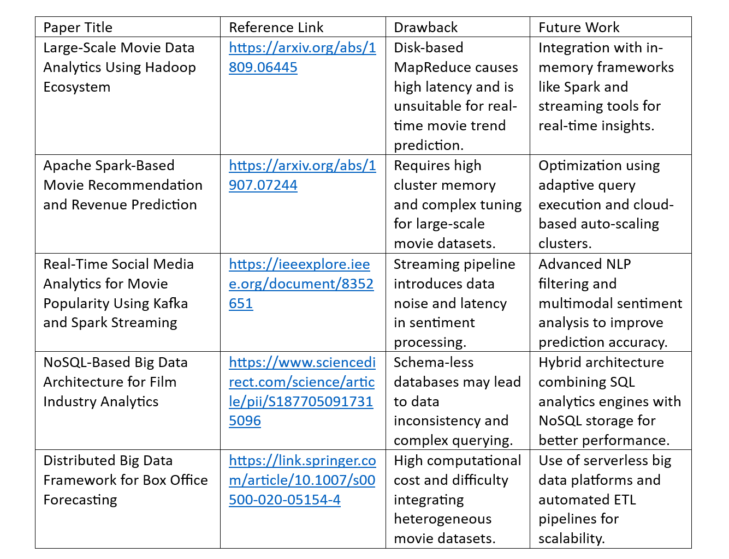
Conclusion and Future Enhancements
The project successfully establishes a working academic prototype for AI-assisted email organization and analytical monitoring.
It integrates mailbox connectivity, automated classification, and dashboard-based decision support within a coherent software architecture.
Future enhancements may include advanced machine learning models, broader dataset evaluation, stronger personalization, and production-grade deployment support.
The proposed big-data extension further enables the project to evolve toward large-scale institutional usage and deeper analytical intelligence.

Slide 7
THANK YOU
AI-Powered Email Classifier | Review-3

