Slide 1
VerTech.
Urban farming solutions

Slide 2
Current problem in industry
Increasing population, urbanization, and unabated climate change
Sustainability of the traditional farming model based on large rural farms is likely to come under threat
Wastage of food and increased greenhouse gas emissions for transporting food.

Slide 3
Solution for industry
Our proposed solution pertains to the manufacturing and urban agricultural sectors.
An IoT based monitoring system that integrates the sensor array with the Bolt platform to provide the user with data analytics and management dashboard.
We propose an easy interface that optimises the vertical farming practice which requires minimal management, and increases yields through proper monitoring.

Slide 4
List of hardware equipments and software used
Development boards and modules :
● MSP-EXP432P401R - Launchpad Evaluation Board
● Bolt hardware module
Sensors:
● DHT sensor (Humidity and temperature)
● Soil moisture sensor
● LDR sensor
Hardware:
● Solenoid tap
● LED strip/UV lights
● 12V supply
Cloud:
● Bolt platform

Slide 5
Cost incurred in developing the project
Item | Cost
TI-MSP432 | 800
Bolt IoT | 650
Sensors(DHT11, LDR, Soil Moisture sensor) | 385
Solenoid tap | 450
Fan | 150
Relay | 70
TOTAL | Rs. 2500

Slide 6
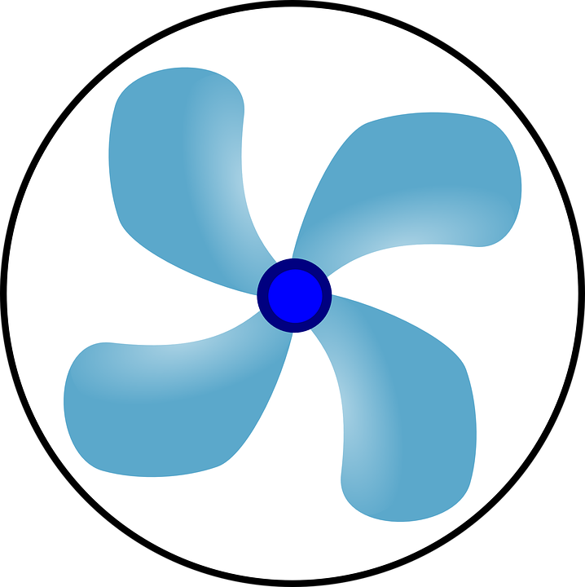
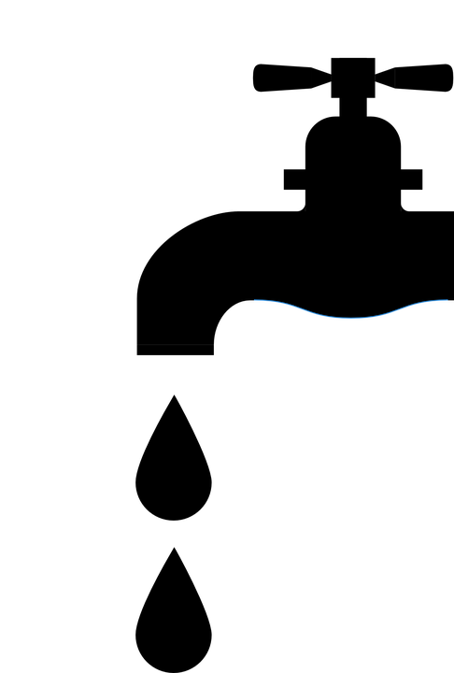

BLOCK DIAGRAM
Bolt Cloud
Bolt
hardware
W
R
Sensor
array
Humidity
Development
Board
LDR
Moisture
Temperature
Application
Temperature control
DispenserValve
LED

Slide 7
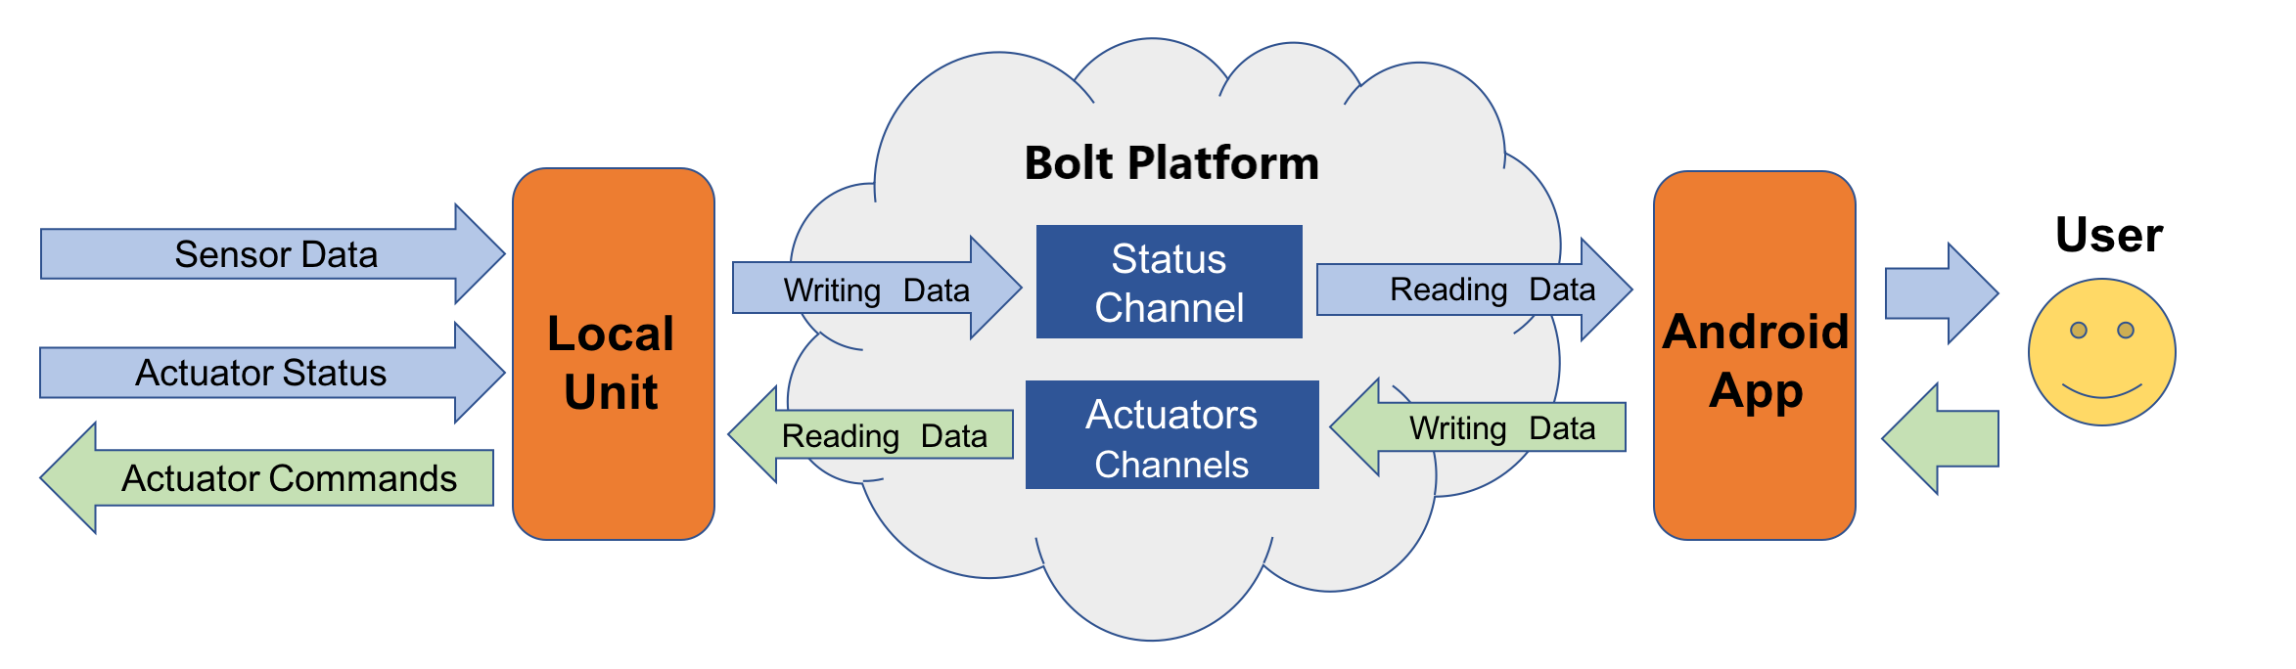
Data Flow

Slide 8
https://www.youtube.com/watch?v=BxnKrUaqTBc&t=2s

