Slide 1
RACE CAR
-a project on object oriented programming using C++ and sFml

Slide 2
OBJECTIVES
TO BE FAMILIAR WITH OBJECT ORIENTED PROGRAMMING(oop)
To learn what TEAM WORK IS
TO LEARN AN ADDITIONAL GRAPHICS LIBRARY FOR DEVELOPMENT OF PROGRAM
TO BE ABLE TO SET THE MIND FOR DEVELOPMENT OF A PROGRAM
FINALLY,TO BE ABLE TO CREATE A PROJECT USING OOP

Slide 3
INTRODUCTION
Race car is a simple game in which there is a car which has to get to the finish line without colliding to any of the obstacles encountered while in the track. The game terminates as soon as the car reaches the finish point.

Slide 4
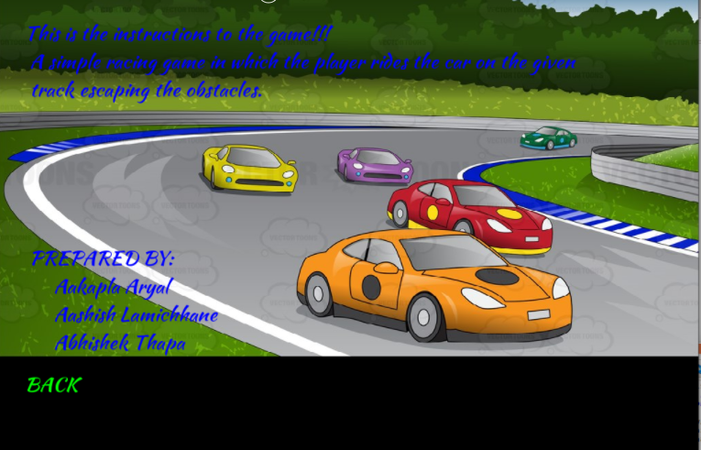

Slide 5
METHODOLOGY
Analyzing the concept that can be used to develop proper program.
Discussion on the topic that might be faced onwards.
Making the project schedule.
Initial coding for creating logic.
Coding the program.
Execution and testing the program.
Debugging.
Program Documentation.

Slide 6
HOW DOES IT WORK?
1. First render window is created.
2. On render window a track is drawn.
3.Then the object that is car is made just above the track.
4.Movement of track as per the input taken from keyboard
5.If there car collides then the game ends else it reaches the end line and the objective is complete.
Following block diagram will make it more clear:

Slide 7
BLOCK DIAGRAM

Slide 8
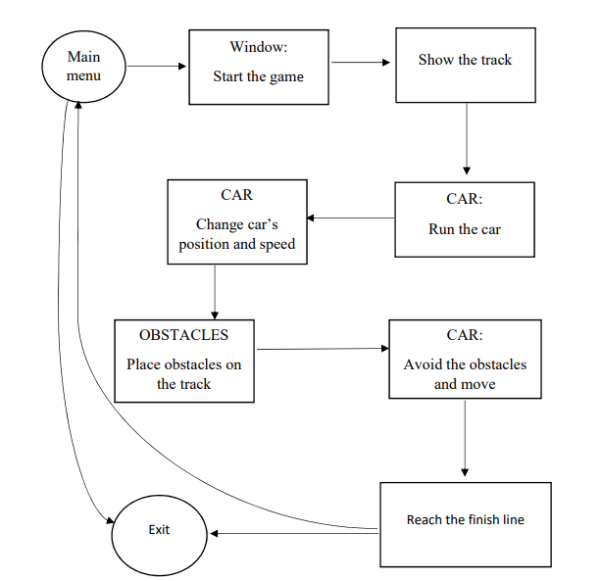

Slide 9
THANK YOU

