Slide 1



Slide 2
INTRODUCTION
Baghchal is an ancient hunt board game from Nepal.
Its name means "moving tigers", and is played by two players, one controlling four tigers, the other controlling twenty goats.
The game is played on a 5×5-point grid. Pieces are positioned at the intersection of the lines and not inside the areas delimited by them.
Directions of valid movement between these points are connected by lines.

Slide 3
OBJECTIVE
• To become familiar with the basic concepts of OOP such as classes, objects, inheritance, polymorphism,Standard Template Library etc and implementation of the OOP.
• To learn about third party library features that can be used with C++. We aim to implement these library files to enhance our project and our knowledge.
• To gain valuable experience and knowledge on design of games. The project will familiarize us with the game development cycle.
• To learn more things about GUI and their use in our CUI based coding in order to create an intuitive program that matches today’s standard.
• To give a digital identity to Baghchal game which is not so popular with the new generation.
• To gain experience on group cohesion and work division.
• And to get familiar with collaboration tools of coding projects

Slide 4
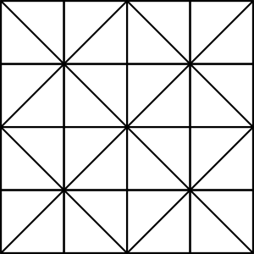
ALGORITHM USED
38
For board
g
a
ff
0x38=00111000
a
g

Slide 5
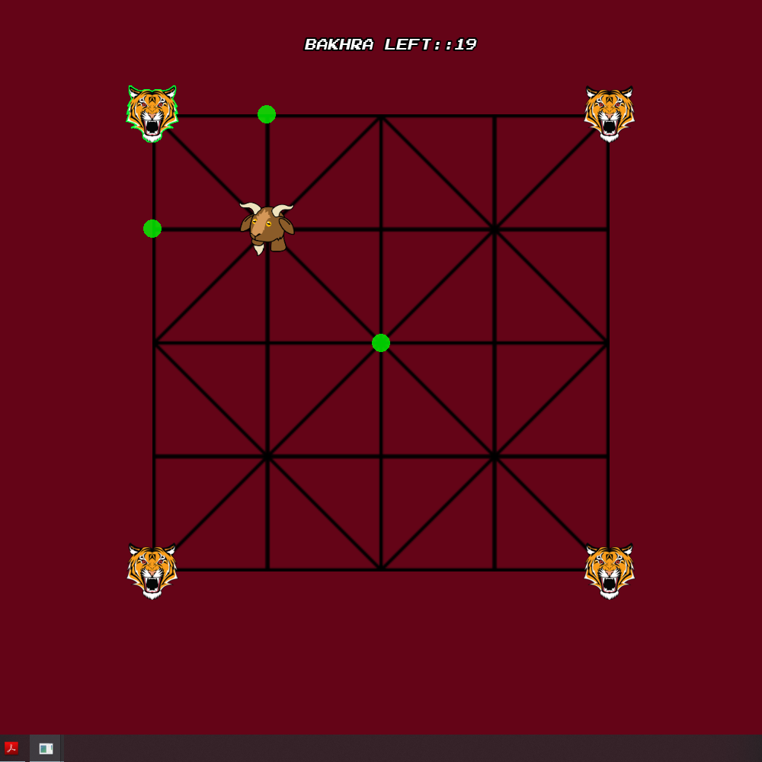
For bagh move

Slide 6
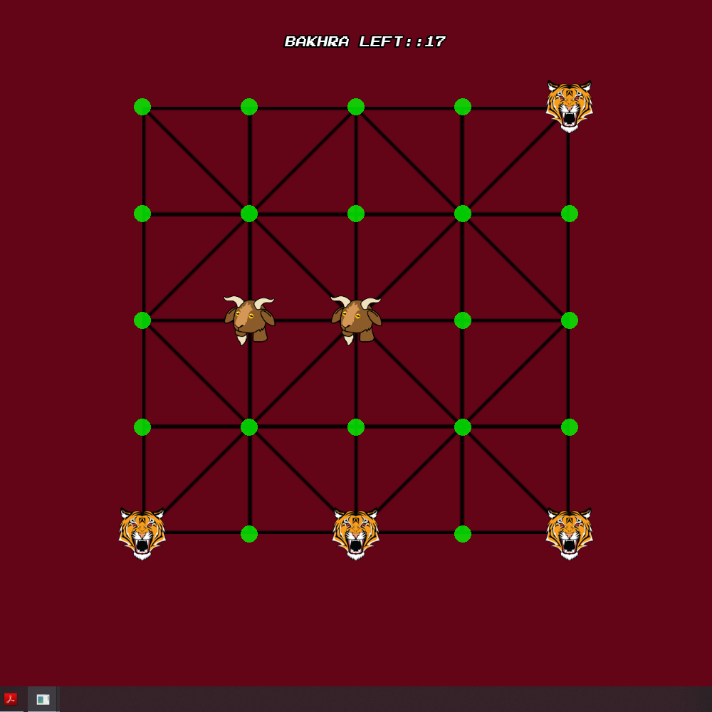
For bakhra position

Slide 7
Problems Faced and solutions
▪ During the project, we as a team had difficulties while collaborating in coding stage as we were unfamiliar with the coding tools.
▪ Learning graphics library in short period of time was challenging.
▪ It was difficult to develop a user interface that matched the gameplay of real Baghchal game.

Slide 8
Application
▪ Enjoy a great game on the new and best computerized way.
▪ It is suitable for all age people for entertainment and time pass.
▪ It can be a great tool to improve strategy developing skills.

Slide 9
Limitations and Future Enhancements
Our game is just a though the popular grid is 5x5, there are other types of grid as well which we could not incorporate here.
Both players should play form the input of same mouse.
It can be made an online game where two players can play from different computer.
Text and voice chatting can be added in the online version.

Slide 10
References
➢ Baral, Dayasagar. “The Secrets of Object Oriented Programming in C++”. Bhundipuran Prakashan. November 2010.
➢ Deitel, Paul.” C++ How to Program”. Prentice Hall. 2012
➢ www.stackoverflow.com
➢ www.dsbaral.com.np
➢ www.github.com
➢ www.youtube.com
➢ www.wikipedia.com
➢ www.google.com

Slide 11
TEAM MEMBERS
AASHISH ADHIKARI 074BEX401
AASMAN BASHYAL 074BEX402
PRAKASH DHAKAL 074BEX423

Slide 12
Thank you

