Slide 1
Trajectory
DSIS
GT9X-driven WASO, TST, Sleep Efficiency

Slide 2
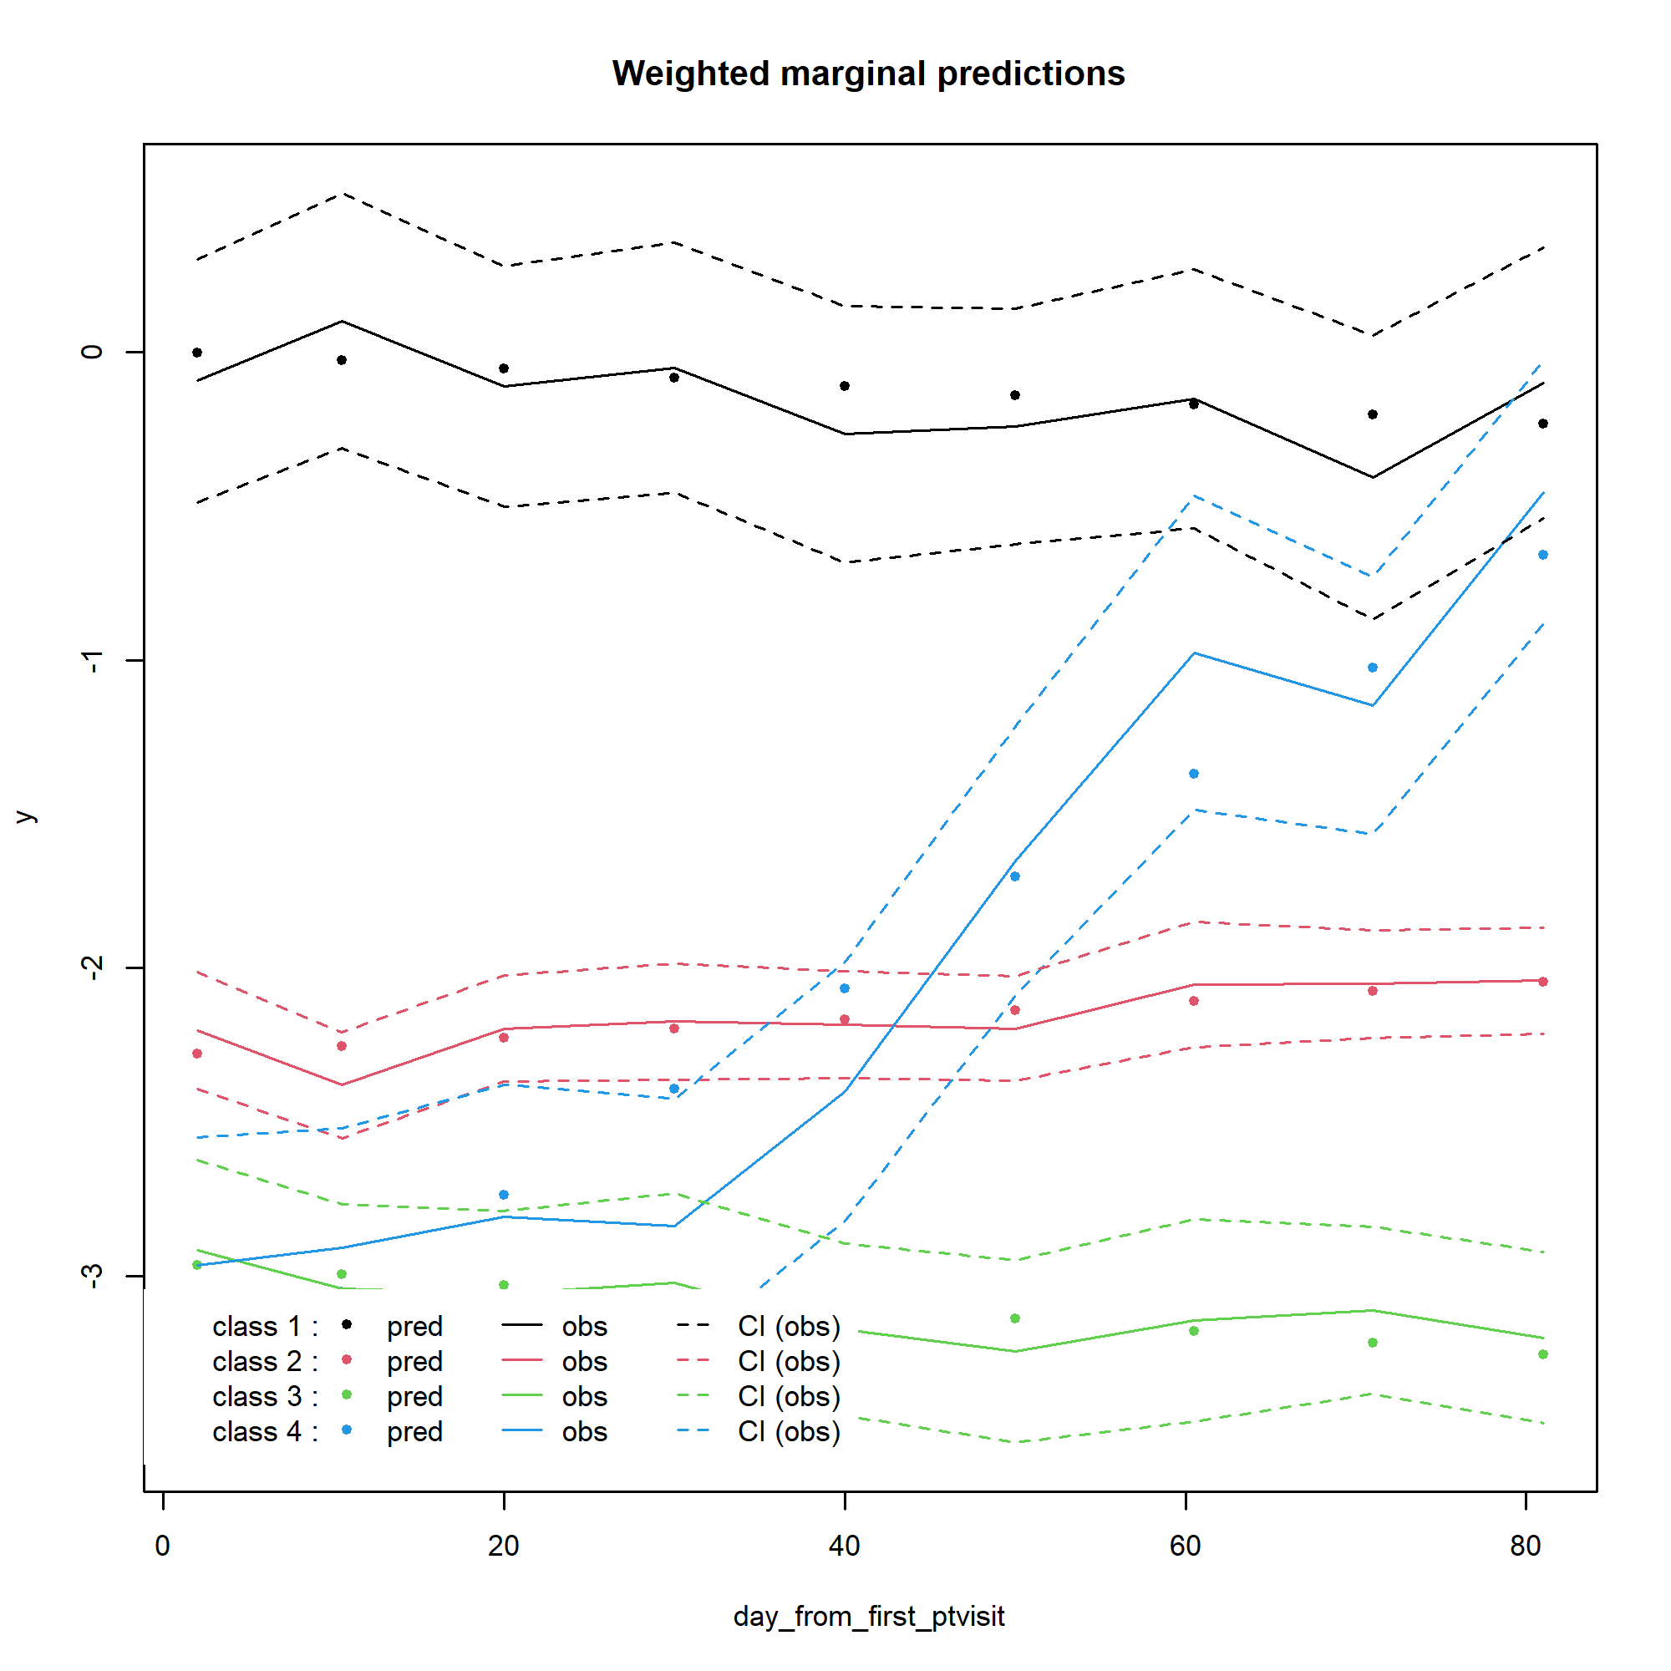
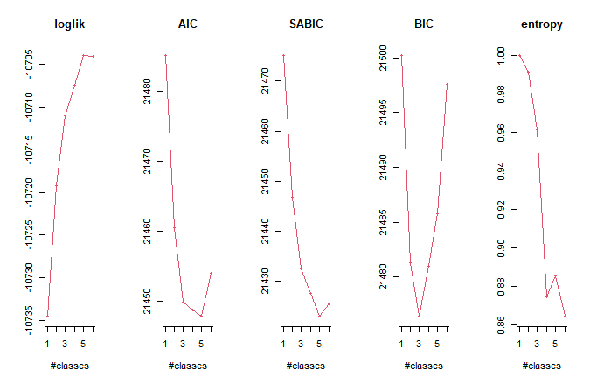
Daily – Sleep Efficiency
Maximizing,
better describing
Lower, better fit
>0.8, well-separated
> postprob(f_beta4)
Posterior classification:
class1 class2 class3 class4
N 7.00 28.00 9.00 5.0
% 14.29 57.14 18.37 10.2
Posterior classification table:
--> mean of posterior probabilities in each class
prob1 prob2 prob3 prob4
class1 0.9993 0.0007 0.0000 0.0000
class2 0.0000 0.9373 0.0500 0.0127
class3 0.0000 0.1479 0.8521 0.0000
class4 0.0000 0.0958 0.0003 0.9040
Posterior probabilities above a threshold (%):
class1 class2 class3 class4
prob>0.7 100 92.86 77.78 80
prob>0.8 100 85.71 77.78 80
prob>0.9 100 78.57 55.56 80
Lee et al. 2018 – at least 10%
Kiadaliri et al 2023 – at least 5%
APPA, > 0.7 for each class

Slide 3
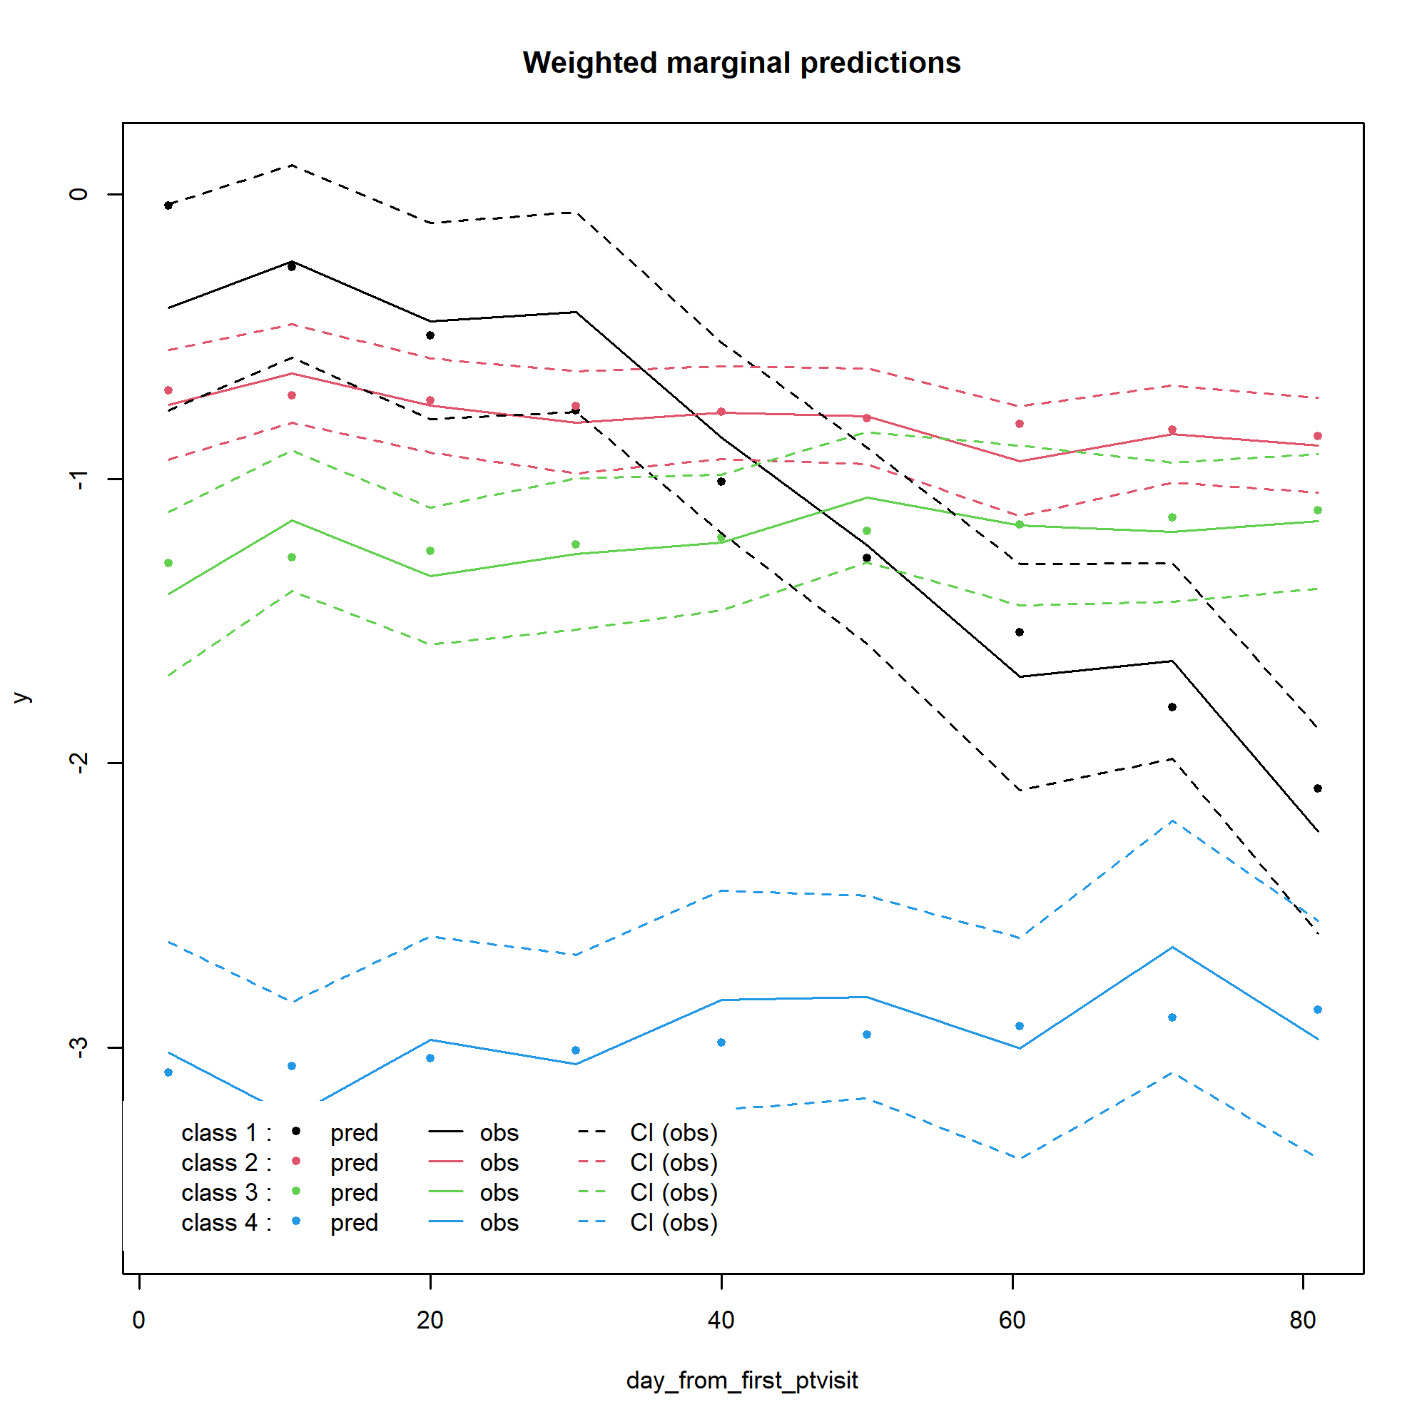
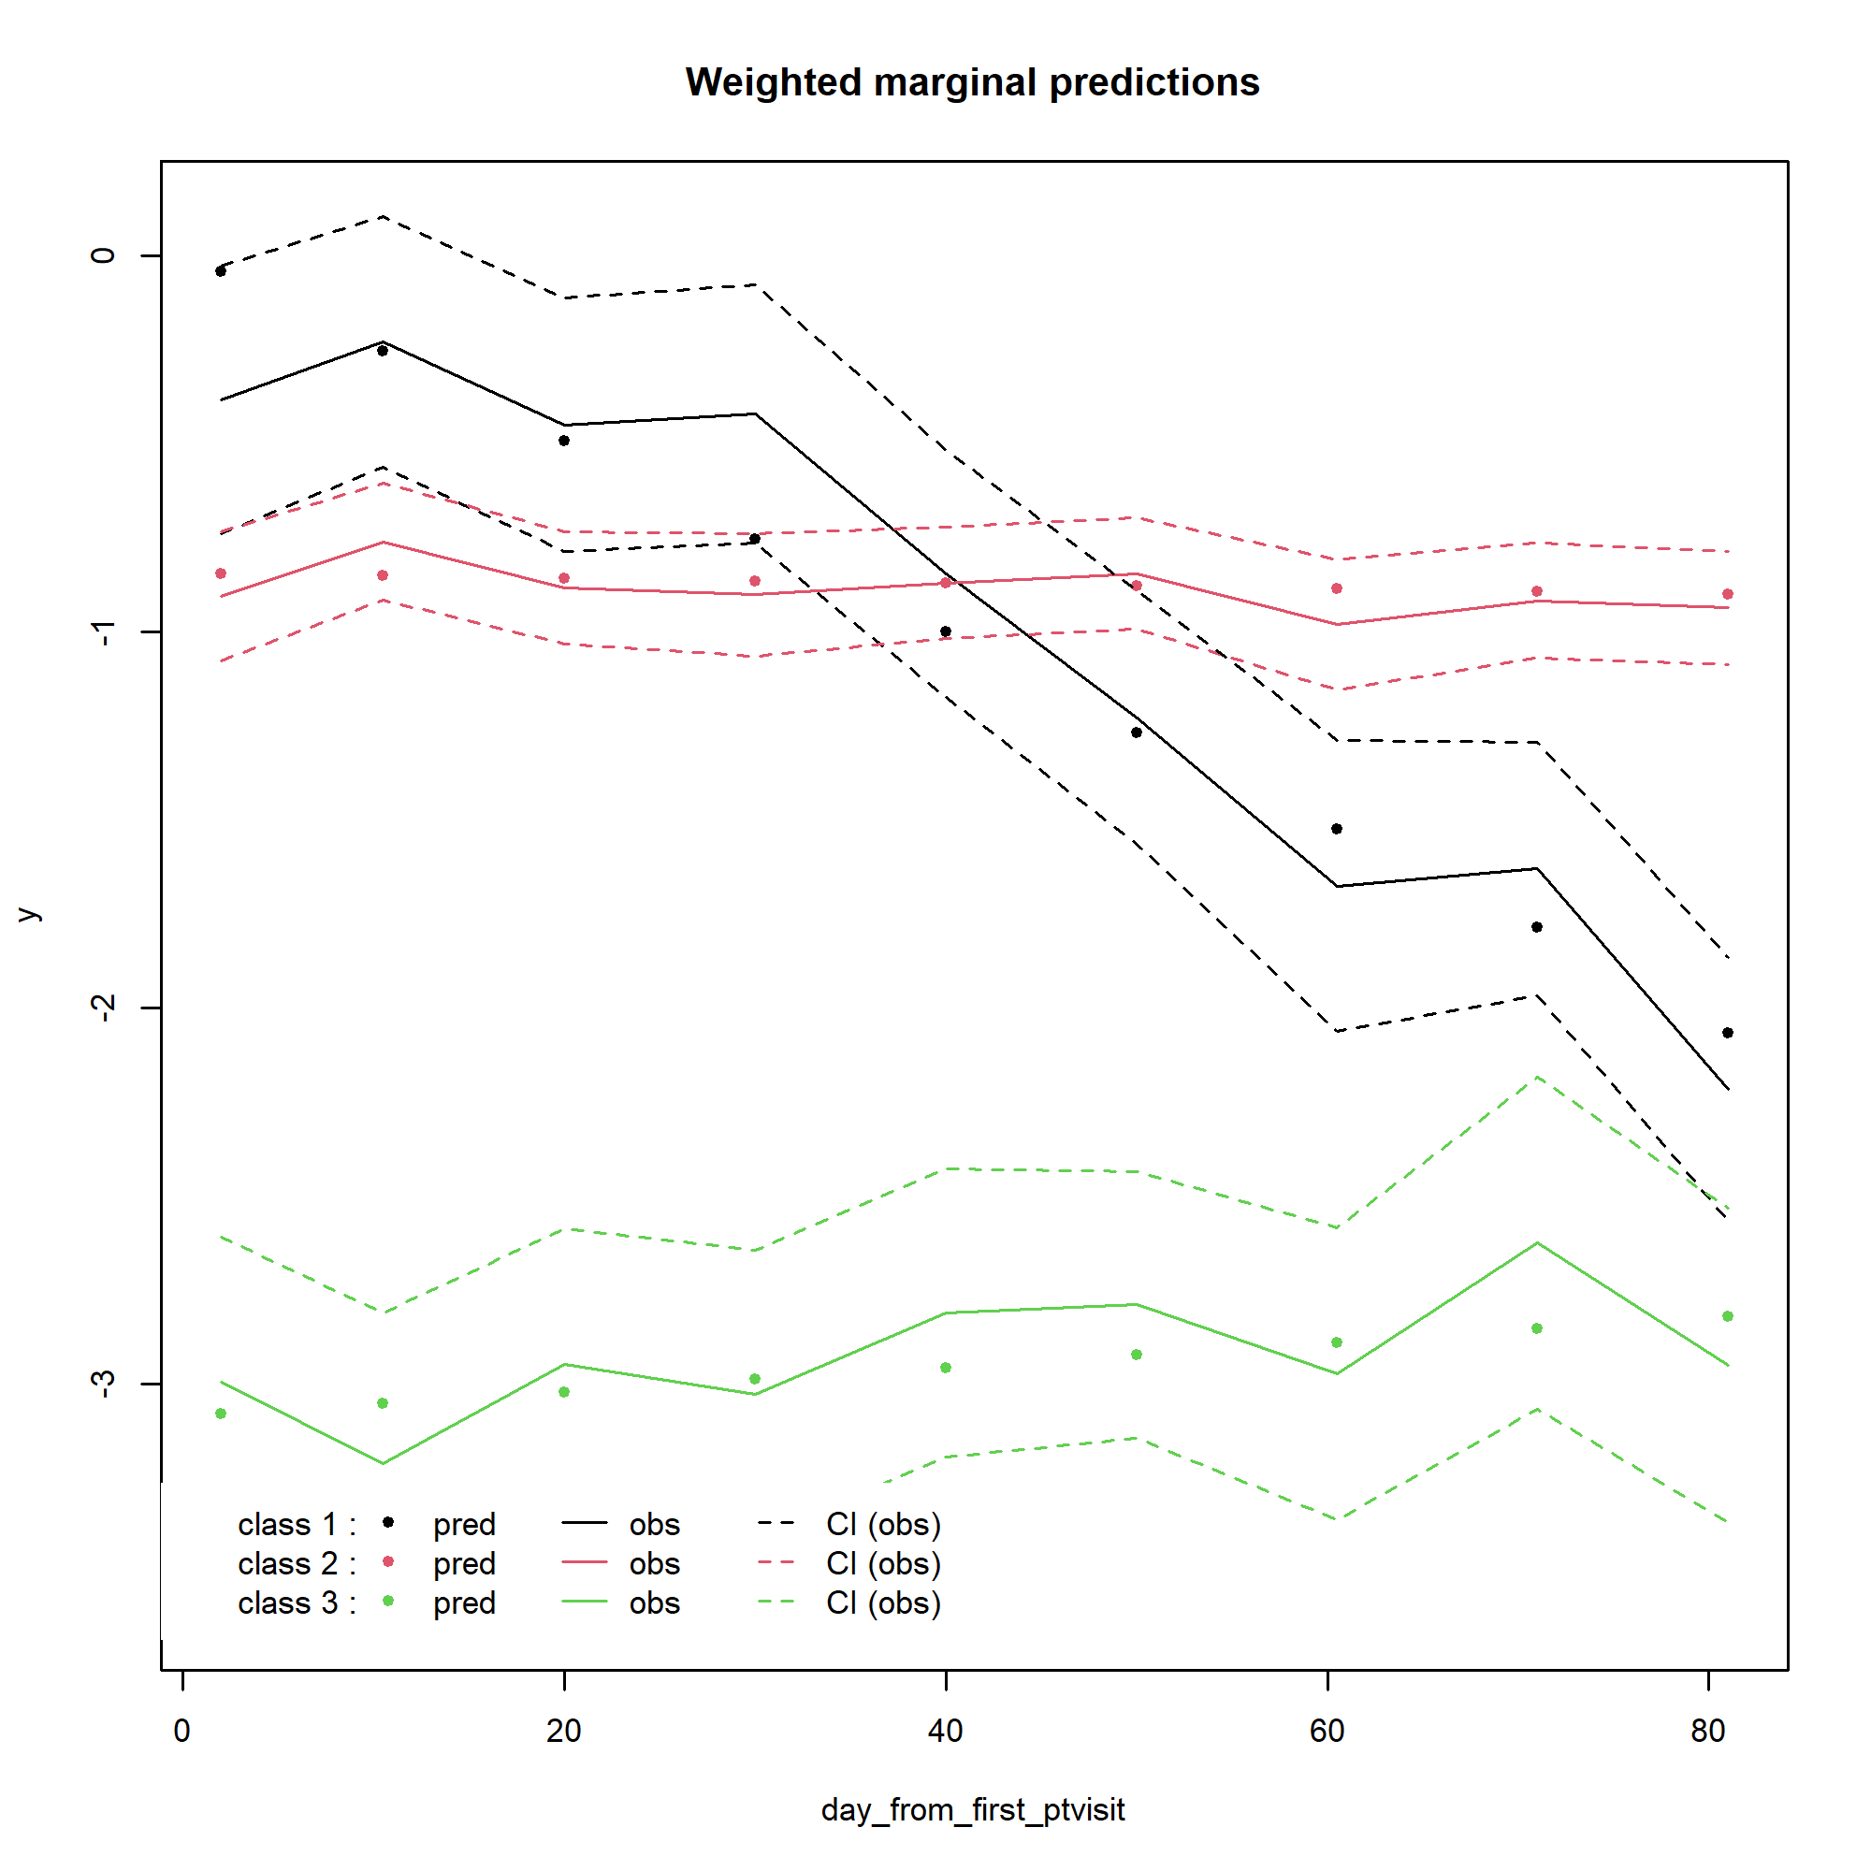
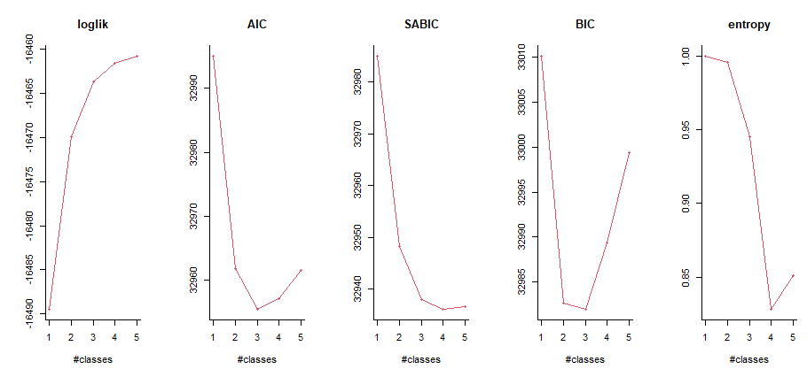
Daily – WASO
Maximizing,
better describing
Lower, better fit
>0.8, well-separated
> postprob(waso_beta4)
Posterior classification:
class1 class2 class3 class4
N 6.00 27.0 9.00 7.00
% 12.24 55.1 18.37 14.29
Posterior classification table:
--> mean of posterior probabilities in each class
prob1 prob2 prob3 prob4
class1 0.9704 0.0295 0.0000 0.0000
class2 0.0207 0.8803 0.0989 0.0000
class3 0.0000 0.1527 0.8462 0.0012
class4 0.0000 0.0002 0.0008 0.9990
Posterior probabilities above a threshold (%):
class1 class2 class3 class4
prob>0.7 100.00 88.89 77.78 100
prob>0.8 100.00 77.78 66.67 100
prob>0.9 83.33 55.56 55.56 100
Lee et al. 2018 – at least 10%
APPA, > 0.7 for each class

Slide 4
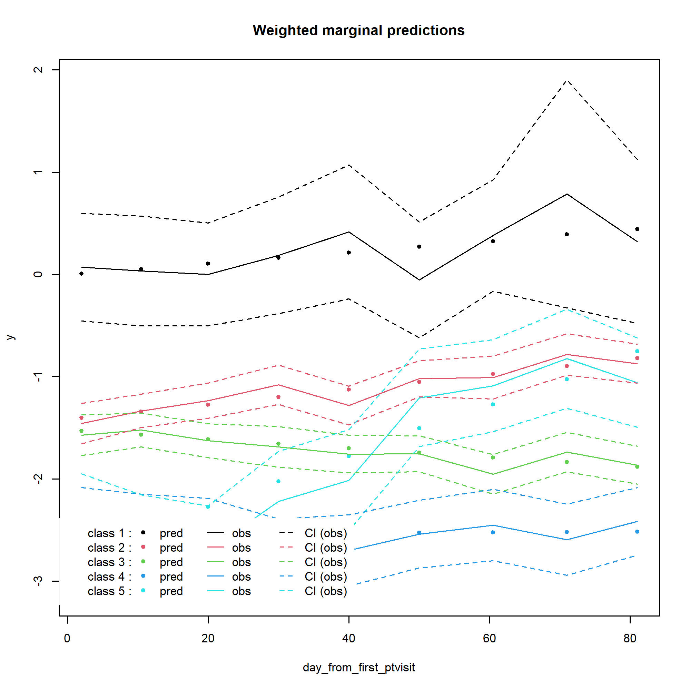
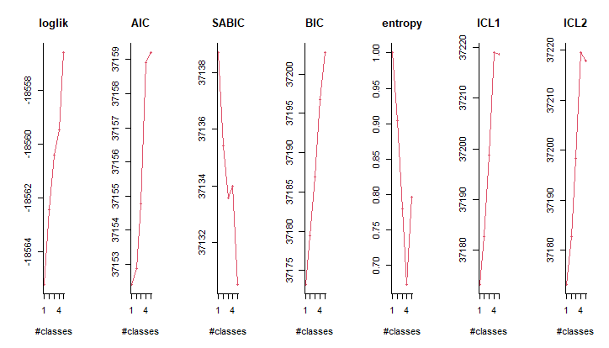
Daily – Total Sleep Time
Maximizing,
better describing
Lower, better fit
>0.8, well-separated
Posterior classification:
class1 class2 class3 class4 class5
N 5.0 17.00 19.00 5.0 3.00
% 10.2 34.69 38.78 10.2 6.12
Posterior classification table:
--> mean of posterior probabilities in each class
prob1 prob2 prob3 prob4 prob5
class1 0.8219 0.1583 0.0192 0.0001 0.0005
class2 0.0003 0.8813 0.0898 0.0000 0.0287
class3 0.0000 0.1146 0.8612 0.0232 0.0010
class4 0.0000 0.0000 0.0299 0.9687 0.0014
class5 0.0000 0.0505 0.1365 0.0158 0.7972
Posterior probabilities above a threshold (%):
class1 class2 class3 class4 class5
prob>0.7 60 88.24 84.21 100 66.67
prob>0.8 60 82.35 73.68 100 66.67
prob>0.9 60 52.94 47.37 100 66.67
Lee et al. 2018 – at least 10%
Kiadaliri et al 2023 – at least 5%
APPA, > 0.7 for each class

Slide 5
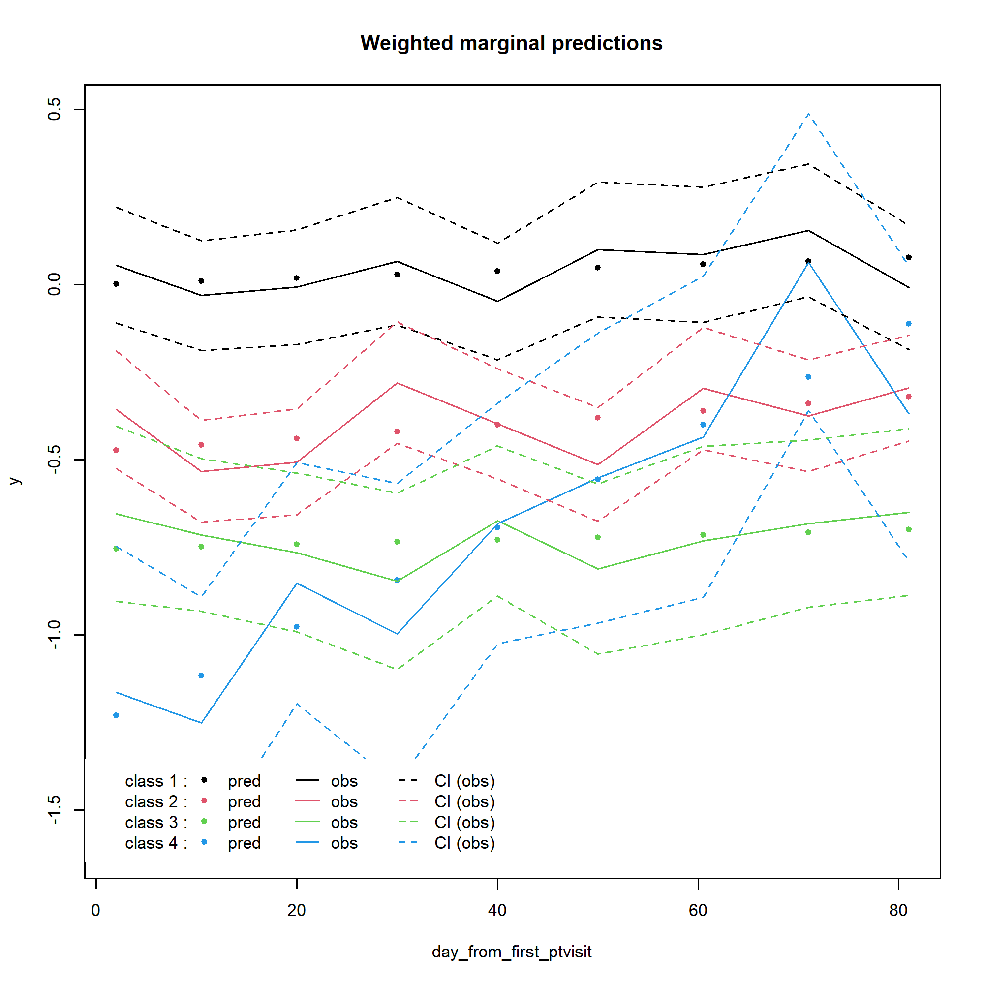
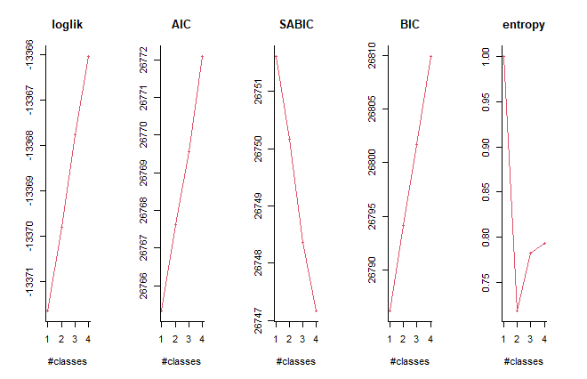
Daily – Sleep Fragmentation Index
Maximizing,
better describing
Lower, better fit
>0.8, well-separated
> postprob(sfi_mspl4)
Posterior classification:
class1 class2 class3 class4
N 19.00 19.00 8.00 3.00
% 38.78 38.78 16.33 6.12
Posterior classification table:
--> mean of posterior probabilities in each class
prob1 prob2 prob3 prob4
class1 0.9087 0.0912 0.0001 0.0000
class2 0.0151 0.8773 0.0706 0.0370
class3 0.0000 0.1043 0.8262 0.0695
class4 0.0000 0.0318 0.1622 0.8059
Posterior probabilities above a threshold (%):
class1 class2 class3 class4
prob>0.7 84.21 84.21 62.5 66.67
prob>0.8 78.95 84.21 62.5 66.67
prob>0.9 78.95 73.68 62.5 66.67
Lee et al. 2018 – at least 10%
APPA, > 0.7 for each class

Slide 6
Trajectory
DSIS
GT9X-driven WASO, TST, Sleep Efficiency

Slide 7
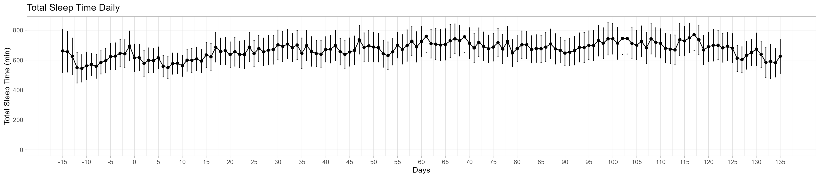
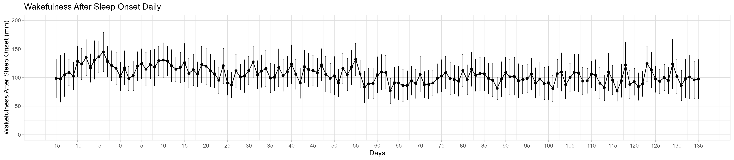
Daily
1 = First PT Visit
1= First PT Visit

Slide 8
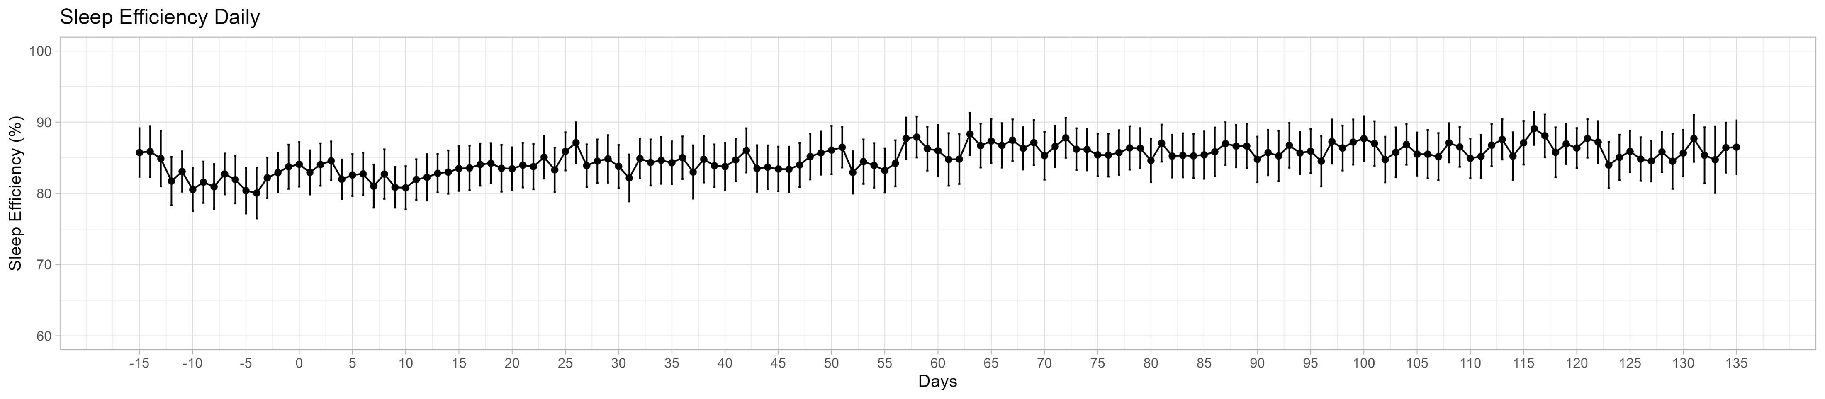
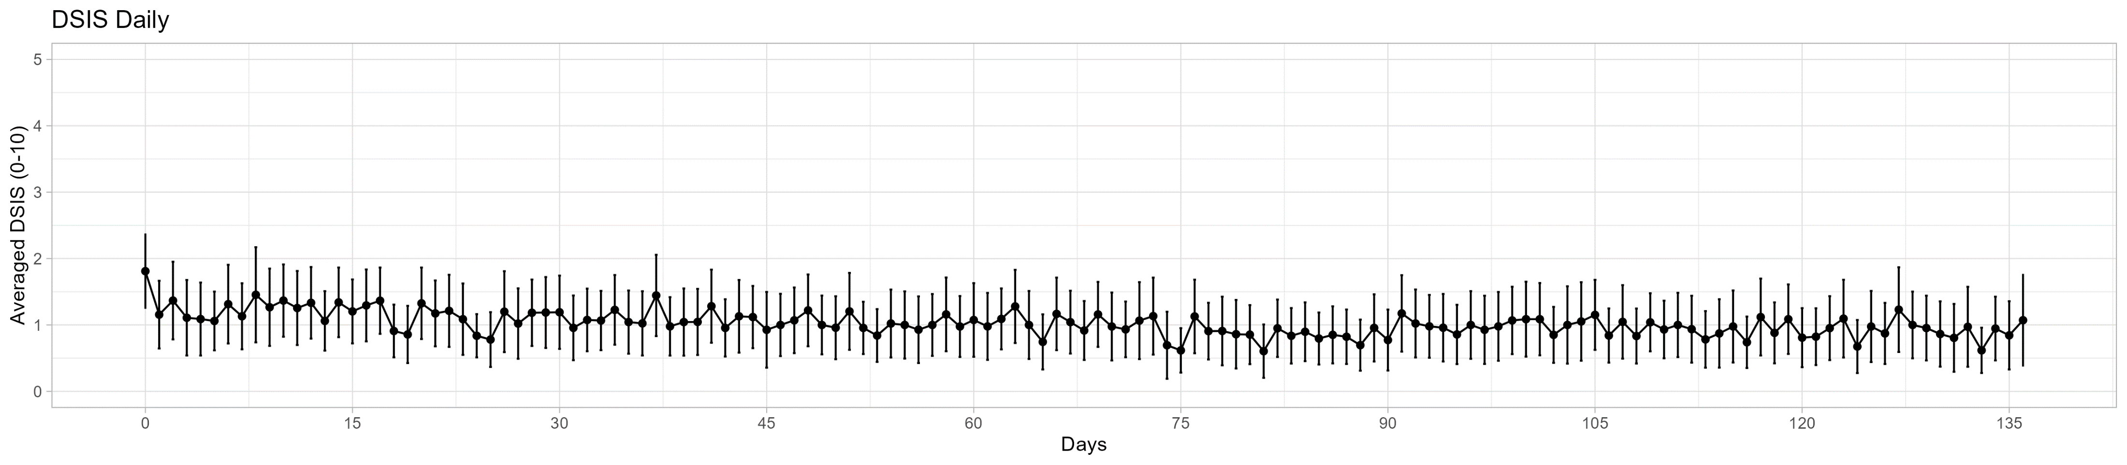
Daily
1 = First PT Visit
0 = Baseline Visit
1 = First PT Visit

Slide 9
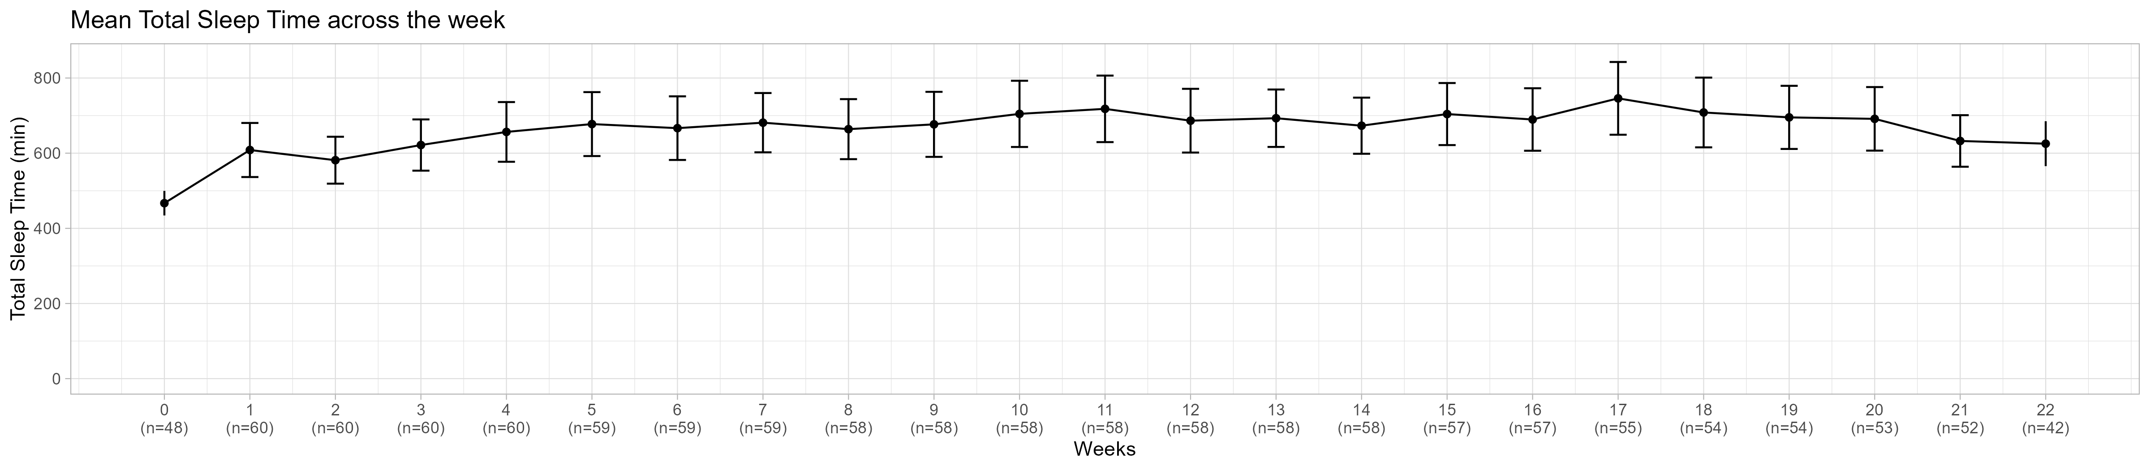
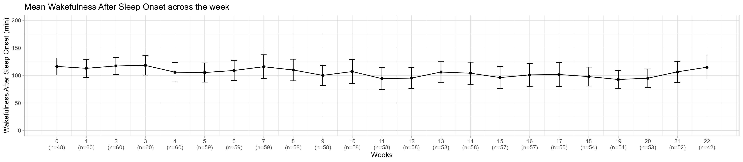
Weekly
1= First Week of First PT Visit
1= First Week of First PT Visit

Slide 10
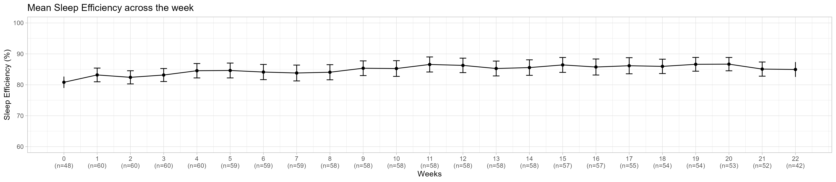
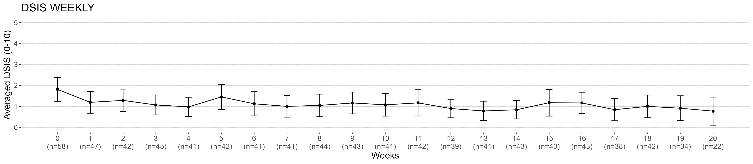
Weekly
1= First Week of First PT Visit
1= First Week of First PT Visit

Slide 11
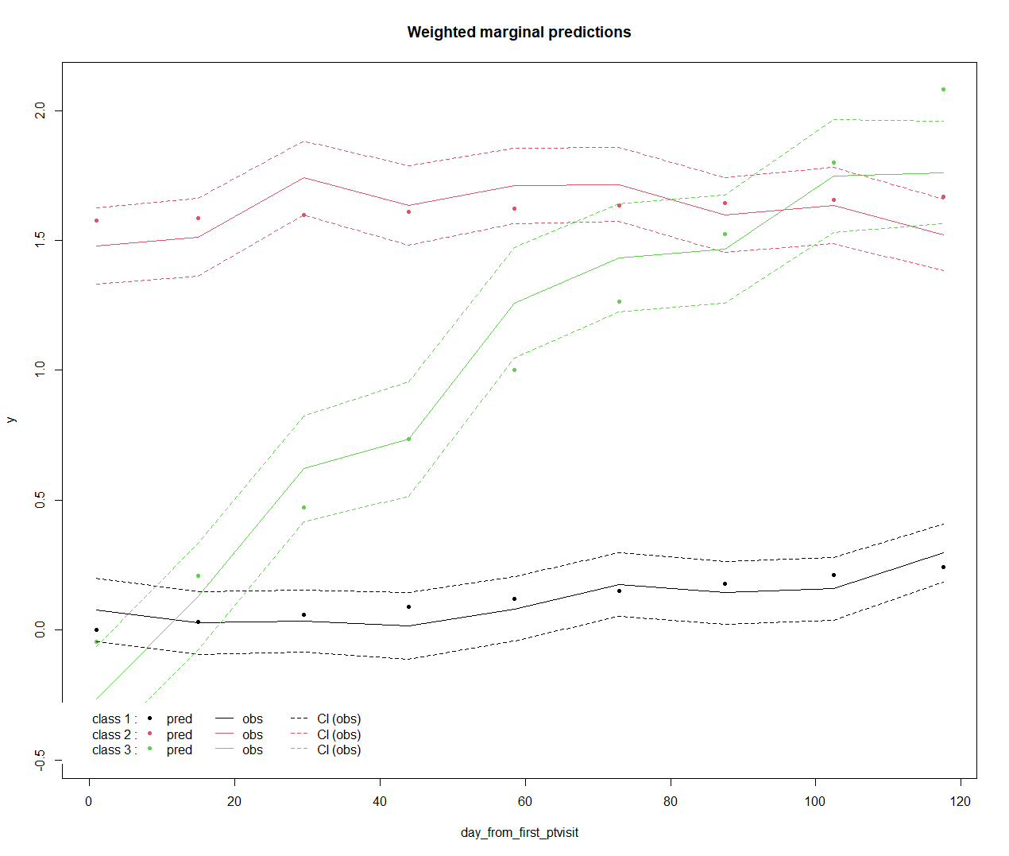
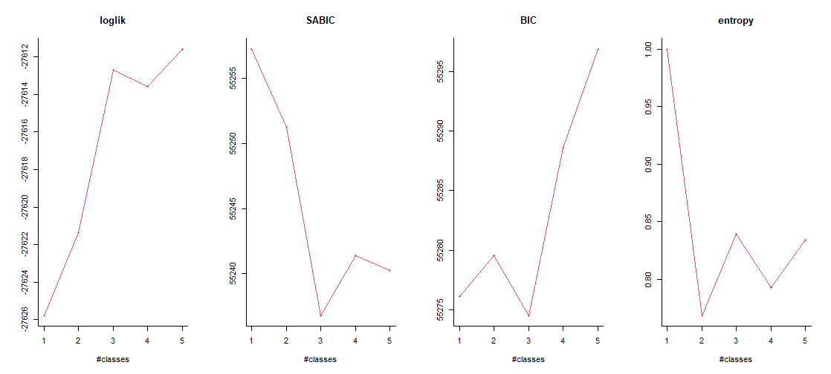
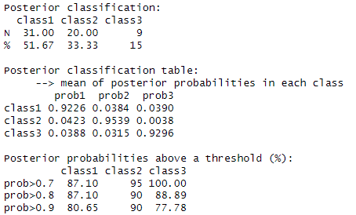
Daily – Sleep Efficiency
Maximizing,
better describing
Lower, better fit
>0.8, well-separated
Lee et al. 2018 – at least 10%
Kiadaliri et al 2023 – at least 5%
APPA, > 0.7 for each class

Slide 12
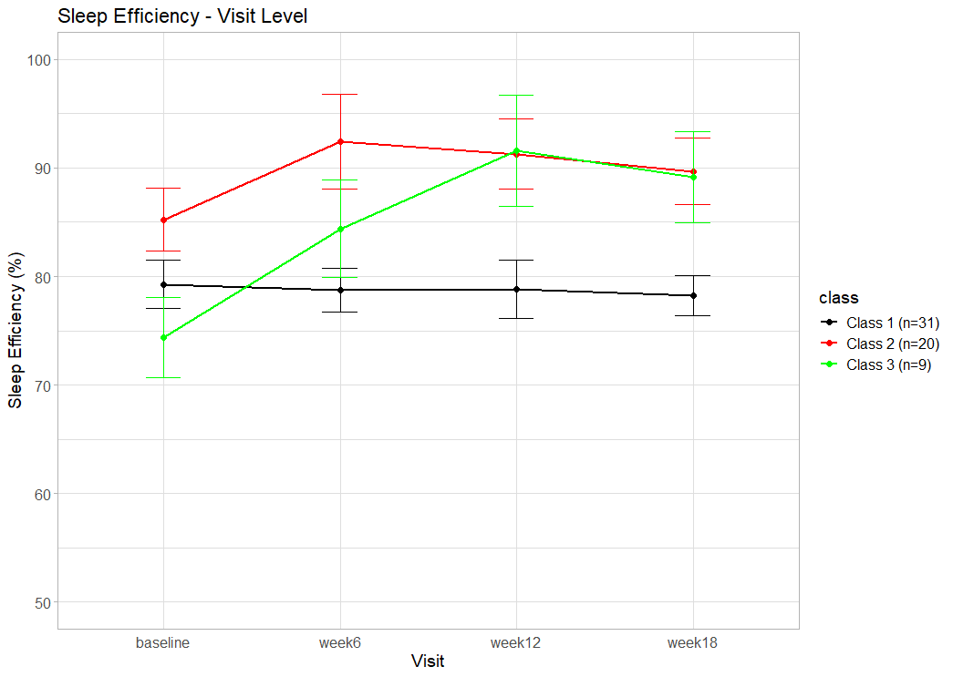
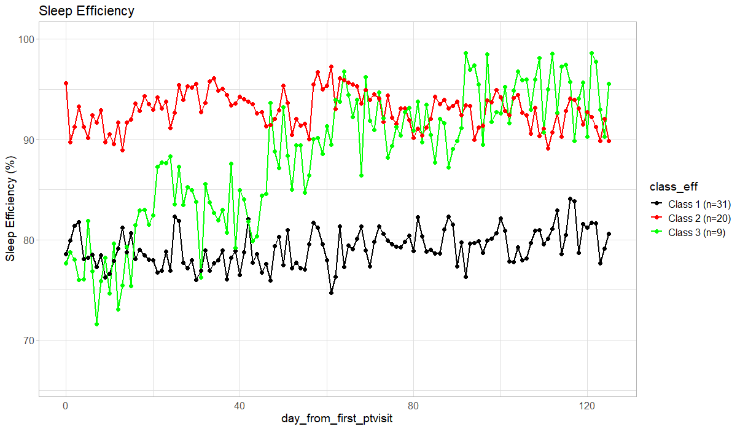

Slide 13
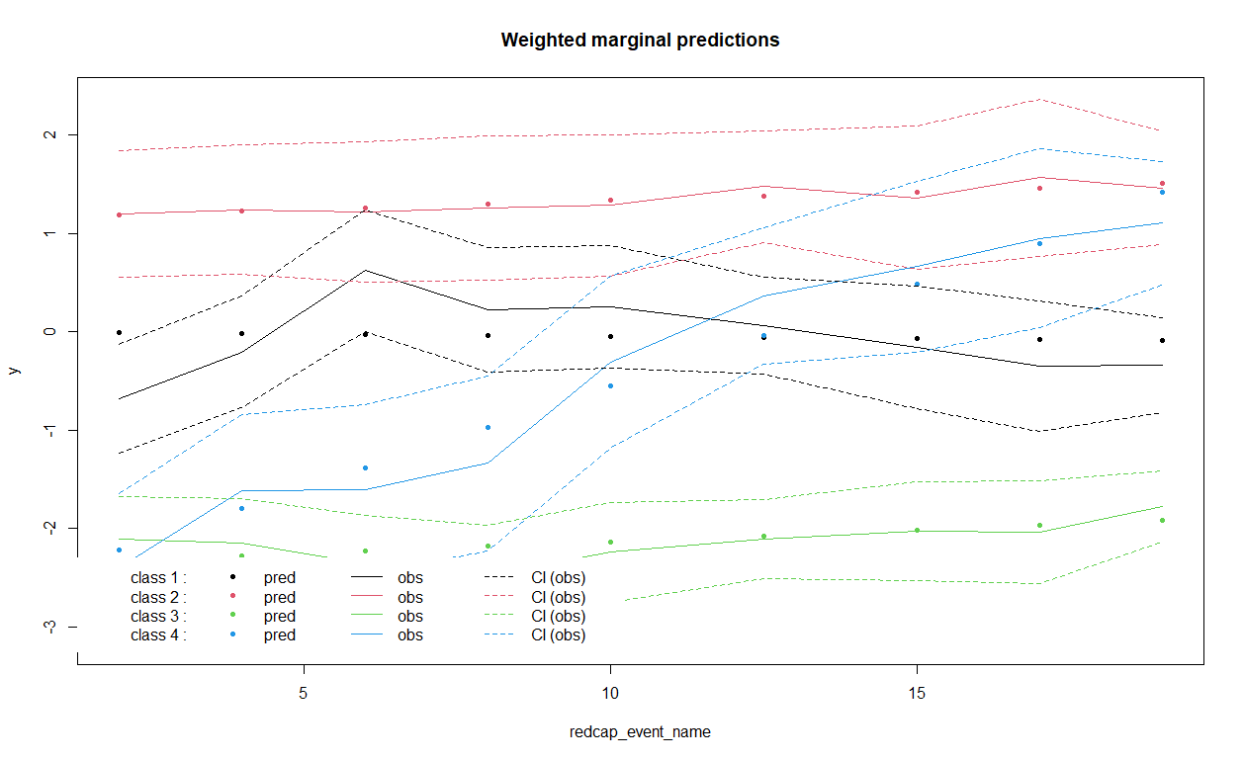
Weekly – Sleep Efficiency Mean

Slide 14
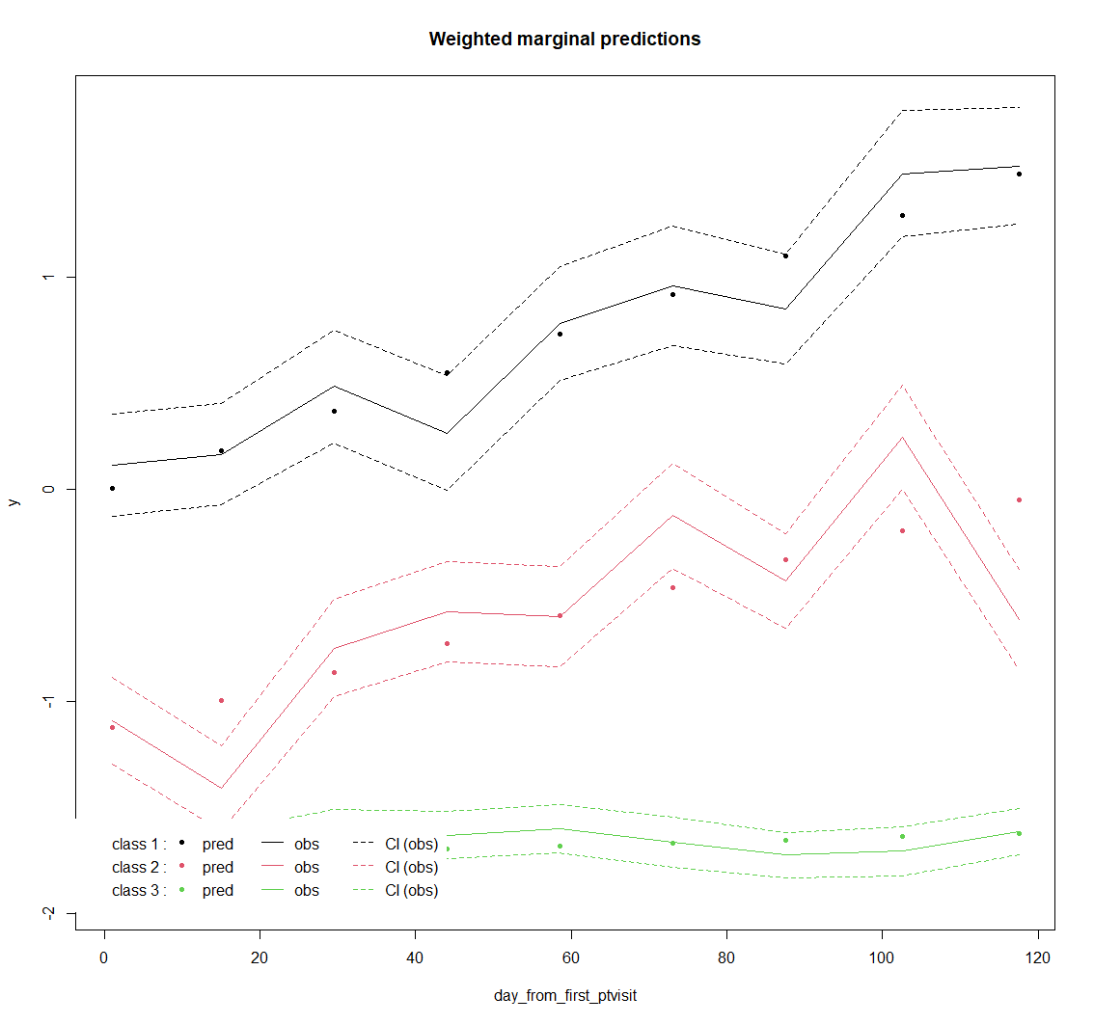
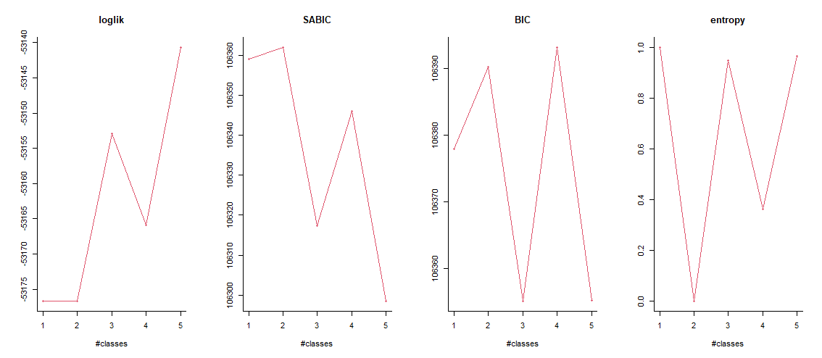
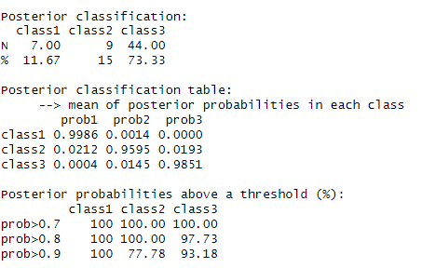
Daily – Total Sleep Time
Maximizing,
better describing
Lower, better fit
>0.8, well-separated
Lee et al. 2018 – at least 10%
Kiadaliri et al 2023 – at least 5%
APPA, > 0.7 for each class

Slide 15
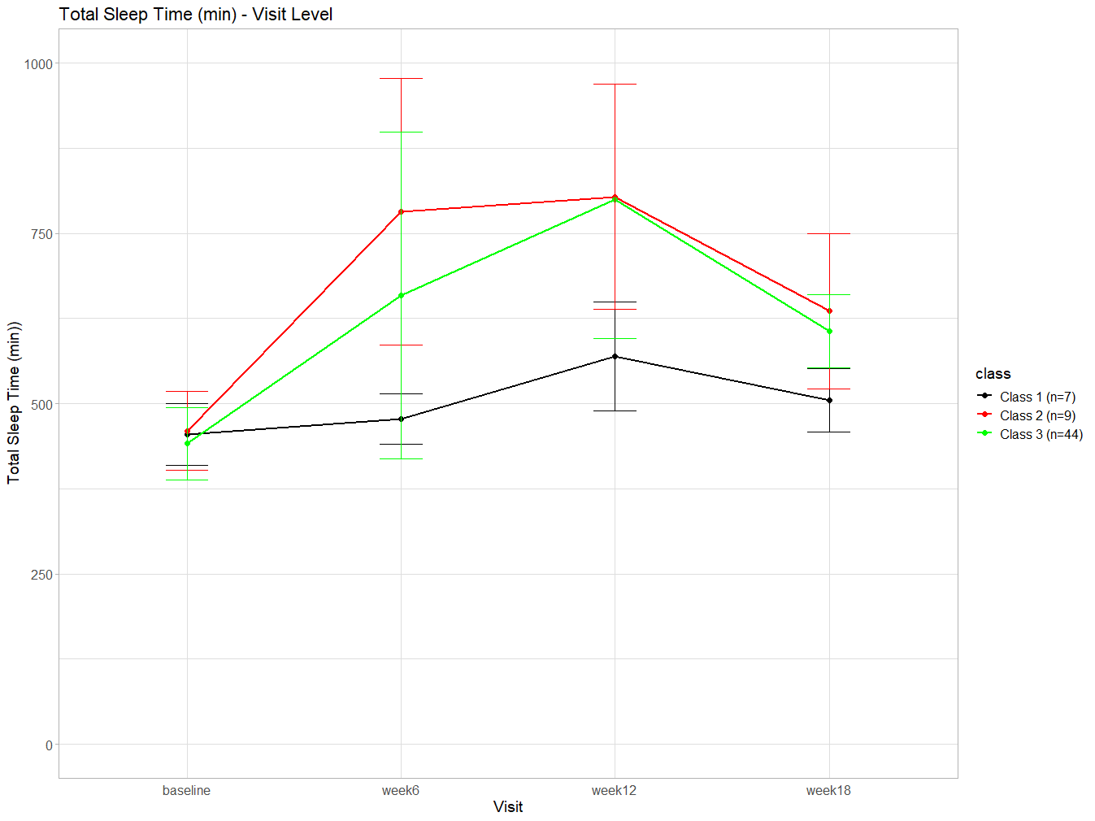
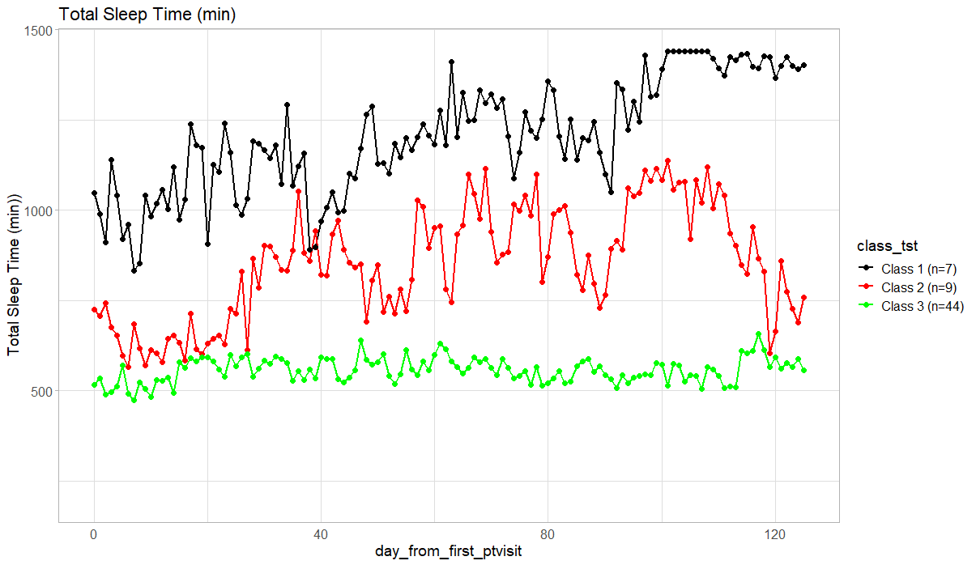

Slide 16
Weekly – Total Sleep Time Mean

Slide 17
Daily – DSIS
Maximizing,
better describing
Lower, better fit
>0.8, well-separated
APPA, > 0.7 for each class

Slide 19
Weekly – DSIS

Slide 20
Pain Trajectory
WOMAC Pain, WOMAC Function

Slide 21
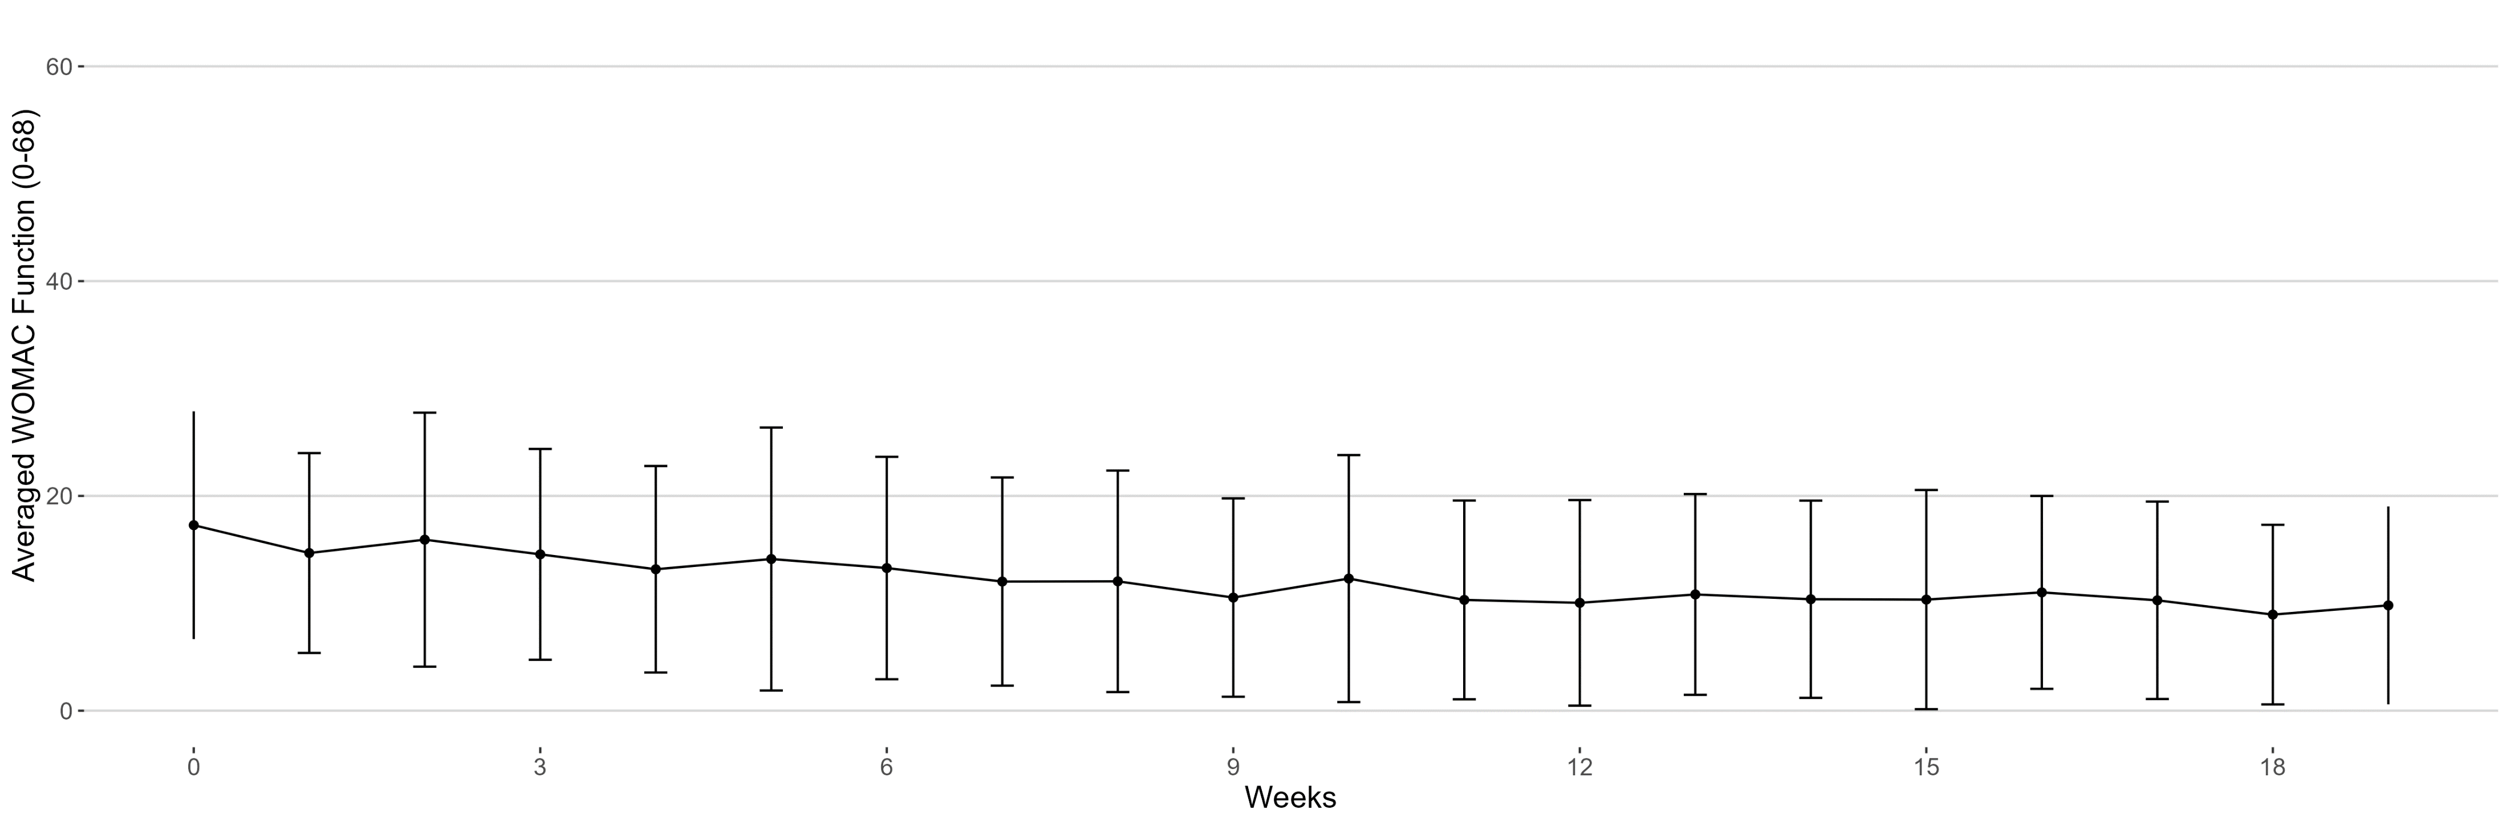
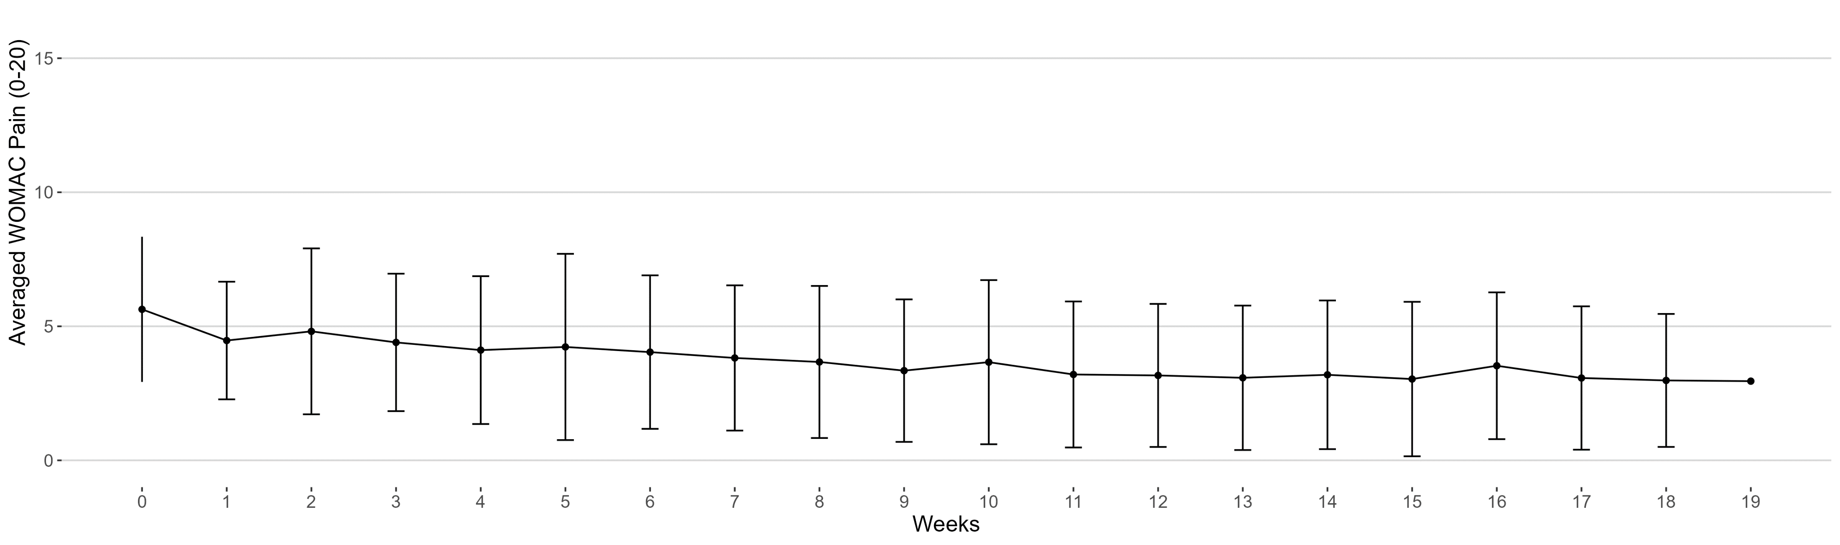
Plot
WOMAC FUNCTION
WOMAC PAIN

Slide 22
LCMM Package in R
lcmm: Estimation of mixed-effect models and latent class mixed-effect models for different types of outcomes (continuous Gaussian, continuous nonGaussian or ordinal); univariate
A linear link function leading to a standard linear mixed model
Estimated models with 1-7 classes
Initial values for the parameters (B) was set as the model with ng=1
Example script for WOMAC Function:
f_linear1 <- lcmm(kd_womac_func ~ weeks , link = "linear", random = ~ weeks, subject = "record_id", ng = 1, data = data_func)
f_linear2 <- lcmm(kd_womac_func ~ weeks , link = "linear", random = ~ weeks, subject = "record_id", data = data_func, ng = 2, B = f_linear1, mixture = ~ weeks)
Optimal number of classes was selected based on a combination of sample size-adjusted Bayesian information criterion (SABIC), average posterior probability of assignment (>0.7 for each class), class size (≥5% of participants), relative entropy (>0.8)
Data Processing
Weeks were filtered within the range of [0,19]
record_id == ‘108’ was excluded

Slide 23
WOMAC FUNCTION

Slide 24
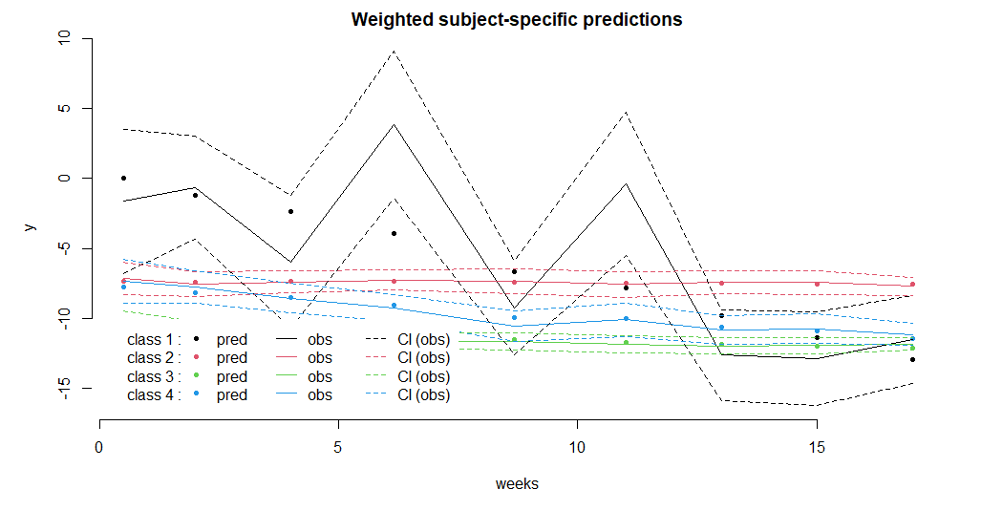
WOMAC Function: Post-fit Estimation
> postprob(f_linear4)
Posterior classification:
class1 class2 class3 class4
N 1.00 18 35.00 6
% 1.67 30 58.33 10
Posterior classification table:
--> mean of posterior probabilities in each class
prob1 prob2 prob3 prob4
class1 1 0.0000 0.0000 0.0000
class2 0 0.9175 0.0420 0.0404
class3 0 0.0321 0.9201 0.0478
class4 0 0.0020 0.1307 0.8673
Posterior probabilities above a threshold (%):
class1 class2 class3 class4
prob>0.7 100 94.44 88.57 100.00
prob>0.8 100 83.33 85.71 83.33
prob>0.9 100 77.78 80.00 33.33
Lee et al. 2018 – at least 10%
Kiadaliri et al 2023 – at least 5%
APPA, > 0.7 for each class
Class 1: W108
Notes:
Loglik: log-likelihood
Conv: convergence, indicator of reaching a stable solution

Slide 25
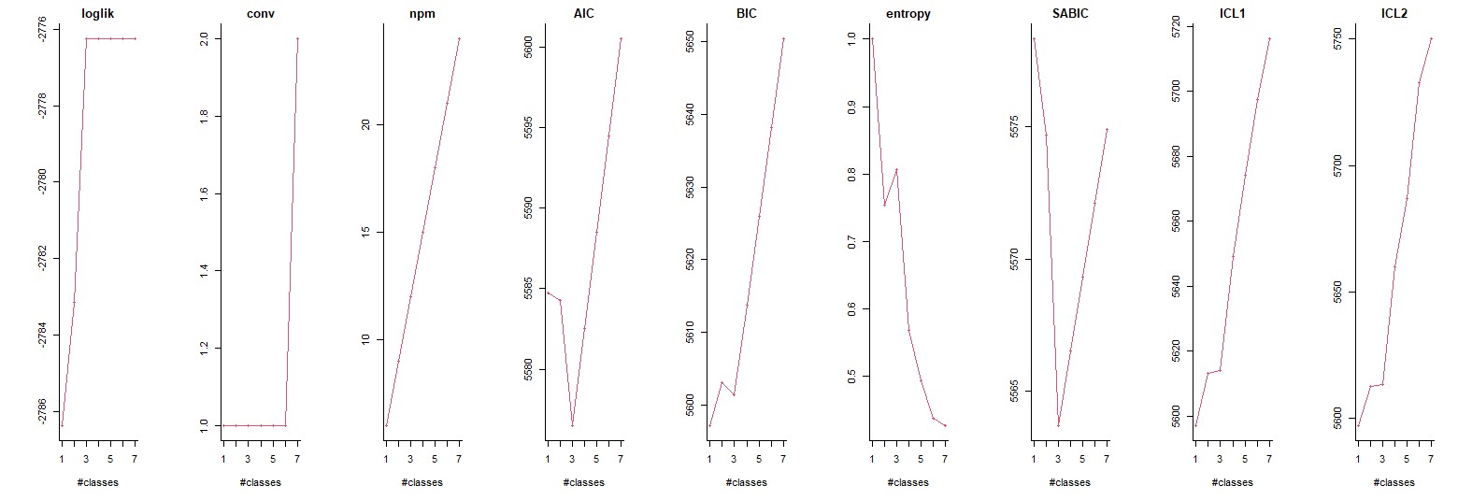
WOMAC Function: Post-fit Estimation
Maximizing,
better describing
Lower, better fit
Lower, better balance between model fit + complexity
>0.8, well-separated
Lower, better fit
G AIC BIC SABIC entropy ICL1 ICL2 %class1 %class2 %class3 %class4 %class5 %class6 %class7
f_linear1 1 5584.719 5597.185 5578.316 1.0000000 5597.185 5597.185 100.00000
f_linear2 2 5584.301 5602.999 5574.696 0.7538363 5613.066 5612.422 28.81356 71.18644
f_linear3 3 5576.514 5601.445 5563.708 0.8065424 5613.984 5613.177 11.86441 30.50847 57.62712
f_linear4 4 5582.514 5613.677 5566.506 0.5675532 5649.048 5659.860 11.86441 32.20339 55.93220 0.00000
f_linear5 5 5588.514 5625.910 5569.305 0.4927156 5674.080 5686.753 15.25424 32.20339 0.00000 52.54237 0
f_linear6 6 5594.514 5638.142 5572.103 0.4374160 5697.615 5732.753 15.25424 33.89831 0.00000 0.00000 0 50.84746
f_linear7 7 5600.514 5650.375 5574.902 0.4273422 5716.121 5750.014 15.25424 33.89831 50.84746 0.00000 0 0.00000 0
Notes:
Loglik: log-likelihood
Conv: convergence, indicator of reaching a stable solution

Slide 26
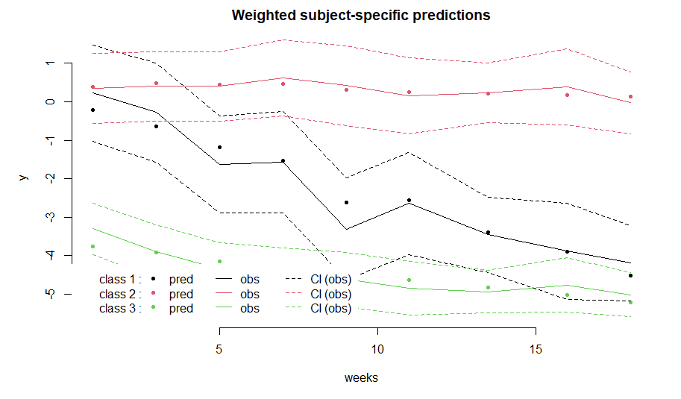
WOMAC Function: Post-fit Estimation
> postprob(f_linear3)
Posterior classification:
class1 class2 class3
N 7.00 18.00 34.00
% 11.86 30.51 57.63
Posterior classification table:
--> mean of posterior probabilities in each class
prob1 prob2 prob3
class1 0.7719 0.0444 0.1837
class2 0.0118 0.9415 0.0467
class3 0.0446 0.0210 0.9344
Posterior probabilities above a threshold (%):
class1 class2 class3
prob>0.7 71.43 94.44 91.18
prob>0.8 42.86 94.44 88.24
prob>0.9 28.57 83.33 82.35
Lee et al. 2018 – at least 10%
Kiadaliri et al 2023 – at least 5%
APPA, > 0.7 for each class
Notes:
Loglik: log-likelihood
Conv: convergence, indicator of reaching a stable solution

Slide 27
WOMAC PAIN

Slide 28
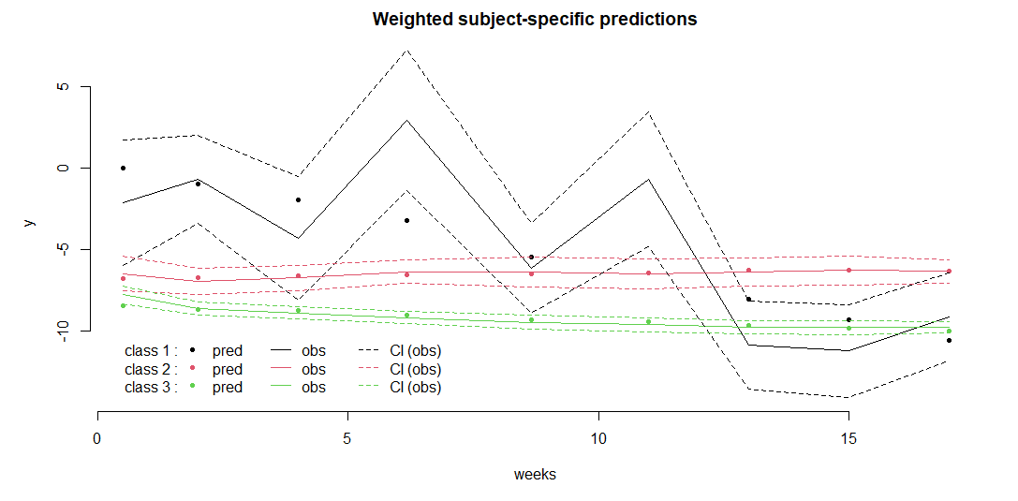
WOMAC Pain: Post-fit Estimation
> # Average Posterior Probability of Assignment (APPA, > 0.7 for each class)
> postprob(p_linear3)
Posterior classification:
class1 class2 class3
N 1.00 7.00 52.00
% 1.67 11.67 86.67
Posterior classification table:
--> mean of posterior probabilities in each class
prob1 prob2 prob3
class1 1 0.0000 0.0000
class2 0 0.8066 0.1934
class3 0 0.0531 0.9469
Posterior probabilities above a threshold (%):
class1 class2 class3
prob>0.7 100 71.43 94.23
prob>0.8 100 57.14 90.38
prob>0.9 100 42.86 84.62
Lee et al. 2018 – at least 10%
Kiadaliri et al 2023 – at least 5%
APPA, > 0.7 for each class
Class 1: W108
Notes:
Loglik: log-likelihood
Conv: convergence, indicator of reaching a stable solution

Slide 29
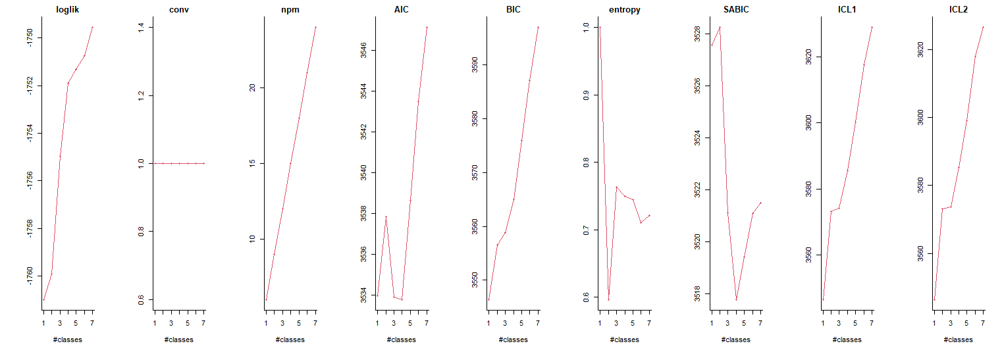
WOMAC Pain: Post-fit Estimation
Lower, better balance between model fit + complexity
Maximizing,
better describing
Lower, better fit
>0.8, well-separated
Lower, better fit
G AIC BIC SABIC entropy ICL1 ICL2 %class1 %class2 %class3 %class4 %class5 %class6 %class7
p_linear1 1 3533.973 3546.438 3527.570 1.0000000 3546.438 3546.438 100.000000
p_linear2 2 3537.847 3556.545 3528.242 0.5965696 3573.043 3573.175 45.762712 54.237288
p_linear3 3 3533.920 3558.850 3521.114 0.7632735 3574.195 3573.755 20.338983 6.779661 72.881356
p_linear4 4 3533.799 3564.962 3517.791 0.7490861 3585.485 3585.321 22.033898 6.779661 23.728814 47.45763
p_linear5 5 3538.644 3576.039 3519.434 0.7450699 3600.247 3599.117 3.389831 6.779661 27.118644 44.06780 18.644068
p_linear6 6 3543.498 3587.126 3521.087 0.7106386 3617.716 3618.099 6.779661 20.338983 5.084746 23.72881 3.389831 40.677966
p_linear7 7 3547.116 3596.977 3521.504 0.7215720 3628.943 3626.477 3.389831 6.779661 3.389831 20.33898 27.118644 5.084746 33.89831
Notes:
Loglik: log-likelihood
Conv: convergence, indicator of reaching a stable solution

Slide 30
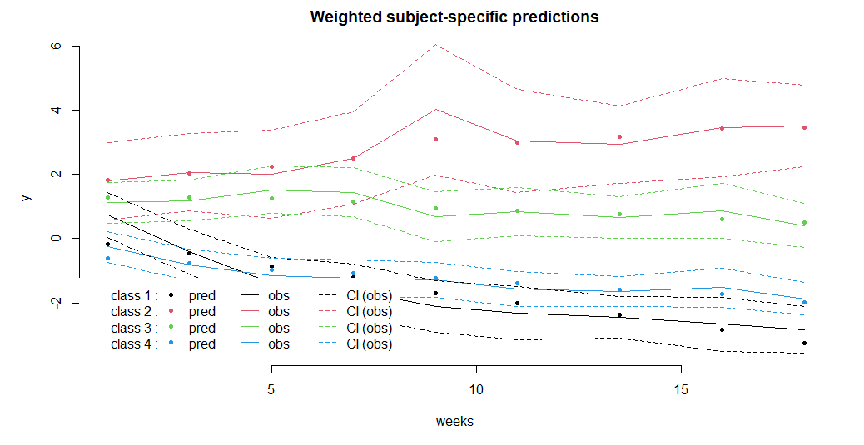
WOMAC Pain: Post-fit Estimation
> postprob(p_linear4)
P
osterior classification:
class1 class2 class3 class4
N 13.00 4.00 14.00 28.00
% 22.03 6.78 23.73 47.46
Posterior classification table:
--> mean of posterior probabilities in each class
prob1 prob2 prob3 prob4
class1 0.8809 0.0000 0.0001 0.1190
class2 0.0000 0.9996 0.0004 0.0000
class3 0.0074 0.0304 0.8110 0.1511
class4 0.0577 0.0003 0.0953 0.8467
Posterior probabilities above a threshold (%):
class1 class2 class3 class4
prob>0.7 84.62 100 71.43 82.14
prob>0.8 76.92 100 64.29 64.29
prob>0.9 53.85 100 50.00 50.00
Lee et al. 2018 – at least 10%
Kiadaliri et al 2023 – at least 5%
APPA, > 0.7 for each class
Notes:
Loglik: log-likelihood
Conv: convergence, indicator of reaching a stable solution

