Slide 1
Apple’s Mobility Data on the Study of the Effectiveness of Stay Home Orders to Reduce COVID-19 Prevalence
RESEARCHERS
Anthony Song, Michael Egle, John Chandara, Jaydon Cobb

Slide 2

The Scoop
In an unprecedented time at the ending of 2019, a terrible pandemic plagued the world which in turn has caused many medical complications and many deaths in the awakening on the year 2020.
Notes:
Postered on every blog, social media platform and internet website for the past three months has been the concept of flattening the curve to reduce the prevalence of this deadly disease.
Government officials in every country have implemented laws on travel and social interactions.
Using the apple mobility data and various other datasets, we strive to answer these questions.
Have citizens obeyed social distancing regulations?
Has it been effective?
How are we, the United States, handling this compared to other regions?
What can we learn from regions that are successful at keeping prevalence low?

Slide 3

Our Sources
Apple Mobility Trends (April, 24, 2020)
Worldometer (April, 24, 2020)
NY Times COVID-19 Github Data (April, 24, 2020)
Notes:
For our project:
We Use 3 main data sets:
The dates for our data sets start on January 13th. On this day the World Health Organization reported the first case of Corona virus, outside of China, this occurred in Thailand, from a woman who had arrived from Wuhan.
Elaborating on the data:
The Apple mobility data we used, collects the relative walking, driving and transit mobility for each respective city or region. The mobility data starts at a baseline (100%) for each region or city. As time passes, the mobility is recorded for that day, values larger than 100% indicate increased mobility, values lower indicate decreased mobility. Reports are published daily and reflect requests for directions in Apple Maps. Don’t worry apple does not track this info back to the user.
For COVID-19 prevalence, for statistics like confirmed cases and deaths, we used Worldometer and the NY times COVID-19 Github data, which provided us with up-to-date information around the world and United States.

Slide 4
Have Citizens Obeyed Social Distancing Regulations?
Has it Been Effective?

Slide 5
Important Notes
We have decided to use deaths as opposed to cases.
Removes the differences in testing capacity between regions.
Severity of cases is more important than quantity of cases.
Population density is more important than population size.
Important for transit & walking numbers to be lower than driving numbers.

Slide 6
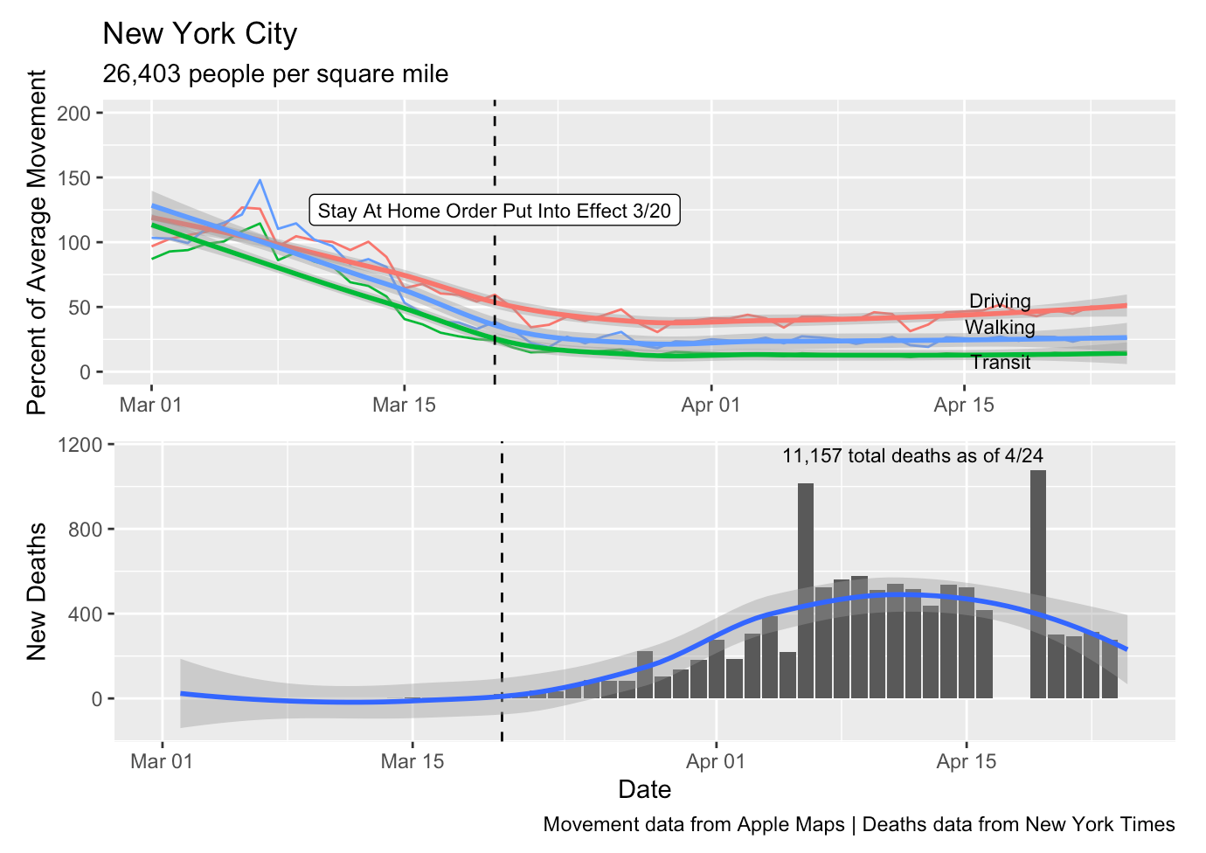

Slide 7
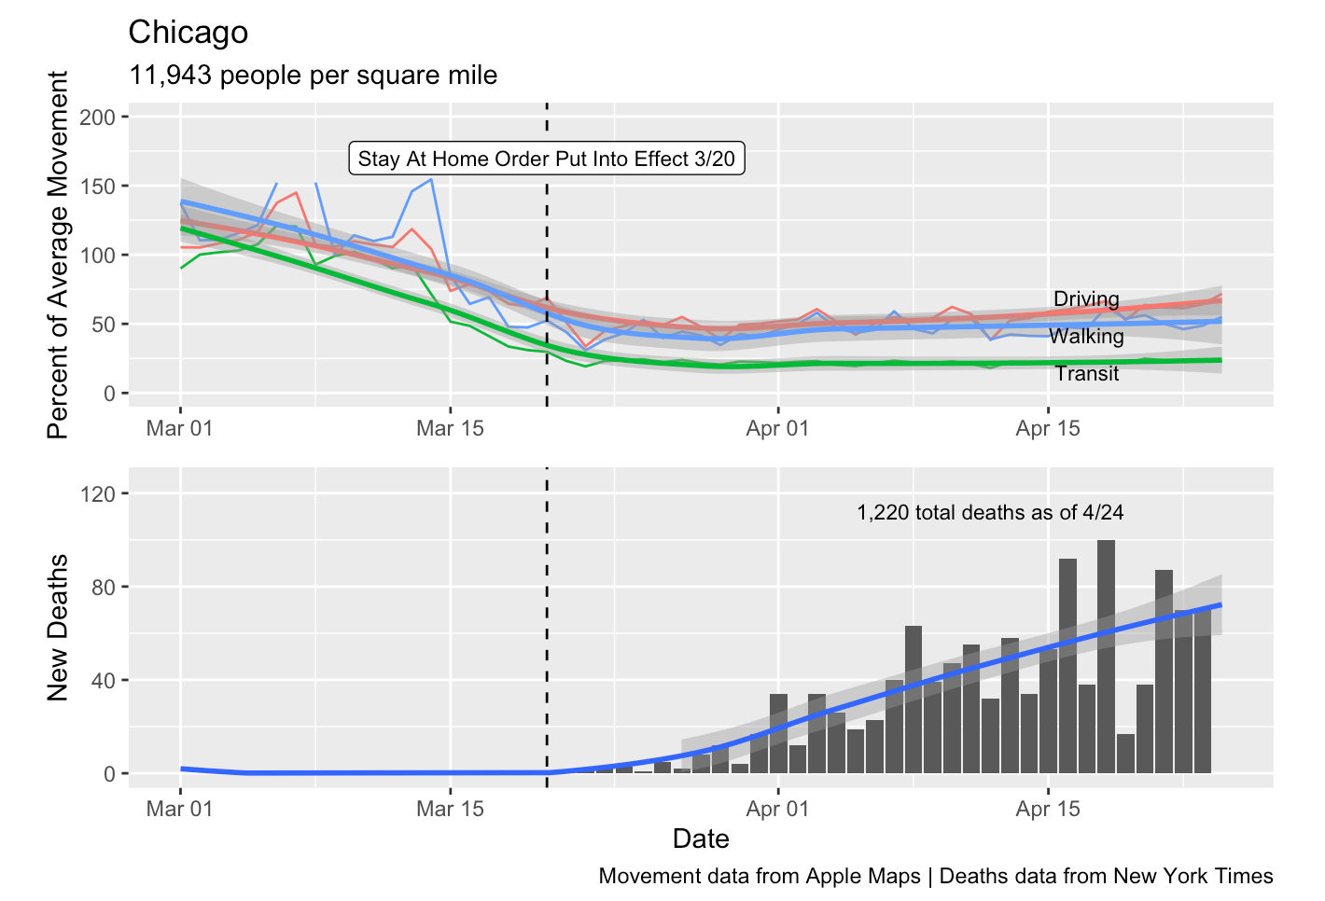

Slide 8
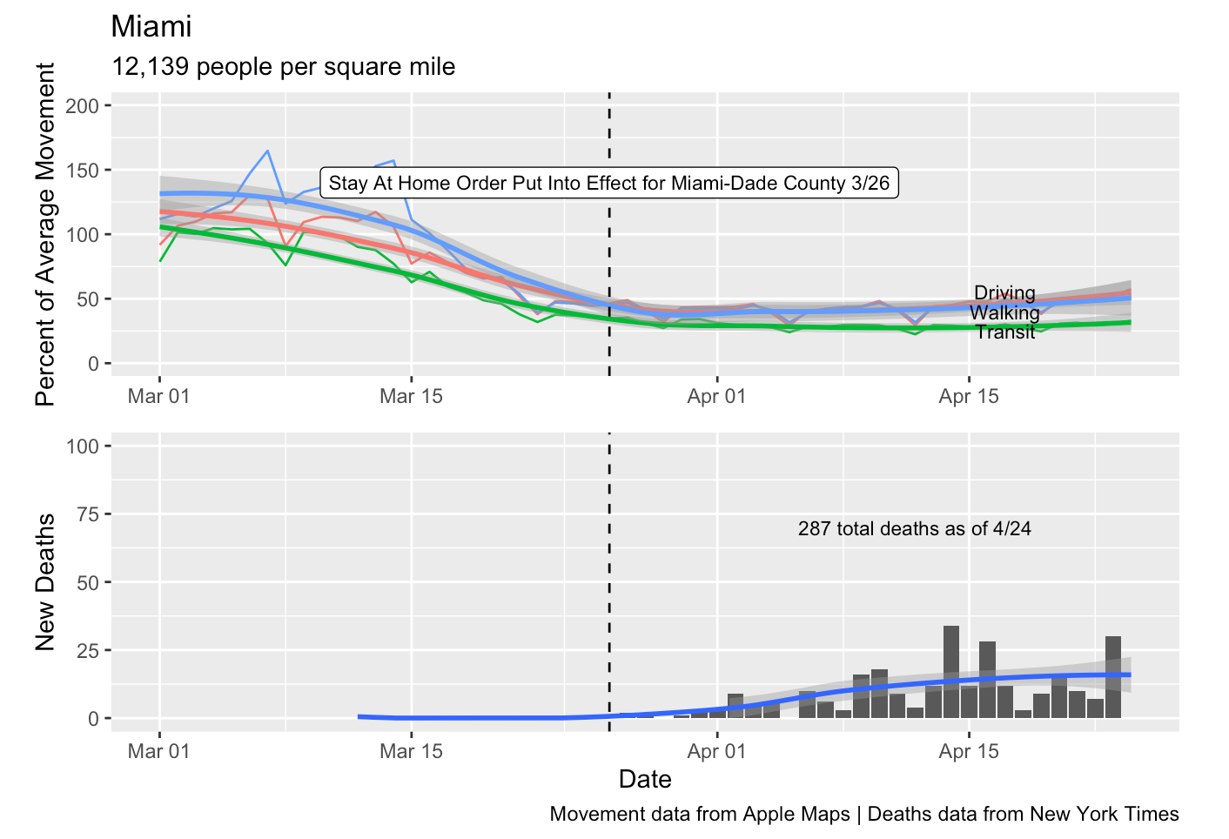

Slide 9
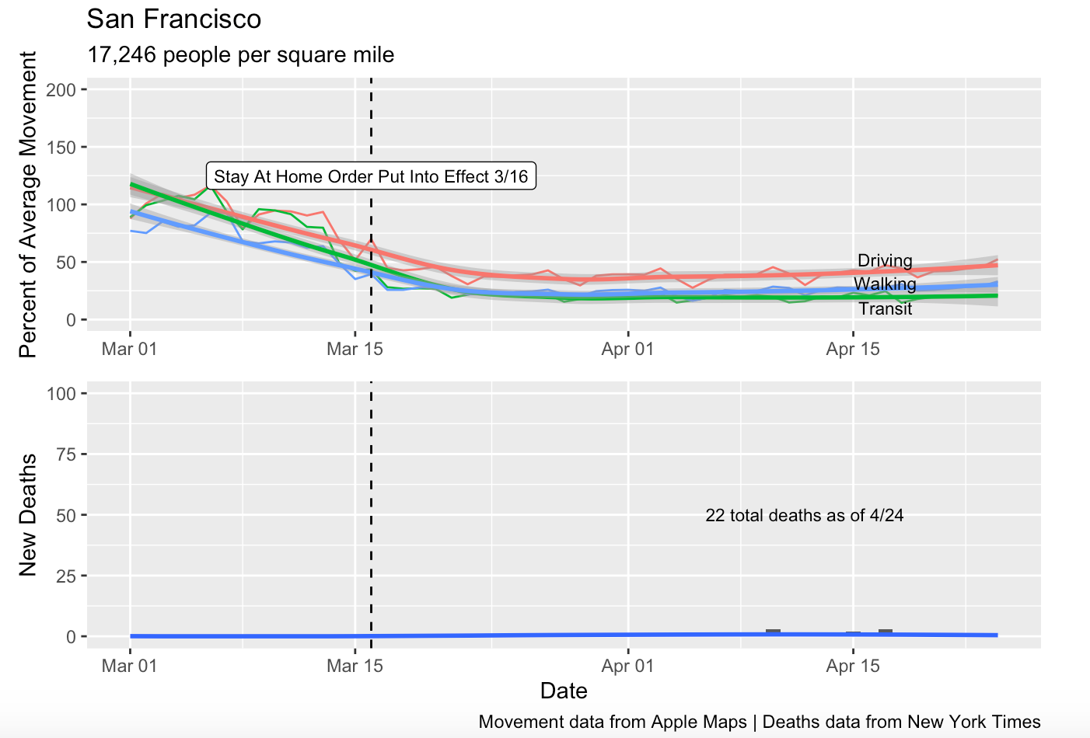

Slide 10
How are we handling this compared to other regions?
What can we learn from regions that are successful at keeping prevalence low?
Notes:
Building off Michael, we can ask more questions that can be answered by the mobility data.
How are we handling this compared to other regions, and what can we learn from regions that are successful and keeping their cases low and their deaths lower.
Two things we want to look at to answer these questions are:
How high their relative mobility is at the time frame after the first confirmed case outside of China, on January 13th.
Building off the first point, how their relative rates of mobility decrease at the time frame of the COVID-19 scare (Mid-February to March).

Slide 11
Important Notes
We looked at death rates per million people
This normalizes the variable.
We targeted only the walking data for this analysis
This category involves mainly social interaction, or interactions near large groups.
We did not account for health system, GDP or regions near the virus origin.
After a preliminary search, we found little correlation in these areas.
Notes:
We analyzed mobility data for 11 available regions.
5 with high death rates and 5 with low death rates and the United States.
Countries with good health systems (UK) had high death rates, and countries with lower graded health systems (Cambodia) had low death rates.
Countries near China, seemed to have low death rates.

Slide 12
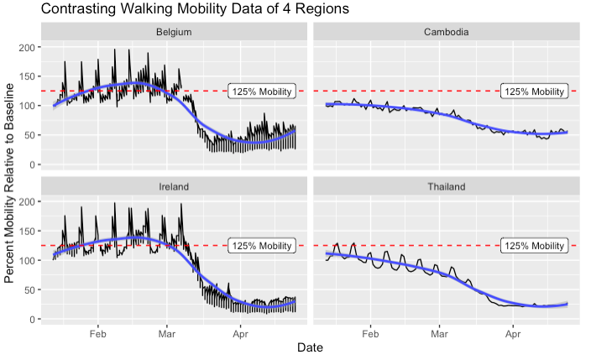
Notes:
Graphing the Walking mobility data with respect to the date. The left two graphs representing high death rates, and the right two graphs representing low death rates.
Belgium DR: 597 deaths per million
Ireland DR: 215 deaths per million
Cambodia DR: 0 deaths per million
Thailand DR: 0.3 deaths per million
There are two trends I want to mention here when looking at these graphs, the two countries on the left have large spikes in mobility, that are substantially above 125% and sometimes reaching nearly 200% or twice the baseline mobility. A lot of movement and potential social interaction during the start of a global pandemic.
Next, The slopes of Belgium and Ireland during March, modeled by the regression line, are much steeper than the slopes of Cambodia and Thailand. Steep slopes can indicate times of chaos in which people change their habits quickly, due large increasing infection rates, possibly attributed to not abiding by social distancing laws.

Slide 13
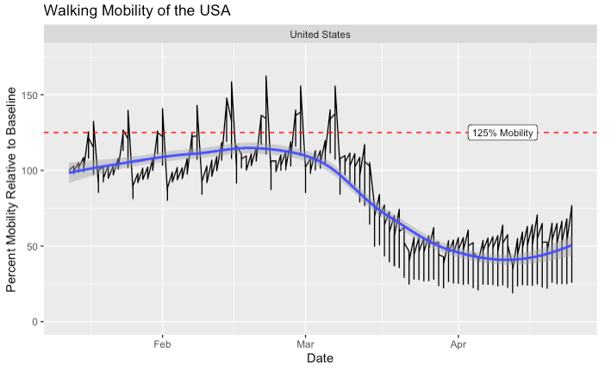
Notes:
So How does the USA Compare?
The US can be seen by the large spikes in mobility from Feb to Mar, over 150% the baseline, possibly meaning not social distancing.
Ive shown where 125% mobility is for reference.
The death rates per million range from 0 to 597 the United States is in the middle around 166.
The rate of decreasing mobility ranges from -0.51 day to -3.5 percent per day, the united states is at about -1.8 percent/day.
Statisctically, we see that the US is battling corona virus moderately, meaning our practices of containment could be improved.

Slide 14
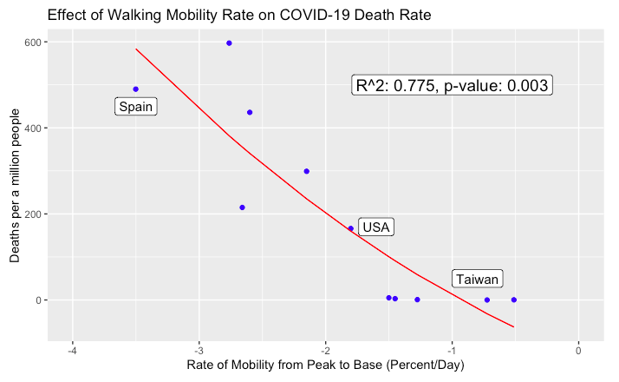
Notes:
What can we learn from regions successfully controlling the virus?
This graph represents a regression on the impact of the rate of the mobility on the number of deaths per million people in each region.
The rate of mobility was determined from a regression performed on each regions walking mobility data. The time frame in which the rate was measured, was from the peak to the base starting in Mid-February the time in which the Coronavirus started spreading rapidly. (More negative corresponds to a steeper slope as seen as the regression line from previous graphs.
In correlation to the deaths per million, we see that as mobility rate becomes smaller, or more negative, meaning a rapid decrease in movement, corresponds to an increase in death rate.
We can interpret this as countries with high death rates were more casual about the coronavirus at the time it was discovered, compared to countries with low death rates. This means that regions with high death rates, thus large negative mobility rates were more prone to continue on their daily lives and continuing to participate in social events, rather than maintaining their baseline mobility and slowly decreasing it.
From successful countries the main takeaway is EARLY ACTION, you should immediately start preparing, governments should be limiting movement and social interactions right away, instead of waiting for development. By going on with daily routines or increasing movement as the weather gets better, we see that there are dire consequences.

Slide 15
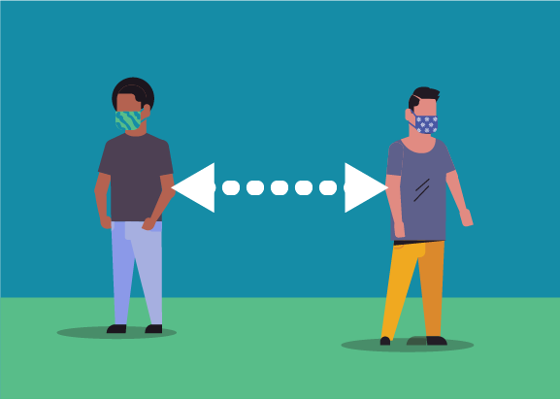
Conclusion
Early action was critical in preventing spread (and deaths)
Citizens obeying social distancing orders is important as well
Notes:
Before we reiterate our analysis.
It is important to address that there may be some confounding variables that we may not have accounted for, these may include, weather, immunity and culture.
Fortunately, we were able to find trends, using the mobility data provided from Apple, we are able to identify trends that related to COVID-19 Prevalence and the effectiveness of stay at home orders.
Furthermore, learning from countries that have been experienced issues with the virus and countries that have successfully battled the virus. In times of the unknown, we should be decreasing social mobility, and governments should be implementing stay at home orders as early as possible, instead of waiting on economic or viral development. The takeaway being early action and obeying social distancing laws. For future its better to be safe than sorry.

Slide 16
References
Burkert, Andi. “Flattening the COVID-19 Curves.” Scientific American Blog Network, Scientific American, 17 Mar. 2020, blogs.scientificamerican.com/observations/flattening-the-covid-19-curves/.
“Real Time World Statistics.” Worldometer, www.worldometers.info/.
“COVID‑19 - Mobility Trends Reports.” Apple, www.apple.com/covid19/mobility.
“Interactive On-going Data.” New York Times, https://www.nytimes.com/interactive/2020/us/coronavirus-us-cases.html
Notes:
Thank you for your time and I hope everyone is staying 6 feet apart.

