Slide 1

Electoral Crime under Democracy: Evidence from Brazil
Andre Assumpcao
GCTR 2019

Slide 2
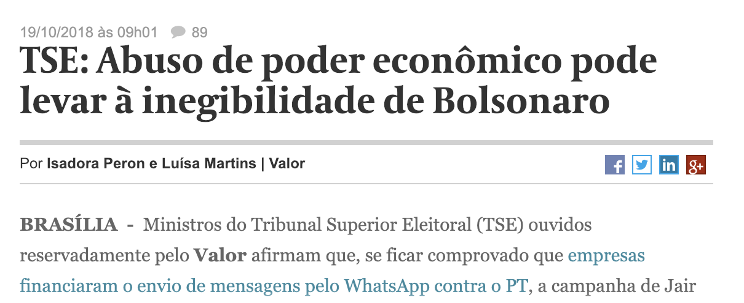
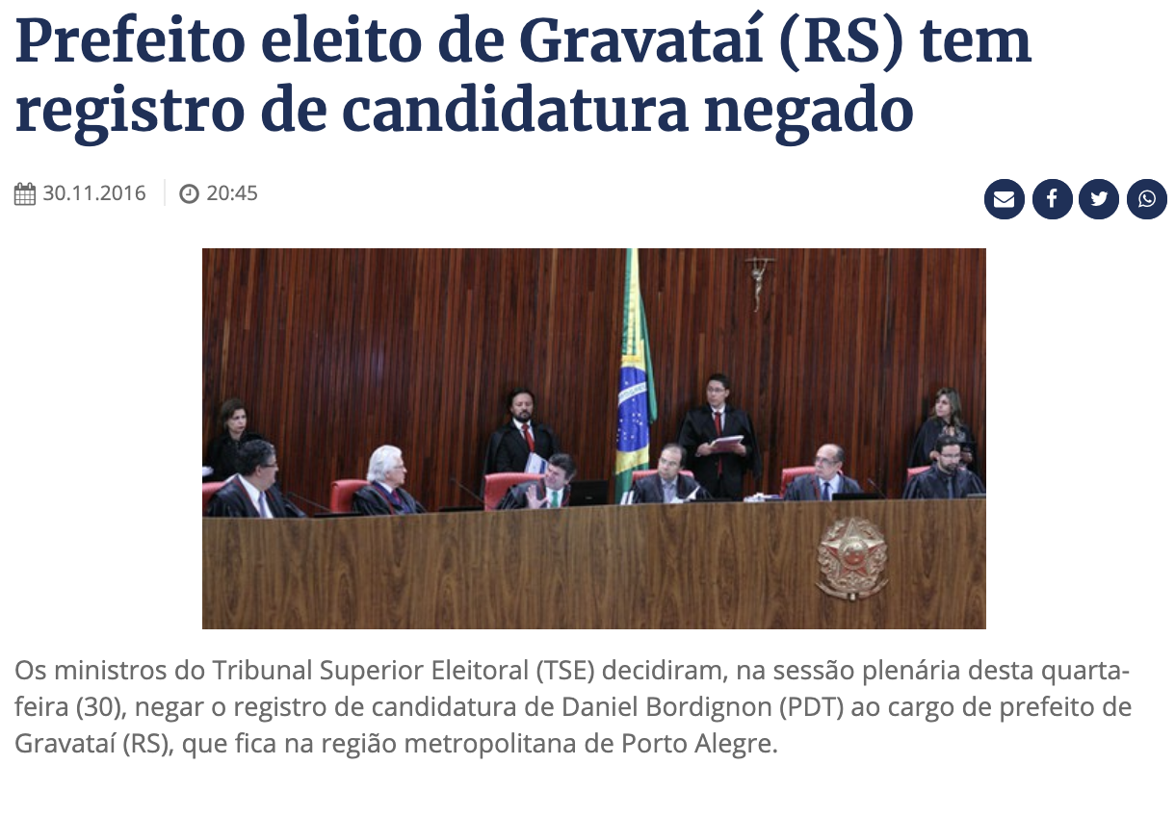
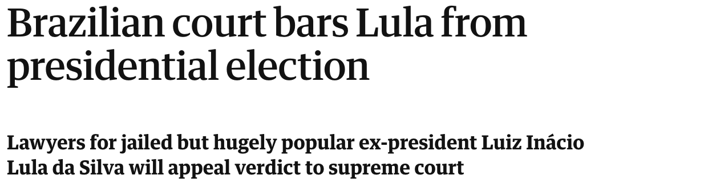
Motivation

Slide 3
Motivation
Electoral crime is a popular research topic in the electoral authoritarianism literature (Schedler, 2015);
We know a lot about severe violations, such as vote buying, fraud, censorship, intimidation (Mares and Young, 2016);
Missing:
Electoral crimes in large, high-quality democracies;
Effects of more obscure crimes (documentation, bookkeeping, illegal campaigning).

Slide 4
Do voters punish candidates convicted for electoral crimes?
Research question

Slide 5
Institutional Background
Brazil has a system of dedicated electoral courts:
4 primary responsibilities:
Electoral rule-making
Judicial consultation
Administration of electoral process
Conflict resolution
TSE (federal)
TREs (state)

Slide 6
Institutional Background
All candidates need judicial authorization to run for elected office
trial sentence
Authorizations can be challenged in court
appeals
Electoral Courts issues final ruling
appeals sentence
Info loaded on EV machines
EV deadline
Election takes place
election day

Slide 7
Identification Strategy (IV)
Registration
deadline
EV
deadline
Election
Day
Candidates whose appeals rulings are pending can be voted for on Election Day
Appeals decisions cannot after votes
Candidates register with TSE
TSE issues trial decisions
Aug 15
Sep 12
Oct 2

Slide 8
Identification Strategy
trial
appeals
authorized
affirmed
reversed
candidacy
affirmed
dismissed
reversed

Slide 9
Data
Candidate-level from TSE containing:
Age
Gender
Education
Marital status
Political experience
Party affiliation
Campaign expenditures
Trial and appeals rulings
Electoral outcomes

Slide 10
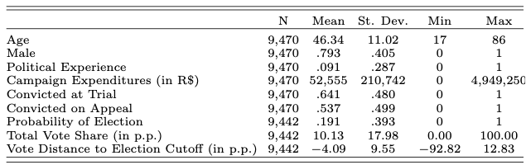
Descriptive Statistics

Slide 11
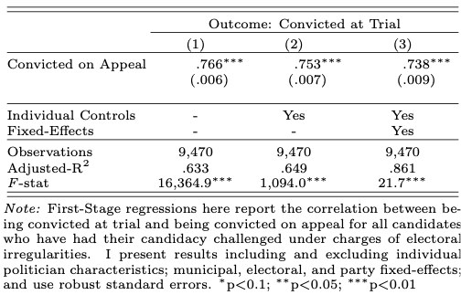
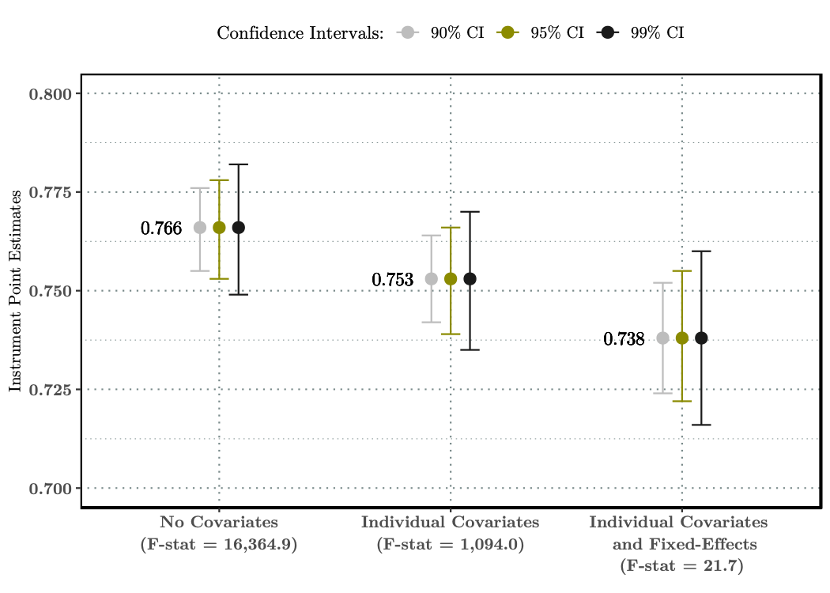
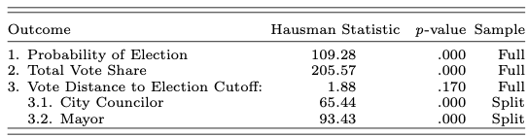
Instrument meets Inclusion Restriction

Slide 12
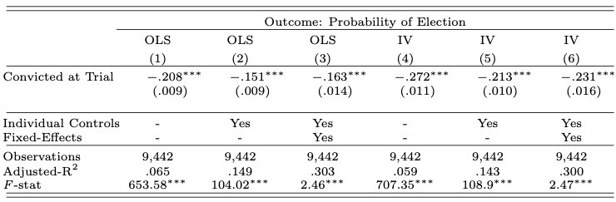
Convictions affect Electoral Performance

Slide 13
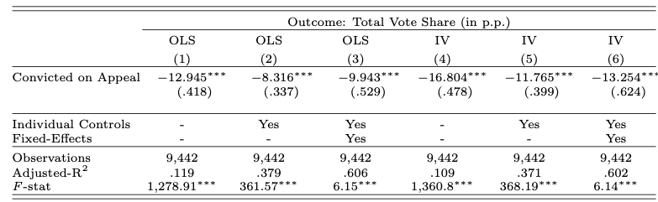
Convictions affect Electoral Performance

Slide 14
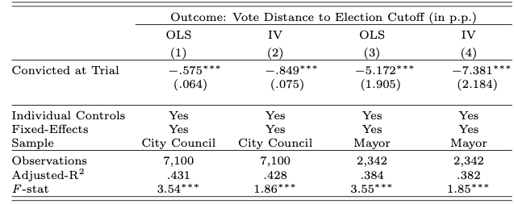
Convictions affect Electoral Performance

Slide 15
Convictions reduce:
the probability of election by 23.1 p.p.
vote share by 13.1 p.p.

Slide 16
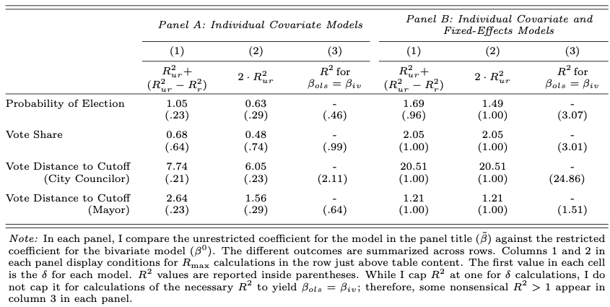
Is there enough unobservable heterogeneity driving IV results?
No!

Slide 17
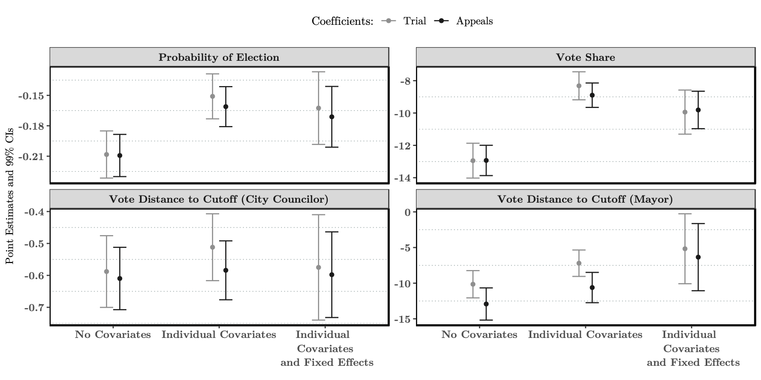
Is there excessive correlation between instruments and covariates?
No!

Slide 18
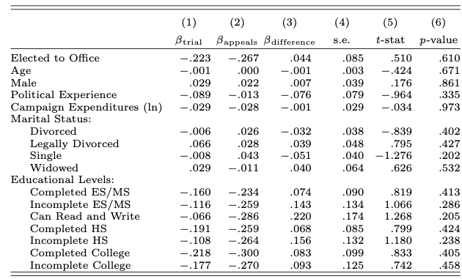
Do judges change their sentencing behavior during judicial review?
No!

Slide 19
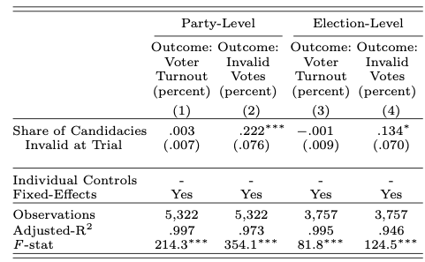
Do voters disengage from the electoral process?
No!

Slide 20
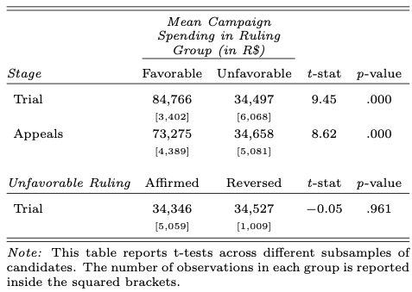
Do candidates quit campaigning?
No!

Slide 21
The mechanism behind the conviction effect is in fact the punishment for electoral crime

Slide 22
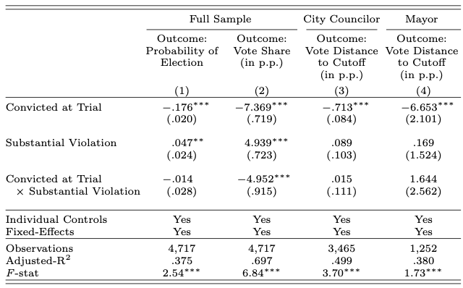
But do voters punish differently, as a function of the crime committed?
No!

Slide 23
Conclusion
Takeaways
Voters punish candidates for electoral crimes
Punishment is lower than in more severe, and clearer, cases
But punishment doesn’t fit the crime
Electoral Courts decisions serve as an additional signal of candidate quality
Brazil, Mexico, India, South Africa would want to strengthen their electoral authorities

