Slide 1

Customer Shopping Behavior Analysis
3,900 purchases — 18 features — goal: uncover spending patterns, segments, product & subscription insights

Slide 2

Dataset Summary
Size
Key Features
Rows: 3,900 · Columns: 18
Demographics, Purchase details, Behavior, Subscription
Missing Data
37 values in Review Rating

Slide 3
Data Preparation (Python)
01
02
03
Load & Explore
Impute Ratings
Standardize
pandas, df.info(), .describe()
Median per product category
Rename columns to snake_case
04
05
Feature Eng.
Finalize
age_group, purchase_frequency_days
Dropped promo_code_used, loaded to PostgreSQL

Slide 4

SQL Analysis — Key Questions
Revenue by gender, discount behavior, top-rated items, shipping comparison, subscriptions, segmentation, top products per category

Slide 5

Revenue by Gender
Male: 157,890 · Female: 75,191
Shipping Comparison
Standard avg $58.46 · Express avg $60.48

Slide 6
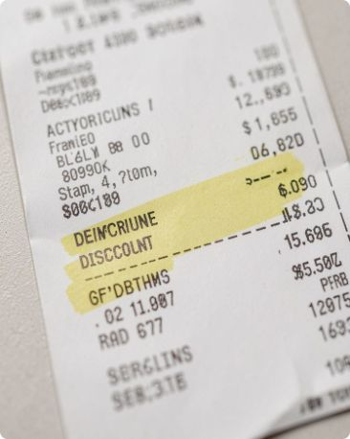

Discounts & High-Spending Users
839 rows: customers who used discounts but spent above average
Discount-Dependent Products
High-Spenders Using Discounts
Top 5 discount rates: Hat 50.00%, Sneakers 49.66%, Coat 49.07%, Sweater 48.17%, Pants 47.37%
Identified multiple customers spending well above average while using discounts

Slide 7
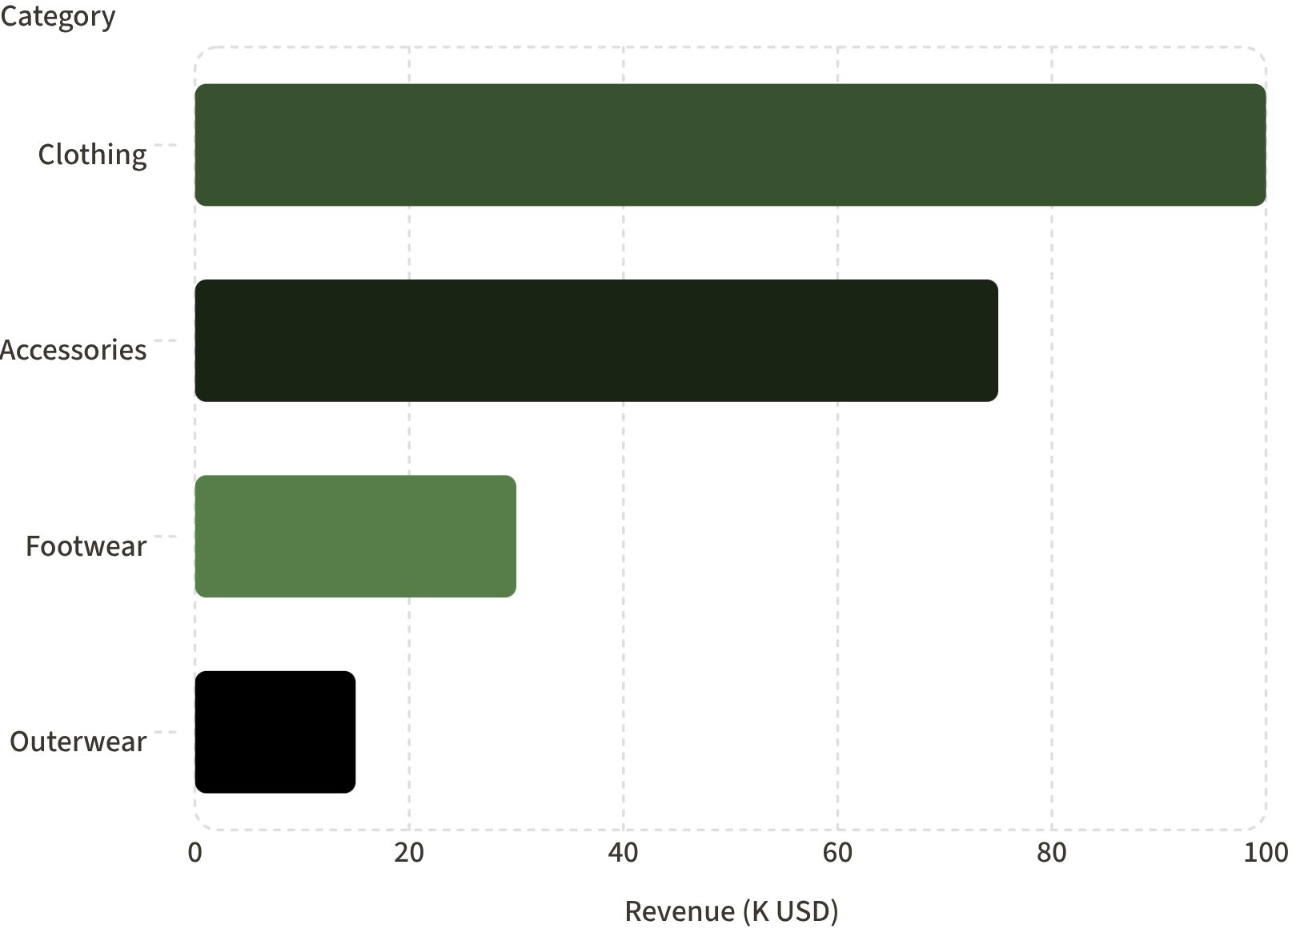
Top Metrics
Customers: 3.9K · Avg purchase: $59.76 · Avg rating: 3.75
Sales by Category
Clothing 1,800 · Accessories 1,200 · Footwear 600 · Outerwear 200

Slide 8
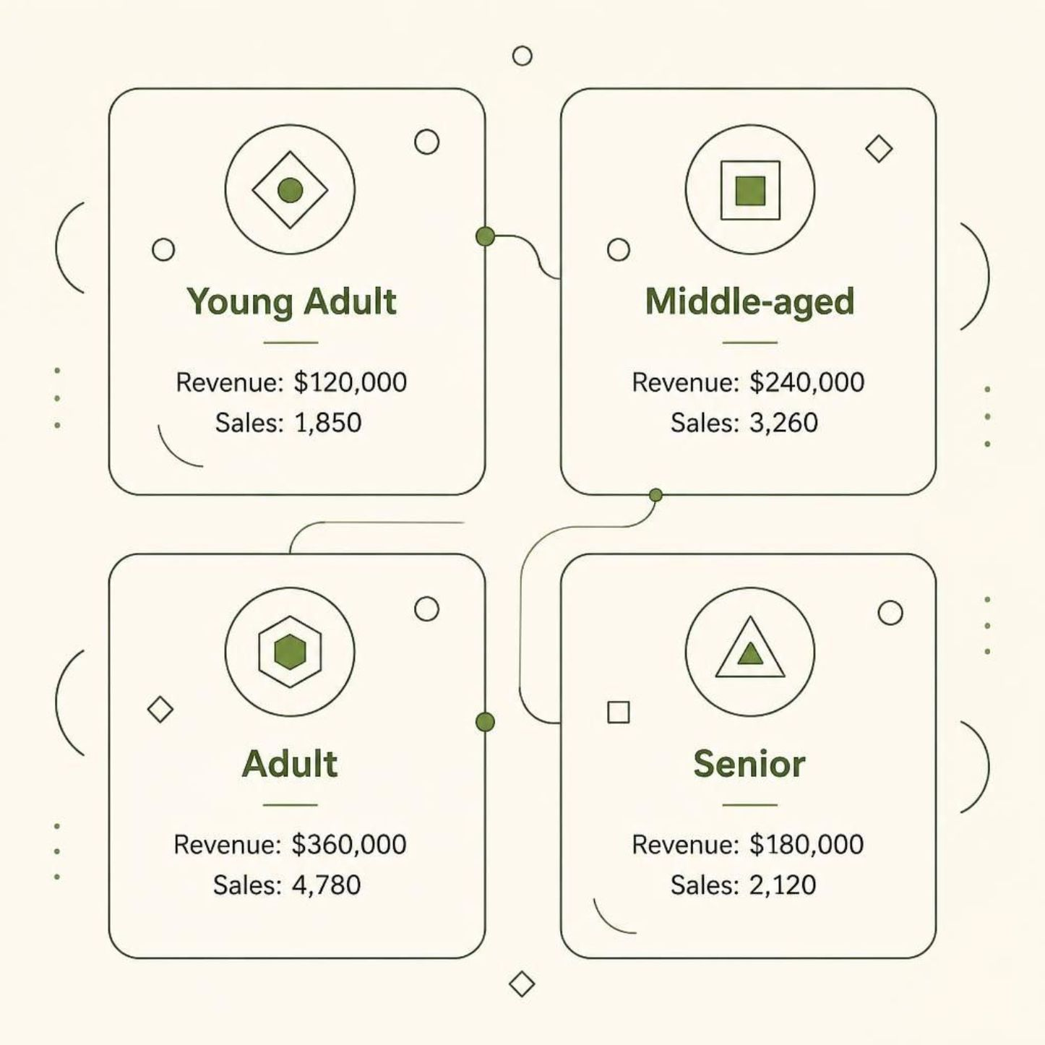
Revenue & Sales by Age
Revenue by age group: Young Adult 62,143 · Middle-aged 59,197 · Adult 55,978 · Senior 55,763
Sales by age group (counts): Young Adult 900 · Middle-aged 850 · Senior 800 · Adult 750

Slide 9

Dashboard (Power BI)
Interactive dashboard with KPIs, donut for subscriptions (Yes 27% · No 73%), revenue & sales charts, age-group breakdowns

Slide 10

Business Recommendations
Boost Subscriptions
Loyalty Programs
Discount Policy
Promote exclusive benefits for subscribers
Reward repeat buyers to increase loyalty
Review balance between sales lift and margins
Product Positioning
Targeted Marketing
Promote top-rated & best-selling items
Focus on high-revenue age groups & express-shipping users

