Slide 1




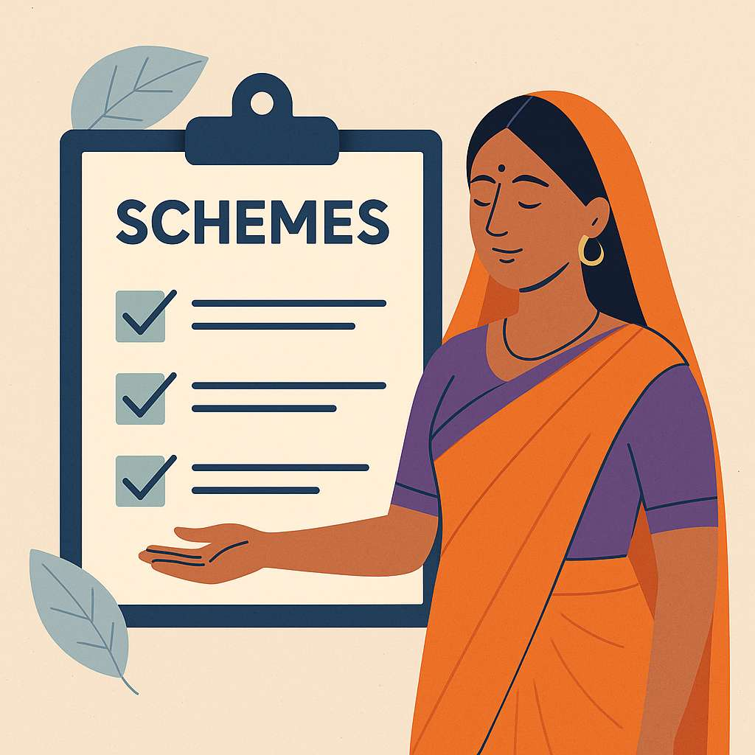
NariYukti’25
Sahayini - “Helping Every Woman
Find the Support She Deserves.”
Theme: Rural Women Empowerment
Team Details: Aastha Yadav, Payal Pal, Niharika Dubey

Slide 2
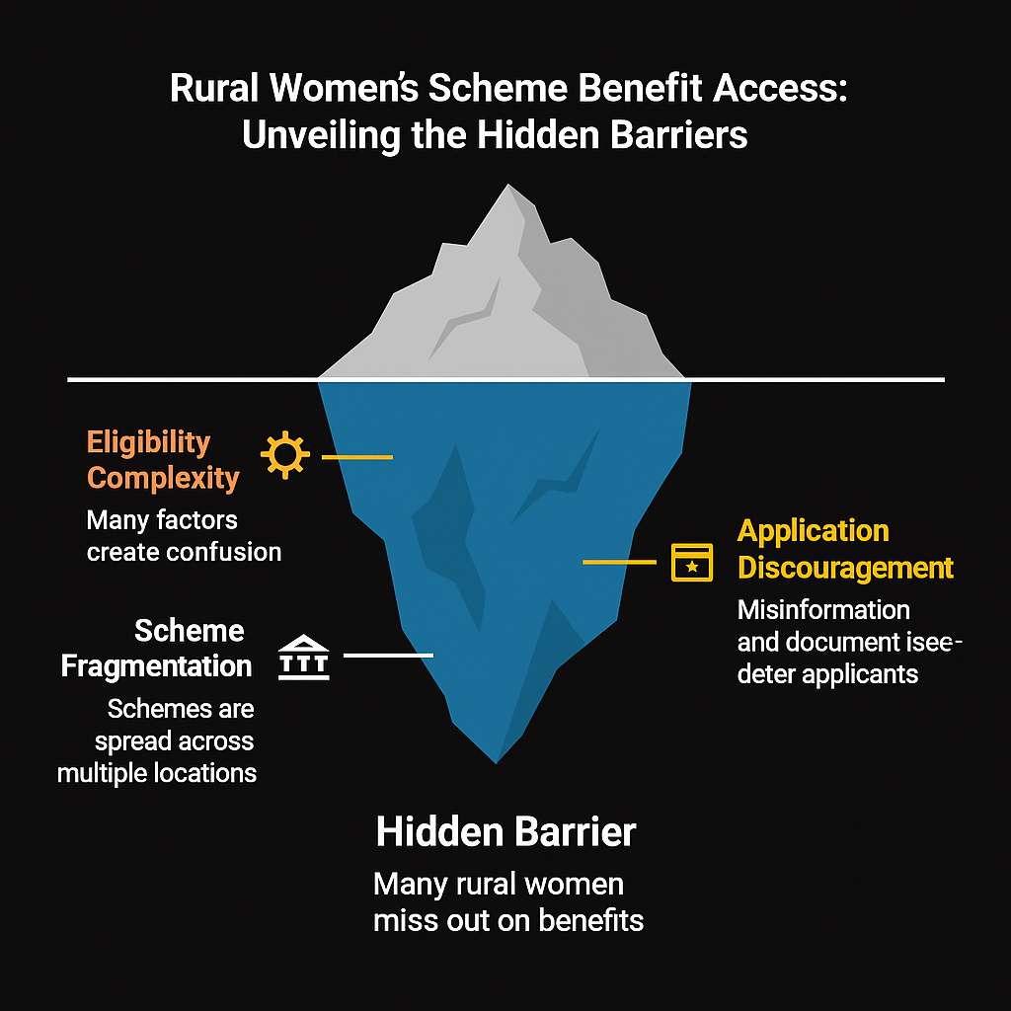
Problem Statement: Rural women are unaware of which government schemes they are eligible for due to scattered information, complex rules, and low digital literacy, resulting in missed benefits.
Describe the real-world challenge.
70% of eligible rural women never receive scheme benefits despite being qualified.
Eligibility depends on many factors (income, caste, occupation, documents), causing confusion.
Document issues, misinformation, and time-consuming processes discourage women from applying.
Schemes are spread across multiple websites, departments, and offline offices.
Who is affected? (target users)
Rural women with low digital literacy.
Pregnant women and new mothers eligible for health-related schemes.
Widows, single mothers, and elderly women.
Self-help group (SHG) members.
Why does it matter? (motivation)
Eliminates fraud and exploitation by agents.
Helps bridge the gap between government benefits and real beneficiaries.
Empowered women uplift entire families and communities.
Access to schemes directly improves women’s income, health, and education.

Slide 3
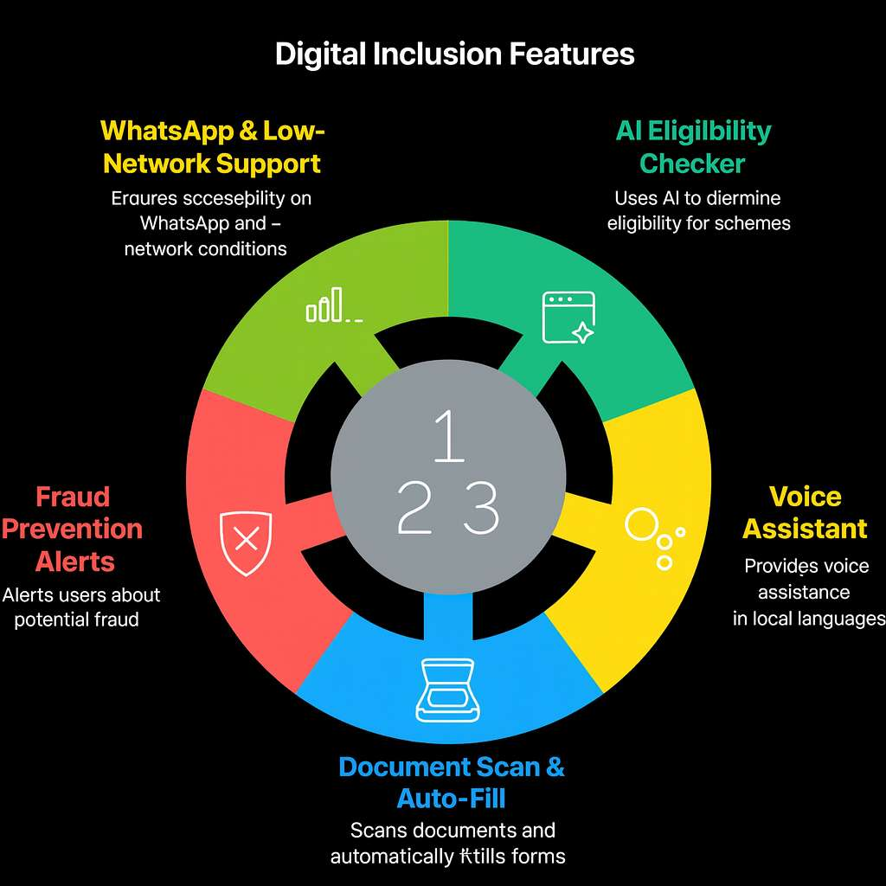
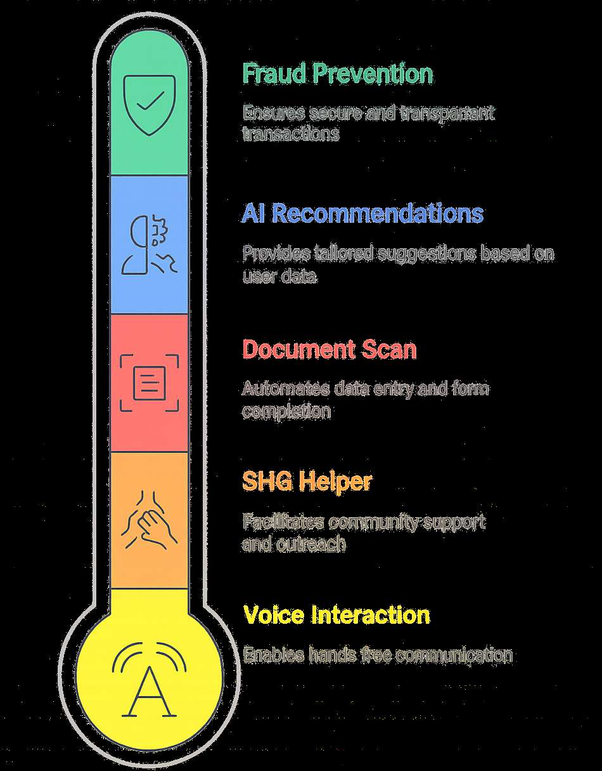
Proposed Solution: Sahayini is an AI-based assistant that helps rural women easily find which government schemes they are eligible for and guides them step-by-step to apply—using voice, simple questions, and WhatsApp support.
Key Features/Functionality:
AI-based scheme eligibility checker
Voice assistant in local language
Document scan & auto-form fill
Fraud-prevention alerts for safe guidance
WhatsApp and low-network support
Offline Mode: App stores basic scheme data locally so women can access information without internet.
What Make It Different /Innovative?
Voice-First, Local-Language Interaction
SHG & ASHA Helper Mode
Personalized Recommendations Using AI
Document Scan + Auto-Form Fill Using OCR
Fraud Prevention & Transparency

Slide 4
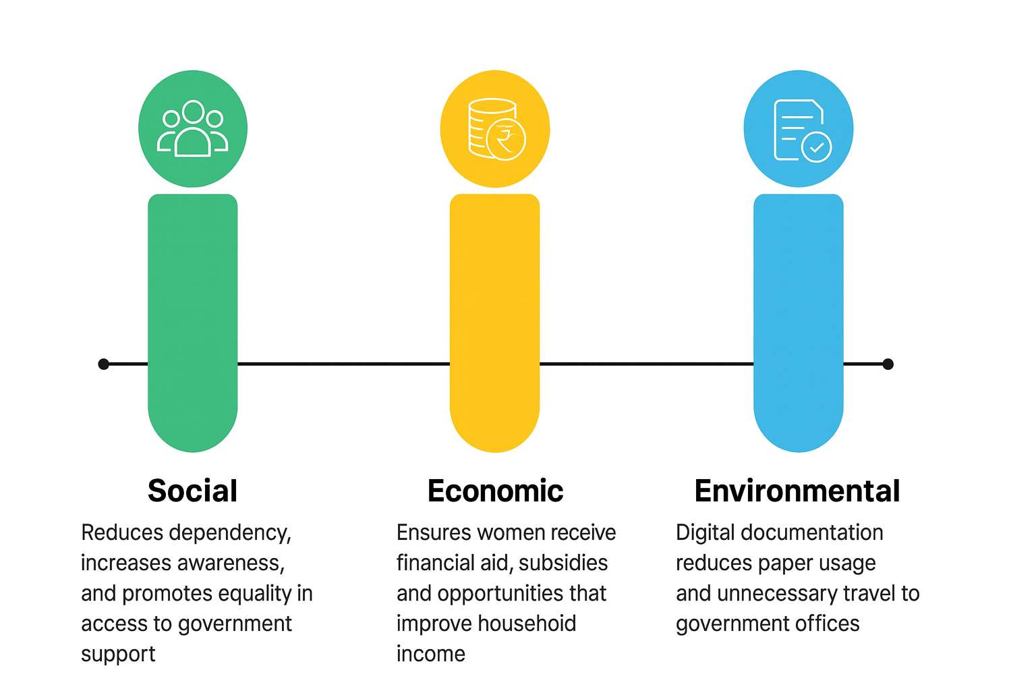
Significance & Benefits
Who will benefit and how?
Rural women gain easy access to the schemes they deserve without confusion or middlemen.
Low-income families receive timely financial support, health benefits, and education schemes.
SHGs and ASHA workers get a tool to help multiple women efficiently.
Social, economic, or environmental impact.
Social: Reduces dependency, increases awareness, and promotes equality in access to government support.
Economic: Ensures women receive financial aid, subsidies, and opportunities that improve household income.
Environmental: Digital documentation reduces paper usage and unnecessary travel to government offices.
How it aligns with inclusivity and empowerment.
Designed for low-literacy, rural, and marginalized women, ensuring no one is excluded.
Voice-based and local-language support makes the platform accessible to every woman.
Empowers women with knowledge, independence, and confidence to use government systems without fear or exploitation.

Slide 5
Technical Solution
Component | Technical Direction | Technologies / Tools / Platforms
Frontend | Build a simple, user-friendly interface with local language support | React.js, HTML, CSS, Bootstrap
Backend | Handle eligibility logic, API processing, and data flow | Node.js, Express.js / Python Flask
Database | Store user details, schemes, documents, and status | Firebase / MongoDB
AI Eligibility Engine | Match user inputs with schemes using rule-based AI | Python, JSON rule sets, ML logic
Voice Assistant | Enable speech input and voice guidance | Google Speech-to-Text, Text-to-Speech API
WhatsApp Integration | Provide updates and application support via WhatsApp | WhatsApp Cloud API / Twilio
OCR Document Scan | Extract data from documents for auto-form filling | Tesseract OCR / Google Vision API
Authentication | Simple login suitable for rural users | Firebase Auth / OTP-based login
Hosting / Deployment | Deploy both frontend and backend quickly and reliably | Vercel,Netlify
Version Control | Manage team collaboration and code changes | GitHub
UI/UX Prototype | Create mockups and design screens | Figma / Canva

Slide 6
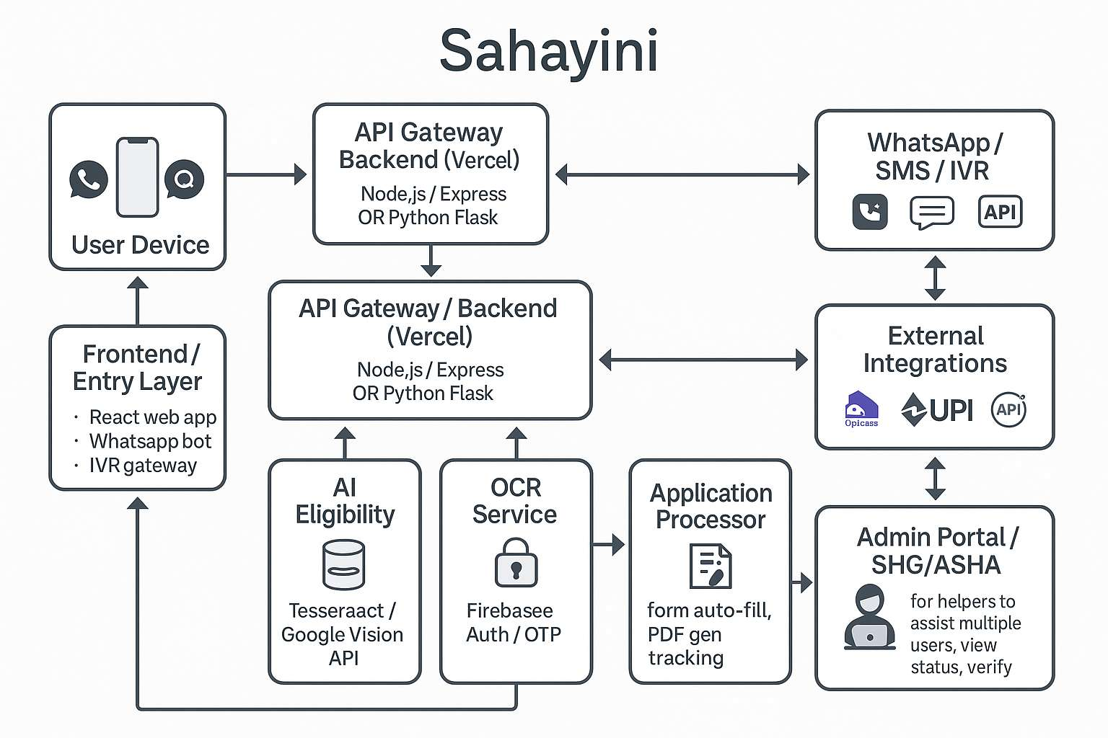
Approach

Slide 7
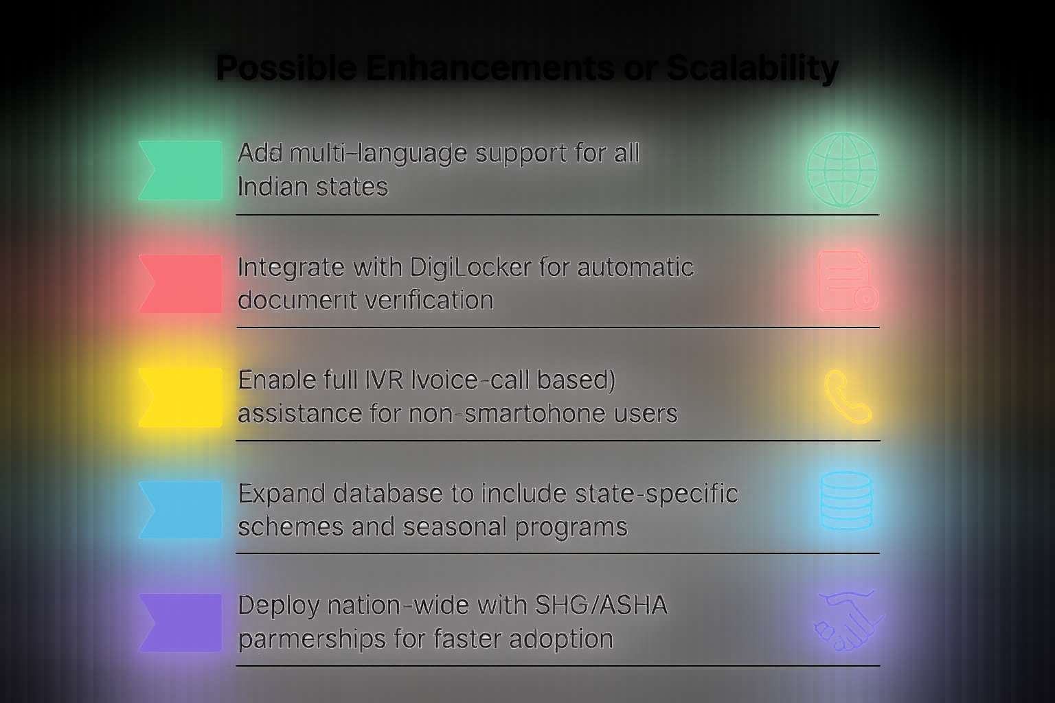
Future Scope & Conclusion
Possible enhancements or scalability.
Add multi-language support for all Indian states.
Integrate with DigiLocker for automatic document verification.
Enable full IVR (voice-call based) assistance for non-smartphone users.
Expand database to include state-specific schemes and seasonal programs.
Deploy nation-wide with SHG/ASHA partnerships for faster adoption.
Expected outcomes or vision.
Rural women gain easier, faster access to government benefits without confusion.
Reduction in fraud and dependency on middlemen.
Improved financial stability and empowerment at the family and community level.
A future where every woman can claim her rights through simple, accessible digital tools.
“Sahayini isn’t just a tool—it’s a step toward a more inclusive future.”

Slide 8
References
Reference Name | Description | Official Link
myScheme Portal | Government of India’s unified scheme discovery platform | https://www.myscheme.gov.in
DigiLocker | Digital document wallet for verification & storage | https://www.digilocker.gov.in
Ministry of Women & Child Development | Official schemes for women & children | https://wcd.nic.in/schemes
National Health Mission | Maternal, child & women health programs | https://nhm.gov.in
PM Awas Yojana | Housing scheme guidelines & details | https://pmaymis.gov.in
NSAP (Pension Schemes) | Widow, disability & elderly pension assistance | https://nsap.nic.in
SHG – DAY-NRLM | Self-Help Group resources & rural livelihood programs | https://aajeevika.gov.in
Digital India Mission | Digital inclusion & government service digitization | https://digitalindia.gov.in
Ministry of Rural Development | Rural welfare & poverty alleviation schemes | https://rural.nic.in
WhatsApp Cloud API | Messaging automation for notifications & support | https://developers.facebook.com/docs/whatsapp

